Slide 1
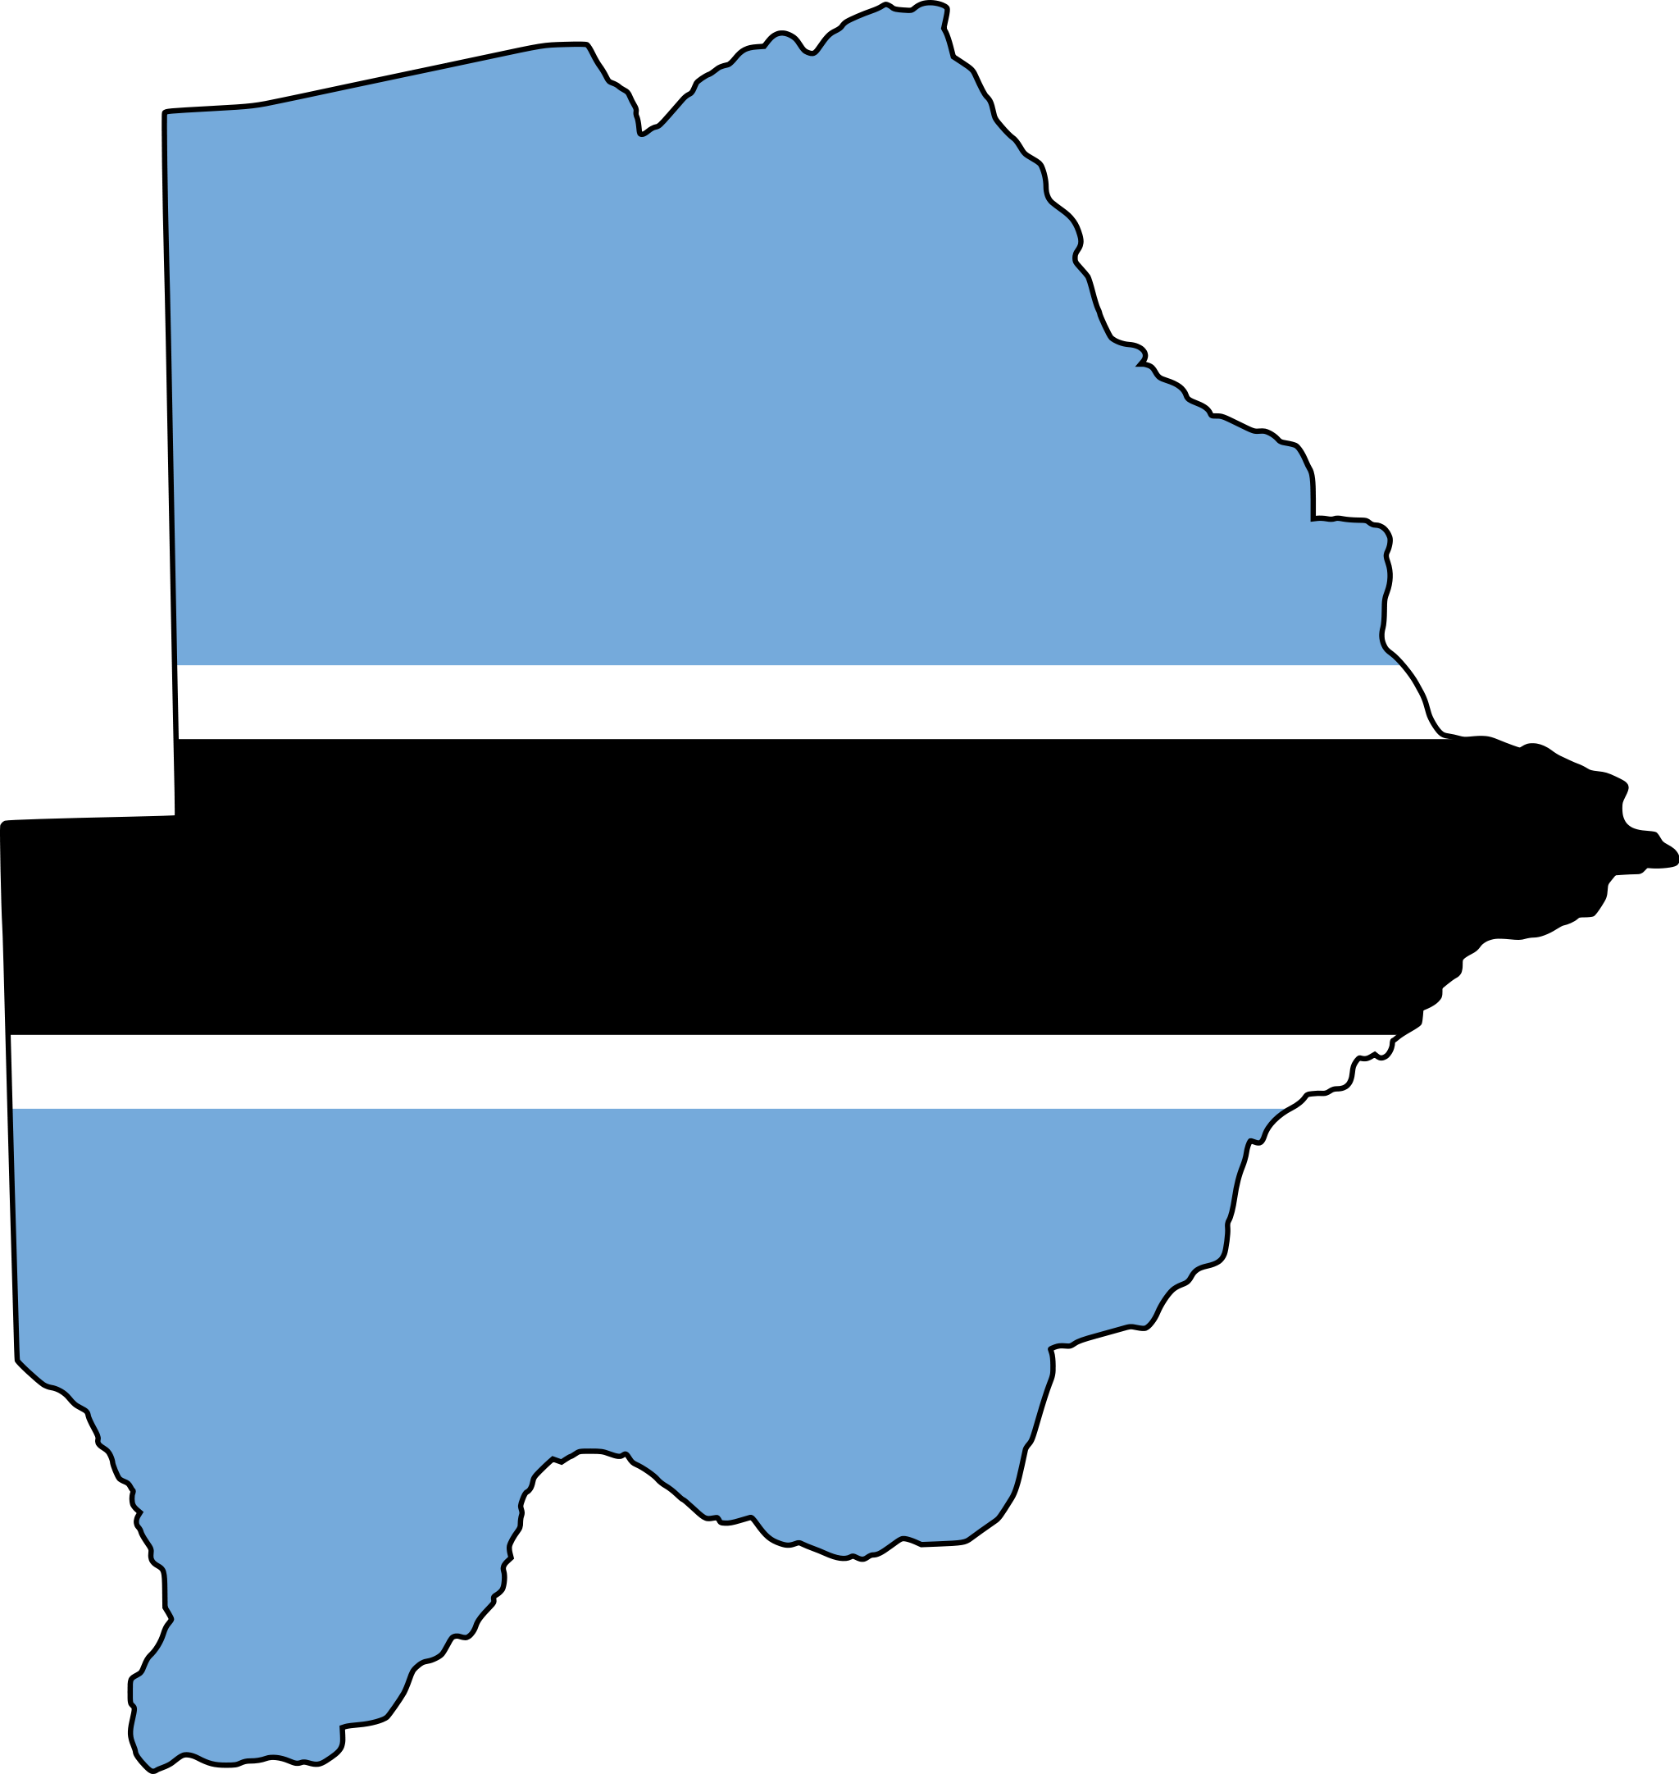
How to Make a Traditional Meal and See Botswana
Compiled by: Mary Allison, Haley Dorrell, and Perry Flynn

Slide 2
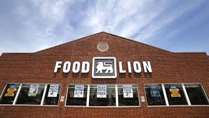
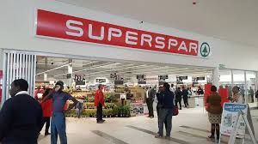
Making a traditional Setswana meal is not too difficult. First, get all the ingredients at the grocery store/lebenkele. Grind, boil, drain, pound, and serve.
Notes:
ingles

Slide 3
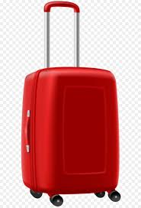
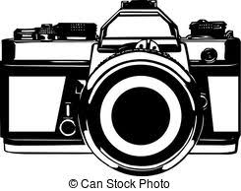
Unless of course, the grocery store/lebenkele is closed.
In that case, go home and pack a suitcase. Take your shopping list, and go ahead and grab your camera too!
Shopping List
1. Beef
2. Vegetables
3. Sorghum Meal
4. Salt

Slide 4
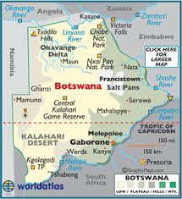
Dumelang = Hello
Sala sentle = Goodbye
Then catch a plane bound for Africa from North Carolina. Use the 22 hours on board to learn some Setswana.
O Tsogile jang? = How are you?
Ke itumetse = Thank you
Ntlwana e kae? = Where is the bathroom?
Notes:
Dumelang – Hello
Go siame – Goodbye
O Tsogile jang? – How are you
Itumelele dijo – Bon appetit
Ntlwana a kae? - Where is the bathroom

Slide 5
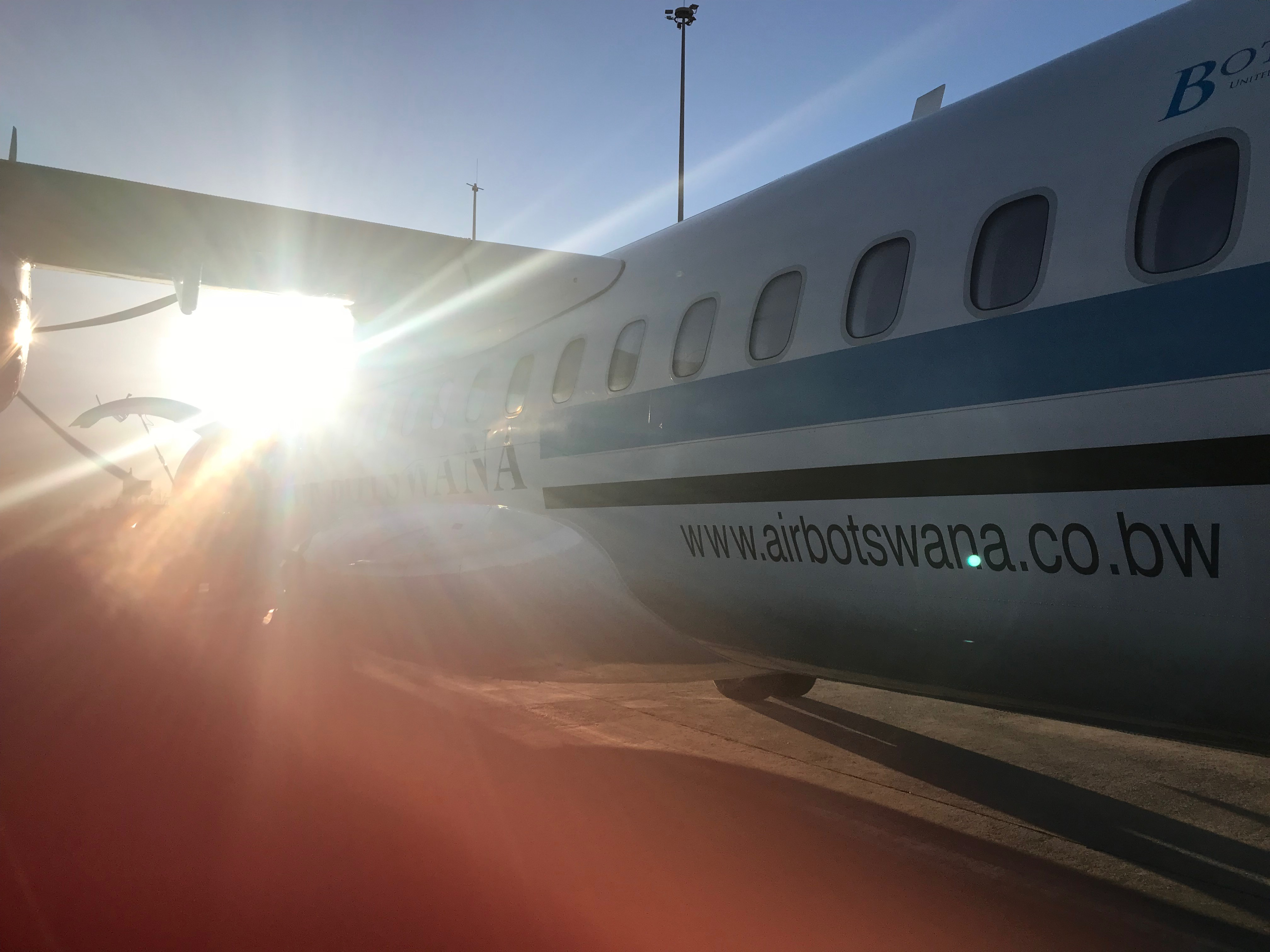
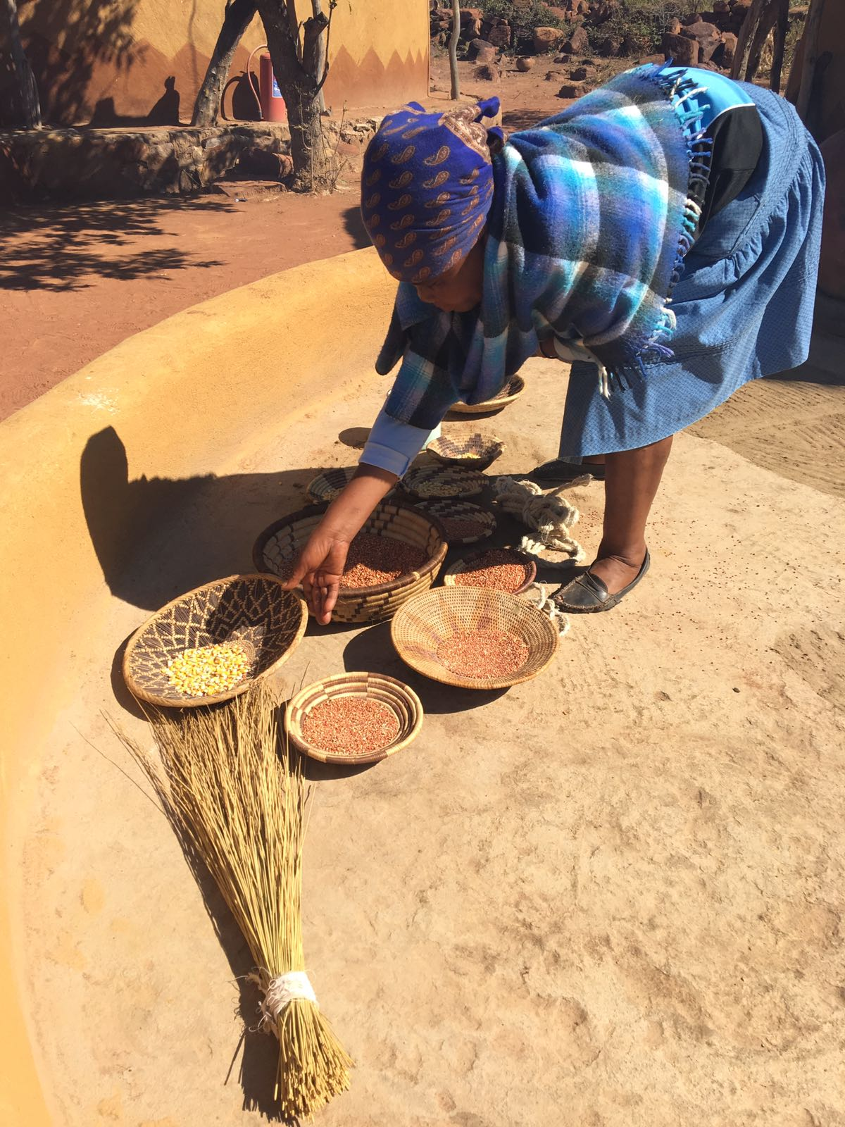
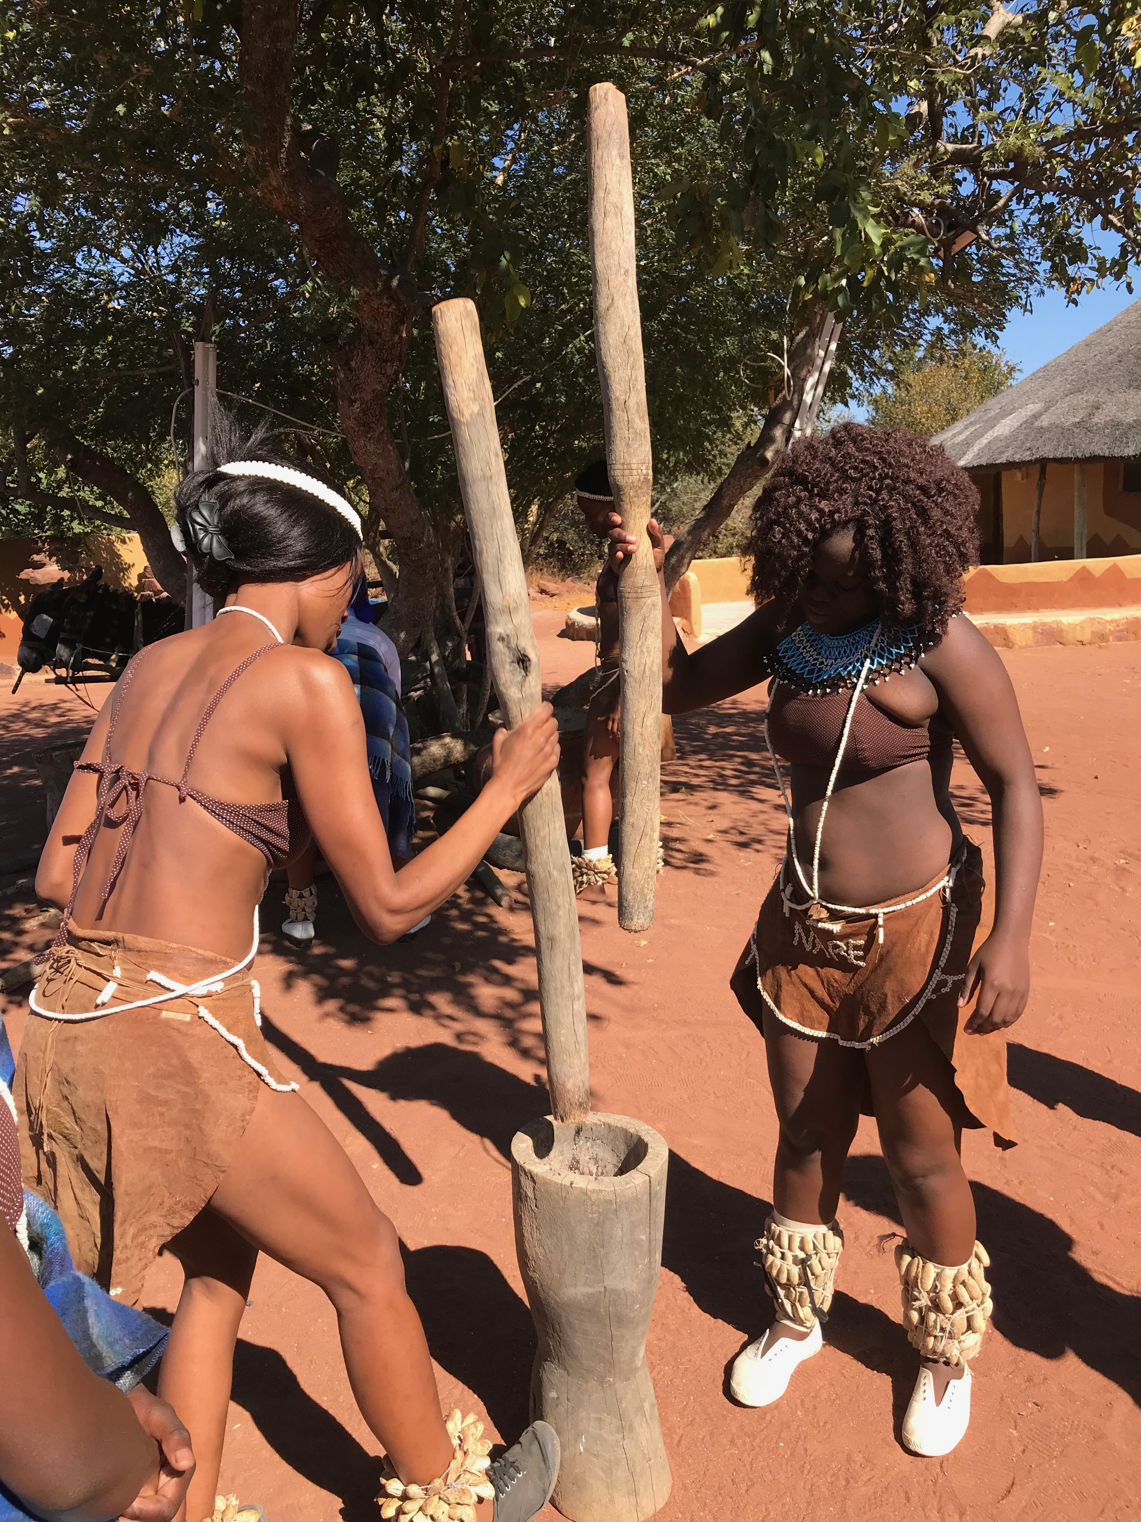
Your plane lands in the capital of Botswana, Gaborone. Hop on a taxi and ask the driver to take you to Bahurutshe Cultural Village. Ask the women of the village to share some sorghum/mabele.
Fun Fact!
This is a traditional grinding of sorghum
Notes:
Extensions:
Gaborone:
- Gaborone was named for chief Gaborone of the Tlokwa tribe
- One of the fastest growing cities of the world
- It’s near the Notwane River making coming and going of trade easy
Sorghum:
- It is an upright growing grass
- Also called Milo
- In the United States it is a feed for cattle
- In the United States it grows in Oklahoma because it does not require a lot of water and can survive long hot summers
*Some words and concepts are the same in both countries!

Slide 6
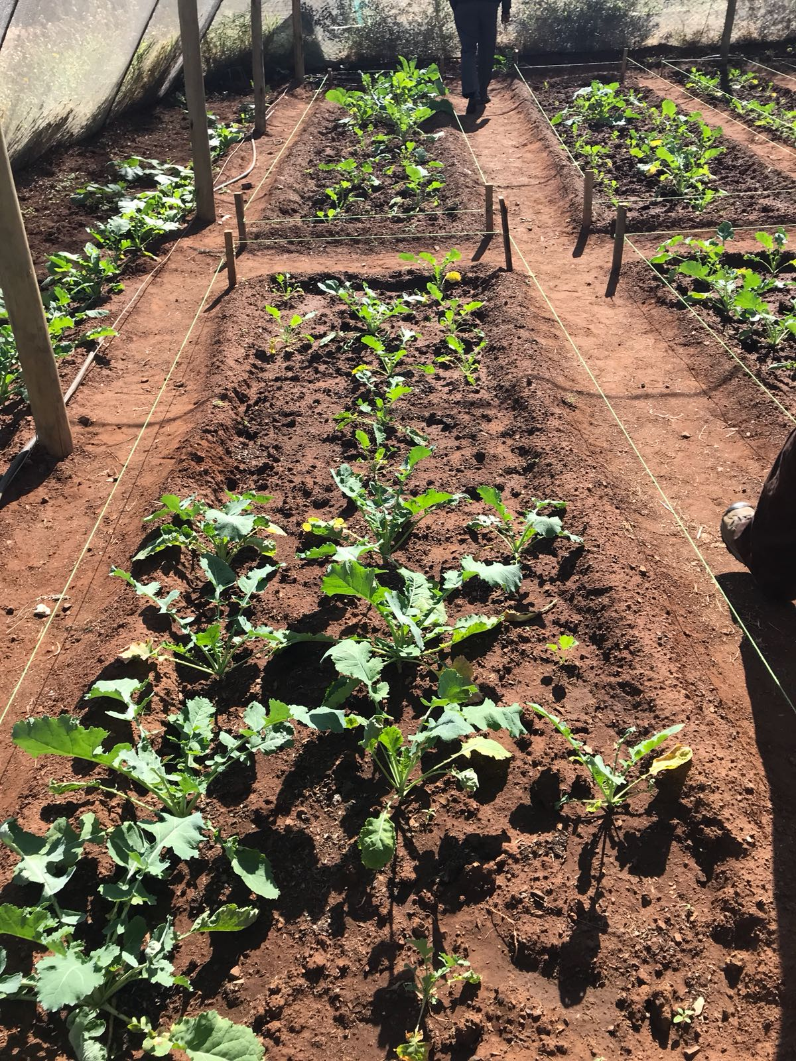
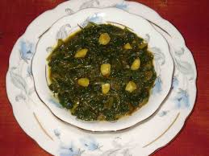
Then hop on a bus/bese to Francistown and search for a local farmer. Ask the farmer to let you gather fresh greens from his garden. Don’t forget to say thank you! (Ke a leboga)
Fun Fact!
In Botswana these fresh greens are used to make a dish called Morogo
Notes:
Extensions:
Francistown
- It is the second largest city in Botswana (about 150,000 people)
- Located at the meeting of the Tati and Inchwe Rivers
- Mining of cobalt, nickel, and copper are important industries

Slide 7
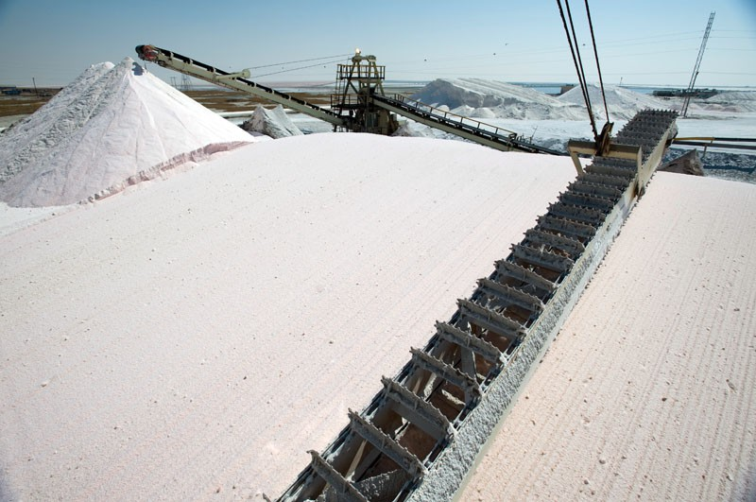
On the way to Kasane, take a left to get to the Sua Pan salt mine. Be sure to pick up a small bag of salt to season/go loka your meal.
Notes:
Extensions:
Kasane:
- Kasane is located near the four corners where Botswana, Namibia, Zambia, and Zimbabwe meet
- Tourism is the primary industry to visit Victoria Falls and Chobe National Park
Sua Pan
- It is also known as the Sowa Pan
- It is a natural topographic depression within the Makadikgadi region of Botswana
- It is near the village of Sowa whose name means salt
Picture of sua pan salt mine

Slide 8
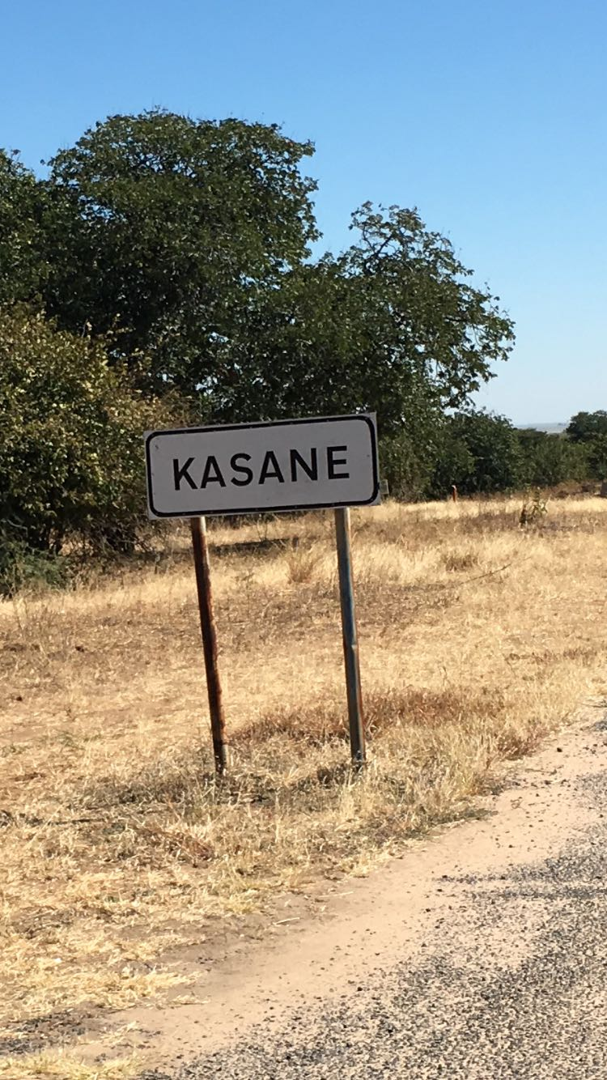
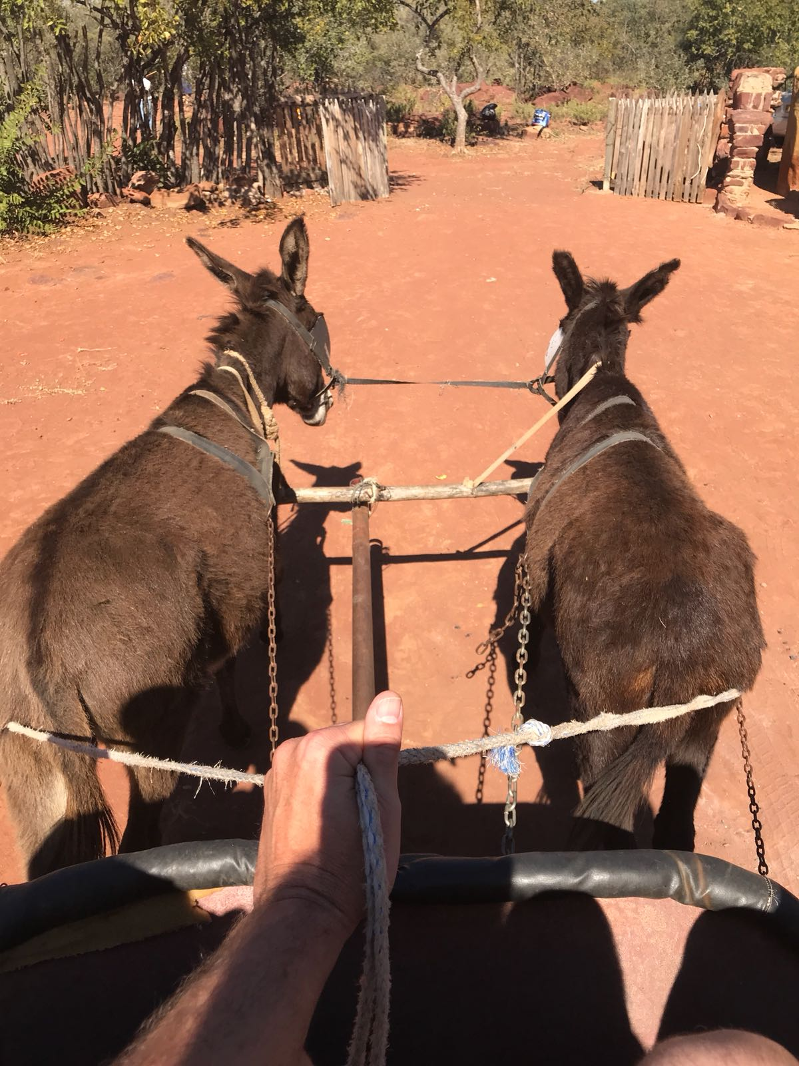
Unfortunately, your van breaks down just outside of Kasane. Lucky for you, a donkey cart/sekotsekara stops to give you a bumpy ride into town.
Fun Fact!
People still use donkey carts for rural transportation; some donkeys run freely around their homes and across highways by themselves
Donkey/Tonki

Slide 9
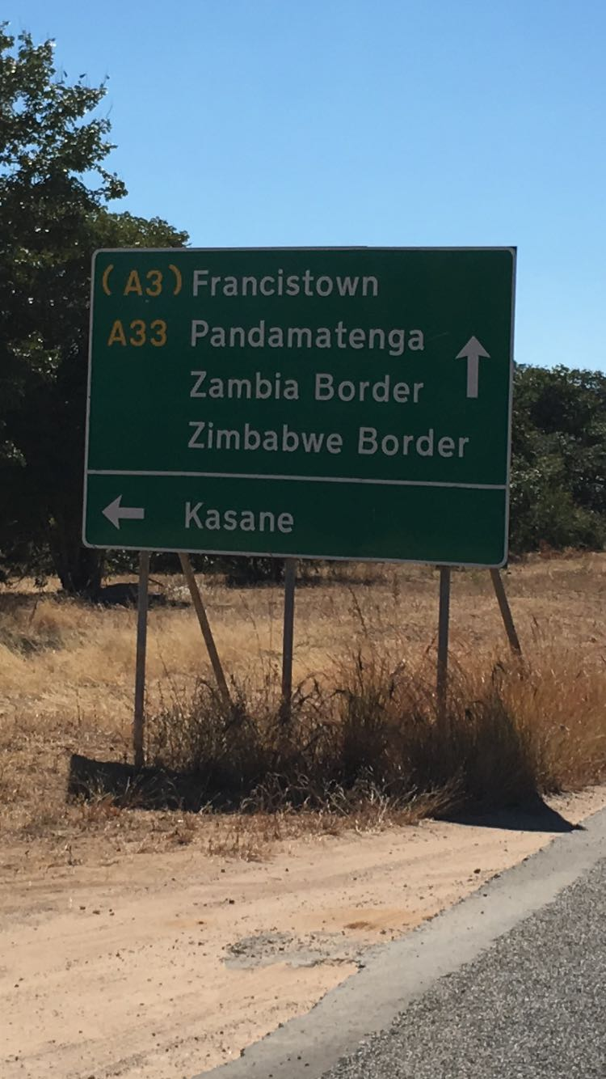
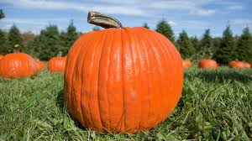
Kasane is at the top right corner of Botswana bordering/mo molelwaneng wa Chobe National Park. It’s been a rainy summer and the pumpkins are ready to harvest. Find the largest pumpkin/lephutshe that you can carry!
Notes:
Extension:
Chobe National Park:
- It is the first national park that was formed in Botswana
- It is 11,700 kilometers – activity for the children to convert to miles
- It was established in 1967
- It has the largest elephant population of any national park in Africa
- The animals that are located there are elephants, leopards, lions, hyenas, zebras, impalas, hippos, giraffes, and many different types of birds

Slide 10
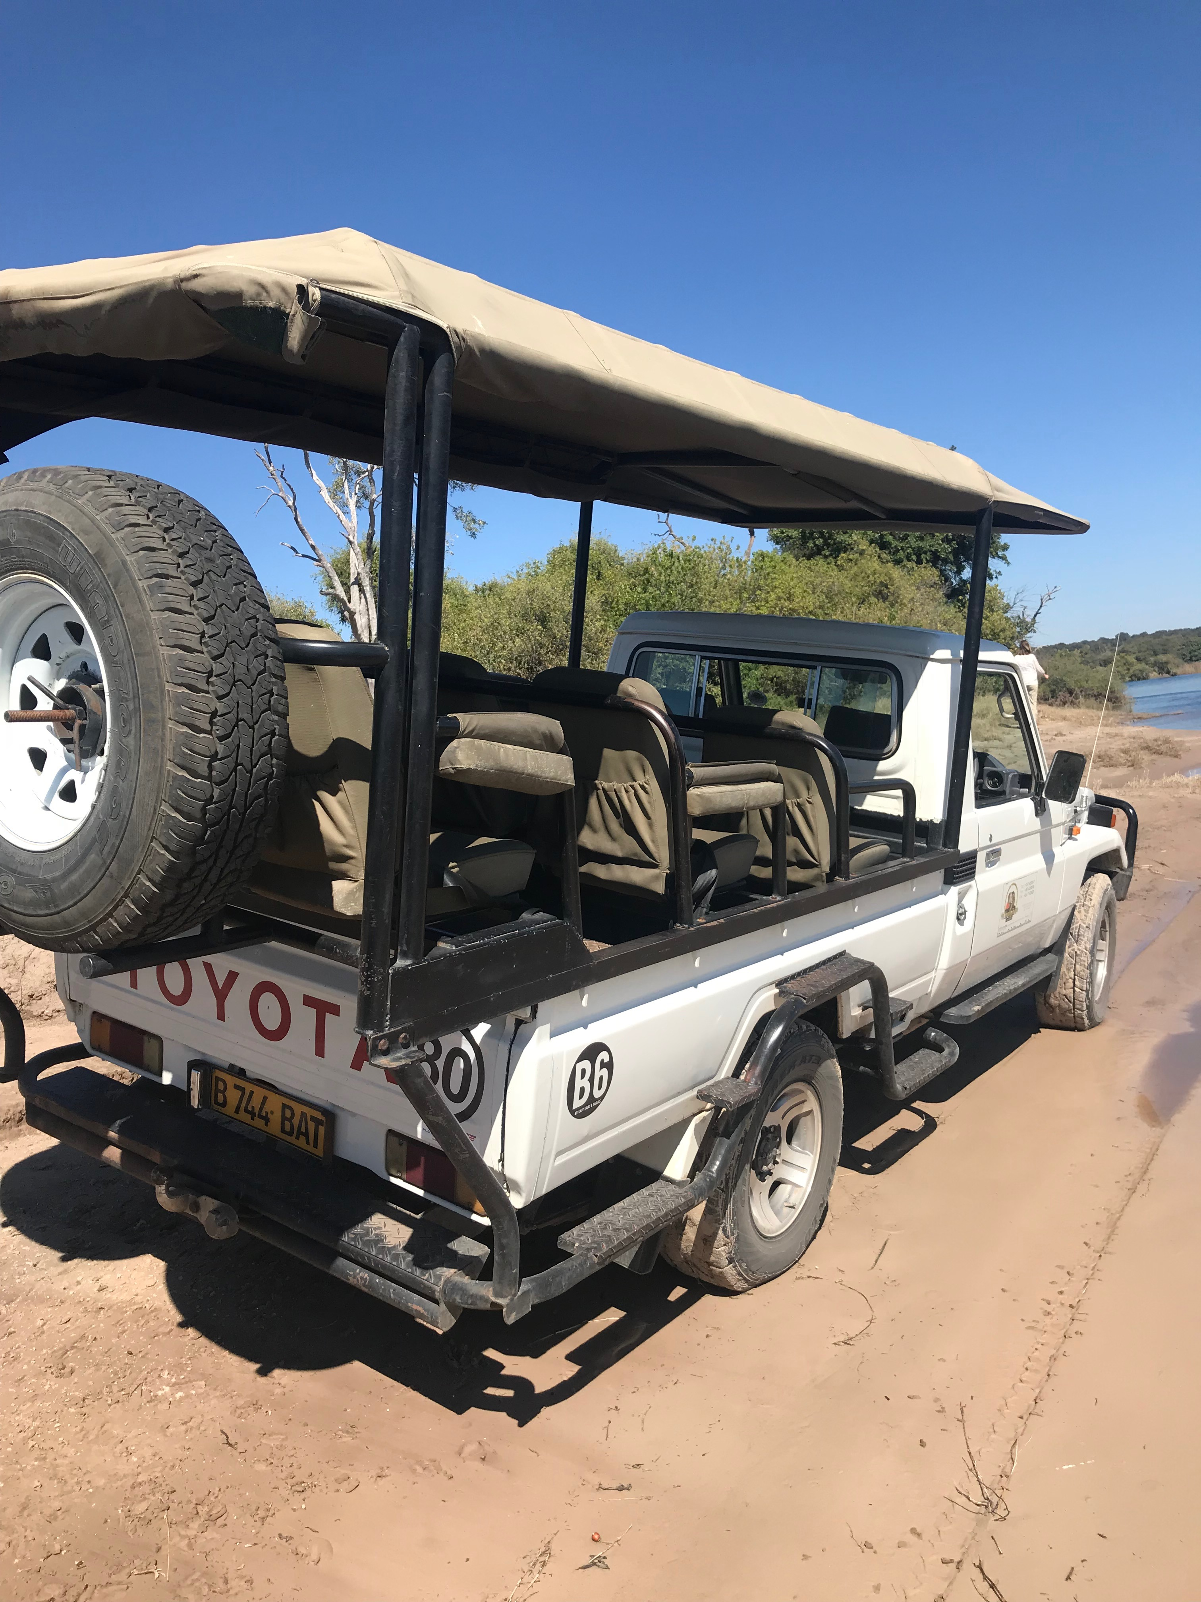
You only need one more ingredient for your dish. It is in Maun which is far to walk so catch a ride on a Jeep full of tourists/bajanala that passes by.
Fun Fact!
In Botswana, people drive on the left side of the road
Notes:
Vocabulary – Tourists

Slide 11
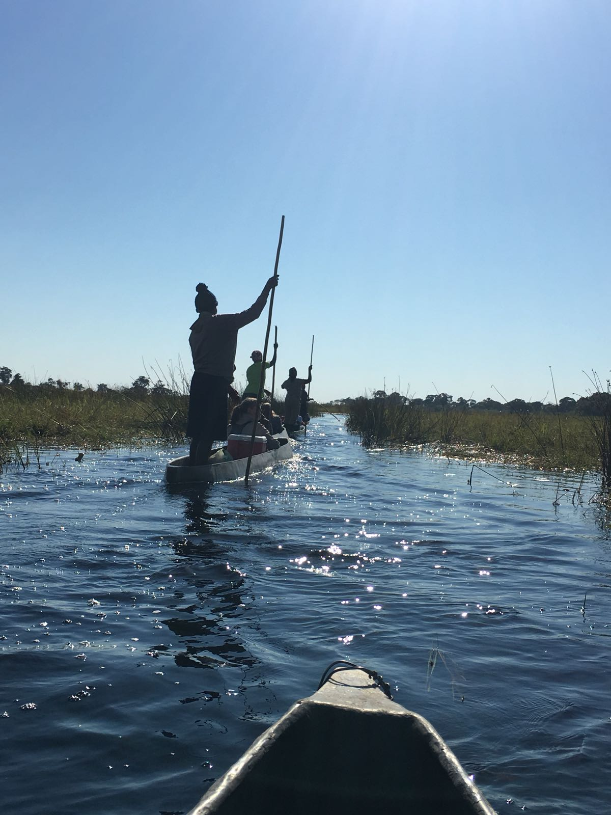
Eight hours later, you arrive in Maun, located at the tip of the Okavango Delta. By this time you have become friends with the tourists. They invite you on a two hour canoe/Mokoro ride.
Notes:
Extensions:
Okavango Delta:
- It is the largest inland delta in the world (define what a delta is)
- It grows three times in size between March and August
- It has more than 150,000 islands
- It has 530 bird species
Mokoro:
- It is propelled by a man who pushes a pole
- They are made from the Kigelia tree

Slide 12
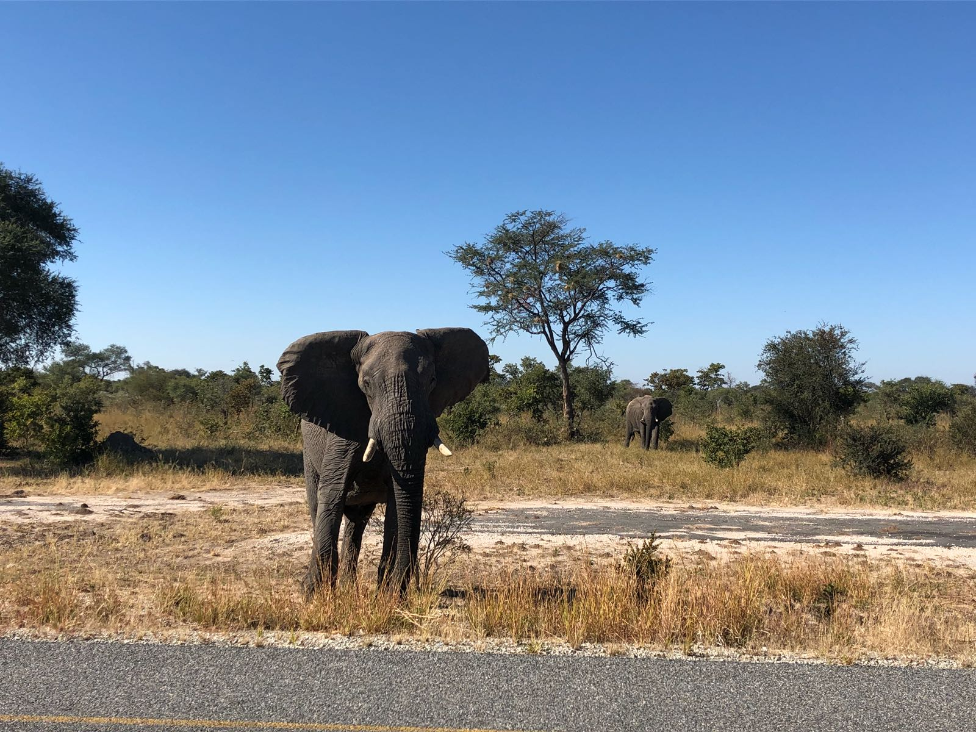
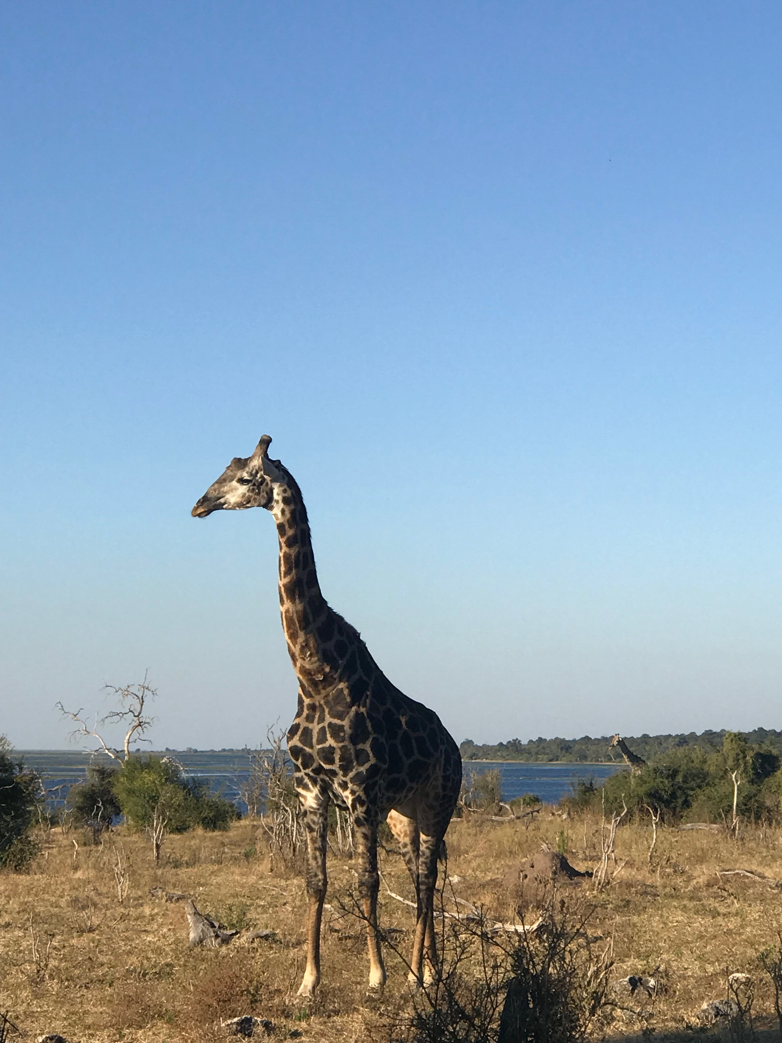
It’s a great time for pictures. You see giraffes, rhinos, hippos, elephants, and crocodiles! Suddenly, you remember that you need one more ingredient to complete your meal.
Elephant/Tlou
Giraffe/Thutlwa

Slide 13
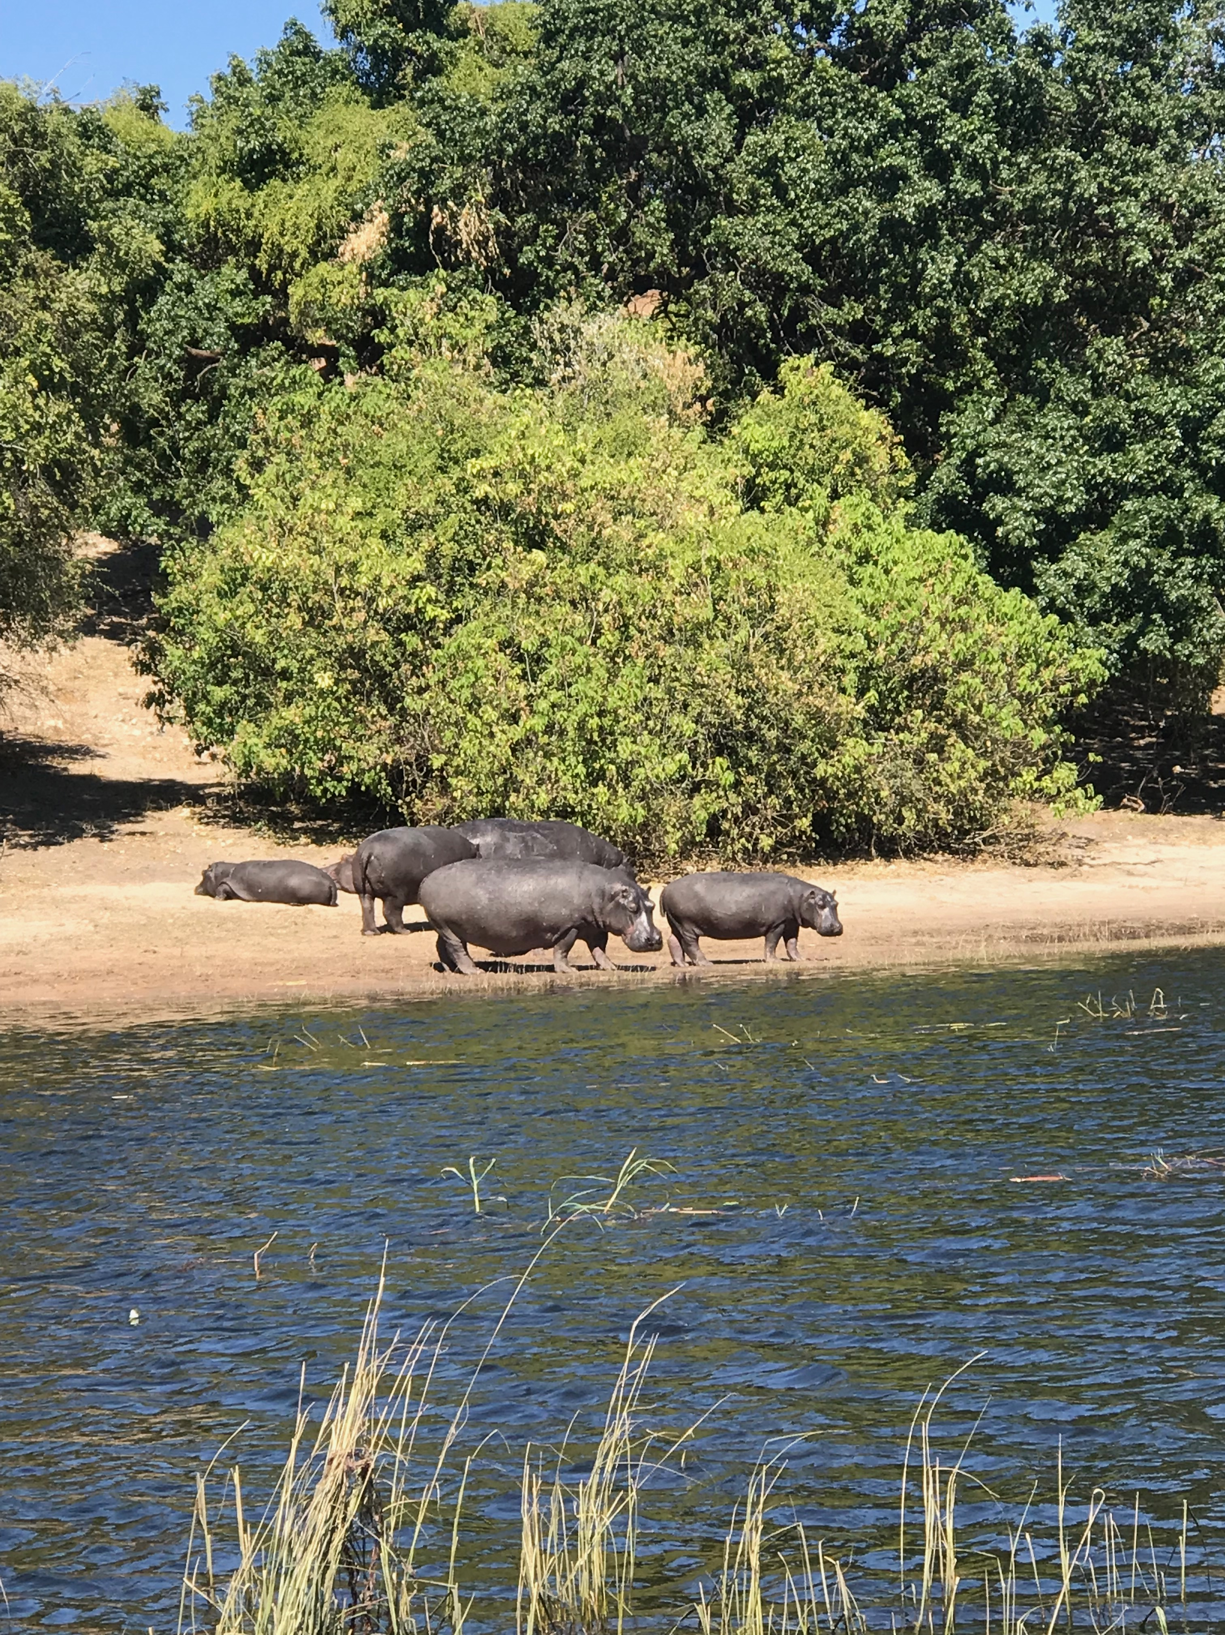
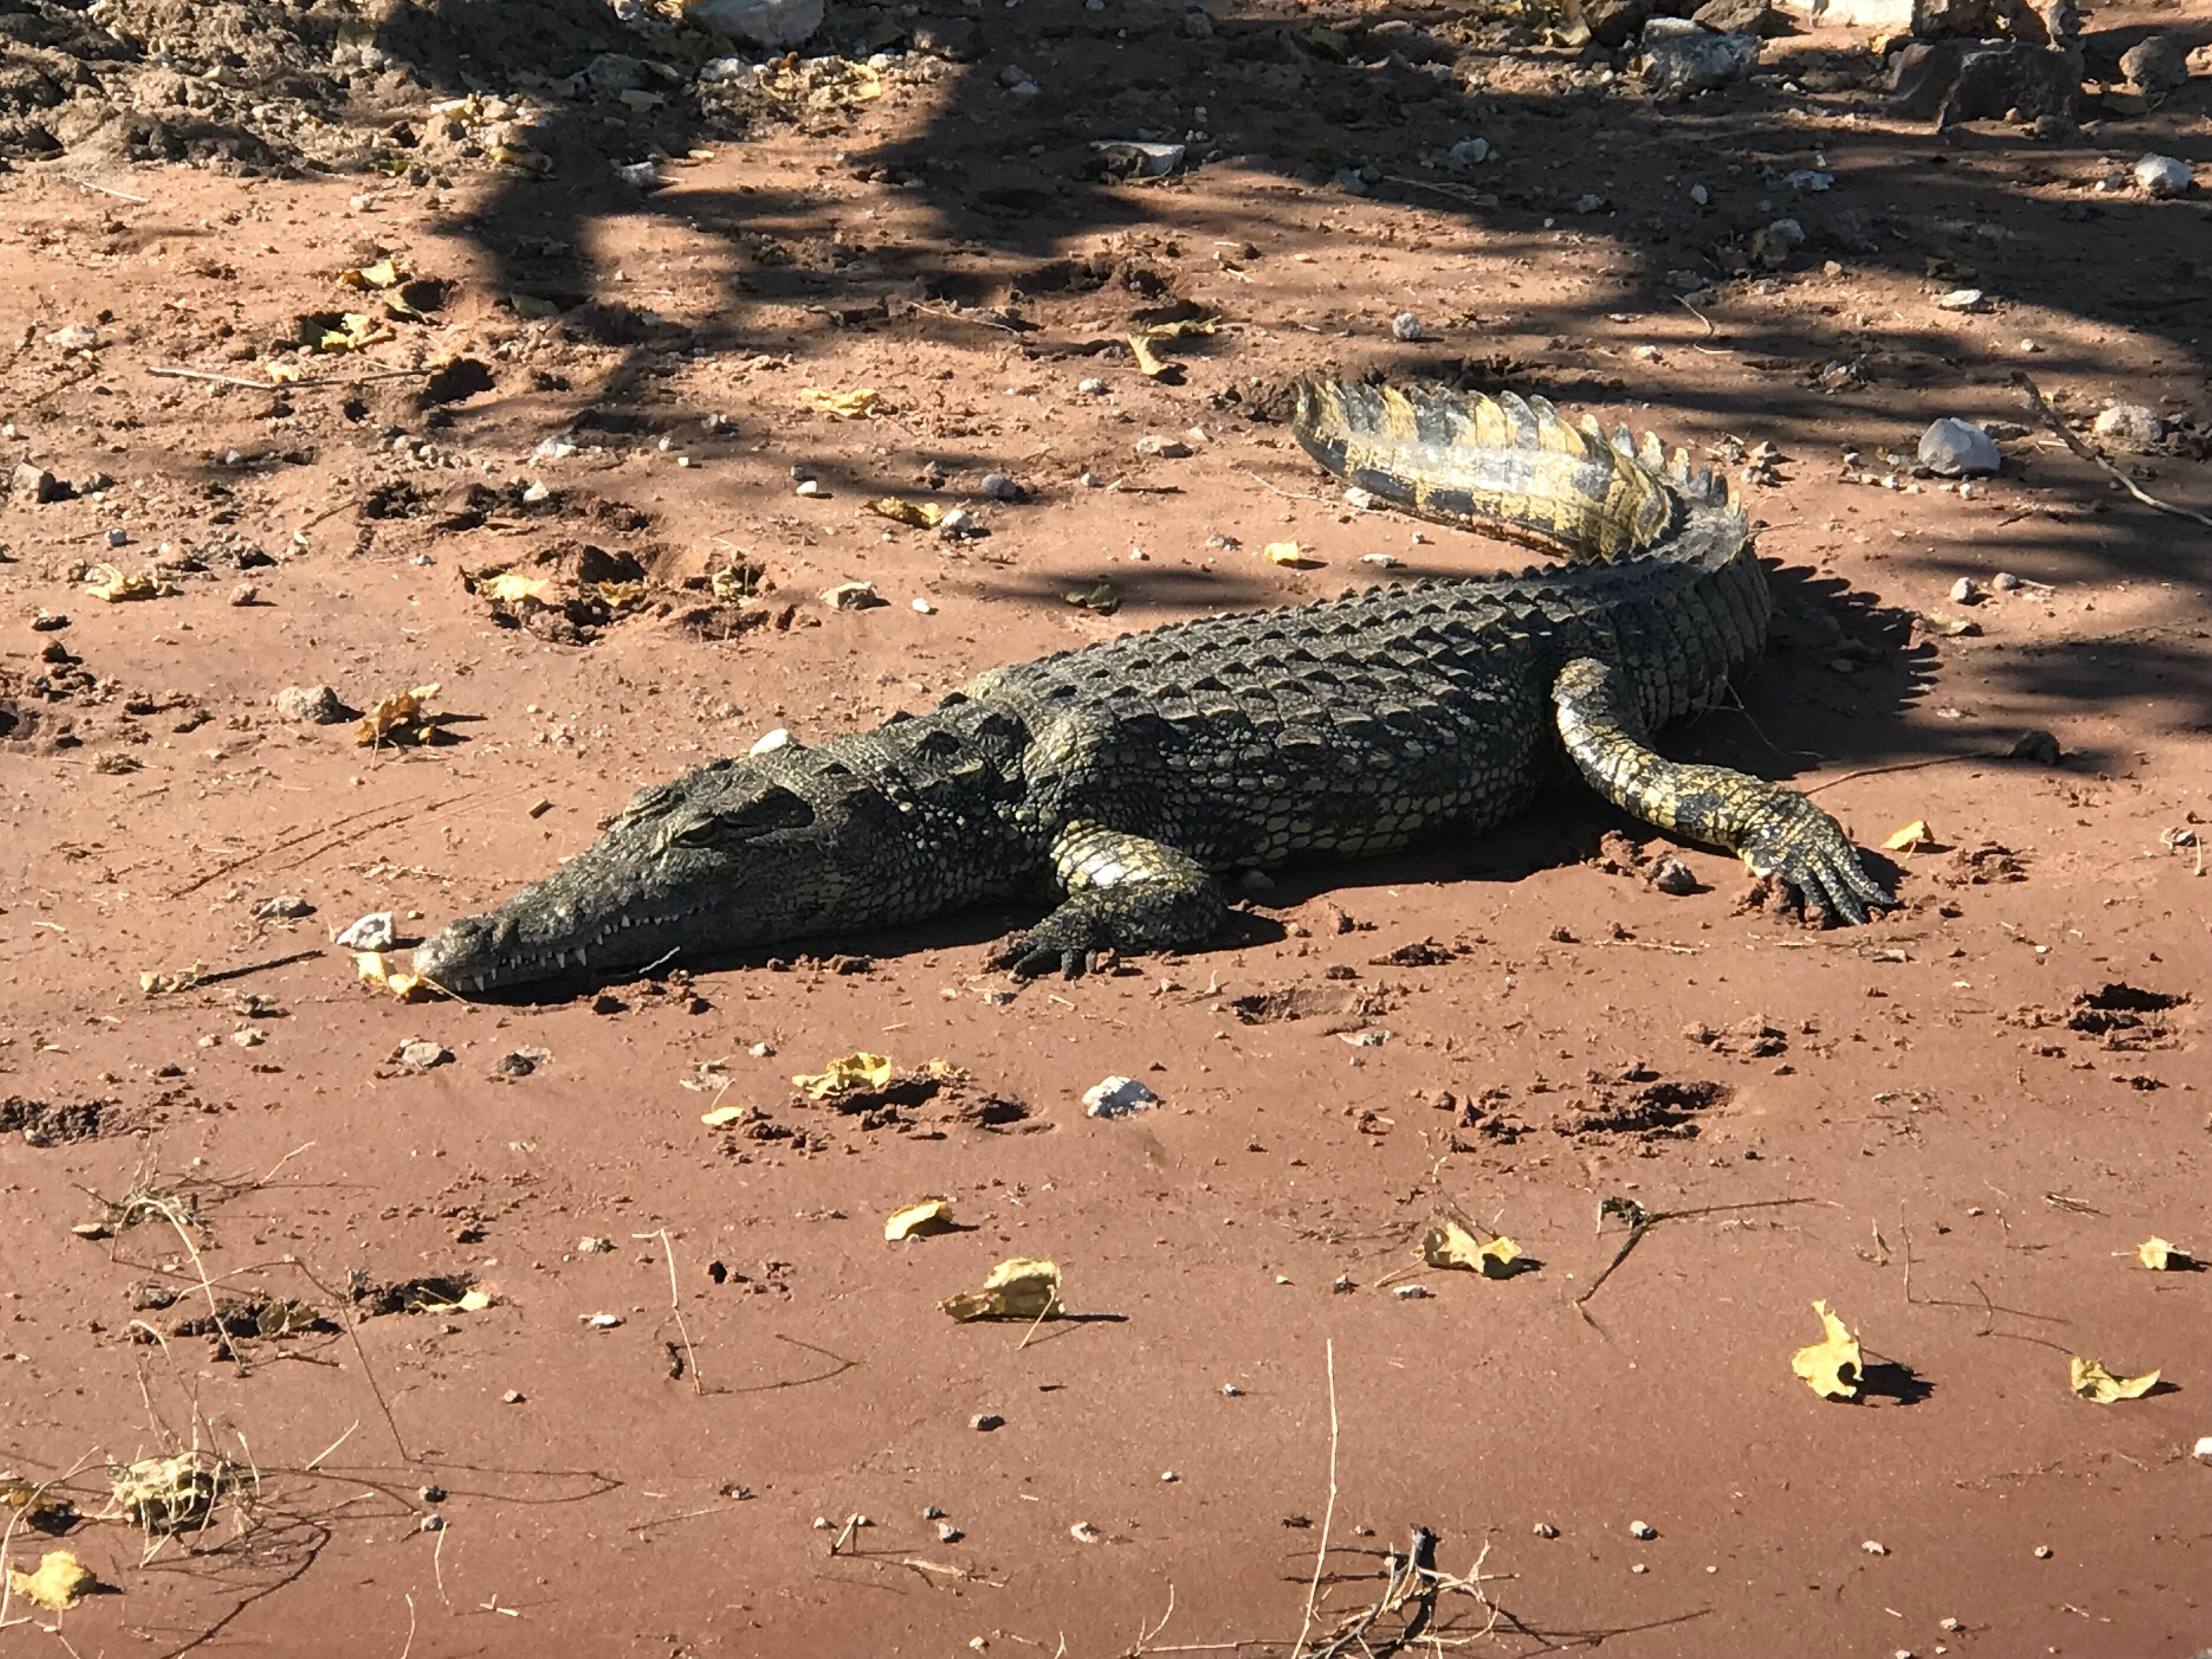
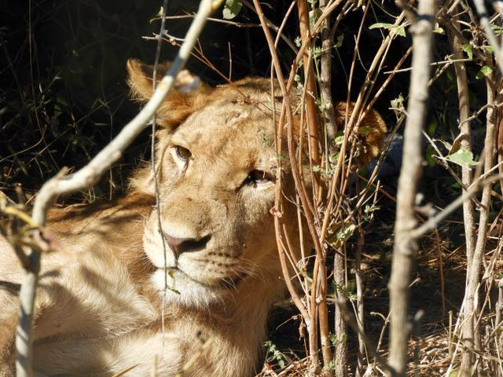
Crocodile/Kwena
Lion/Tau
Hippo/Kubu
Fun Fact!
If a lion track is wet in the sand this means it is fresh within a few hours due to sweat.

Slide 14
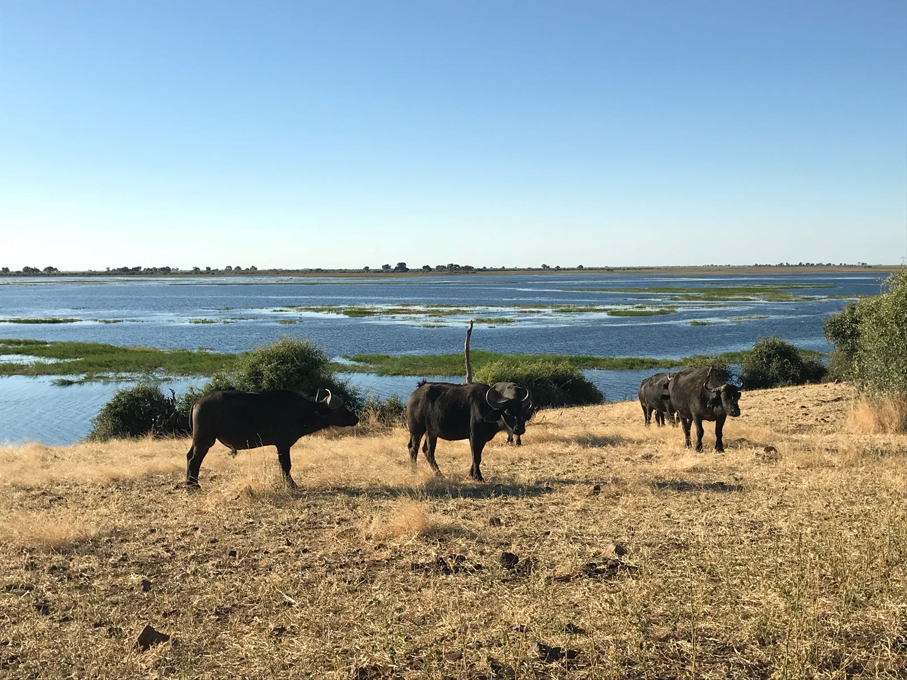
When you step off the Mokoro, you ask where to find your final ingredient. The guide points west to a nearby cattle farm. The farmer has fresh meat ready for you to buy!
Fun Fact!
It costs about 500 pula to ride on a Mokoro. In the United States this equals to about 50 US dollars
Cow/Kgomo
Notes:
Extensions:
Cattle Farming
- There are about as many people as there are cows in Botswana

Slide 15
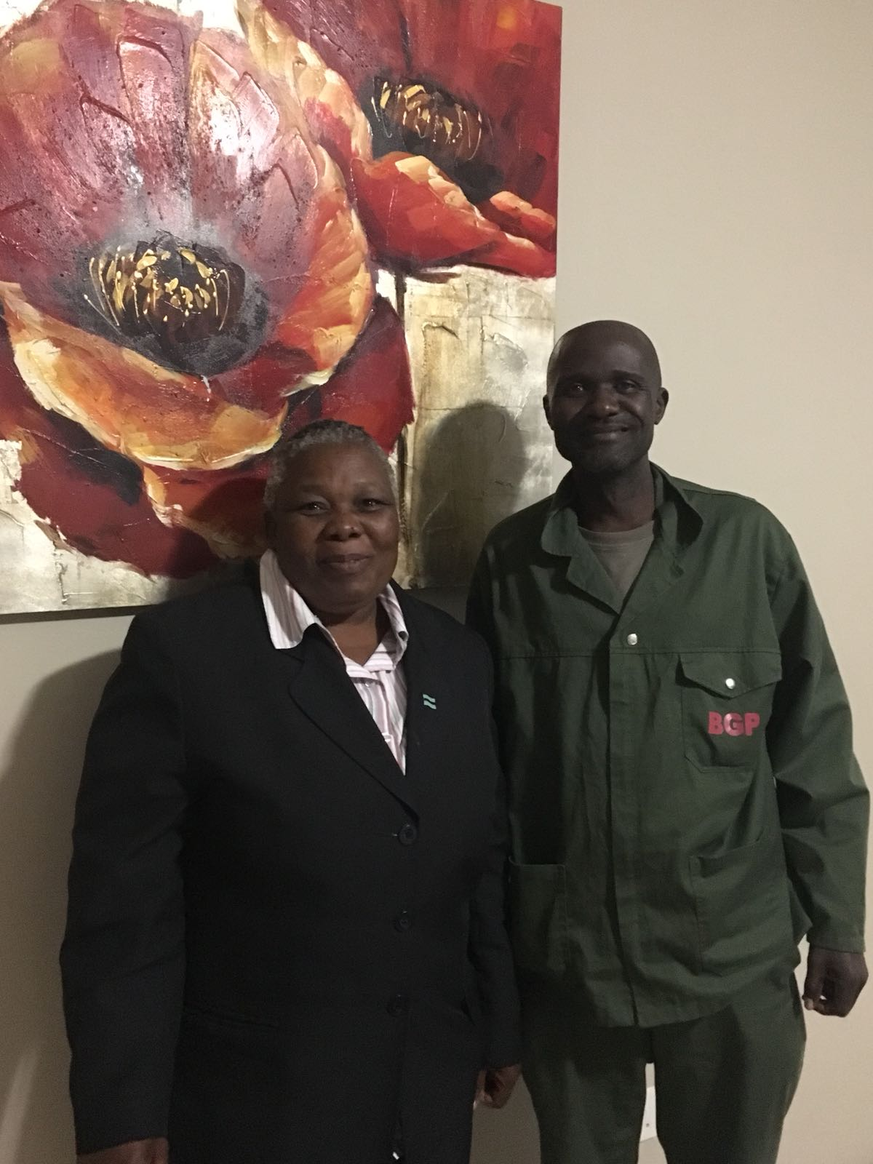
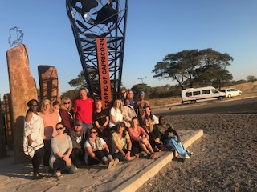
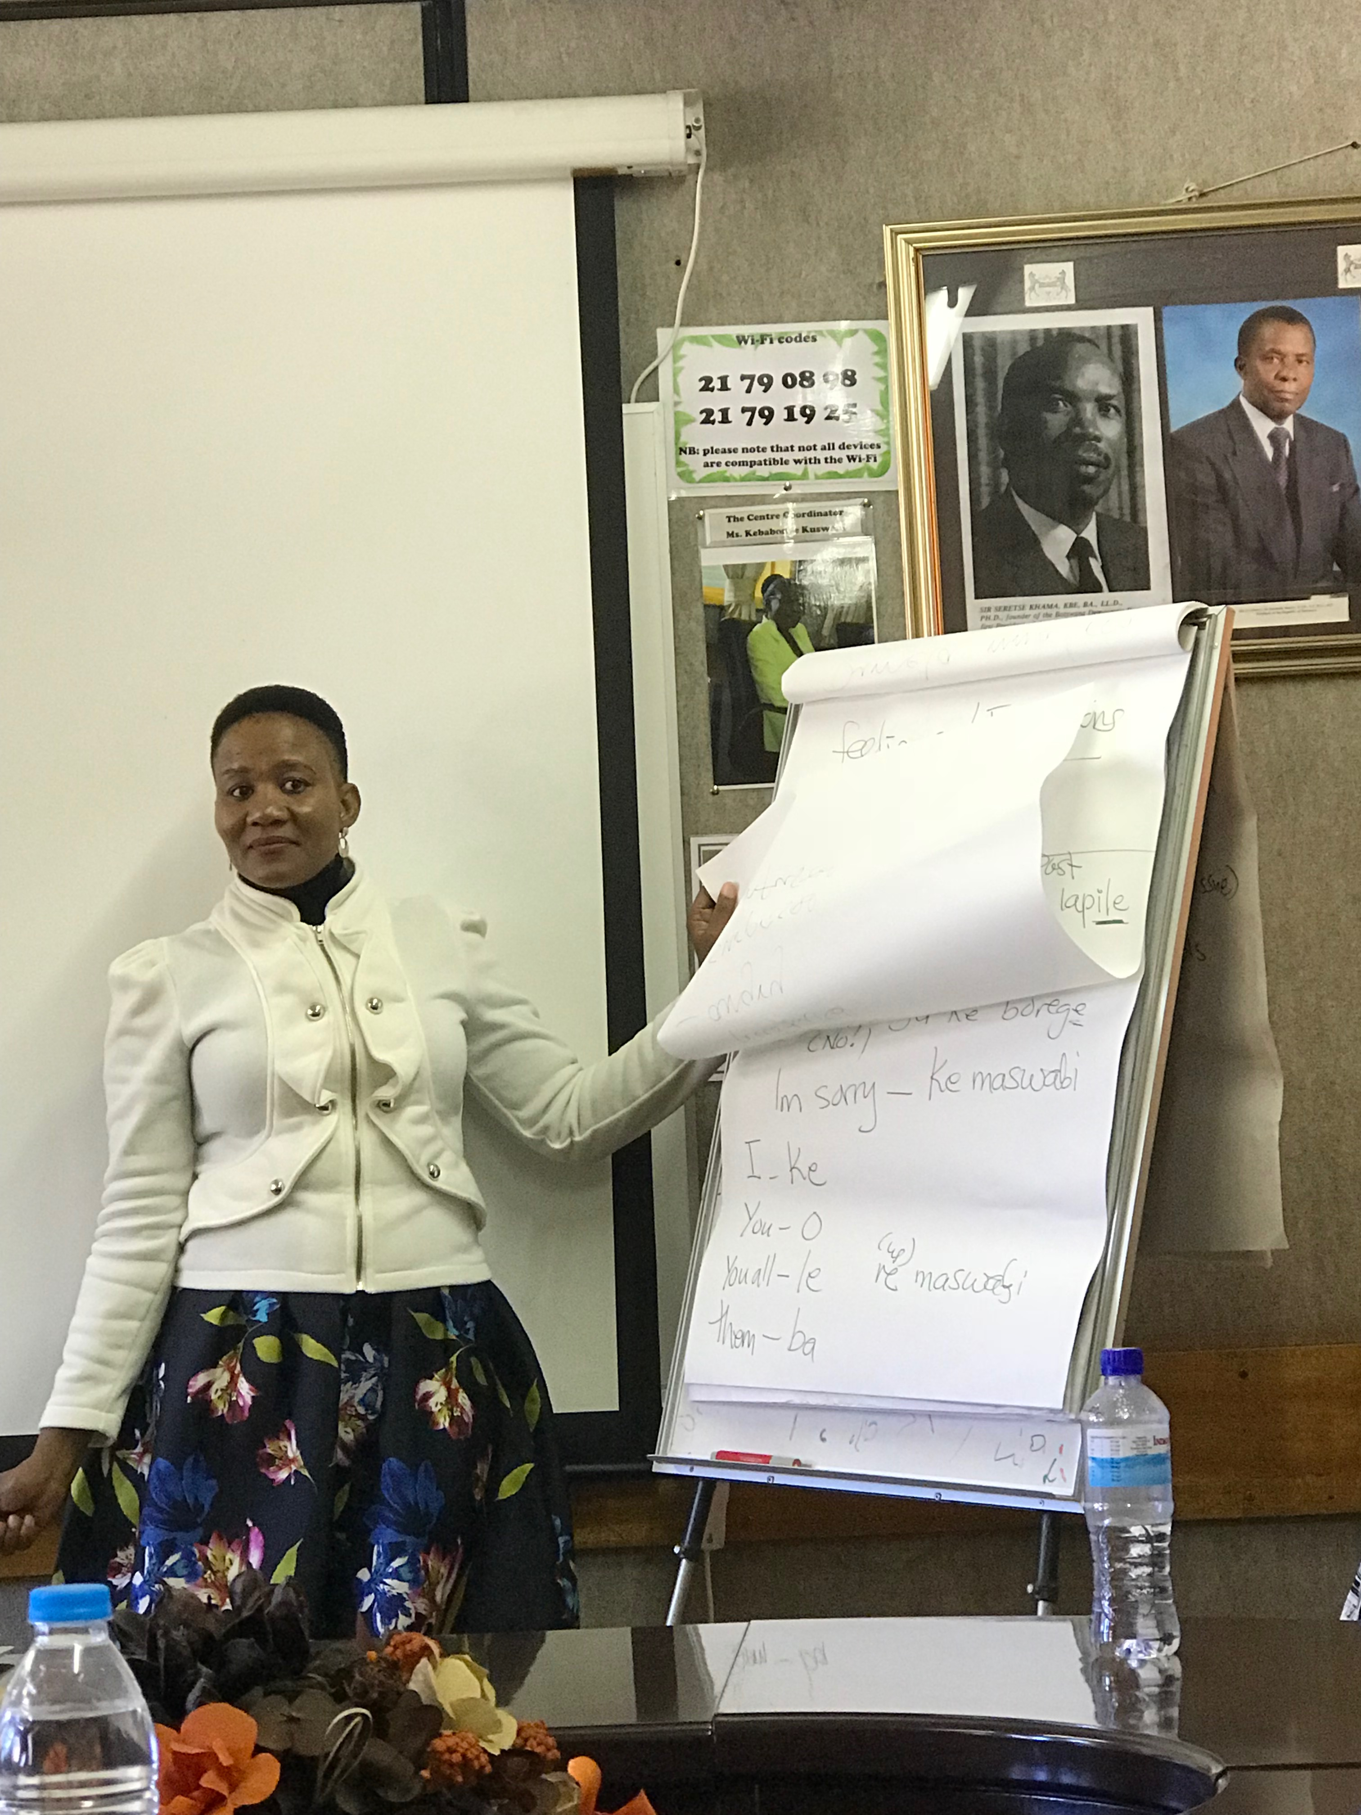
Time to fly back to Gaborone and cook your traditional meal with the new friends you have made on your trip.
Notes:
Extensions:
Flight back to Gaborone from Maun
- Plane - one hour and thirty minutes
- Car – nine hours

Slide 16
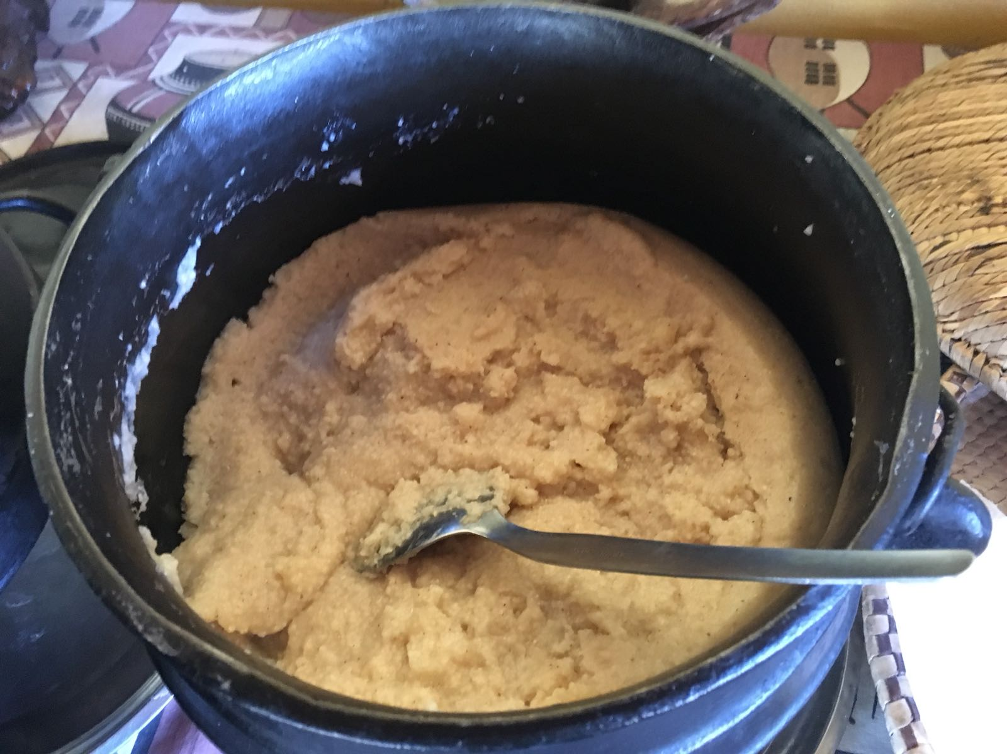
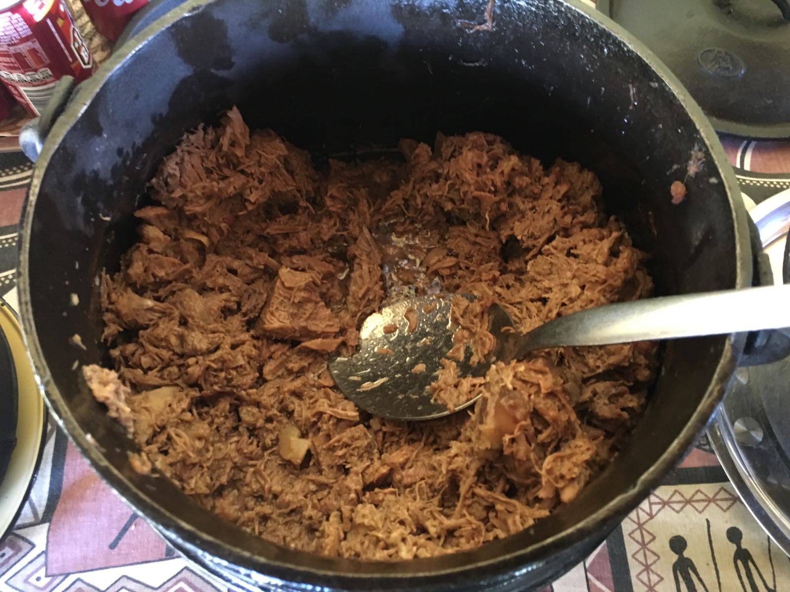
Now all you have to do is pound/thuga the sorghum.
Boil/Bedisa three big pots of water to prepare the vegetables, seswaa, and porridge.
Cook/Go apaya the meat and vegetables while stirring the porridge.

Slide 17
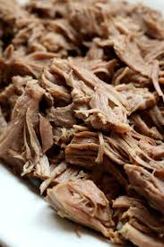
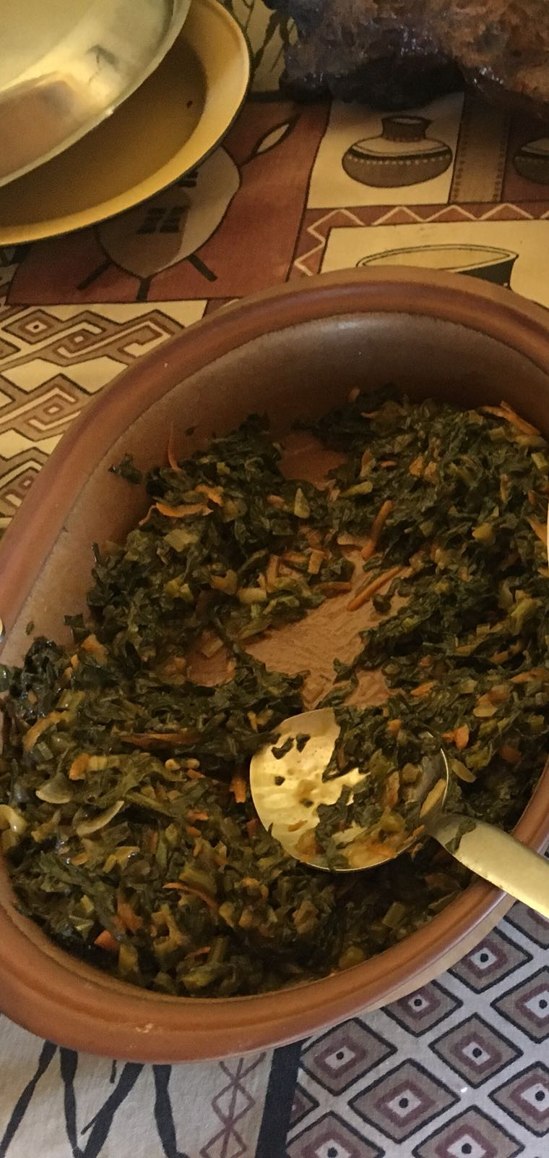
Pound/Thuga the meat and add salt.
Drain/Ntsha the water from the vegetables.
Add salt to the greens/loka morogo.
Time to serve!

Slide 18
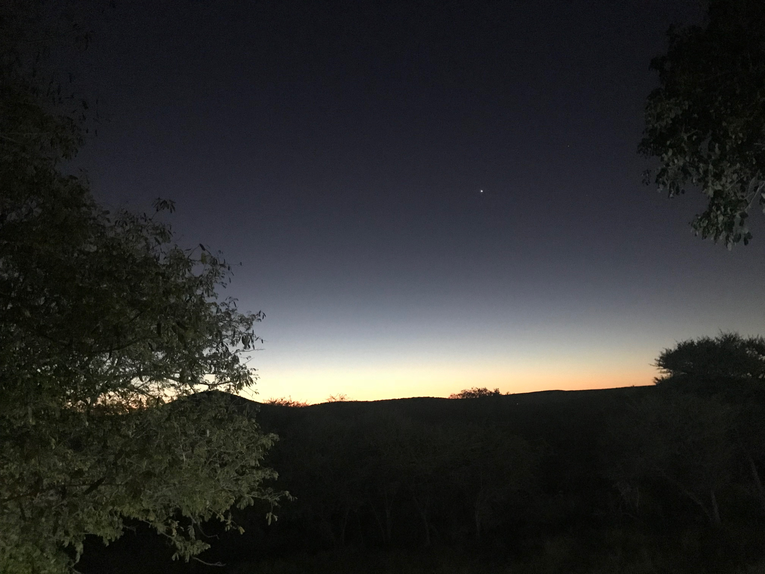
The sun is setting and the “time to eat star”/kopadilalelo is high above you. Enjoy the meal/Itumelele dijo, everyone!
Notes:
Bon appetit!

