Slide 1
Botswana: Nature Conservation
By: Nancy MacDonald, Jessie Nosworthy, Natalie Williamsf
An Adapted Approach for All Learners

Slide 2
Collaboration
8 Schools: 7 primary, 1 secondary
3 contained deaf education units
8 had special education units
Inclusive classrooms
Interviewing teachers indicated the importance of signing and instruction when teaching and testing students
Emphasis on environmental education and nature conservation
Standard 5: Lesson 3 Nature Conservation unit adaptation

Slide 3
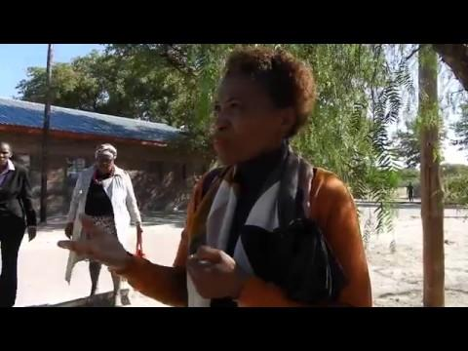
Notes:
video

Slide 4
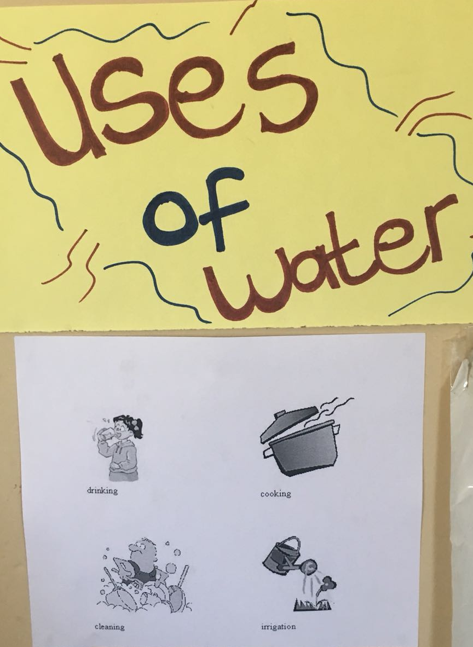
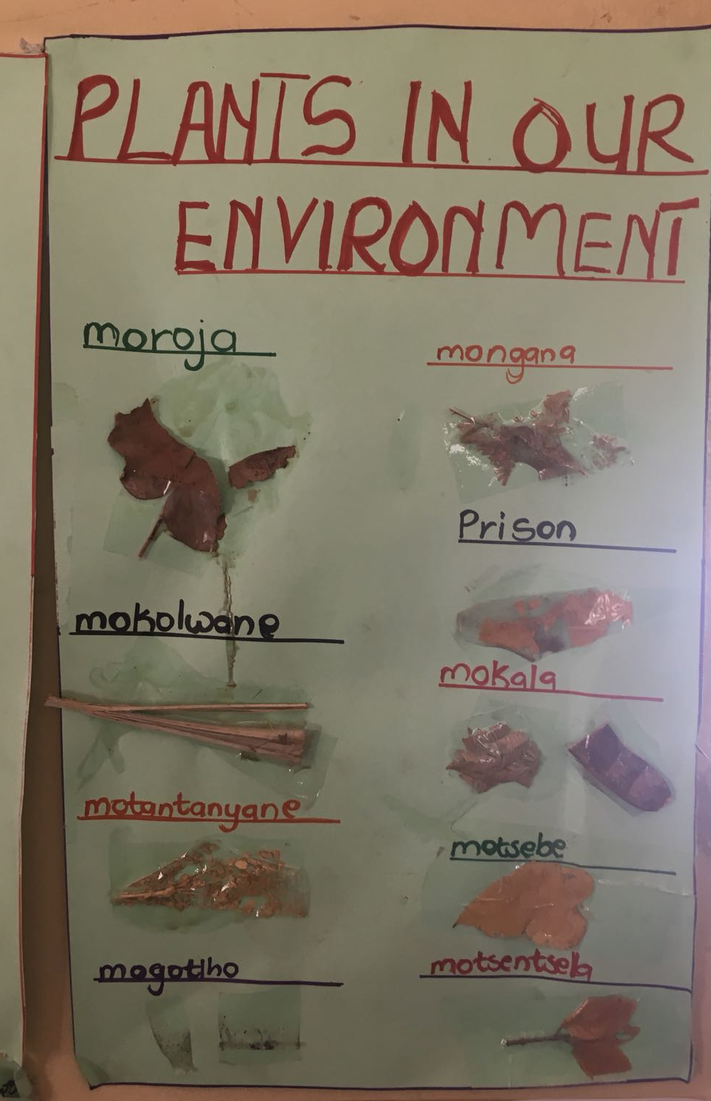
In the Classroom

Slide 5
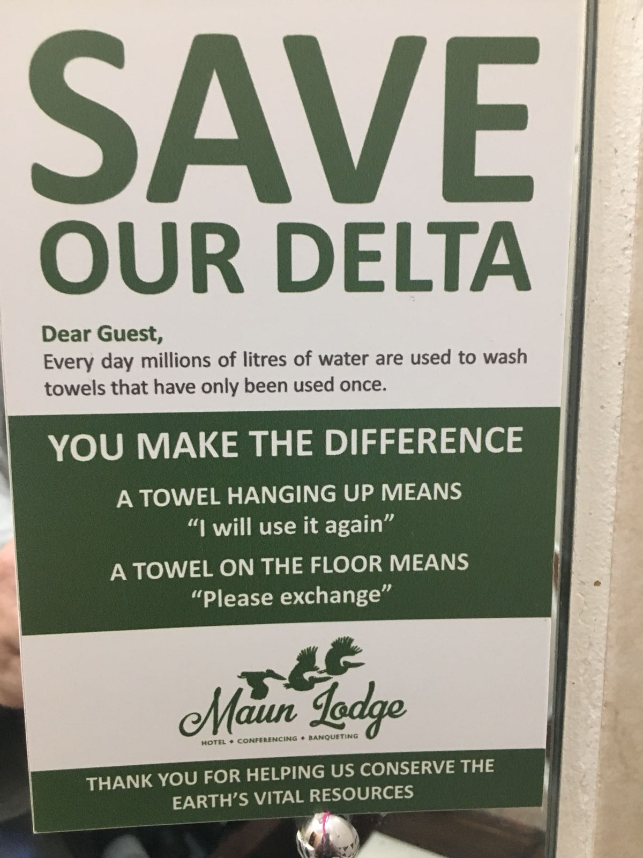
In ecotourism

Slide 6
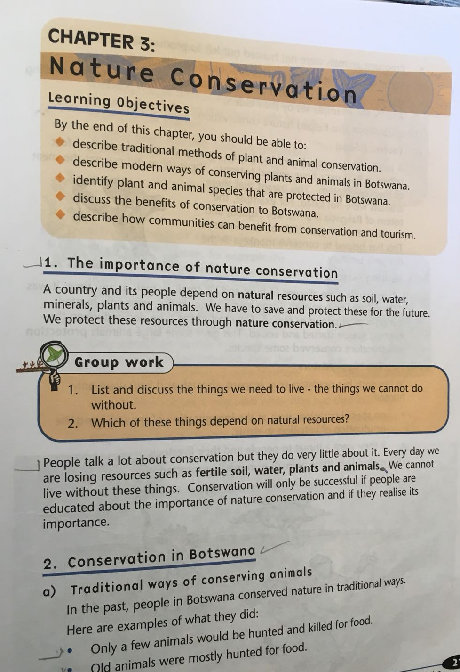
In curriculum

Slide 7
Unit Summary
1
Science and English language arts based
Week-long unit = 2 days content learning, 2 days working in class on a project, 1 day to share project
Universal Design for Learning (UDL) allows all students access to information in an inclusive classroom. Includes modifications to materials and various modes of instruction for visual, auditory, tactile and kinesthetic support
Project-based learning increases student engagement and provides methods for assessment for all learners and increased learning through project sharing.
Assessment of student learning is through in-class exercises and a rubric for the student project

Slide 8
Objectives of the Lesson
Heinemann’s Standard 5 English Pupil’s Text
Describe traditional methods of plant and animal conservation.
Describe modern ways of conserving plants and animals in Botswana.
Identify plant and animal species that are protected in Botswana.
Discuss benefits of conservation to Botswana.
Describe how communities can benefit from conservation and tourism.

Slide 9
Materials
Text book
Adapted book
Bubble Map
Communication Board
Animal Slides
Sign Language Vocabulary Video
“Things We Need to Live” HO
Modified Text HO
Matching Terms HO
Project HO

Slide 10
Teaching Strategies

Slide 11
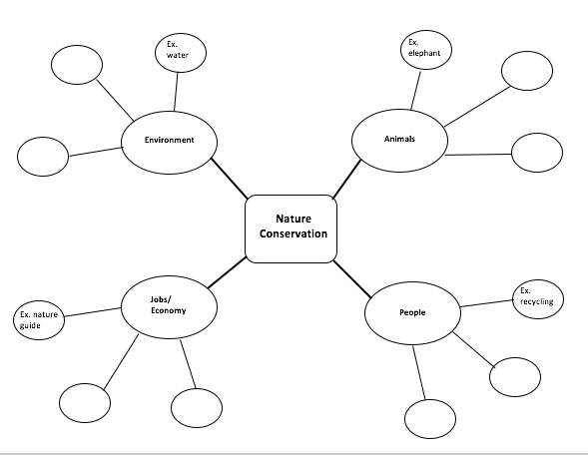
Bubble Map

Slide 12
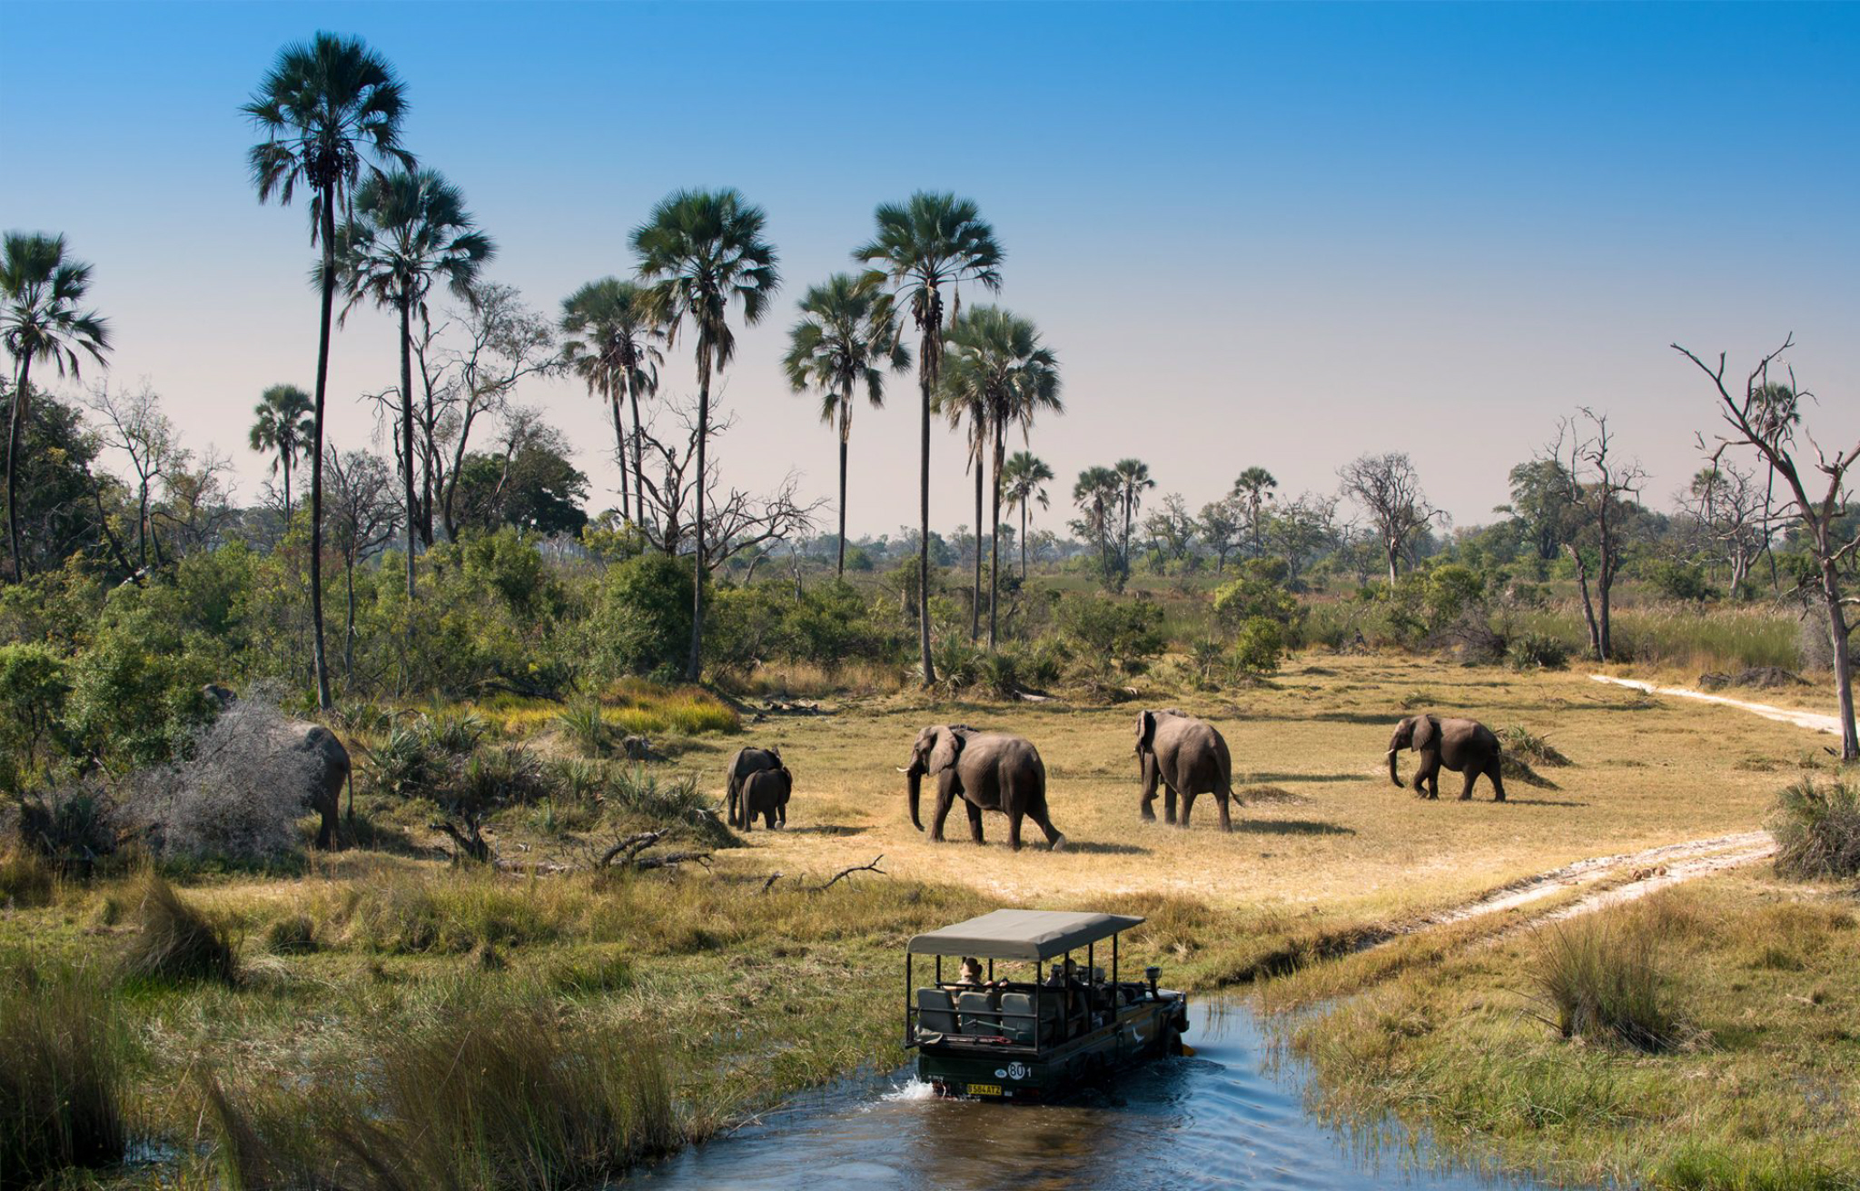
Activity 1:
Guided
Instruction
Concept focus: Bubble Map
Benefits of nature conservation
Meets Objectives 3 and 4

Slide 13
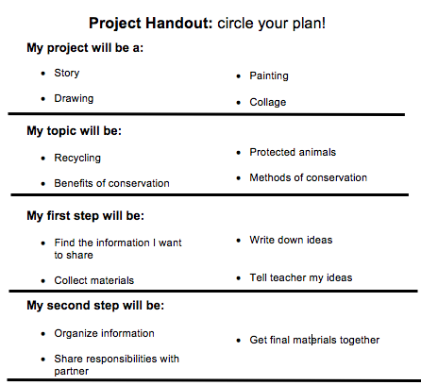
Activity 2:
Project-based
Learning
Allows students to explore and demonstrate knowledge of content learned in class
Student-choice learning, allows more options for knowledge sharing among classmates
Meets Objectives 1-5
Allows assessment for content learning for students of all abilities
“Create a project that shows your knowledge of modern or traditional methods of conservation in Botswana.”

Slide 14
Adaptations
For many types of learners

Slide 15
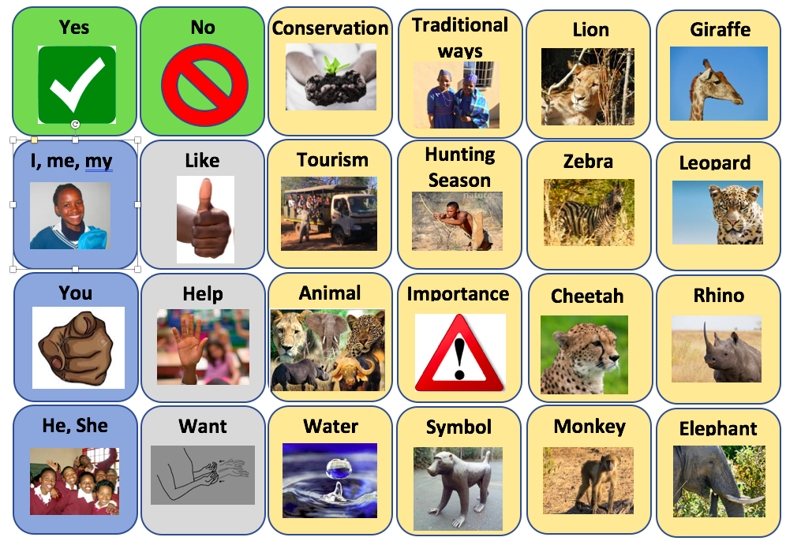
Visual
Communication Board
1
Allows students to participate in classroom activities and discussion by making selections and pointing to their individual board
Great for non-verbal communicators
Core Vocabulary + Lesson Vocabulary
Notes:
For visual we created a communication board which is a great way for non-verbal communicators to participate in our activites
We have categorized these based on color so the right half being the lesson vocabulary and the left having core vocabulary including pronouns, and verbs. We also added yes and no so they can participate in simple questions

Slide 16
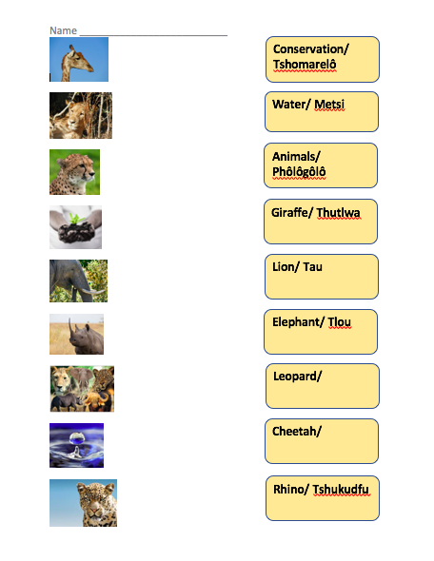
Visual
Adapted Text (bigger font and fewer words)
Great for students who are visually impaired or intellectually impaired
Vocabulary Matching
Great for students who are hearing impaired or intellectually impaired or have other learning disabilities

Slide 17
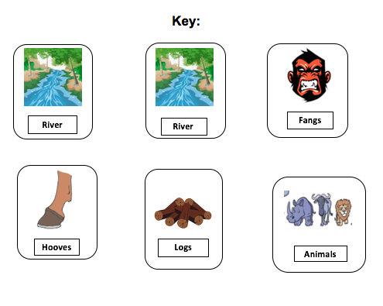
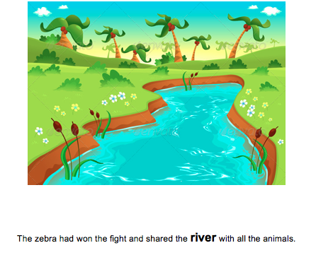
This adapted book provides texture for increased sensory input, modified text, bolded vocabulary, and matching
This would work for children with ID, visual impairments, ASD, and other learning disabilities
Youtube read aloud:
https://www.youtube.com/watch?v=t8YfCtuhVKY&t=2s
Tactile
How the Zebra Got its Stripes: Story Book
Book with texture additions
Ex: gluing sand onto the book

Slide 18
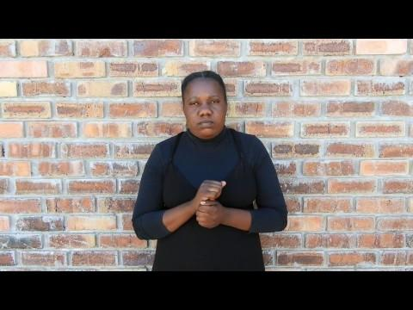
Kinesthetic
Supplemented the text with a video for deaf learners
This would also be a great kinesthetic method of learning for all learners
The action of the sign helps create a connection in the brain between the motion and target vocab
And it’s FUN!

Slide 19
Ke a leboga! Sala Sentle!
https://drive.google.com/open?id=1G6pvnzgLZQuc5C8H9uhAXSEVH-M91a49
Please feel free to contact us at:
nwilliams3@catamount.wcu.edu or jpnosworthy1@catamount.wcu.edu

