Slide 1
ACROSS OCEANS- IDENTIFYING SIMILARITIES AND DIFFERENCES FROM OUR LAND TO YOURS
Matt Cuddington, M.A., CCC-SLP
Jenny Jones, SLP Graduate Student
Mamie Shutt, Special Education Teacher

Slide 2
OBJECTIVES
North Carolina 3rd grade Essential Standard:
3.G.1 Understand the earth's patterns by using the five themes of geography:
Location*
Place*
Human environment interaction
Movement
Regions*

Slide 3
LESSON OBJECTIVE
Social Studies
Geography of Botswana as compared to North Carolina, United States of America
3.G.1.1- Find absolute and relative locations of places within the local community and region
3.G.1.6- Compare various regions according to their characteristics

Slide 4
CURRICULUM/ CLASSROOM OBSERVATION
During our visit we have been able to observe the differences in regions as we traveled through the country from Gaborone to Francistown, Kasane, and Maun.
Participants have also observed the teaching of Botswana history throughout many of the classrooms we visited, such as differences in population density in different regions.
Physical features of the land play an important role and greatly impact population. This creates a direct link between standards.

Slide 5
COLLABORATION
Observation and participation in classrooms in 8 schools throughout Botswana
Speaking with Duduetsang Moroka, Speech Therapist and Maleshwana Mauco, Behavior Analyst
Setswana language and cultural studies with Bontle Molefe and Miso Baipidi

Slide 6
CONTENT
Teacher will present a world map to orient students to Botswana and NC
Engage students by gathering background knowledge
Where is Africa?
Where is Botswana?
Where is America?
Where is North Carolina?
What is a geographical feature?
What is a mountain/hill?
What is a desert/piedmont?
What is a delta/coast?

Slide 7
*

Slide 8
REFERENCE MATERIALS
Maps: World, Botswana, North Carolina
Graphics:
NC: mountains, piedmont, and coast
Botswana: desert, hills, and delta

Slide 9
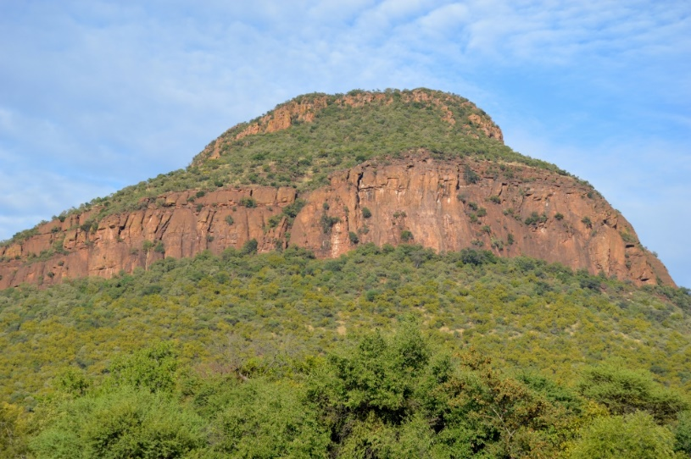
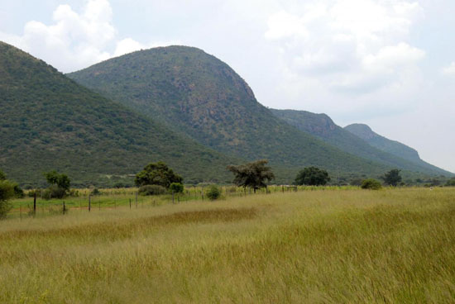
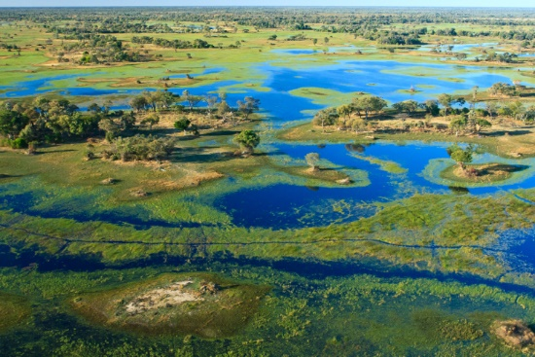
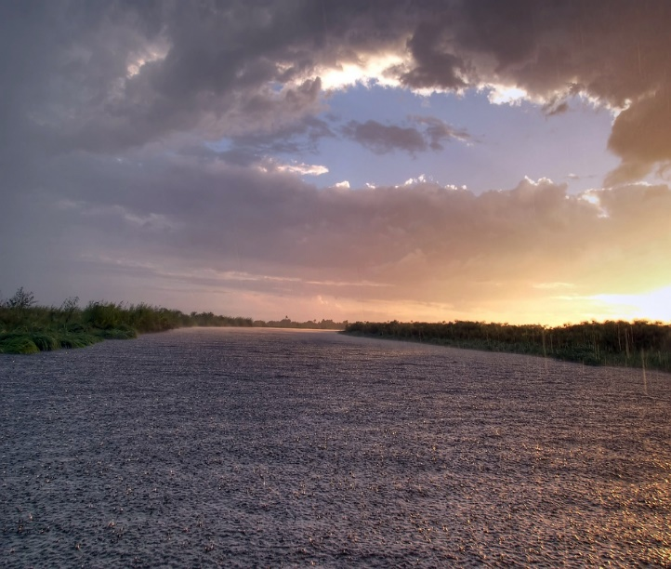
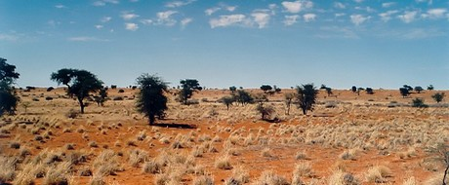
FEATURES OF BOTSWANA

Slide 10
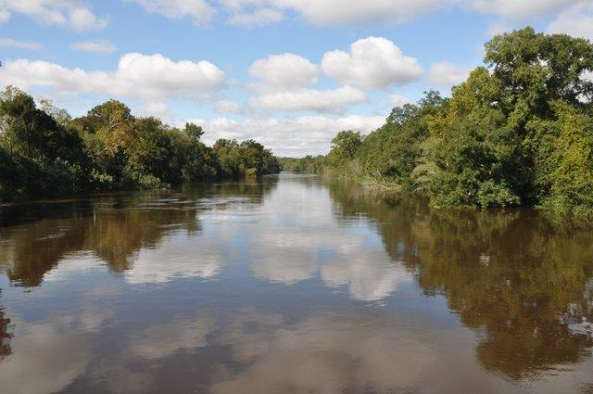
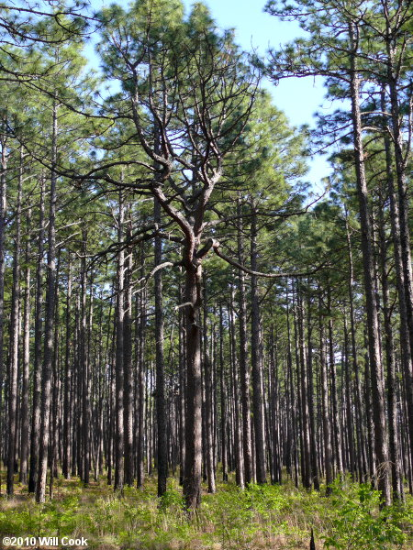
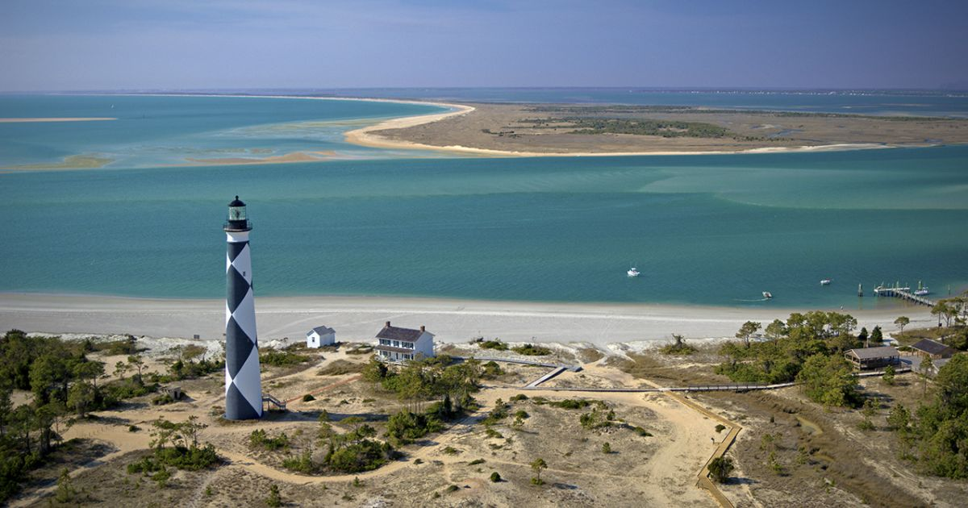
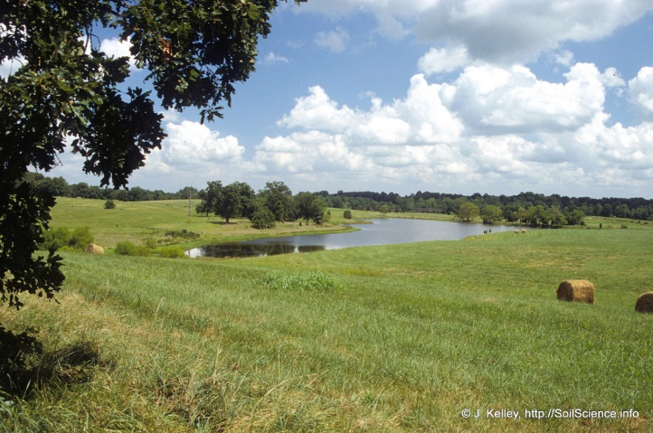
FEATURES OF NORTH CAROLINA

Slide 11
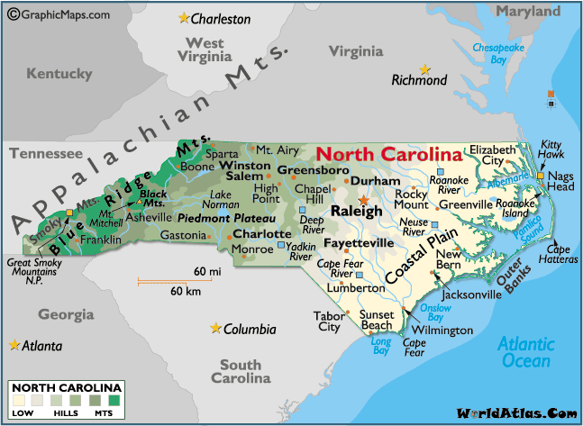

Slide 12
CONTENT
What do you know about the physical geographical features in either of these places?
Differences in trees
Vegetation
Soil type
Look for knowledge of specific features that will be discussed
Language and vocabulary
Mountain – thaba
Hill – thabana
Desert – sekaka
Bush - naga

Slide 13
ACTIVITIES
Learners will make “foldables” that list and describe the different features and regions
Teacher will provide pictures of the different regions/features and have learner locate and place where the corresponding pictures belong on map
*some students may only be able to identify features and not be able to differentiate regions
Students could identify regions by coloring different parts of a map

Slide 14
EVALUATION
Similarities
Differences
T Chart
Similarities and Differences
Chart can be completed in various ways:
Writing
Sorting
Matching

Slide 15
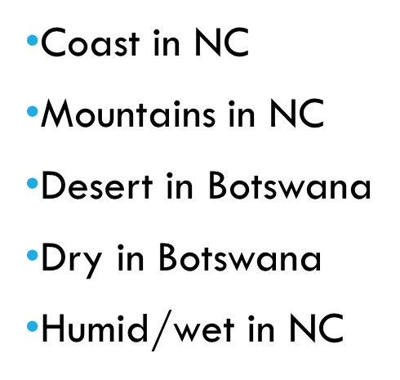
EVALUATION
Similarities
Differences
Hills
Low lands
Rivers
Written Example
Can be modified based on each learner’s ability level

Slide 16
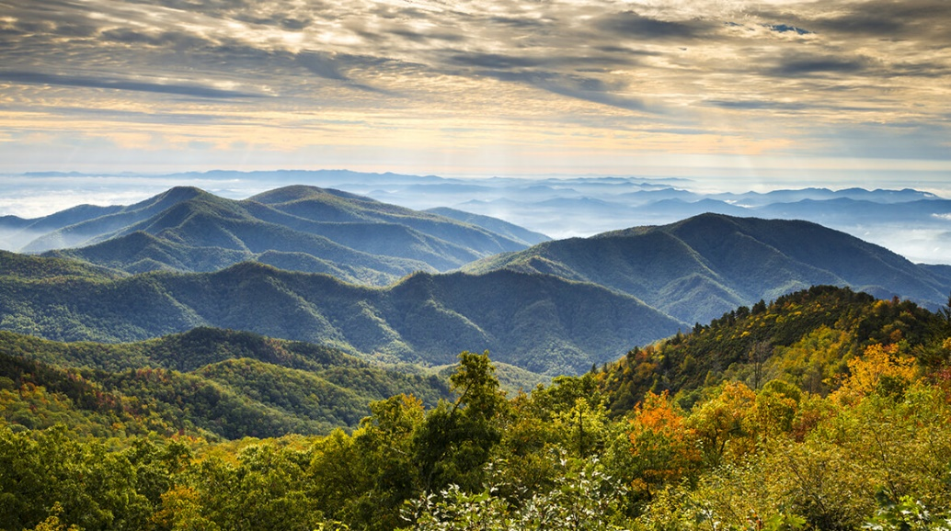
EVALUATION
Similarities
Differences
Sorting Example
Can be modified based on each learner’s ability level
Pictures or objects provided

Slide 17
UNIVERSAL DESIGN FOR LEARNING
Representation
Pre-teaching concepts
Graphic organizers (foldable)
Interactive maps
https://www.topozone.com/north-carolina/
Coloring pages
http://www.supercoloring.com/coloring-pages/north-carolina-map
http://www.supercoloring.com/coloring-pages/botswana-map-outline
Tactile/sensory objects
Sand, leaves, tree branches, grass, water
Video clips
https://www.youtube.com/watch?v=fj63VPbNhbA&feature=youtu.be
https://www.youtube.com/watch?v=iiv6m62z7Ig
Notes:
Tier 2- one map, all pictures for the region
Tier 3- one map, one picture
Use cut outs if the world map is too overwhelming
Puzzle for learners who might have visual impairments, website with audio. Can orally describe features.
Sorting the pictures will be beneficial for learners with fine motor difficulties/difficulties with writing
Students with hearing impairments will benefit from many of the visuals included in the lesson such as interactive maps

Slide 18
UNIVERSAL DESIGN FOR LEARNING
Action/Expression
Sorting pictures
Labeling maps
Verbally describing features
Dictate to scribe
Identifying corresponding textures to features
Engagement
Maps
Pictures
Videos
Textures
Centers
Partner work

Slide 19
EXTENSION
Speech/ Language Goals
Using visual and verbal cues, Maitumelo will verbally answer “what” and “where” questions in 8 out of 10 trials over 3 consecutive sessions.
Given verbal and visual prompts, Thabo will use geographical vocabulary terms (i.e. mountains, hills, rivers, piedmont, coast, desert, savannah, delta, etc.) when describing similarities and differences of various regions in 8 out of 10 trials over 3 targeted sessions.

Slide 20
CONTACT INFORMATION
Matt Cuddington, M.A., CCC-SLP
mccuddington12@gmail.com
Mamie Shutt, Special Education Teacher
bajaseaturtle@yahoo.com
Jenny Jones, WCU Graduate Student
jrjones13@catamount.wcu.edu

