Slide 1
Botswana’s National Animal

Slide 2
Zebra/
pitse ya
naga

Slide 3
Protected Animals

Slide 4
Giraffe/ Thutlwa

Slide 5
Rhino/ Tshukudu

Slide 6
Cheetah/ Letotse

Slide 7
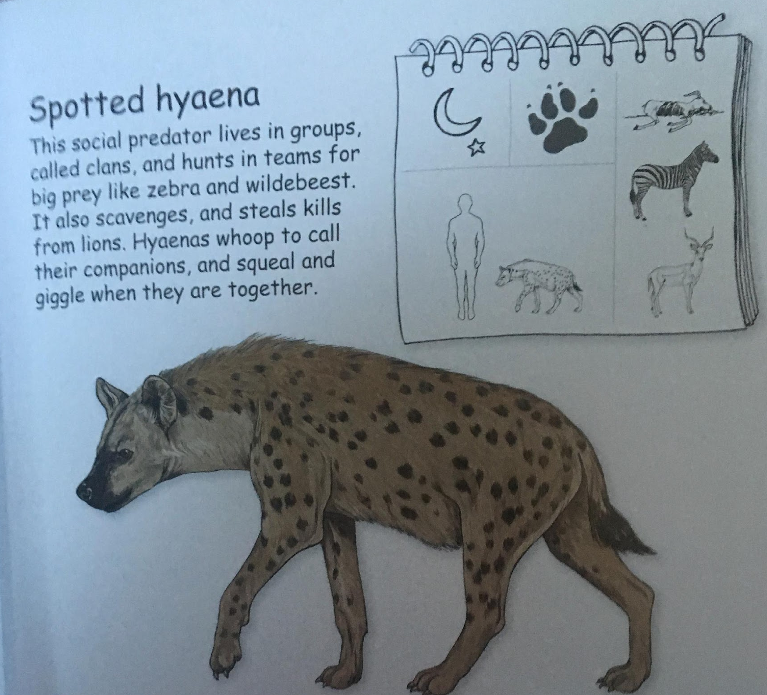
Hyaena/ Phiri

Slide 8
Hippo/
kubu

Slide 9
Partially Protected Animals

Slide 10
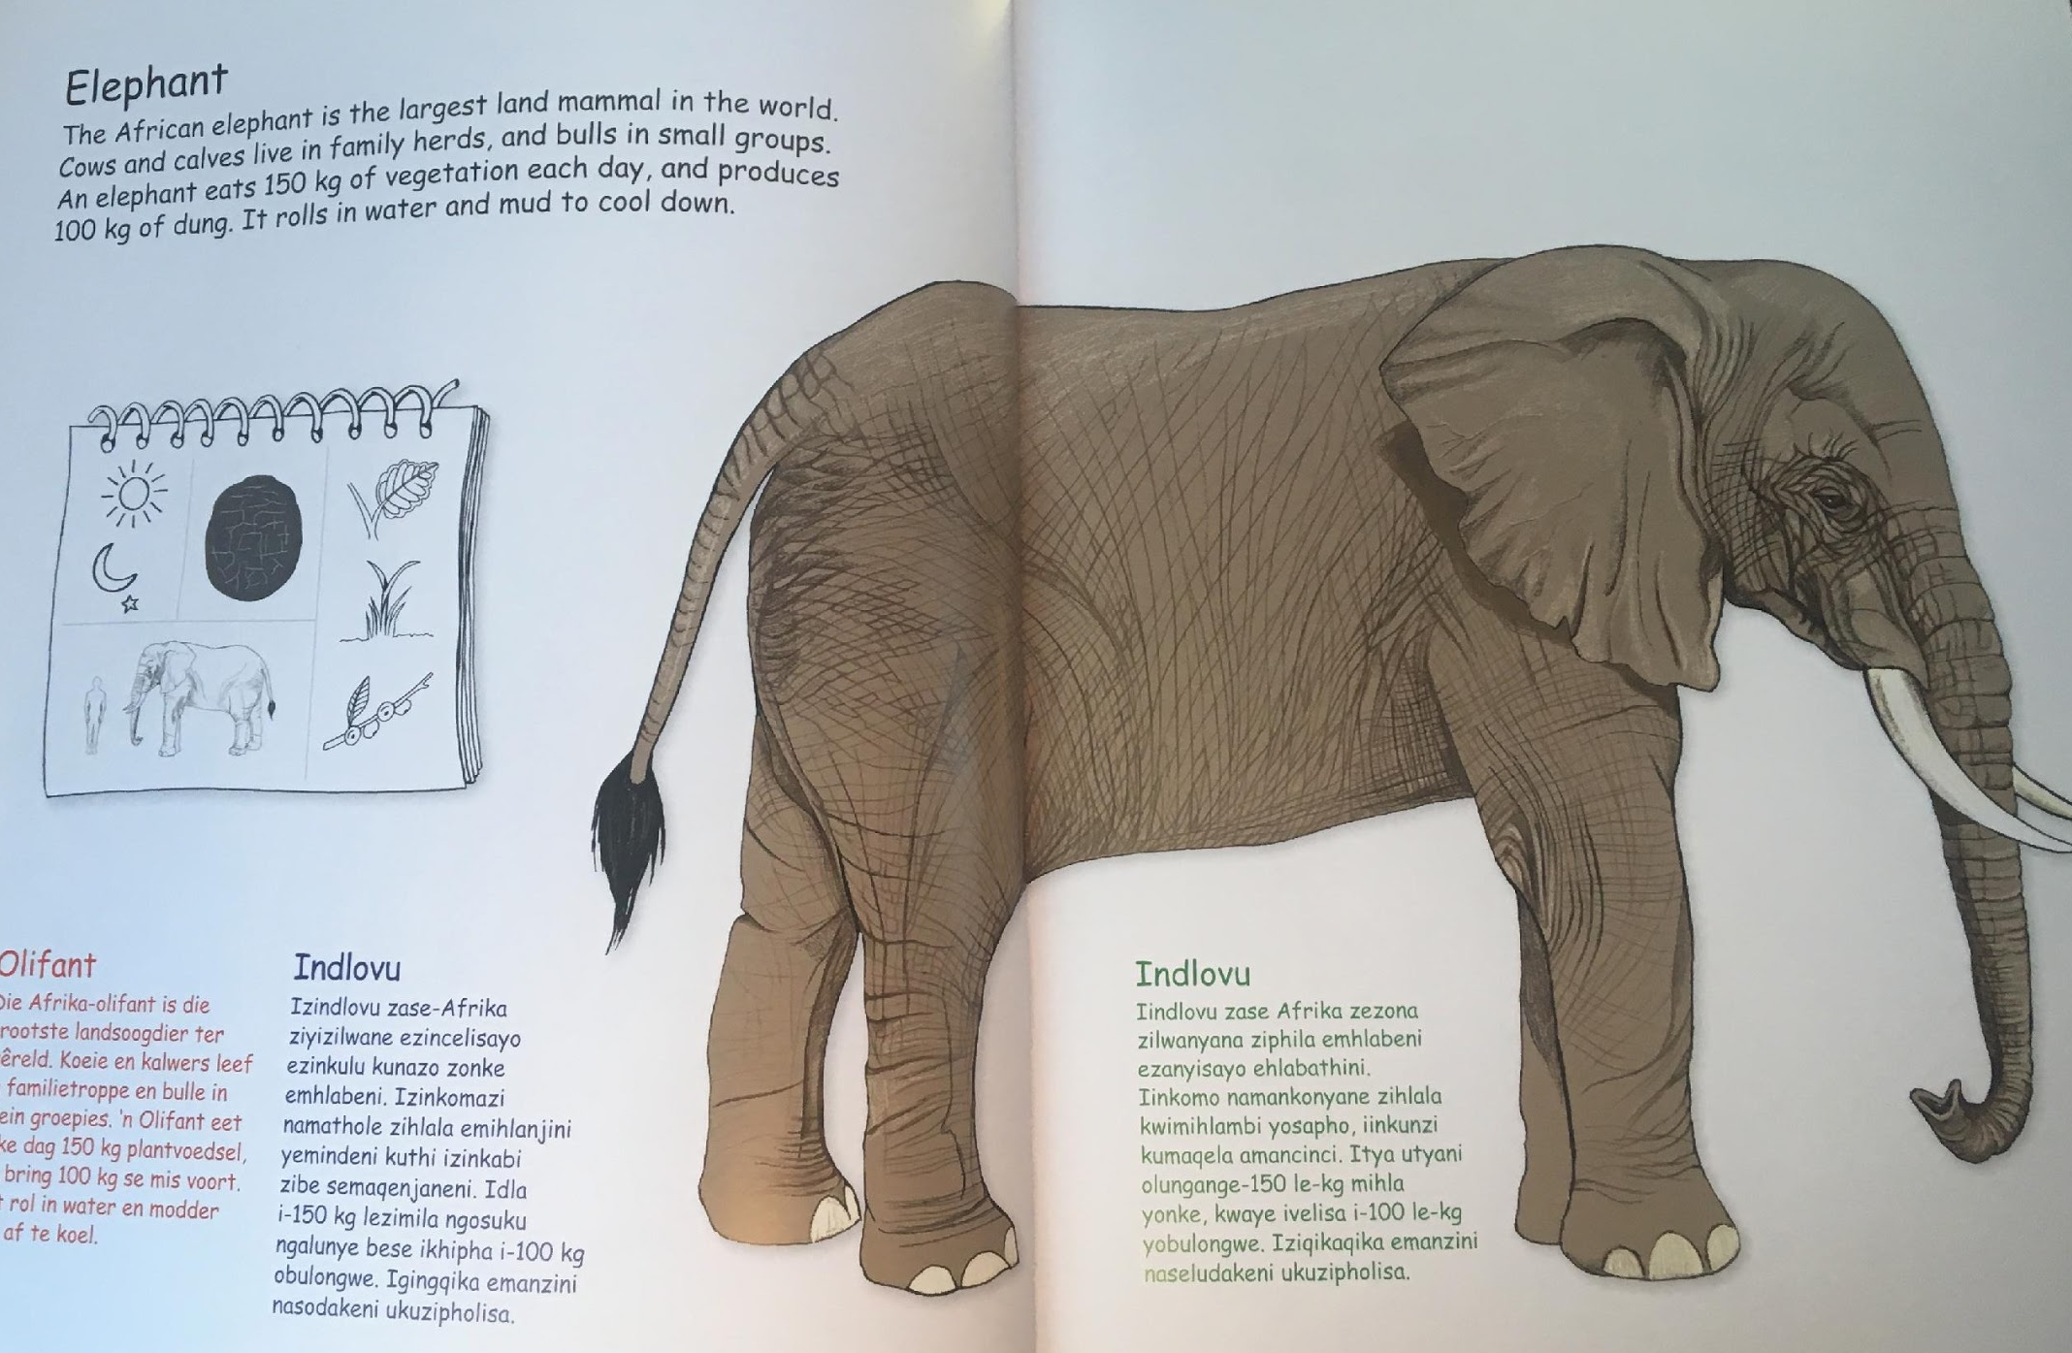
Elephant/ Tlou

Slide 11
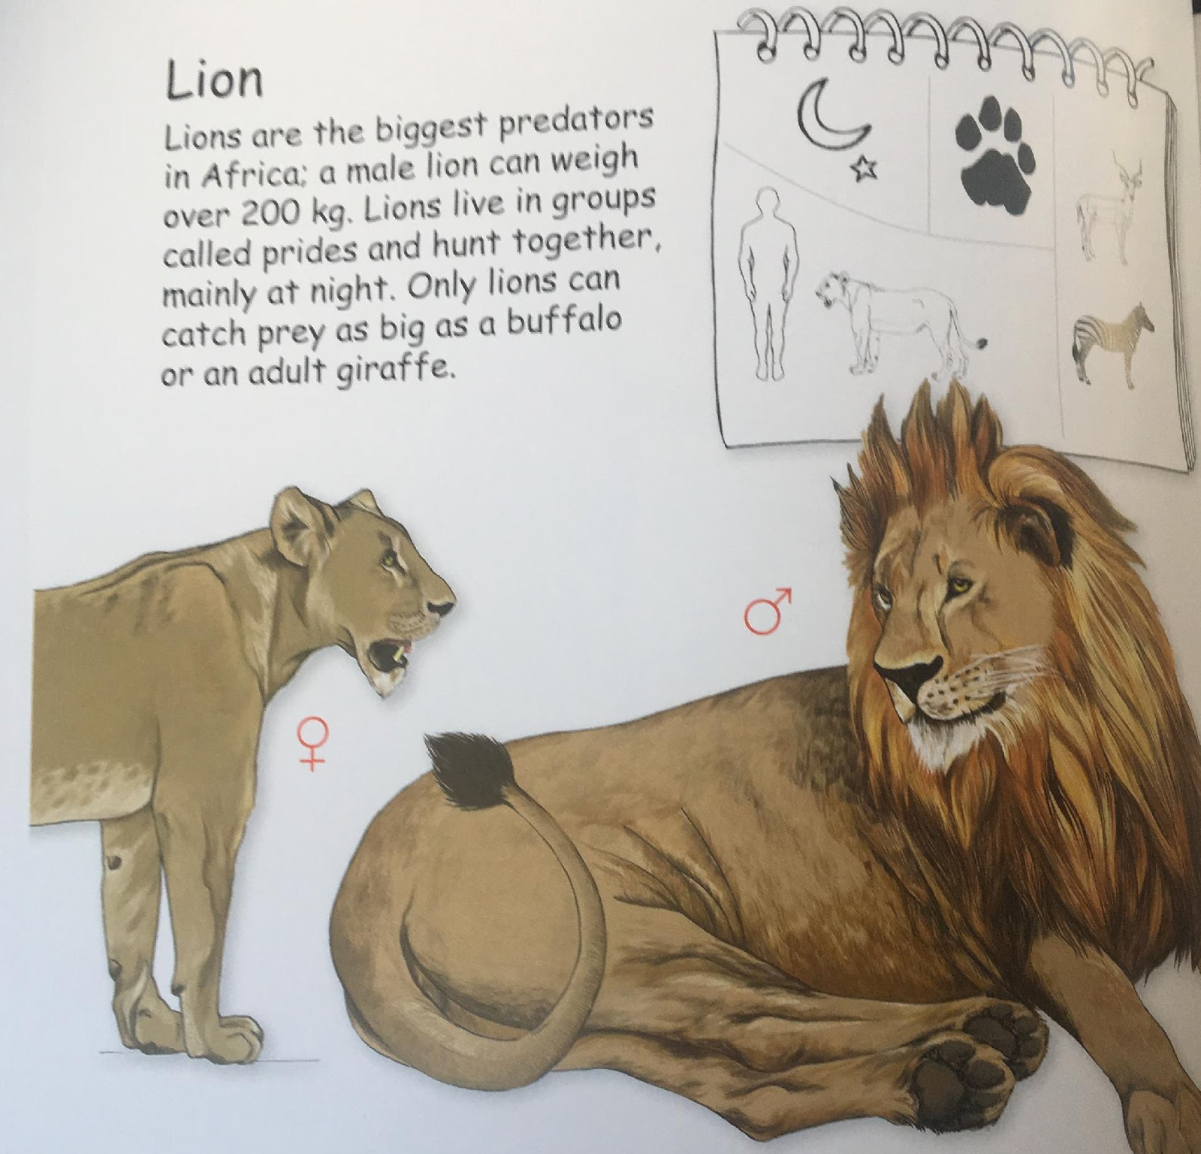
Lion/ Tau

Slide 12
Leopard/ lengau

