Slide 2
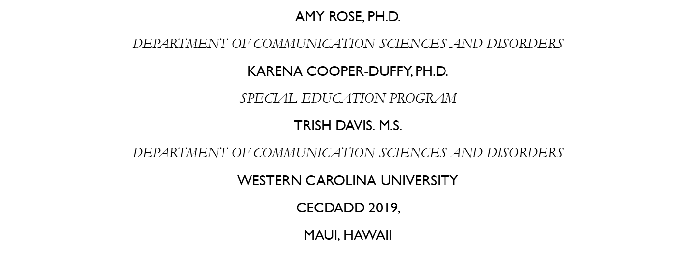
Teaching Children with Autism through a Collaborative Partnership with Western Carolina University and Autism Botswana.
Notes:
AR

Slide 3
The contents of this presentation were developed under a grant from the Fulbright-Hays Group Projects Abroad (GPA), U.S. Department of Education. However, these contents do not necessarily represent the policy of the Department of Education, and you should not assume endorsement by the Federal Government.
For further information, visit the GPA website.
Notes:
AR

Slide 4
Objectives:
Participants will :
Learn about the similarities and differences regarding the education of students with autism in Botswana, Africa and in the US.
Learn about collaborative international personnel preparation strategies when sharing information with professionals and families from Botswana, Africa.
Learn about the importance of cross-cultural practices when collaboratively providing personnel preparation activities internationally.
Notes:
KCD

Slide 5
Activities to date - foundation
Presentations at Autism Botswana Conference – parent feedback
Worked alongside teachers in schools with special units
Parent share through video-conferencing
Established collaboration with Camphill (autism unit)
President of Autism Botswana, Maleshwane Mauco
Partnership with Ministry of Basic Education, Department of Special Support Services
Notes:
KCD

Slide 6
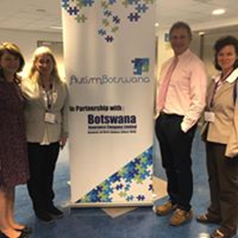
Our website: https://affiliate.wcu.edu/botswana2018/
Program Abstract
Curriculum Projects
Pictures
Video
Resources
Presentations
Family Share Event
Notes:
KCD

Slide 7
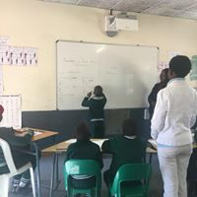
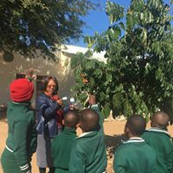
1) Understanding the education of children with autism in Botswana, Africa and the United States.
Notes:
AR

Slide 8
Characteristics of children on the autism spectrum
DSM-V - CDC
WHO
Similarities
Range of severity
Deficits in social communication
Restricted, repetitive behaviors and interests
Symptoms present in early childhood
Differences
Behavior
Attention
Notes:
AR

Slide 9
Procedures for diagnosis
Age of diagnosis
Assessment timeline
Referral
Awareness
Barriers
Similarities
Delays between parent first concern and process initiated; cost and access; challenges navigating system
Differences
Botswana: later diagnosis; one center for assessment; one SLP; social worker often first to identify; lack of awareness of ASD characteristics; stigma
Notes:
AR

Slide 10
Types of services/interventions
Governmental
NGO (non-profits)
Private pay
Home
Similarities
Special education classrooms; different levels of support; functional skills
Differences
United States – early intervention focus; public school system starting at age 3; varies by state; allied professions; behavioral specialists; training
Notes:
AR

Slide 11
Family support/educational options
Autism Botswana
Autism Speaks
Examples of family support in US: TEACCH; Family Support Network; EC Assistance Center; etc.
Similarities
Government/public schools
Rural vs. city
Increasing awareness and access
Lack of support/understanding by family members
Journey of advocacy
Differences
In Botswana: just starting with family support; typically social workers visiting villages; few options; transportation
Notes:
AR/KCD

Slide 12
Goals for each country for education of children on the autism spectrum
Botswana:
MOESD Inclusive Education Policy
Create awareness
Establish early intervention
Educate stakeholders
United States:
U.S. Department of Education’s Individuals with Disabilities Education Act (IDEA)
Early Identification
Transition to adulthood
Notes:
AR

Slide 13
2) Understanding how to collaboratively provide personnel preparation internationally with educators, administrators and families of children with autism
Strategies identified in the research literature regarding international professional development:
Study abroad
Online communication
Discussions/debriefing
Sharing of expertise
Experiential learning
Group instruction
Readings
Video modeling
Role play and feedback
Less talking
More hands on
Visuals
Reciprocal*****
Video modeling
Role play and feedback
Notes:
KCD

Slide 14
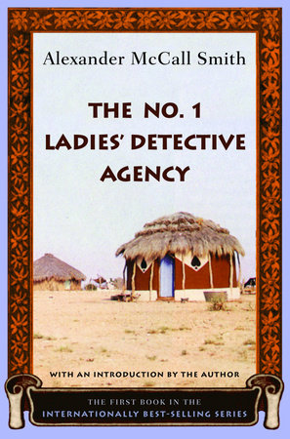
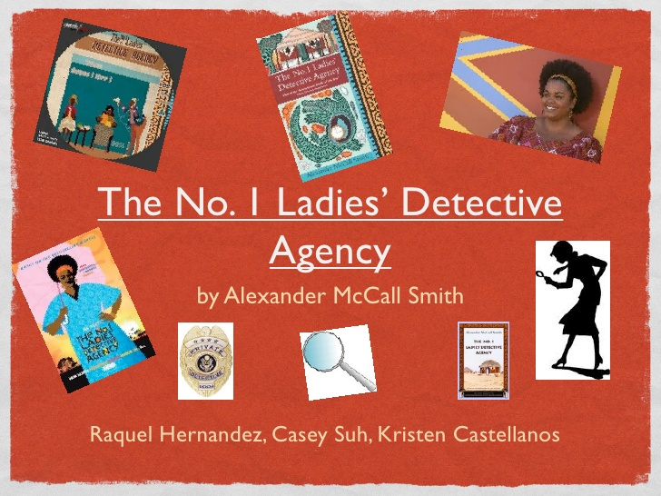
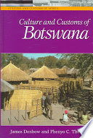
3) Understanding the importance of cross-cultural practices when working with children with disabilities, professionals at a conference and families who have children with disabilities.
Literature!!
Notes:
AR

Slide 15
Journal article: teaching group counseling in Botswana (Coker & Majuta, 2015)
Respect (“botho”): means “wait your turn,” or “don’t interrupt.” “Cutting off” group members is not appropriate in Botswana. Everyone is important!
Age difference is a factor: pay respect and deference to individuals based on age. Elders add cultural value and credibility to the group.
Building rapport: name tags, use of Setswana names
Group Facilitation: respect for authority; straight lecture
Collectivism and advice-giving: group members are very caring and give lots of advice and directives to other group participants; may impede individual from developing strategies to cope on their own
Verbal/non-verbal communication: switching between English/Setswana; reluctant to identify personal strengths; smiles indicate cognitively present – not agreement
Notes:
AR/KCD*I didn’t think there would be kids with autism here too – cultural awareness; unique to us but ASD is worldwide.

Slide 16
Book: Culture and Customs of Botswana (Denbow and Thebe, 2006)
Religion and worldview
Literature and Media
Art and Architecture
Cuisine and Traditional Dance
Traditional village
Gender roles, marriage, and family
Social customs and lifestyle
Music, dance, and theater
Notes:
AR

Slide 17
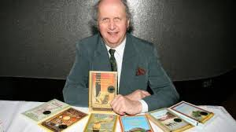
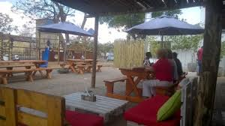
Book: #1 Ladies Detective agency series (alexander macCall smith)
Provided cultural context
#1 Ladies Detective Agency tours in the capital city of Gaborone
#1 Ladies Coffee House
Notes:
AR

Slide 18
References
Coker, A. & Majuta, A. (2015). Teaching group counseling in Botswana: Two U.S. trained counselors discuss experiences and share cultural considerations for practices. The Journal for Specialists in Group Work, 40(1), 102-116.
Denbow, J. & Thebe, P. (2006). Culture and Customs of Botswana. Westport, Connecticut: Greenwood Press.
Smith, A., (1998). The #1 Ladies Detective Agency Series. Scotland: Polygon, Edinburgh

Slide 19
Feel free to contact us for more information!
Amy Rose
Karena Cooper-Duffy
Trish davis
Autism botswana
ajrose@wcu.edu
Western Carolina University
(828) 227-3289
kcooper@wcu.edu
Western Carolina University
(828) 227-3285
pdavis@wcu.edu
Western Carolina University
(828) 227-2826
mmauco@gmail.com
President, Autism Botswana

Slide 20
The End
Questions?

