Slide 1
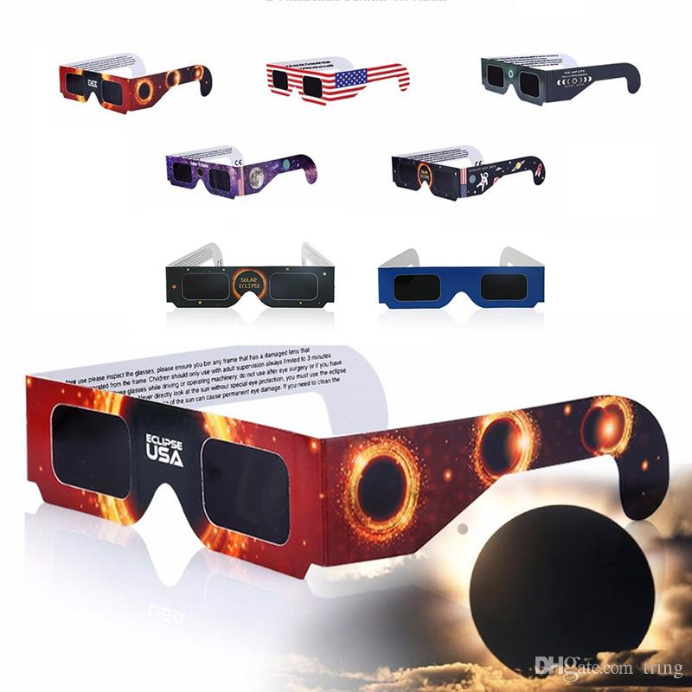
BRAND NEW… HYPNO GLASSES!!!
Only $99!
(Plus Tax)
Everyone has a pair!
Get your own pair TODAY!!!!

Slide 2
The Hypno Glasses are brand new!
They are only $99 plus tax!
If you are wondering what the fuss is all about then this is it…
The new Hypno Glasses can hypnotize anyone, even yourself!
If you have a bullying problem or you’re about to be fired from your job, then you could just get the glasses and hypnotize anyone that is giving you any problems.

Slide 3
How Do They Work?
The Hypno Glasses wirelessly connect to your thoughts.
If you want to hypnotize someone, then have that person in mind and repeat this phrase three times (while thinking of the person): hypnotize them, hypnotize them, hypnotize them.
Next, physically go to that person, close your eyes, and count to five slowly. When you open your eyes stare right at them while wearing the hypno glasses, and that person will repeat this phrase: Hypnotize complete.
If you do not repeat these steps, precisely in this order, then the hypnotization will not work properly.

Slide 4
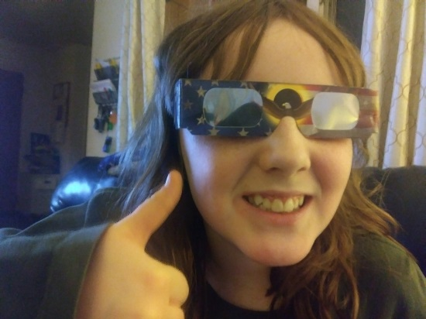
All About the Hypno Glasses
Description:
The hypno glasses have a shaded glass lens that is able to hypnotize anyone you want.
They come in many colors, including:
Red
Orange
Gold
Yellow
Lime Green
Olive Green
Hunter Green
Royal Blue
Light Blue
Teal
Indigo
Purple
Violet
Hot Pink
Magenta
Silver
Gray
Dark Gray
Beige
Brown
Black

Slide 5
Characterization
It could even help fictional characters, such as Nikki Maxwell from the Dork Diaries series or Grover from What I Came to Tell You.
Both characters face different problems; one of the problems is the bamboo forest is getting cut down, and the other is that the main character is getting bullied.
Both Characters, Nikki and Grover could use the hypno glasses to solve their problems and these special glasses could help with many other things in their lives.
Nikki- The character could use the hypno glasses to hypnotize the bully and her little sister Brianna from bugging her all the time.
Grover- The character could use the hypno glasses to hypnotize the people that are going to cut down the bamboo forest and he could also use the glasses to hypnotize his friend to come back from moving away.

