Slide 1
PROJECT INTERACT
AN INTERPROFESSIONAL TRAINING OPPORTUNITY FOR GRADUATE STUDENTS IN PSYCHOLOGY, SPECIAL EDUCATION, AND SPEECH-LANGUAGE PATHOLOGY

Slide 2
The contents of this PowerPoint were developed under a grant from the U.S. Department of Education, #H325K1990050. However, these contents do not necessarily represent the policy of the U.S. Department of Education, and you should not assume endorsement by the Federal Government. Project Officer, Anita Vermeer.

Slide 3
WHAT IS PROJECT INTERACT?
Project INTERACT (Interprofessional Autism Collaborative Training) is a 5-year, Department of Education funded Personnel Preparation grant
INTERACT will train 12-15 students each year, 4-5 from each of the participating WCU disciplines (Psychology, Special Education, and Speech-Language Pathology
Training will occur in one calendar year
Courses will occur in the Spring, Summer (May and first and second summer sessions), and Fall terms
Collaborative clinical opportunities will occur during the summer and fall

Slide 4
PURPOSE OF PROJECT INTERACT
To increase the number and quality of personnel serving children with high-intensity needs
INTERACT specifically trains participants (hereafter referred to as scholars) to meet the high intensity needs presented by children with Autism and moderate to severe intellectual disabilities

Slide 5
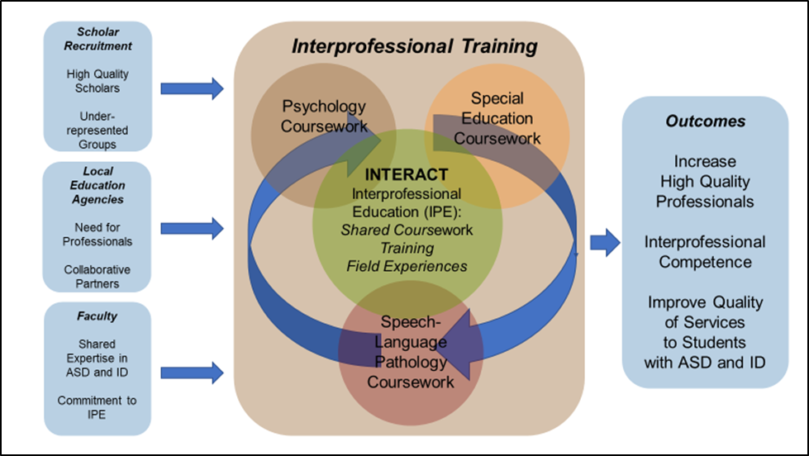
INTERACT MODEL OF INTERPROFESSIONAL TRAINING

Slide 6
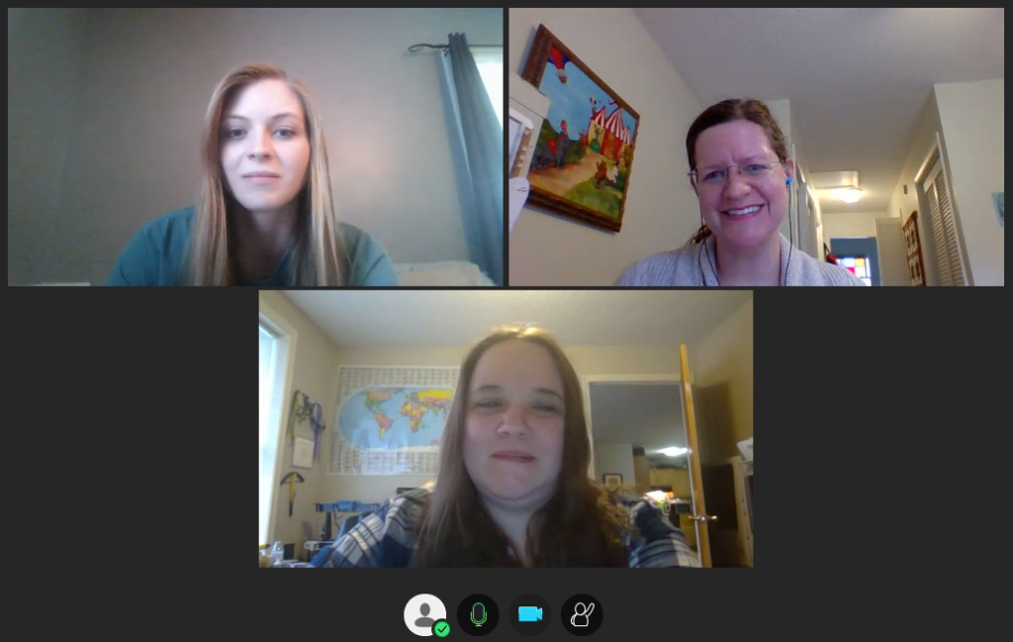
PROJECT INTERACT ONLINE COURSES
Seminar 1 (Spring) – Interprofessional Teaming and Autism Spectrum Disorder
Seminar 2 (May Mini-mester) – Comprehensive Treatment Models for Autism Spectrum Disorders
Seminar 3 (Summer I) - Interprofessional Assessment of Autism Spectrum Disorder
Seminar 4 (Summer II) – Interprofessional Intervention for Autism Spectrum Disorder
Seminar 5 (Fall) – Interprofessional Capstone
15 total Credits leading to a program certificate (9 credit hours are in the summer)- There will be online meeting times to facilitate team building and interactive learning

Slide 7
PROJECT INTERACT CLINICAL OPPORTUNITIES
Scholars will be divided creating teams comprised of representatives of each participating discipline
In the Assessment course (Summer I), each team will work together to conduct an assessment with a child.
In the Intervention course (Summer II), each team will work together to conduct a consultation of a child.
In the Capstone course (Fall), students will work collaboratively to deliver one evidenced-based practice with a child
Scholars will be training and delivering services alongside discipline peers in a fully immersive interprofessional experience
Scholars will work with families

Slide 8
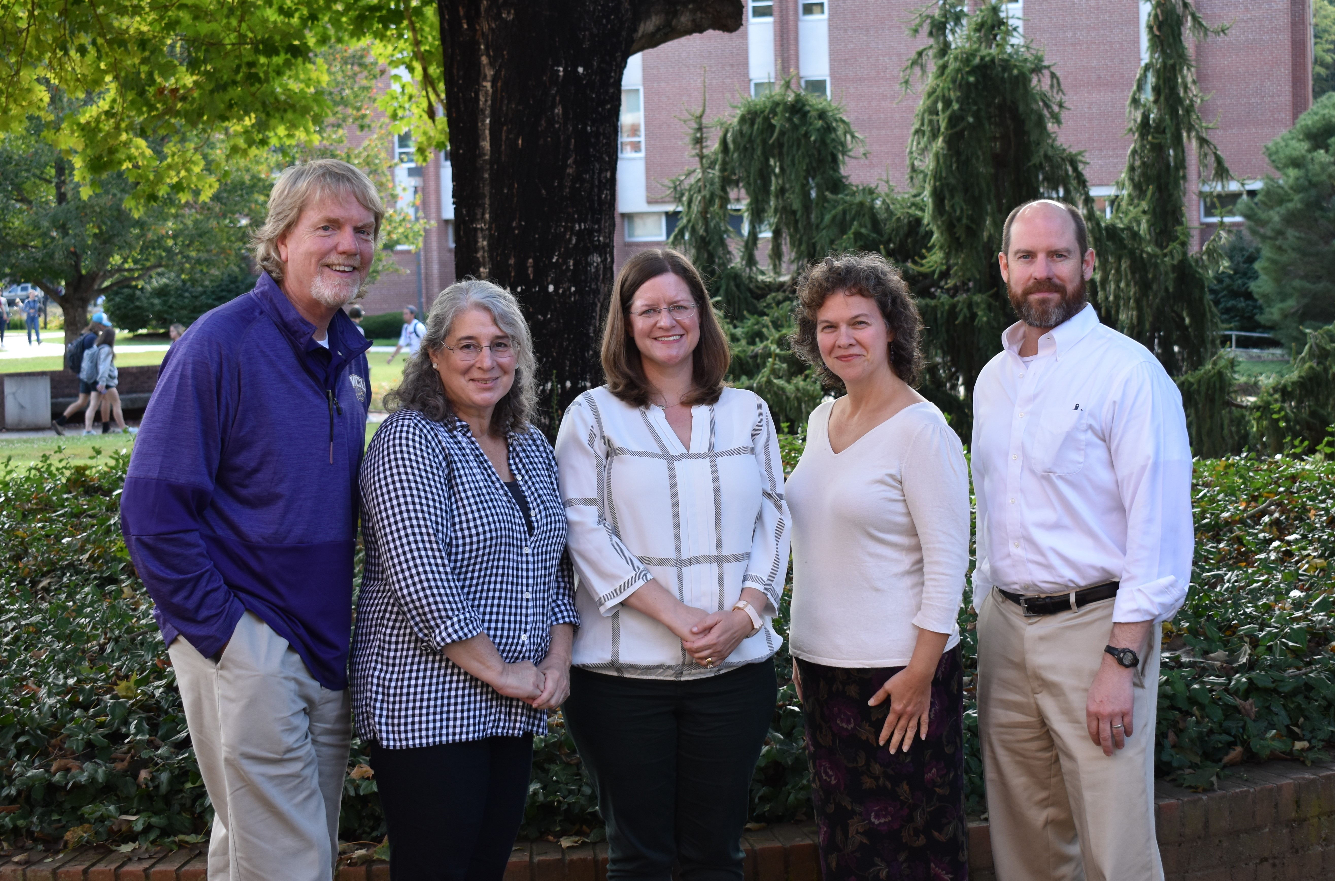
INTERACT FACULTY
INTERACT faculty are nationally recognized experts in Autism and Intellectual Disabilities including: (left to right)
Billy Ogletree, Ph.D., WCU Speech-Language Pathology ogletree@wcu.edu
Amy Rose, Ph.D., WCU Speech-Language Pathology ajrose@wcu.edu
Johanna Price, Ph.D., WCU Speech-Language Pathology jprice@wcu.edu
Karena Cooper-Duffy, Ph.D. WCU Special Education kcooper@wcu.edu
Jonathan Campbell, Ph.D., WCU Psychology jmcampbell@wcu.edu
Questions? Contact any INTERACT faculty or Grant Coordinator, Machelle Cathey (mcathey@wcu.edu).

Slide 9
SCHOLAR BENEFITS
Scholars will receive cutting-edge interprofessional education and practice experiences
Scholars will have one year of graduate school paid for at an in-state rate. Out of state students may be required to pay costs above and beyond the in-state rate.
Scholars will have access to a travel fund for continuing education
Scholars will receive a certificate of training post completion (VERY USEFUL with job searches)

Slide 10
SCHOLAR REQUIREMENTS
Scholars will be required to work in settings serving IDEA eligible children during two of the five years following grant completion.
Any part- or full-time work settings serving children will meet this requirement

Slide 11
HOW TO APPLY?
Required application materials:
Letter of interest/application
This letter must detail your interest in working interprofessionally with children with Autism and intellectual disabilities.
Resume
DEADLINE – Scholars for 2024 participation must have materials completed by September 22, 2023 . The online application is found on our website: https://affiliate.wcu.edu/projectinteract/scholar-application/. INTERACT will actively seek to recruit and support students form underrepresented groups.
Interviews will be conducted later in the Fall semester.

