Slide 1


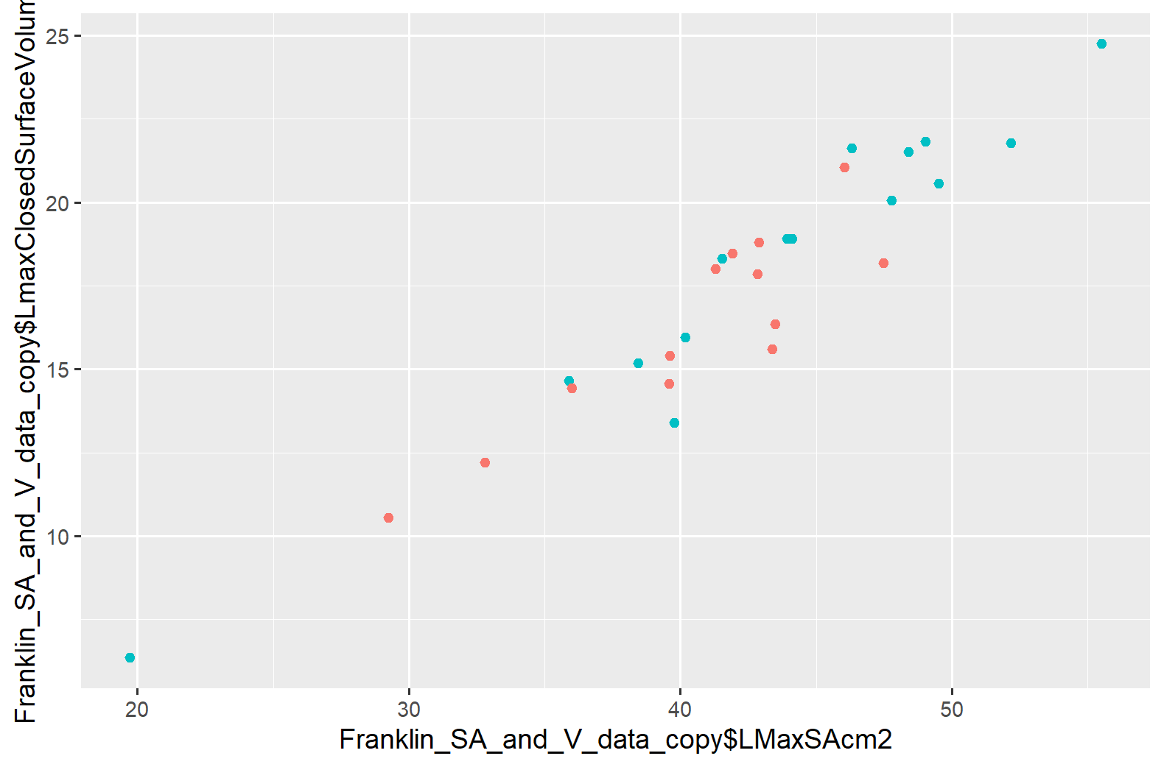
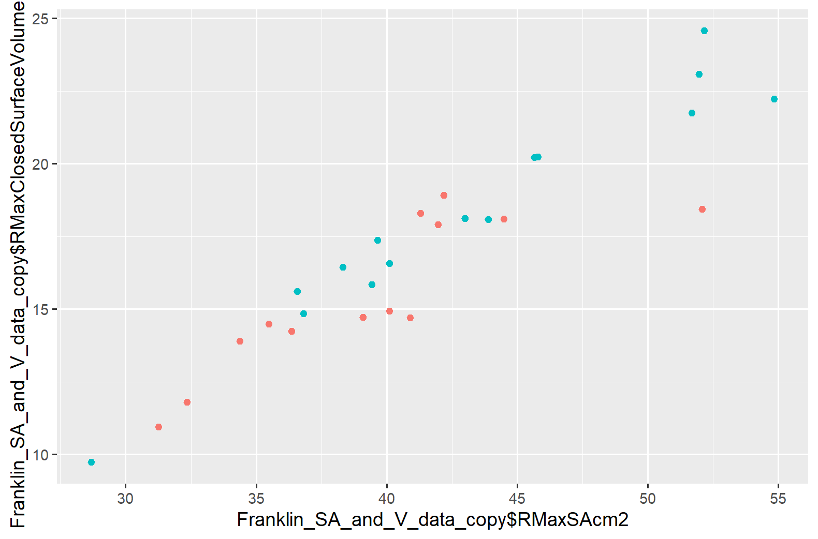
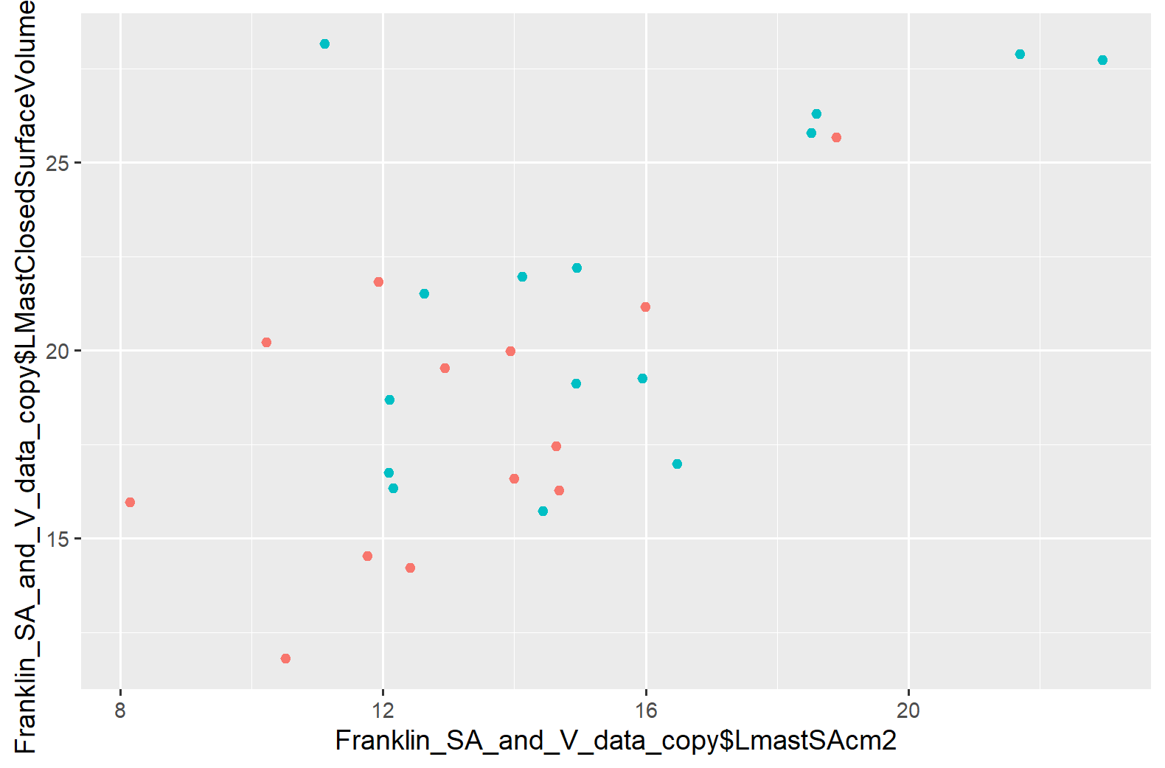
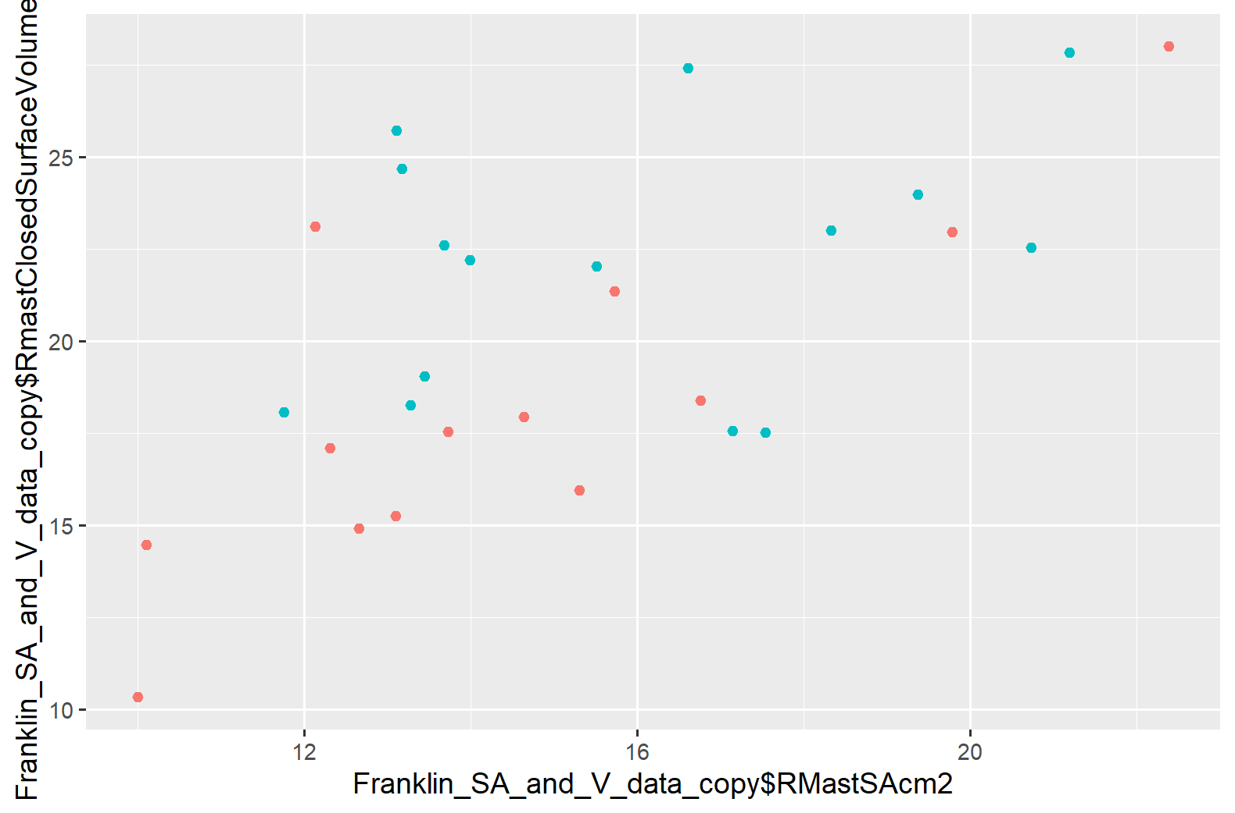
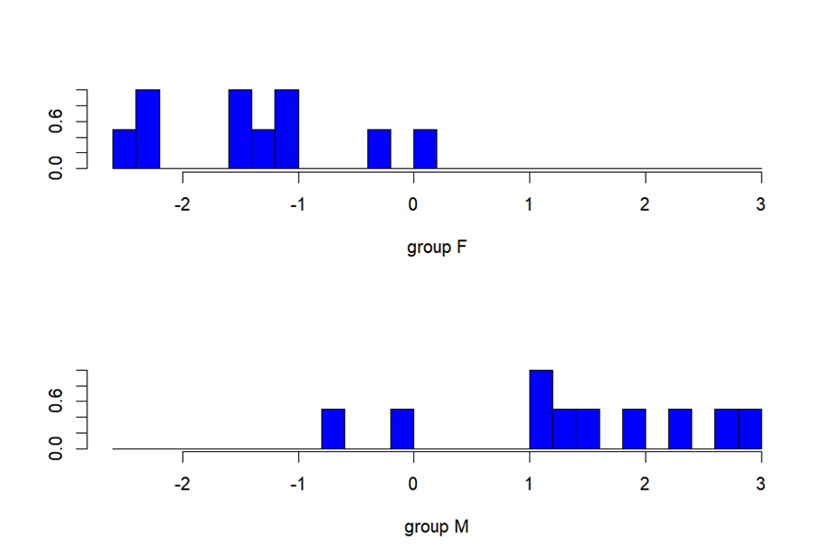
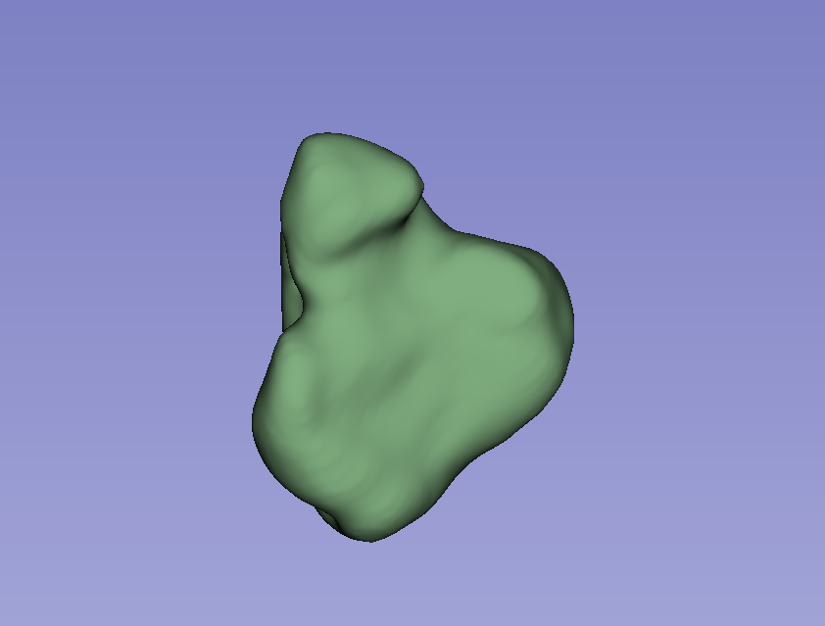
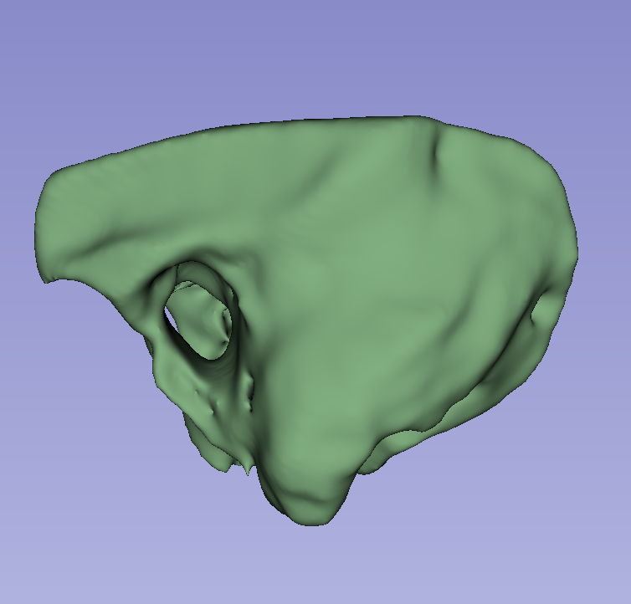

Assessing Potential for Individual Variation in Maxillary Sinuses and Mastoid Air Cells: Metric Size Components
Tayler R. Franklin and Kaleigh C. Best, Ph.D.
Department of Anthropology and Sociology, Western Carolina University
Introduction
Table 1: The results of Shapiro-Wilks tests for normalcy and subsequent descriptive statistics for bilateral surface area and volume for maxillary sinuses and mastoid processes.
Discussion
Personal identification is the method of associating an unknown individual with a known identity. In forensic anthropology the frontal sinus, a highly-variable cavity in the mid-facial region of the cranium, has been extensively researched for its potential applicability in personal identification methods.¹⁻⁵ However, the other facial sinuses and cranial cavities have been underrepresented in research, despite sharing some developmental origins with the frontal sinus⁶. The following study was conducted to assess the potential of two other cranial structures, the maxillary sinuses and mastoid region, for their applicability to personal identification. While other studies⁷⁻¹⁰ explore their variation or provide a case study highlighting their potential for ID,¹¹ this novel research quantifies and assesses these spaces for variation bilaterally and between individuals using metric components.
Aspect | Shapiro-Wilks p-value | Minimum | Mean | Maximum | Standard Deviation
LMax Vol (cm³) | 0.419 | 6.36 | 17.33 | 24.74 | 3.94
LMax SA (cm²) | 0.101 | 19.72 | 42.1 | 55.53 | 7.19
RMax Vol (cm³) | 0.8999 | 9.74 | 17.00 | 24.57 | 3.55
RMax SA (cm²) | 0.4059 | 28.69 | 41.45 | 54.85 | 6.70
LMast Vol (cm³) | 0.1798 | 11.80 | 19.99 | 28.14 | 4.48
LMast SA (cm2) | 0.1747 | 8.15 | 14.39 | 22.96 | 3.40
RMast Vol (cm³) | 0.4837 | 10.34 | 20.35 | 28.00 | 4.42
RMast SA (cm²) | 0.2135 | 10.01 | 15.27 | 22.39 | 3.31
Descriptive statistics show both regions have similar volume and surface area bilaterally. The maxillary sinuses have the largest surface area while the mastoid processes demonstrate larger volume on average. Depending on the personal identification method used, either could be useful in analysis.
Comparing surface area to volume within each region show relatively positive associations (Figure 3); these results indicate that as surface area increases, volume also tends to increase. This is attributed primarily to factors of overall size. The mastoid region shows less tightly grouped associations, possibly indicating more variation in the relationship between the dimensions.
Examining area in relation to biological sex, RMax Vol, LMast Vol, and RMast Vol are significantly different, while LMast SA approaches the threshold of significance (α =0.05) (Table 2). These findings likely reflect known sexually dimorphic differences in humans¹⁵.
LDFA to examine the potential of sex classification of the mastoid region and maxillary sinuses reveals a joint 85% accuracy rate (Figure 4). This is likely reflective of size-based sexual dimorphism present in these anatomical regions¹⁵.
Individual bilateral differences are not significantly observed in metric components (Table 3), which is likely due to bilateral symmetry in human crania.
Size-related differences are unsurprisingly present in both regions, with individual metric variation present between individuals showing potential for future methodology development.
The mastoid region should be further isolated to the mastoid air cells and re-evaluated for use in personal identification.
L Maxillary Simus Volume
R Maxillary Sinus Volume
Methods
Cranial computed tomography (CT) scans of 28 anonymized individuals (15 male, 13 female) were obtained from the New Mexico Decedent Image Database (NMDID).¹² Selection criteria were individuals 30-60 years old, listed as White/Caucasian race, with no reported facial trauma or reconstruction. 3D renderings of the maxillary sinuses and mastoid regions were obtained bilaterally for each individual using the 3D Slicer Image Computing Software¹³ (Figures 1 and 2). The renderings were then quantified in volume and surface area using 3D Slicer and exported to R Statistical Software¹⁴ for analysis.
Prior to further analyses, tests for normalcy were conducted using graphical and Shapiro-Wilks tests in addition to other descriptive statistics (Table 1). Data were then plotted by sex (Figure 3) and examined for significance using a Welch ANOVA (Table 2). Using all parameters, data were subjected to a linear discriminant function analysis (LDFA) (Figure 4) and bilateral differences were compared (Table 3).
A.
L Maxillary Sinus Surface Area
B.
R Maxillary Sinus Surface Area
R Mastoid Process Volume
R Mastoid Process Volume
C.
L Mastoid Process Surface Area
D.
R Mastoid Process Surface Area
Figure 3: Scatterplots demonstrating the relationship of A) left maxillary sinus surface area and volume; B) right maxillary sinus surface area and volume; C) left mastoid process surface area and volume; and D) right mastoid process surface area and volume. For all plots, pink dots represent female individuals and blue dots represent male individuals.
Conclusions
Table 2: Welch ANOVA results comparing biological sex to bilateral surface area and volume.
This pilot study, despite a limited sample size, quantifies two historically understudied cranial cavities in surface area and volume. Quantification of size-based differences in the maxillary sinuses and mastoid region reveals the potential for both sex-based and individual variation in both surface area and volume. Further investigation into these regions, including morphological aspects, should be conducted.
Aspect by Sex | F | df | p-value
LMax Vol (cm³) | 1.9438 | 23.952 | 0.1761
LMax SA (cm²) | 1.2966 | 23.435 | 0.2663
RMax Vol (cm³) | 5.3535 | 24.805 | 0.02926
RMax SA (cm²) | 2.5308 | 25.69 | 0.1239
LMast Vol (cm³) | 5.0892 | 25.96 | 0.03273
LMast SA (cm2) | 4.0984 | 25.693 | 0.05344*
RMast Vol (cm³) | 6.2806 | 22.081 | 0.02007
RMast SA (cm²) | 1.254 | 23.699 | 0.274
Figure 4: Linear discriminant function analysis results for sex classification utilizing surface area and volume for maxillary sinuses and mastoid regions.
Acknowledgments and References
Table 3: Statistical significance of bilateral differences among maxillary sinuses and mastoid regions.
We would like to thank and acknowledge the Western Carolina University Department of Anthropology and Sociology for their continued support. We also highlight and thank Dr. Rebecca L. George for her contributions to the early designs of this study.
M
L
A
P
Aspect | t | df | p-value
L v R Max Vol (cm³) | 0.3317 | 53.423 | 0.7414
L v R Max SA (cm²) | 0.35244 | 53.729 | 0.7259
L v R Mast Vol (cm³) | -0.98565 | 53.957 | 0.3287
L v R Mast SA (cm²) | -0.30146 | 53.99 | 0.7642
Figure 1: Rendering of the anterior surface of the left maxillary sinus in 3D Slicer. Note that the rendering is representative of a hollow cavity defined by osseus borders.
Figure 2: Rendering of the lateral surface of the left mastoid region in 3D Slicer. Note that the rendering is representative of osseus tissue, not the isolated mastoid air cells.
Please use the QR code to view the references section.
Notes:
Notes for Tayler/me to do:
I kinda roughed the background- check proportions of margins and shapes. Center results better, text in tables needs to be centered.

Slide 2
Assessing Potential for Individual Variation in Maxillary Sinuses and Mastoid Air Cells: Metric Size Components
Tayler R. Franklin and Kaleigh C. Best
Department of Anthropology and Sociology, Western Carolina University
Introduction
Table 1: The results of Shapiro-Wilks tests for normalcy and subsequent descriptive statistics for bilateral surface area and volume for maxillary sinuses and mastoid processes.
Discussion
Personal identification is the method of associating an unknown individual with a known identity. In forensic anthropology The frontal sinus, a highly-variable cavity in the mid-facial region of the cranium, has been extensively researched for its potential applicability in personal identification methods.¹⁻⁵ However, the other facial sinuses and cranial cavities have been underrepresented in research, despite sharing some developmental origins with the frontal sinus⁶. The following study was conducted to assess the potential of two other cranial structures, the maxillary sinuses and mastoid region, for their applicability to personal identification. While other studies⁷⁻¹⁰ explore their variation or provide a case study highlighting their potential for ID,¹¹ this novel research quantifies and assesses these spaces for variation bilaterally and between individuals using metric components.
Aspect | Shapiro-Wilks p-value | Minimum | Mean | Median | Maximum
LMax Vol (cm³) | 0.419 | 6.36 | 17.33 | 18.09 | 24.74
LMax SA (cm²) | 0.101 | 19.72 | 42.1 | 42.87 | 55.53
RMax Vol (cm³) | 0.8999 | 9.74 | 17.00 | 16.97 | 24.57
RMax SA (cm²) | 0.4059 | 28.69 | 41.45 | 40.50 | 54.85
LMast Vol (cm³) | 0.1798 | 11.80 | 19.99 | 19.41 | 28.14
LMast SA (cm2) | 0.1747 | 8.15 | 14.39 | 14.05 | 22.96
RMast Vol (cm³) | 0.4837 | 10.34 | 20.35 | 20.20 | 28.00
RMast SA (cm²) | 0.2135 | 10.01 | 15.27 | 14.32 | 22.39
Descriptive statistics show both regions have similar volume and surface area bilaterally. The maxillae have the largest surface area out of the paranasal sinuses studied, while the mastoid processes demonstrate larger volume on average. Depending on the personal identification method used, either could be useful in analysis.
Comparing surface area to volume within each region show relatively positive associations (Figure 3); these results indicate that as surface area increases, volume also tends to increase. This is attributed primarily to factors of overall size. The mastoid region shows less tightly grouped associations, possibly indicating more variation in the relationship between the dimensions.
Examining area in relation to biological sex, RMax Vol, LMast Vol, and RMast Vol were considered significantly different, while LMast SA approached the threshold of significance (α =0.05) (Table 2). These findings likely reflect known sexually dimorphic differences in humans¹⁵.
LDA to examine the potential of sex classification of the mastoid region and maxillary sinuses reveals a joint 85% accuracy rate (Figure 4). This is likely reflective of size-based sexual dimorphism present in these anatomical regions¹⁵.
Individual bilateral differences are not significantly observed in metric components (Table 3), which is likely due to bilateral symmetry in human crania.
Size-related differences are unsurprisingly present in both regions, with individual metric variation present between individuals showing potential for future methodology development.
The mastoid region should be further isolated to the mastoid air cells and re-evaluated for use in personal identification
L Maxillary Simus Volume
R Maxillary Sinus Volume
Methods
Cranial computed tomography (CT) scans of 28 anonymized individuals (15 male, 13 female) were obtained from the New Mexico Decedent Image Database (NMDID).¹² Selection criteria were individuals 30-60 years old, listed as White/Caucasian race, with no reported facial trauma or reconstruction. 3D renderings of the maxillary sinuses and mastoid regions were obtained bilaterally for each individual using the 3D Slicer Image Computing Software¹³ (Figures 1 and 2). The renderings were then quantified in volume and surface area using 3D Slicer and exported to R Statistical Software¹⁴ for analysis.
Prior to further analyses, tests for normalcy were conducted using graphical and Shapiro-Wilks tests in addition to other descriptive statistics (Table 1). Data were then plotted by sex (Figure 3), and examined for significance using a Welch ANOVA (Table 2). Using all parameters, data were subjected to a linear discriminant function analysis (LDFA) (Figure 4) and bilateral differences were compared (Table 3).
A.
L Maxillary Sinus Surface Area
B.
R Maxillary Sinus Surface Area
R Mastoid Process Volume
R Mastoid Process Volume
C.
L Mastoid Process Surface Area
D.
R Mastoid Process Surface Area
Figure 3: Scatterplots demonstrating the relationship of A) left maxillary sinus surface area and volume; B) right maxillary sinus surface area and volume; C) left mastoid process surface area and volume; and D) right mastoid process surface area and volume. For all plots, pink dots represent female individuals and blue dots represent male individuals.
Conclusions
Table 2: Welch ANOVA results comparing biological sex to bilateral surface area and volume.
This pilot study, despite a limited sample size, quantifies two historically understudied cranial cavities in surface area and volume. Quantification of size-based differences in the maxillary sinuses and mastoid region reveals the potential for both sex-based and individual variation in both surface area and volume. Further investigation into these regions, including morphological aspects, should be conducted.
Aspect by Sex | F | df | P-value
LMax Vol (cm³) | 1.9438 | 23.952 | 0.1761
LMax SA (cm²) | 1.2966 | 23.435 | 0.2663
RMax Vol (cm³) | 5.3535 | 24.805 | 0.02926
RMax SA (cm²) | 2.5308 | 25.69 | 0.1239
LMast Vol (cm³) | 5.0892 | 25.96 | 0.03273
LMast SA (cm2) | 4.0984 | 25.693 | 0.05344*
RMast Vol (cm³) | 6.2806 | 22.081 | 0.02007
RMast SA (cm²) | 1.254 | 23.699 | 0.274
Figure 4: Linear discriminant function analysis results for sex classification utilizing surface area and volume for maxillary sinuses and mastoid regions.
Acknowledgments and References
Table 3: Statistical significance of bilateral differences among maxillary sinuses and mastoid regions.
We would like to thank and acknowledge the Western Carolina University Department of Anthropology and Sociology for their continued support. We also highlight and thank Dr. Rebecca L. George for her contributions to the early designs of this study.
M
L
A
P
Aspect | t | df | p-value
L v R Max Vol (cm³) | 0.3317 | 53.423 | 0.7414
L v R Max SA (cm²) | 0.35244 | 53.729 | 0.7259
L v R Mast Vol (cm³) | -0.98565 | 53.957 | 0.3287
L v R Mast SA (cm²) | -0.30146 | 53.99 | 0.7642
Figure 1: Rendering of the anterior surface of the left maxillary sinus in 3D Slicer. Note that the rendering is representative of a hollow cavity defined by osseus borders.
Figure 2: Rendering of the lateral surface of the left mastoid region in 3D Slicer. Note that the rendering is representative of osseus tissue, not the isolated mastoid air cells.
Please use the QR code to view the references section.
Notes:
Notes for Tayler/me to do:
I kinda roughed the background- check proportions of margins and shapes. Center results better, text in tables needs to be centered.

