Slide 1
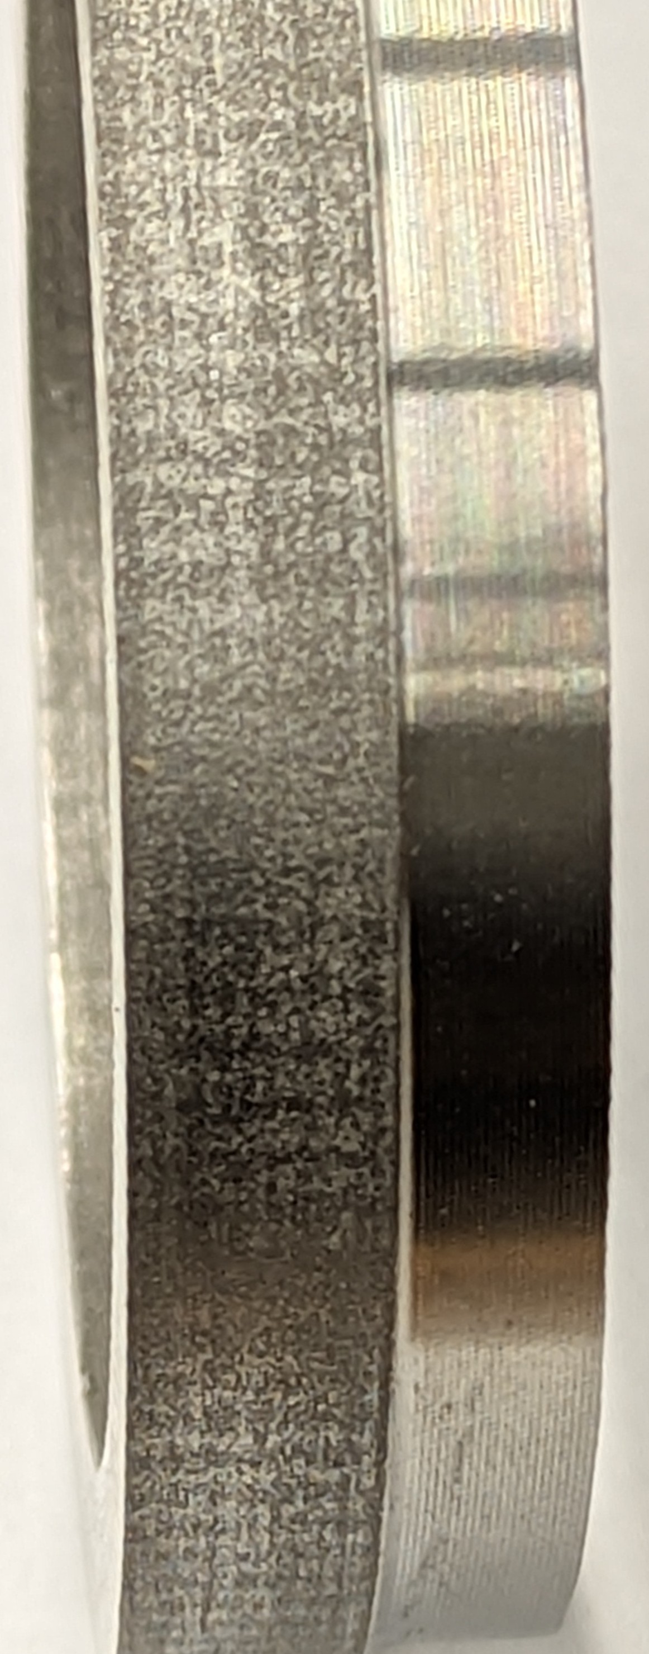
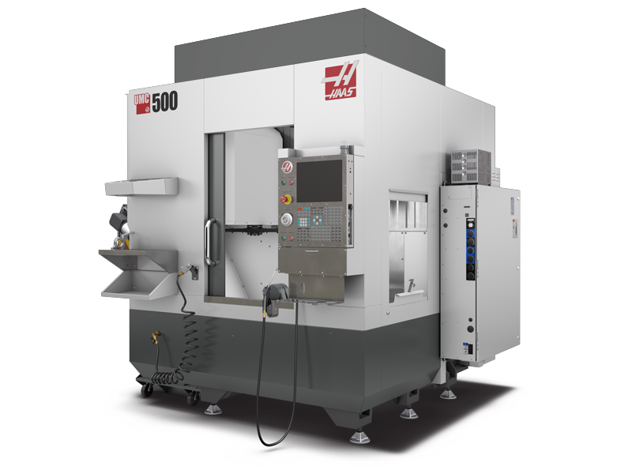
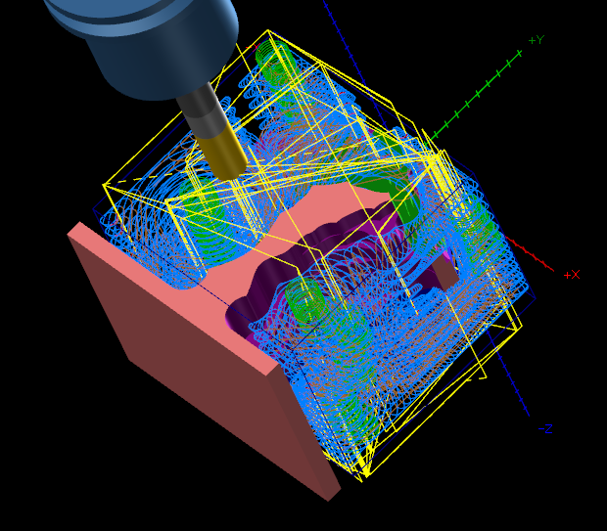
Establishing Repeatable Post-Processing Protocols for Powder Bed Fusion Metal Additive Parts Using 5-Axis CNC Machining
Alexander Borrelli
College of Engineering
ABSTRACT
While Powder Bed Fusion (PBF) additive manufacturing excels at producing complex metal geometries, the resulting parts frequently exhibit poor surface finishes and dimensional inaccuracies. These qualities require extensive post-processing to achieve final part qualification. Current post-processing methods often lack documented standardization, leading to workflow inefficiencies and inconsistent part quality.
INTRO / GOALS / OBJECTIVES
This research focuses on bridging the gap between PBF manufacturing and final precision requirements by developing a standardized, repeatable post-processing method using a 5-axis computer numerical control (CNC) machine. By analyzing the unique machining dynamics of PBF-manufactured parts, this study establishes optimized CAD adaptations, computer aided manufacturing (CAM) workflows, workholding strategies, and toolpath parameters. The proposed protocols will significantly reduce setup times, minimize operator-induced variability, and ensure consistent dimensional accuracy and surface finish. Ultimately, this research provides a scalable framework for integrating additive and subtractive manufacturing processes in advanced production environments.
METHODS
The Post-Processing Workflow
Part Design & Preparation for AM
Using CAD software to design the initial component with specific material left on critical faces.
Incorporating specific geometric features into the raw PBF print solely for the purpose of locating and indicating the part later in the CNC machine.
Pre-Machining Inspection & Metrology
Verify initial PBF part to quantify thermal distortion and shrinkage
Workholding & Fixturing Strategy
Designing and manufacturing dedicated fixtures that mate with complex PBF geometry to ensure rigid clamping without distorting the part
CAM Programming & Toolpath Optimization
Utilize Mastercam to program the 5-axis toolpaths
Machining Execution & Quality Verification
Using 5-axis machining to bring critical dimensions and surface finish
Apply quality management methodologies to measure the parts against the definitions for success and ensuring the workflow is statistically repeatable.
EXPECTED RESULTS
Enhanced Surface Finish
A dramatic qualifiable reduction in surface roughness from PBF printed parts to engineering requirements
Dimensional Accuracy and Process Capability
Achieving engineering tolerances (e.g .0004in over 10 inches) in critical part features
Setup Standardization and Repeatability
Significantly decrease the variance of setup times and operator errors.
Optimized CAM workflow Efficiency
The establishment of a dynamic 5-axis toolpath tailored specifically to the material resulting in predictable tool wear and optimized cycle time.
NEXT STEPS
Phase 1: CAM Strategy & Workholding Design
Importing PBF part models into Mastercam to develop 5-axis toolpaths.
Designing and machining custom fixtures to securely hold near-net-shape additive geometries without distorting the parts.
Phase 2: Experimental Machining Trials
Executing initial 5-axis finishing passes on raw PBF metal samples to establish baseline cutting parameters (RPM, feeds, depth of cut).
Monitoring the setup for tool wear, vibration, and thermal effects unique to printed metal parts
Phase 3: Metrology & Surface Analysis
Utilizing precision measurement tools to evaluate the surface roughness (Ra) and dimensional accuracy of the machined parts against the original CAD models.
Comparing the geometric dimensioning and tolerancing (GD&T) results against standard production requirements.
Phase 4: Protocol Optimization
Iterating on the CAM toolpaths and machining parameters based on the metrology data.
Finalizing a standardized, repeatable post-processing workflow that can be consistently applied to future PBF components.
Acknowledgements
Basel Alsayyed, Ph.D., P.Eng., CMfgE, | Faculty Mentor, Engineering Technology Program Director
John "Monty" Graham | Interim Director Rapid Center
Figure 1 HAAS UMC500 the machine that will be used to post-process PBF manufactured parts
Adapted from: https://www.haascnc.com/content/dam/haascnc/pdp_feed/machines/UMC-500.png
Figure 3
Comparison of PBF part before and after basic post processing on lathe
Figure 2 5-axis toolpath in Mastercam 2025

