Slide 1
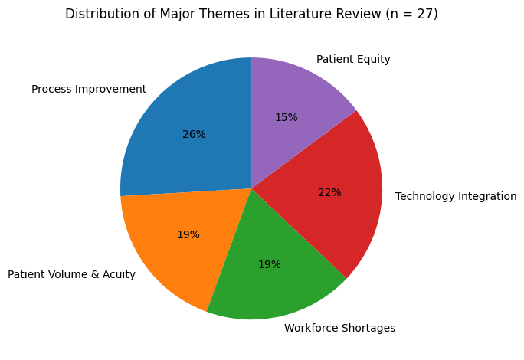
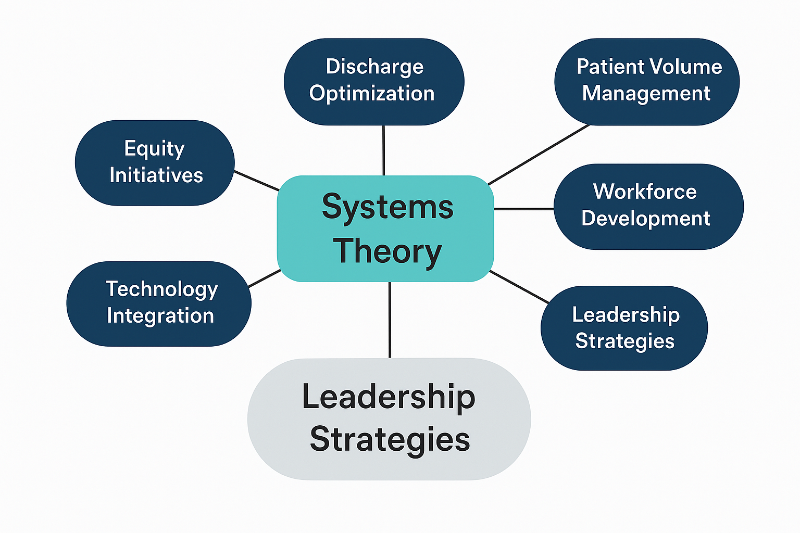
Emergency Department Throughput: Leadership Strategies to Improve Patient Flow
Amanda Hall, BSN, RN, CGRN, NE-BC, Ramona Whichello DNP, RN, NEA-BC, Amy Putnam DNP, RN, CNE
Western Carolina University – MS(N) Program
ABSTRACT
Emergency department (ED) overcrowding remains a persistent challenge that affects patient safety, quality of care, and operational efficiency. This literature review synthesized evidence from 27 peer‑reviewed studies published between 2018 and 2025 examining leadership and operational strategies that influence ED throughput. Major themes included discharge delays, patient volume and acuity management, workforce shortages, technology integration, process improvement, and patient equity. Findings indicate that leadership engagement, early discharge planning, predictive staffing models, technology‑supported decision making, and coordinated hospital‑wide process improvement initiatives significantly improve patient flow and reduce crowding. Systems Theory provides a framework for understanding ED throughput as an interconnected system influenced by clinical workflows, staffing structures, and hospital capacity.
Key Findings:
• Leadership engagement improves system coordination (Devia et al., 2025; Mangum et al., 2021; McKenna et al., 2019; Youssef et al., 2024).
• Early discharge planning reduces boarding (Bailey et al., 2024; Importa et al., 2018; Mostafa & El-Atawi, 2024).
• Predictive staffing aligns workforce with demand (El Hussein et al., 2022; Heiks & Sabine, 2022; Hodgson et al., 2024; Morley et al., 2018; Notarnicola et al., 2024).
• Technology dashboards improve decision making (Ashan et al., 2019; Hu et al., 2025; Porto, 2024; Vainieri et al., 2020; Wang et al., 2025; Wolf et al., 2022).
METHODS
A comprehensive literature review was conducted using CINAHL Plus, MEDLINE Complete, APA PsycArticles, Academic Search Premier, and Health Source: Nursing/Academic Edition. Search terms included leadership, emergency department throughput, patient flow, crowding, staffing shortages, and quality improvement. Studies were limited to peer‑reviewed English publications from 2018–2025.
• 212 records identified
• 168 records after duplicates removed
• 41 full‑text articles reviewed
• 27 studies included in final synthesis
Critical appraisal was performed using CASP tools and PRISMA guidelines.
RESULTS
Six major themes influence ED throughput:
Process Improvement: Lean methodologies, provider‑in‑triage models, and fast‑track pathways reduce length of stay and improve workflow efficiency (Bailey et al., 2024; Devia et al., 2025; Importa et al., 2018; Mangum et al., 2021; McKenna et al., 2019; Mostafa & El-Atawi, 2024; Youssef et al., 2024).
Patient Volume and Acuity Management: Split‑flow and vertical care models improve capacity during high demand (Habib & Sudaryo 2022; Hodgins et al., 2023; Hsieh et al., 2023; Samadbeik et al., 2024; Zaboli et al., 2025).
Workforce Shortages: Nursing shortages and staffing instability increase delays and left‑without‑being‑seen rates (El Hussein et al., 2022; Heiks & Sabine, 2022; Hodgson et al., 2024; Morley et al., 2018; Notarnicola et al., 2024).
Technology Integration: Predictive analytics, real‑time dashboards, and bed management systems support data‑driven decision making (Vainieri et al., 2020; Wang et al., 2025; Wolf et al., 2022).
Leadership Practices: Executive engagement and interdisciplinary coordination improve system‑wide flow (Ashan et al., 2019; Hu et al., 2025; Porto, 2024).
Patient Equity: Communication and transparency are essential to reduce disparities in emergency care access (Aleksandrovskiy et al., 2022; Calder et al., 2021; Gignac et al., 2023; Onal et al., 2022).
CONCLUSION
ED throughput is a complex systems issue that requires coordinated leadership and hospital‑wide collaboration. Integrated process improvement, predictive staffing, technology‑enabled decision support, and early discharge planning improve patient flow without compromising safety.
RECOMMENDATIONS
• Implement system‑wide throughput strategies led by executive leaders.
• Expand predictive staffing and real‑time operational dashboards.
• Strengthen interdisciplinary collaboration across inpatient and ED services.
• Incorporate equity metrics into throughput monitoring
• Conduct future research using mixed‑methods and diverse healthcare settings.
References
Ahsan, K., Alam, M. R., Morel, D., & Karim, M. A. (2019). Emergency department resource optimisation for improved performance: A review. Journal of Industrial Engineering International, 15(S1), 253–266. https://doi.org/10.1007/s40092-019-00335-x
Aleksandrovskiy, I., Ganti, L., & Simmons, S. (2022). The emergency department patient experience: In their own words. Journal of Patient Experience, 9. https://doi.org/10.1177/23743735221102455
Bailey, R., Segon, A., Garcia, S., Kottewar, S., Lu, T., Tuazon, N., Sanchez, L., Gelfond, J. A., & Bowling, G. (2024). Increasing and sustaining discharges by noon – A multi-year process improvement project. BMC Health Services Research, 24(1). https://doi.org/10.1186/s12913-024-10960-x
Calder-Sprackman, S., Kwok, E. H., Bradley, R., Landreville, J., Perry, J. J., & Calder, L. A. (2021). Availability of emergency department wait times information: A patient-centered needs assessment. Emergency Medicine International, 2021, 1–6. https://doi.org/10.1155/2021/8883933
Devia Jaramillo, G., Esmeral Zuluaga, N., & Velandia Avellaneda, V. (2025). Effective strategies for reducing patient length of stay in the emergency department: A systematic review and meta-analysis. BMC Emergency Medicine, 25(1). https://doi.org/10.1186/s12873-024-01163-y
El Hussein, M., Barnason, S., Normandin, P. A., Kelly, A. W., & Gillespie, G. L. (2022). Connecting the dots! From bench to stretcher side. Journal of Emergency Nursing, 48(5), 494-495-https://doi.org/10.1016/j.jen.2022.07.003
Gignac, E., Dogbey, G., Pevtsov, A., Bass, A., Nagy, T., Farshori, A., & Brannan, G. (2023). Characterizing social insecurity in a rural North Carolina emergency department. Western Journal of Emergency Medicine, 24(3). https://doi.org/10.5811/westjem.54605
Habib, H., & Sudaryo, M. (2023). Association between the emergency department length of stay and in-hospital mortality: A retrospective cohort study. Open Access Emergency Medicine, 313–323. https://doi.org/10.2147/oaem.s415971
Heiks, C., & Sabine, N. (2022). Long term care and skilled nursing facilities. Delaware Journal of Public Health, 8(5), 144–149. https://doi.org/10.32481/djph.2022.12.032
Hodgins, M., Moore, N., & Little, J. (2023). Those who opt to leave: Comparison by triage acuity of emergency patients who leave prior to seeing a medical practitioner. International Emergency Nursing, 70, 101349. https://doi.org/10.1016/j.ienj.2023.101349
Hodgson, N. R., Kwun, R., Gorbatkin, C., Davies, J., & Fisher, J. (2024). Emergency department responses to nursing shortages. International Journal of Emergency Medicine, 17(1). https://doi.org/10.1186/s12245-024-00628-y
Hoot, N. R., & Aronsky, D. (2008). Systematic review of emergency department crowding: Causes, effects, and solutions. Annals of Emergency Medicine, 52(2), 126-136. https://doi.org/10.1016/j.annemergmed.2008.03.014
Hsieh, A., Arena, A., Oraha, A., Cotarelo, A., McLean, M., Hsieh, A., Hsieh, A., Chen, I., Mok, N., & Milizia, R. (2023). Implementation of vertical split flow model for patient throughput at a community hospital emergency department. The Journal of Emergency Medicine, 64(1), 77–82. https://doi.org/10.1016/j.jemermed.2022.10.007
Hu, Y., Chan, C. W., Dong, J., Kazekjian, A., Ophaswongse, C., Sugalski, G., Underwood, J. P., & Perotte, R. (2025). Implementing a prediction driven framework for emergency department nurse staffing to optimize real time decisions. npj Health Systems, 2(1). https://doi.org/10.1038/s44401-025-00019-2
Improta, G., Romano, M., Di Cicco, M., Ferraro, A., Borrelli, A., Verdoliva, C., Triassi, M., & Cesarelli, M. (2018). Lean thinking to improve emergency department throughput at AORN Cardarelli Hospital. BMC Health Services Research, 18(1). https://doi.org/10.1186/s12913-018-3654-0
Mangum, C. D., Andam-Mejia, R. L., Hale, L. R., Mananquil, A., Fulcher, K. R., Hall, J. L., McDonald, L. C., Sjogren, K. N., Villalon, F. D., Mehta, A., Shomaker, K., Johnson, E. A., & Godambe, S. A. (2021). Use of lean healthcare to improve hospital throughput and reduce LOS. Pediatric Quality & Safety, 6(5), e473. https://doi.org/10.1097/pq9.0000000000000473
McKenna, P., Heslin, S. M., Viccellio, P., Mallon, W. K., Hernandez, C., & Morley, E. J. (2019). Emergency department and hospital crowding: Causes, consequences, and cures. Clinical and Experimental Emergency Medicine, 6(3), 189–195. https://doi.org/10.15441/ceem.18.022
Meleis, A. I. (2018). Transitions Theory: Middle-range and situation-specific theories in nursing practice (2nd ed.).
Monahan, A. C., & Feldman, S. S. (2023). The utility of predictive modeling and a systems process approach to reduce emergency department crowding: A position paper. Interactive Journal of Medical Research, 12,e42016. https/doi.org/10.2196/42016
Morley, C., Unwin, M., Peterson, G. M., Stankovich, J., & Kinsman, L. (2018). Emergency department crowding: A systematic review of causes, consequences and solutions. PLOS ONE, 13(8),e0203316. https://doi.org/10.1371/journal.pone.0203316
Mostafa, R., & El-Atawi, K. (2024). Strategies to measure and improve emergency department performance: A review. Cureus. https://doi.org/10.7759/cureus.52879
Notarnicola, I., Lommi, M., Ivziku, D., Carrodano, S., Rocco, G., & Stievano, A. (2024). The nursing theory of complex adaptive systems: A new paradigm for nursing. Healthcare, 12(19), 1997. https://doi.org/10.3390/healthcare12191997
Onal, E. G., Knier, K., Hunt, A. W., Knudsen, J. M., Nestler, D. M., Campbell, R. L., Thompson, K. M., Sunga, K. L., Walker, L. E., Madsen, B. E., Sadosty, A. T., McGregor, A. J., Mullan, A. F., Jeffery, M. M., & Bellamkonda, V. R. (2022). Comparison of emergency department throughput and process times between male and female patients: A retrospective cohort investigation by the reducing disparities increasing equity in emergency medicine study group. JACEP Open, 3(5), e12792. https://doi.org/10.1002/emp2.12792
Porto, B. (2024). Improving triage performance in emergency departments using machine learning and natural language processing: A systematic review. BMC Emergency Medicine, 24(1). https://doi.org/10.1186/s12873-024-01135-2
Samadbeik, M., Staib, A., Boyle, J., Khanna, S., Bosley, E., Bodnar, D., Lind, J., Austin, J. A., Tanner, S., Meshkat, Y., de Courten, B., & Sullivan, C. (2024). Patient flow in emergency departments: A comprehensive umbrella review of solutions and challenges across the health system. BMC Health Services Research, 24(1). https://doi.org/10.1186/s12913-024-10725-6
Savioli, G., Ceresa, I. F., Gri, N., Bavestrello Piccini, G., Ricevuti, G., & Bressan, M. A. (2022). Emergency department overcrowding: Understanding the factors to find solutions. Healthcare, 10(2), 279. https://doi.org/10.3390/healthcare10020279
Vainieri, M., Panero, C., & Coletta, L. (2020). Waiting times in emergency departments: A resource allocation or an efficiency issue? BMC Health Services Research, 20(1). https://doi.org/10.1186/s12913-020-05417-w
Wang, S.-T., Weng, S.-J., Yeh, T.-Y., Chen, C.-H., & Tsai, Y.-T. (2025). Optimizing emergency department patient flow through bed allocation strategies: A discrete-event simulation study. INQUIRY: The Journal of Health Care Organization, Provision, and Financing, 62. https://doi.org/10.1177/00469580251335799
Wolf, L., Delao, A., Perhats, C., Baker, K., & Olson, C. M. (2022). Development of nurse sensitive, emergency department–specific quality indicators using a modified Delphi technique. Journal of Nursing Care Quality, 37(4), E59–E66. https://doi.org/10.1097/ncq.0000000000000627
Youssef, E., Benabbas, R., Choe, B., Doukas, D., Taitt, H. A., Verma, R., & Zehtabchi, S. (2024). Interventions to improve emergency department throughput and care delivery indicators: A systematic review and meta‐analysis. Academic Emergency Medicine, 31(8), 789–804. https://doi.org/10.1111/acem.14946
Zaboli, A., Brigo, F., Garbin, T., Clauser, P., Carion, E., Vecchio, J., Cavallucci, M., Armanaschi, L., Siller, M., & Turcato, G. (2025). Fast-track and primary care in the emergency department: Managing more, but not decongesting. Internal and Emergency Medicine. https://doi.org/10.1007/s11739-025-04151-7
THEORY
Concept map illustrating Systems Theory and its relationship to key themes identified in the literature review (Meleis, 2018).

