Slide 1
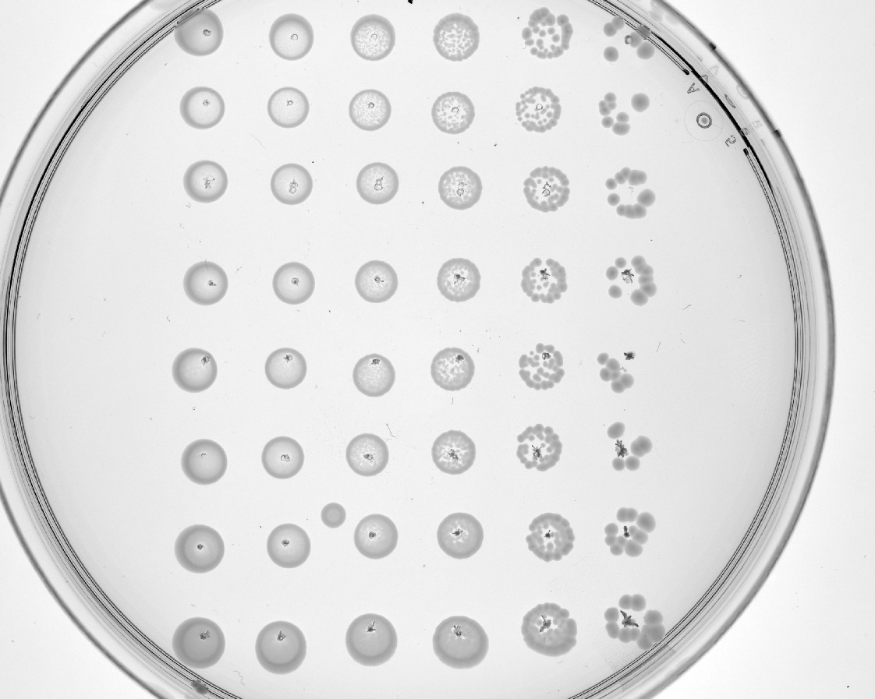
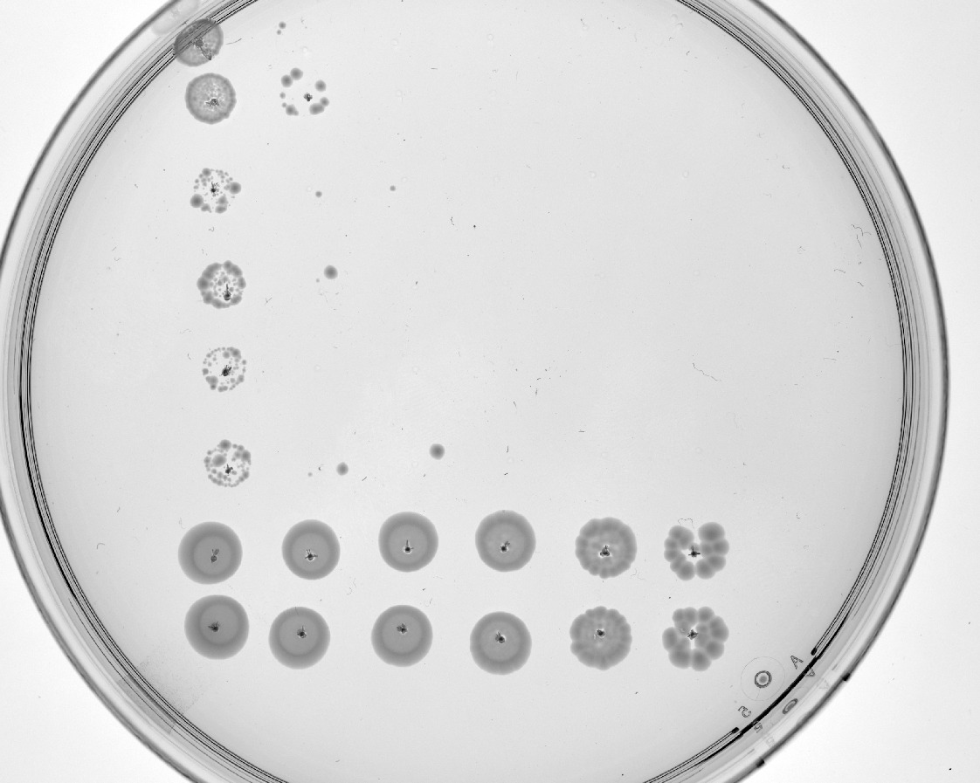
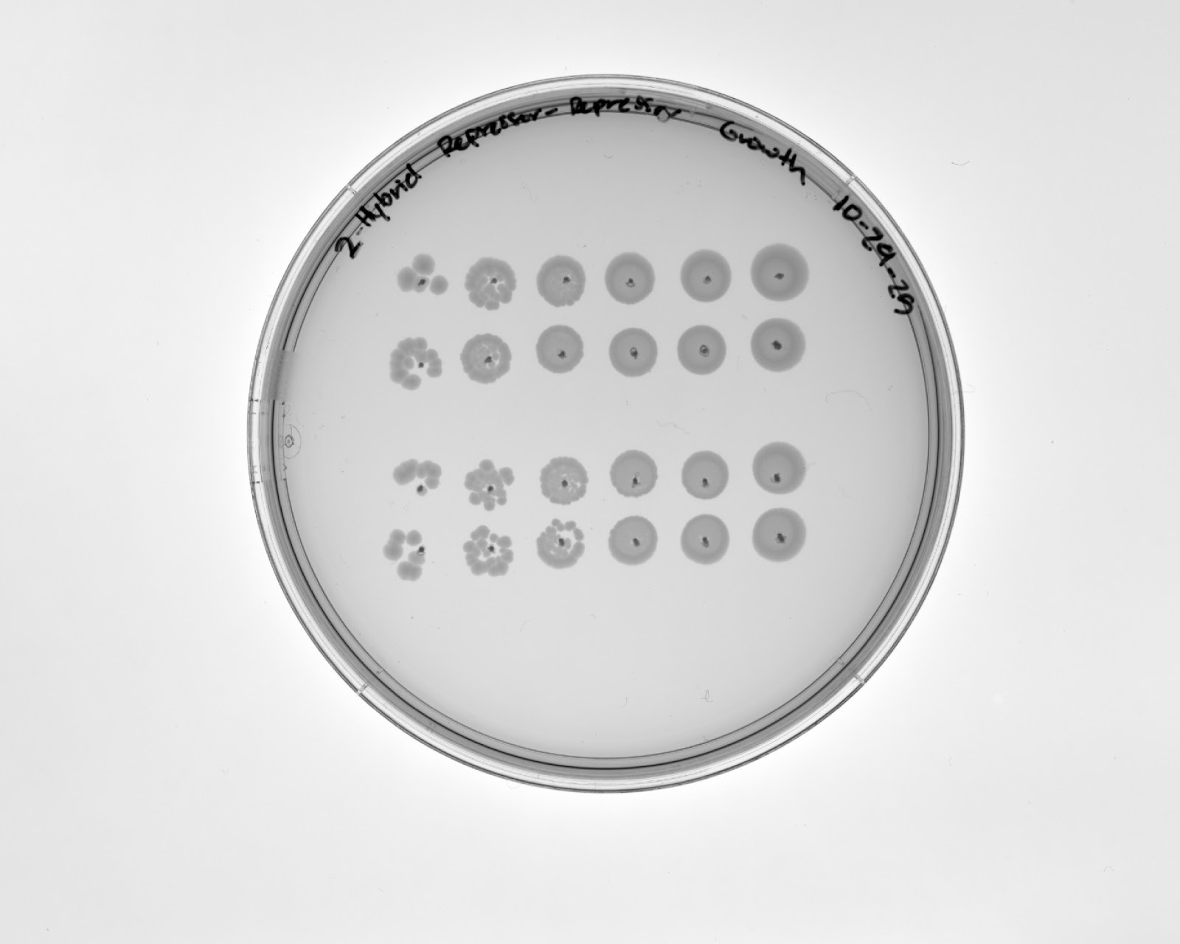
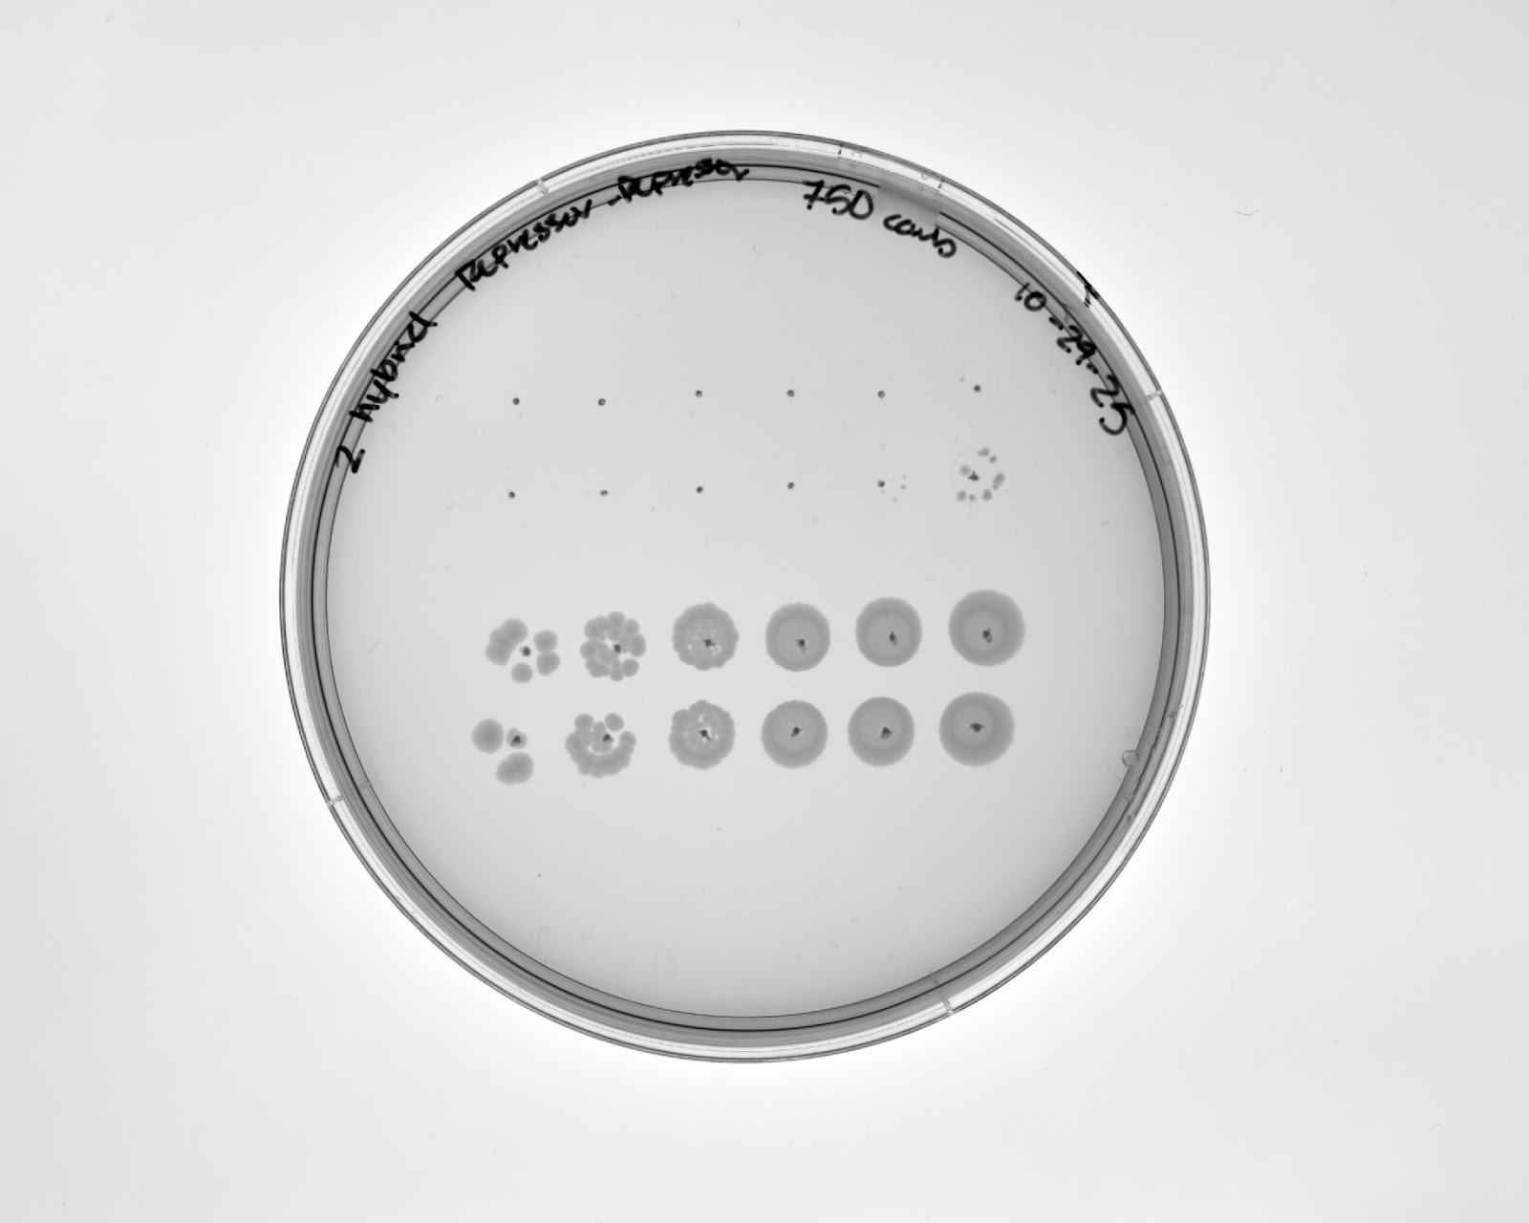
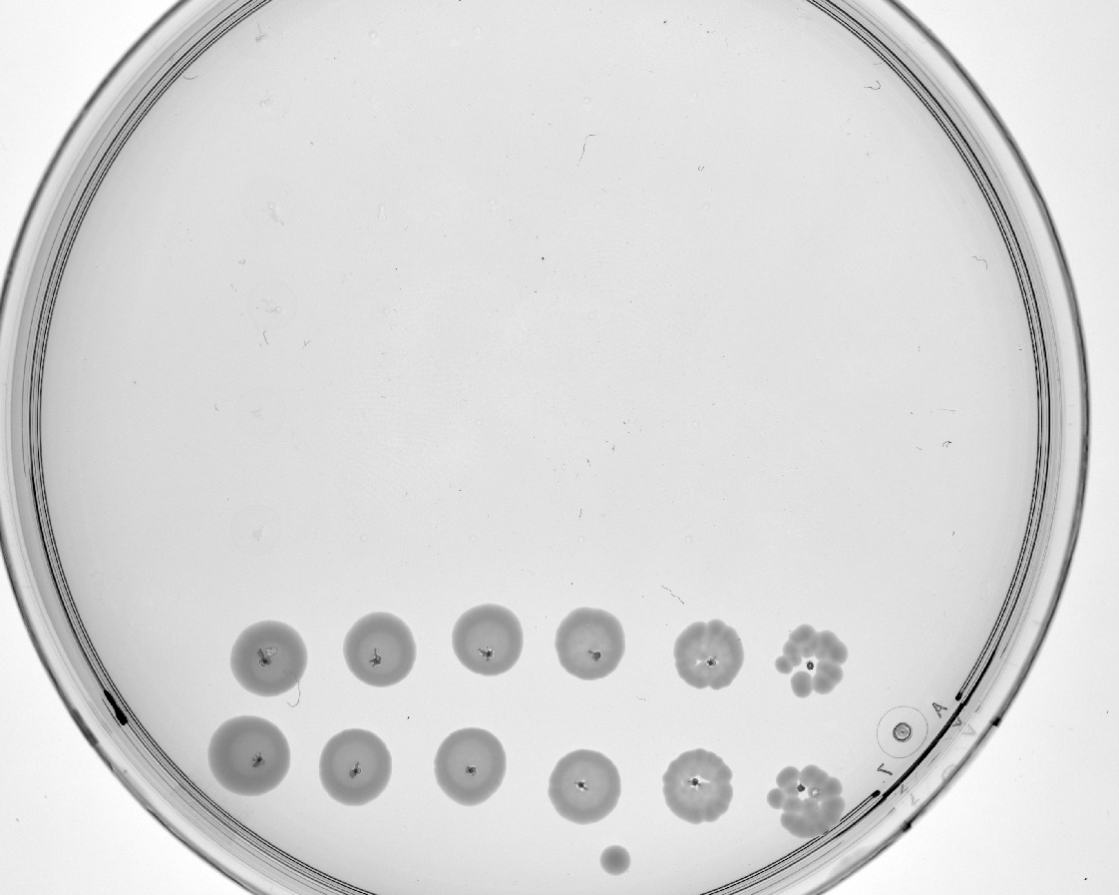
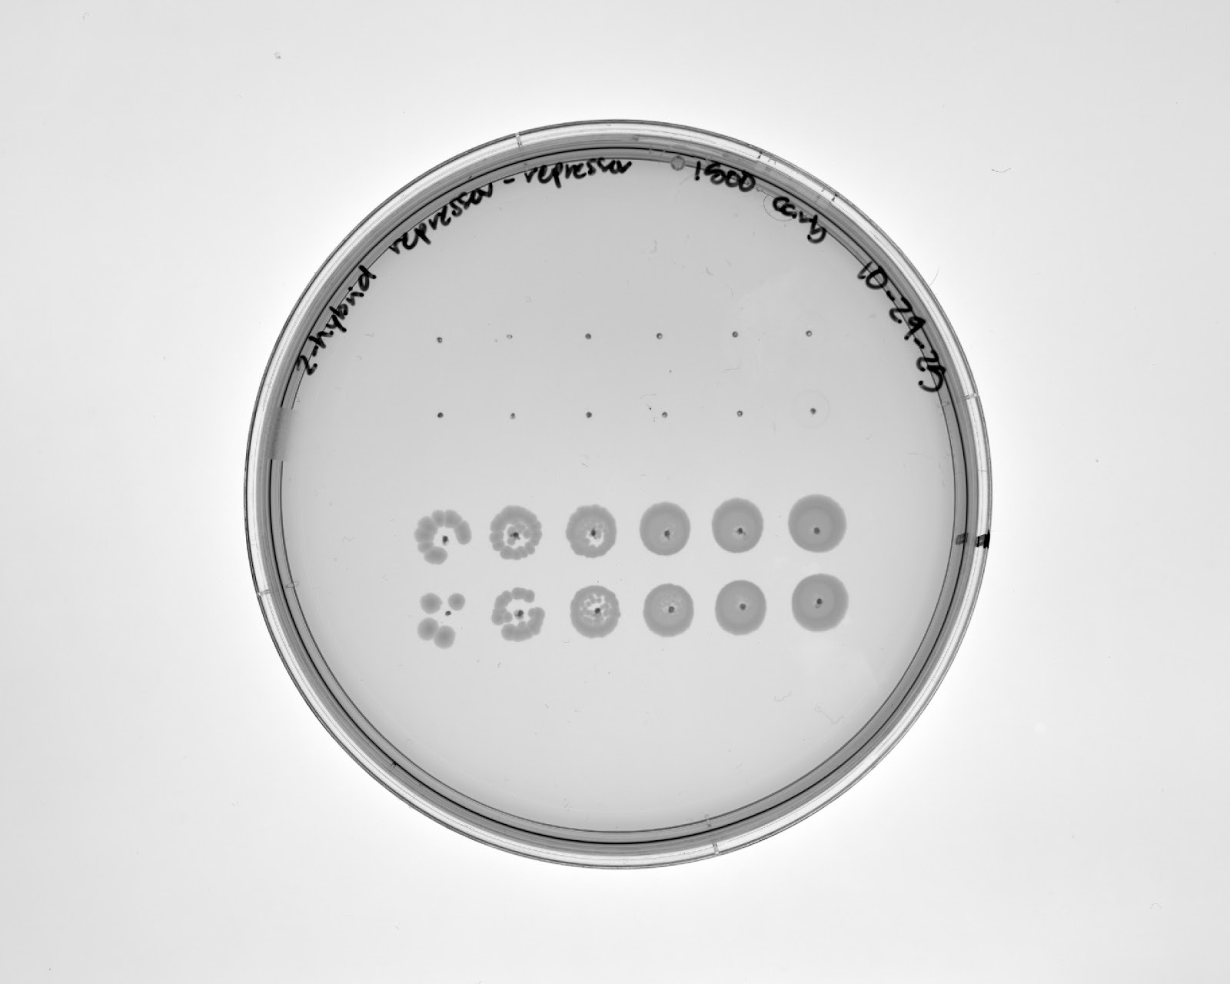
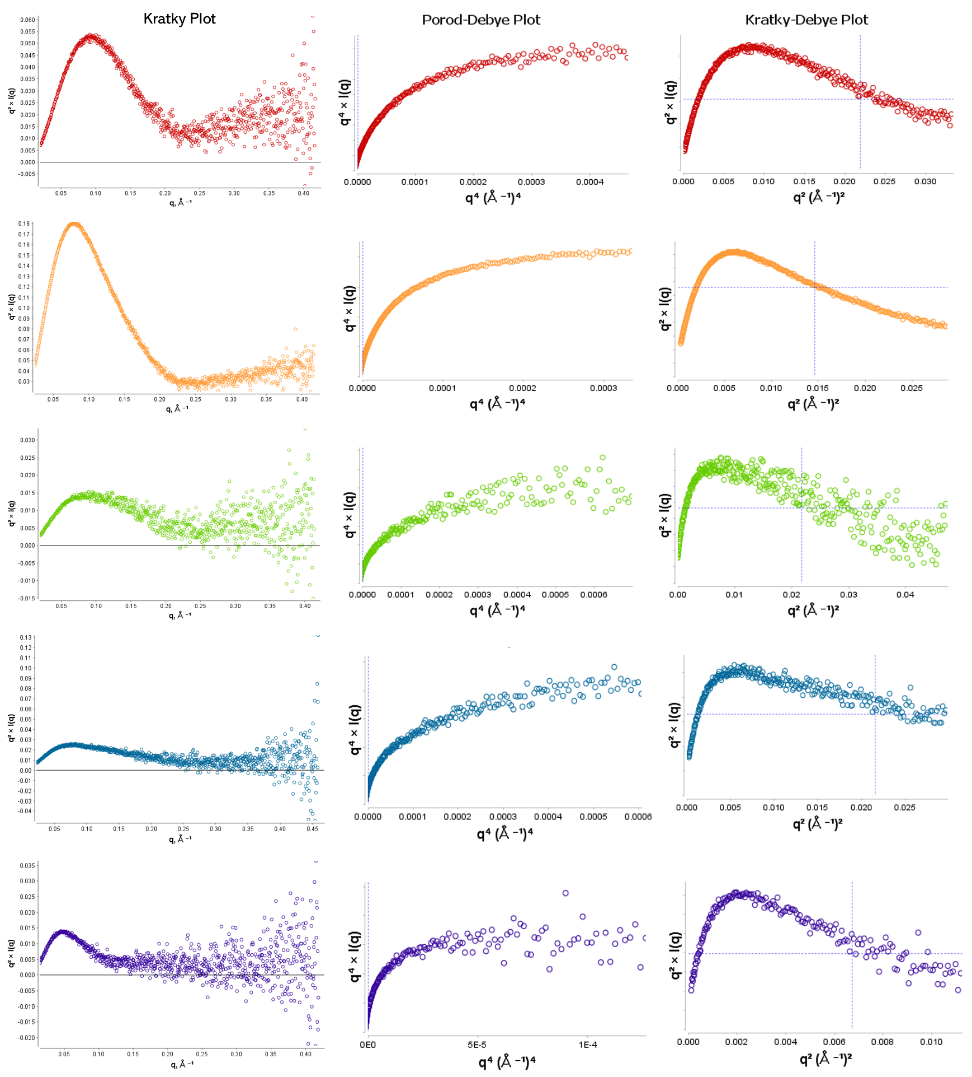
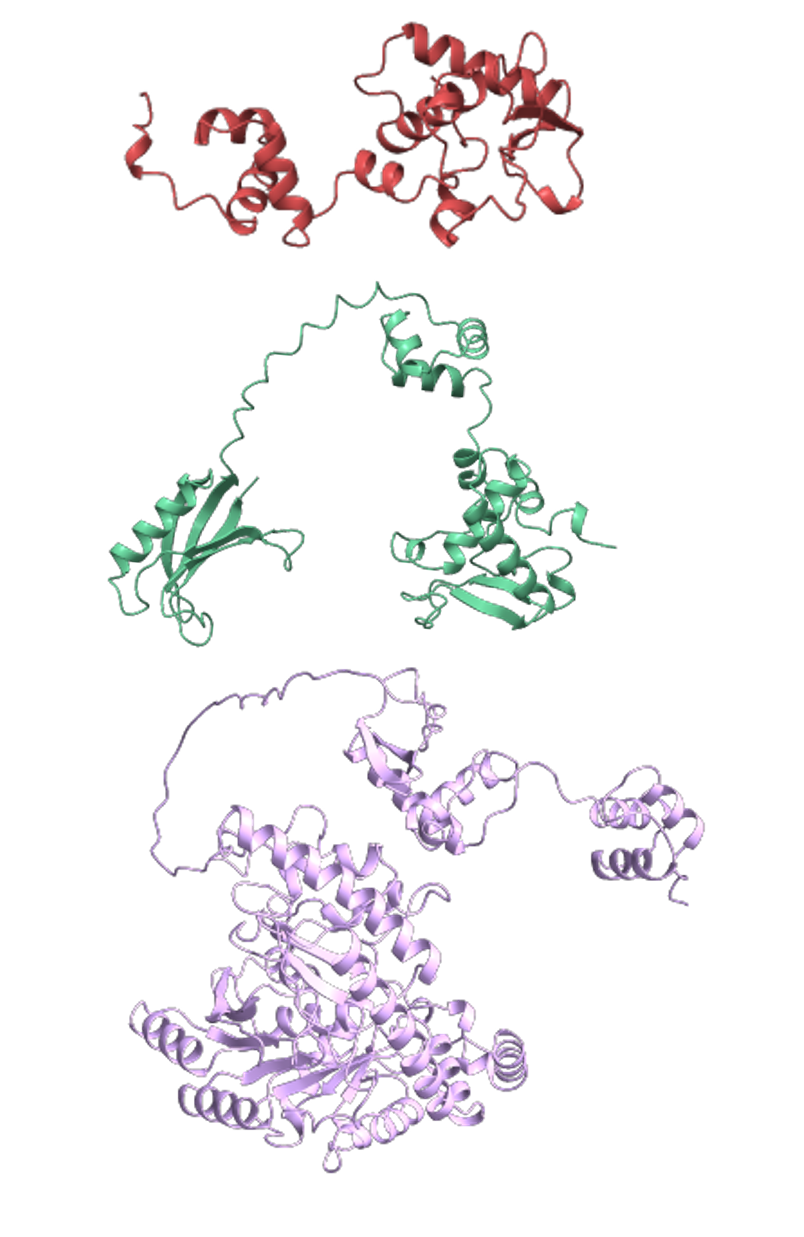
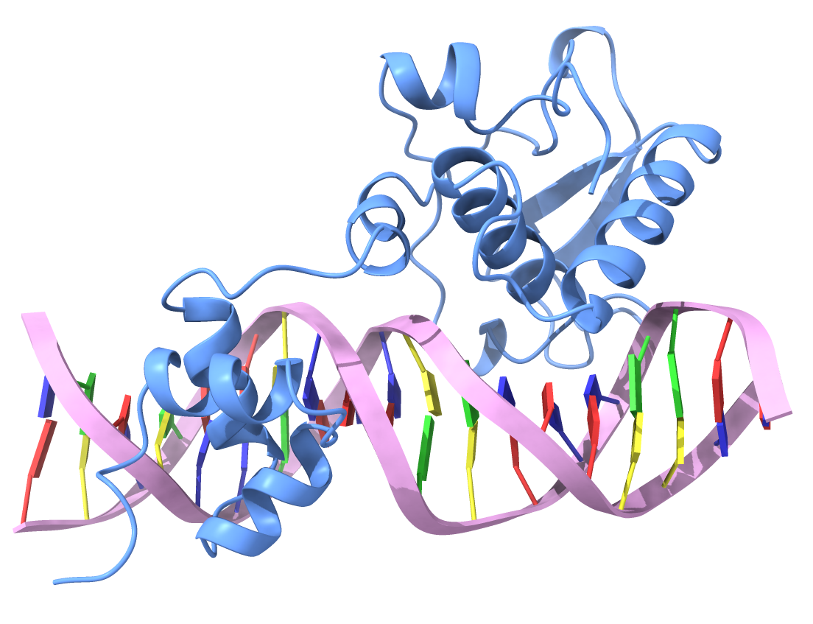
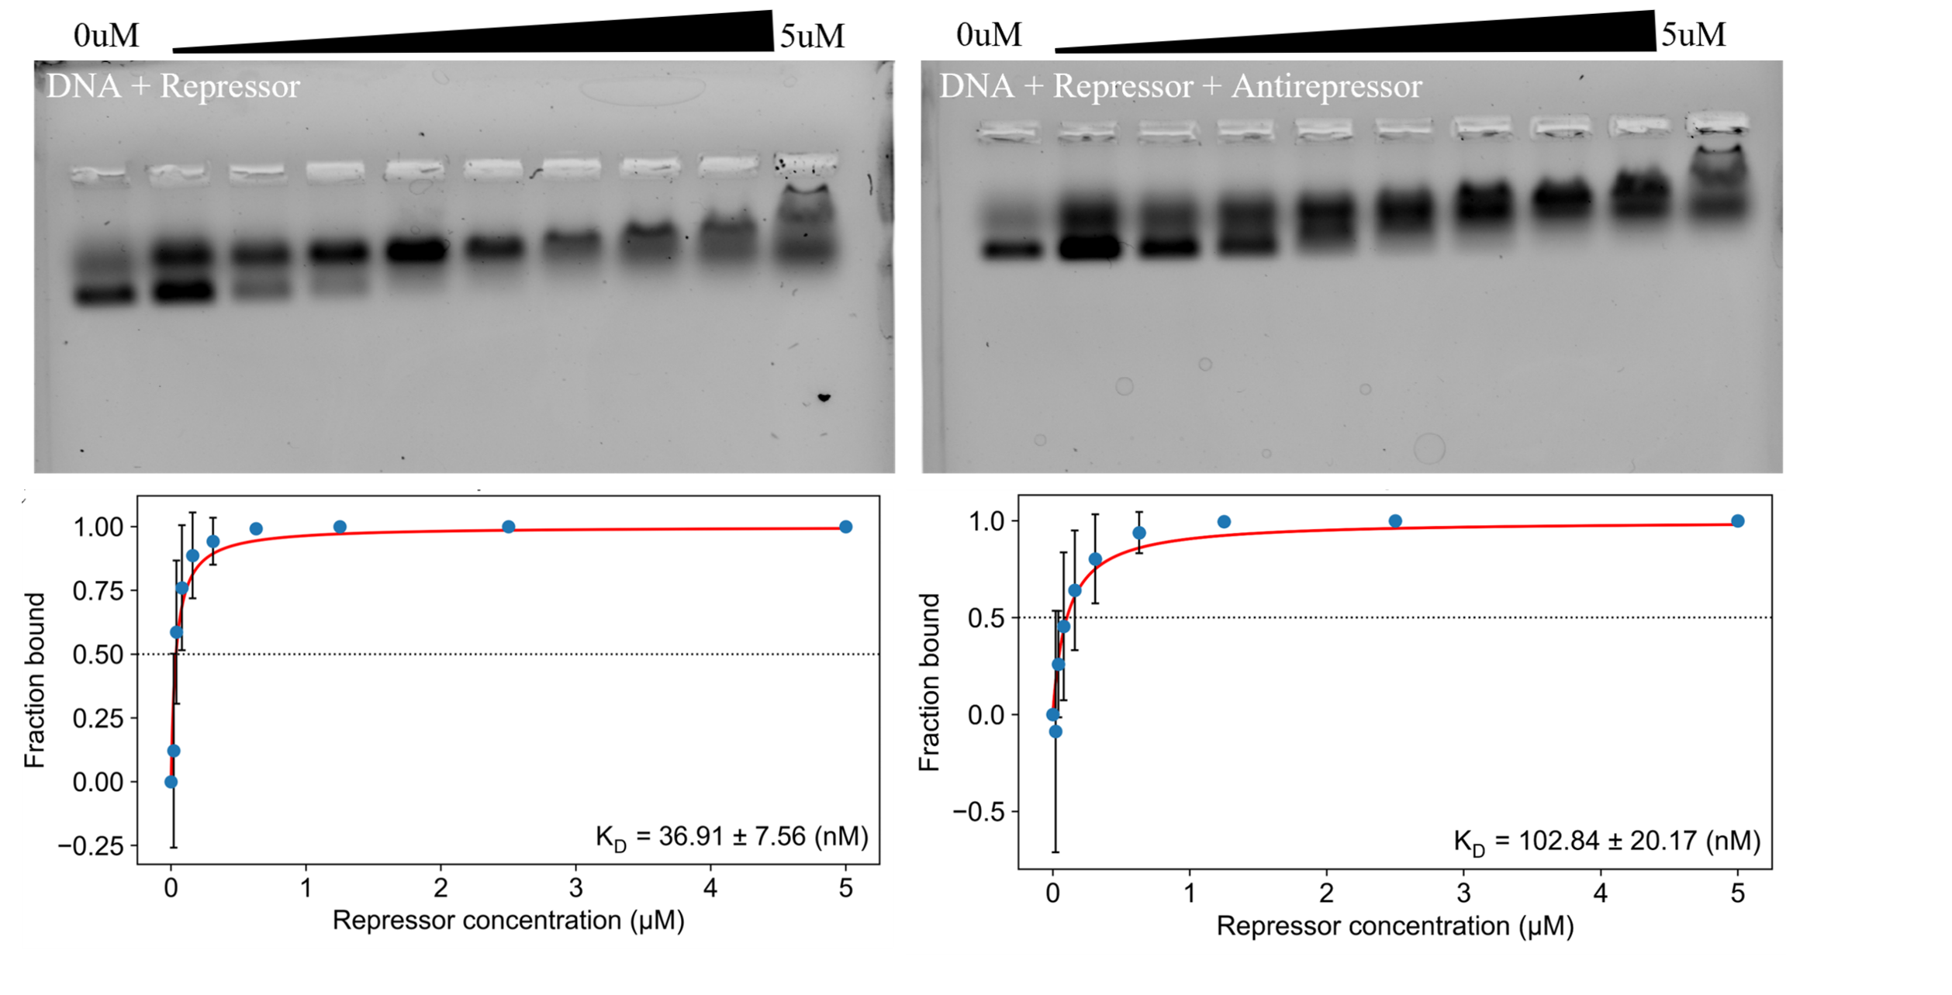
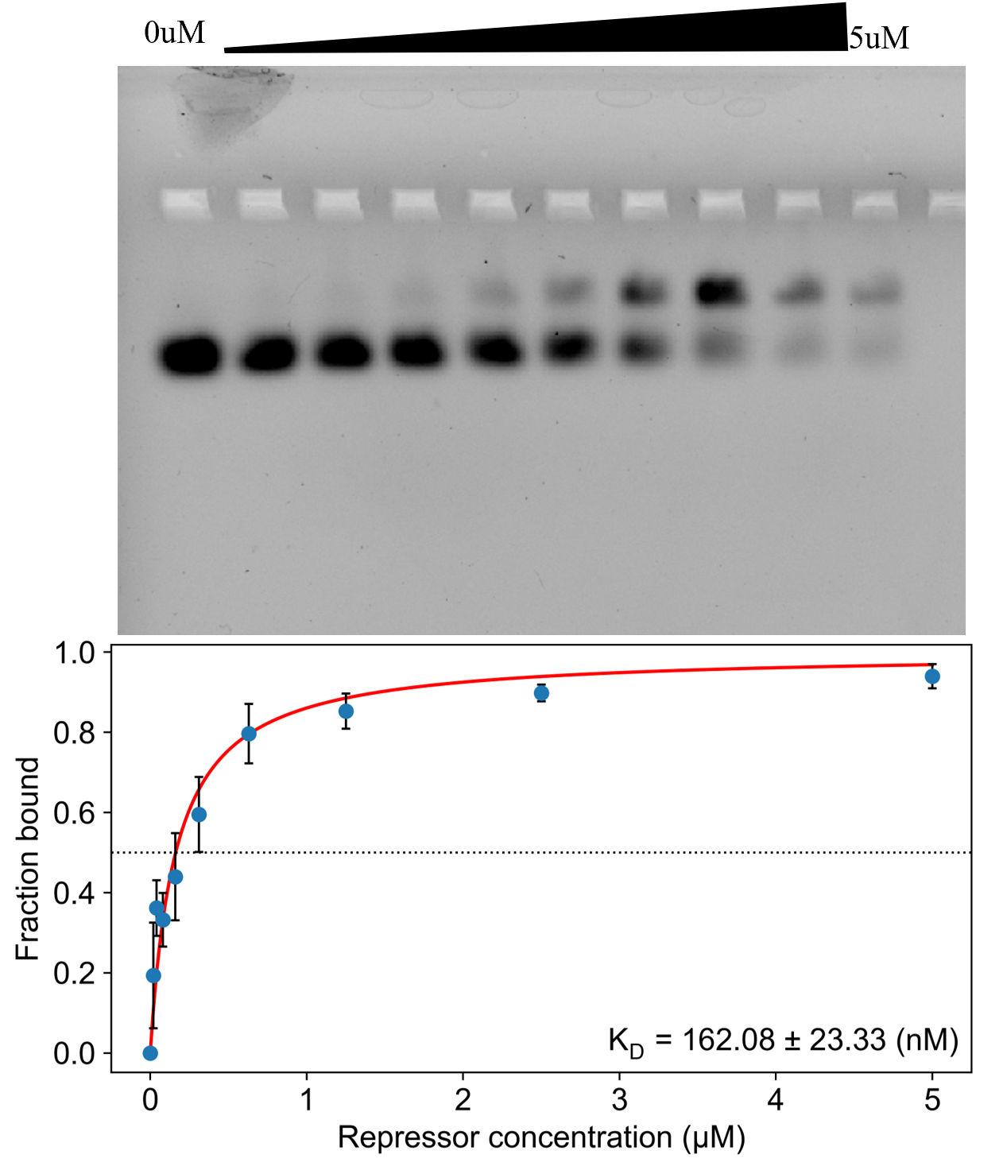
Characterization of Mycobacteriophage Repressor Inactivation and Novel Repressor Fusion Proteins
Ashley Tuhro, Maria D. Gainey, and Jamie R. Wallen
Departments of Chemistry and Physics
Abstract
Bacteriophage repressors are critical regulators of lysogeny, maintaining dormancy in the bacterial hosts by binding to DNA and silencing the transcription of lytic genes. Repressors also bind the DNA of genetically similar bacteriophages to provide the host immunity against subsequent viral infection. Despite their importance, the mechanisms underlying actinobacteriophage (viruses that infect Actinobacteria) repressor inactivation and the transition into the lytic cycle remain largely unknown. This study investigates the repressor found in the cluster A1 mycobacteriophage Adahisdi and its ability to interact with other Adahisdi proteins, including a candidate “antirepressor” gene found in the bacteriophage. To better understand the lysogenic to lytic cycle conversion in Adahisdi, DNA binding assays were performed to observe the ability of the repressor to bind DNA in the presence and absence of the candidate antirepressor. Our results show the repressor has a weakened affinity in the presence of the antirepressor, supporting the antirepressor’s role in promoting the lytic switch. Two-hybrid assays were also conducted to determine if the repressor interacts with itself to form a higher-ordered oligomer as well neighboring genes that cluster near the antirepressor. Results from the two-hybrid assay support that the repressor is monomeric in the cell and only interacts with the antirepressor gene. Finally, bacterial proteins that contain a protein domain fused to a repressor have been previously bioinformatically characterized in our lab. To better understand the oligomeric state and DNA binding capabilities of these proteins in solution, we have performed both DNA binding and small-angle X-ray scattering (SAXS) experiments on three repressor fusions. Our results show that these proteins bind DNA, likely using the repressor domain, and SAXS analyses show that these proteins form both monomers and higher-ordered oligomers in solution. Future work will focus on understanding the biological roles of these repressor proteins in the cell.
Methods
Conclusions
The Adahisdi antirepressor lowers repressor binding affinity by a nearly threefold value
Within the Adahisdi system, the repressor only seems to have strong interactions with gp70 (antirepressor), no other neighboring proteins
Adahisdi repressor exhibits no signs of self interaction
Adahisdi, ENV421, and MocR all have compact protein structure in solution
ENV421 repressor is able to bind to DNA
A
10⁰ 10⁻¹ 10⁻² 10⁻³ 10⁻⁴ 10⁻⁵
10⁰ 10⁻¹ 10⁻² 10⁻³ 10⁻⁴ 10⁻⁵
B
10⁰ 10⁻¹ 10⁻² 10⁻³ 10⁻⁴ 10⁻⁵
10⁰ 10⁻¹ 10⁻² 10⁻³ 10⁻⁴ 10⁻⁵
gene 71 +
gene 67
gene 71 +
gene 71
gene 71 +
gene 68
gene 71 +
gene 69
gene 71 +
gene 70
gene 71 +
gene 70
Growth - no carbenicillin
750ug/mL carbenicillin
Growth - no carbenicillin
750ug/mL carbenicillin
10⁰ 10⁻¹ 10⁻² 10⁻³ 10⁻⁴ 10⁻⁵
10⁰ 10⁻¹ 10⁻² 10⁻³ 10⁻⁴ 10⁻⁵
1500ug/mL carbenicillin
1500ug/mL carbenicillin
Figure 1: A) Bacterial two-hybrid plates displaying potential interactions from Adahisdi gp71 (repressor) with gp67, 68, 69, and 70 (antirepressor). B) Two-hybrid interactions between Adahisdi gp71 with gp70 and 71.
Future Work
Continue to refine binding assays to monitor KD changes in novel repressors
Continue processing data received from SAXS
Identify DNA binding for MocR to conduct similar binding studies
Further two-hybrid testing for different protein combinations within the Adahisdi system
Figure 2: Kratky, Porod-Debye, and Kratky-Debye plots of Adahisdi repressor/no DNA (red), Adahisdi repressor + DNA (orange), ENV421 repressor/no DNA (green), ENV421 repressor + DNA (blue), MocR repressor (2.5 mg/mL) (violet).
Figure 3: Alphafold models for the repressors found in Adahisdi (red), ENV421 (green), and MocR (lilac).
Figure 4: X-Ray crystal structure of Adahisdi repressor bound to DNA.
References
Bonogafsky, H. Characterization of Defense Mechanisms Actinobacteriophages Use to Evade Their Host Bacteria, Western Carolina University, 2025.
Hatfull, G. F. Actinobacteriophages: Genomics, Dynamics, and Applications. Annu. Rev. Virol. 2020, 7 (1), 37–61. https://doi.org/10.1146/annurev-virology-122019-070009.
Mavrich, T. N.; Hatfull, G. F. Evolution of Superinfection Immunity in Cluster A Mycobacteriophages. mBio 2019, 10 (3), e00971-19. https://doi.org/10.1128/mBio.00971-19.
McGinnis, R. J.; Brambley, C. A.; Stamey, B.; Green, W. C.; Gragg, K. N.; Cafferty, E. R.; Terwilliger, T. C.; Hammel, M.; Hollis, T. J.; Miller, J. M.; Gainey, M. D.; Wallen, J. R. A Monomeric Mycobacteriophage Immunity Repressor Utilizes Two Domains to Recognize an Asymmetric DNA Sequence. Nat. Commun. 2022, 13 (1), 4105. https://doi.org/10.1038/s41467-022-31678-6.
A
B
Goals and Objectives
Understand the effect of the antirepressor to repressor binding in the Adahisdi system
Test for interactions between the Adahisdi repressor and neighboring proteins
Achieve structural information on novel repressors using SAXS analysis to create working protein models
Acknowledgments
Thank you to the WCU department of Chemistry and Physics for supporting this work, and the Apodaca fourth floor alcove for encouraging its completion.
Figure 4: A) 0.8% agarose gel, run for 15 minutes at 100V. Binding assay results of Adahisdi DNA + repressor mixture. Repressor concentration increased gradually from 0uM in lane 1 to 5uM in lane 10. Antirepressor concentration is at 5uM. Binding curve representative for Adahisdi, presents the repressor binding affinity (KD) for DNA with and without the presence of the antirepressor. B) binding results for the ENV421 repressor under same conditions as (A), including associated KD value for affinity.

