Slide 1
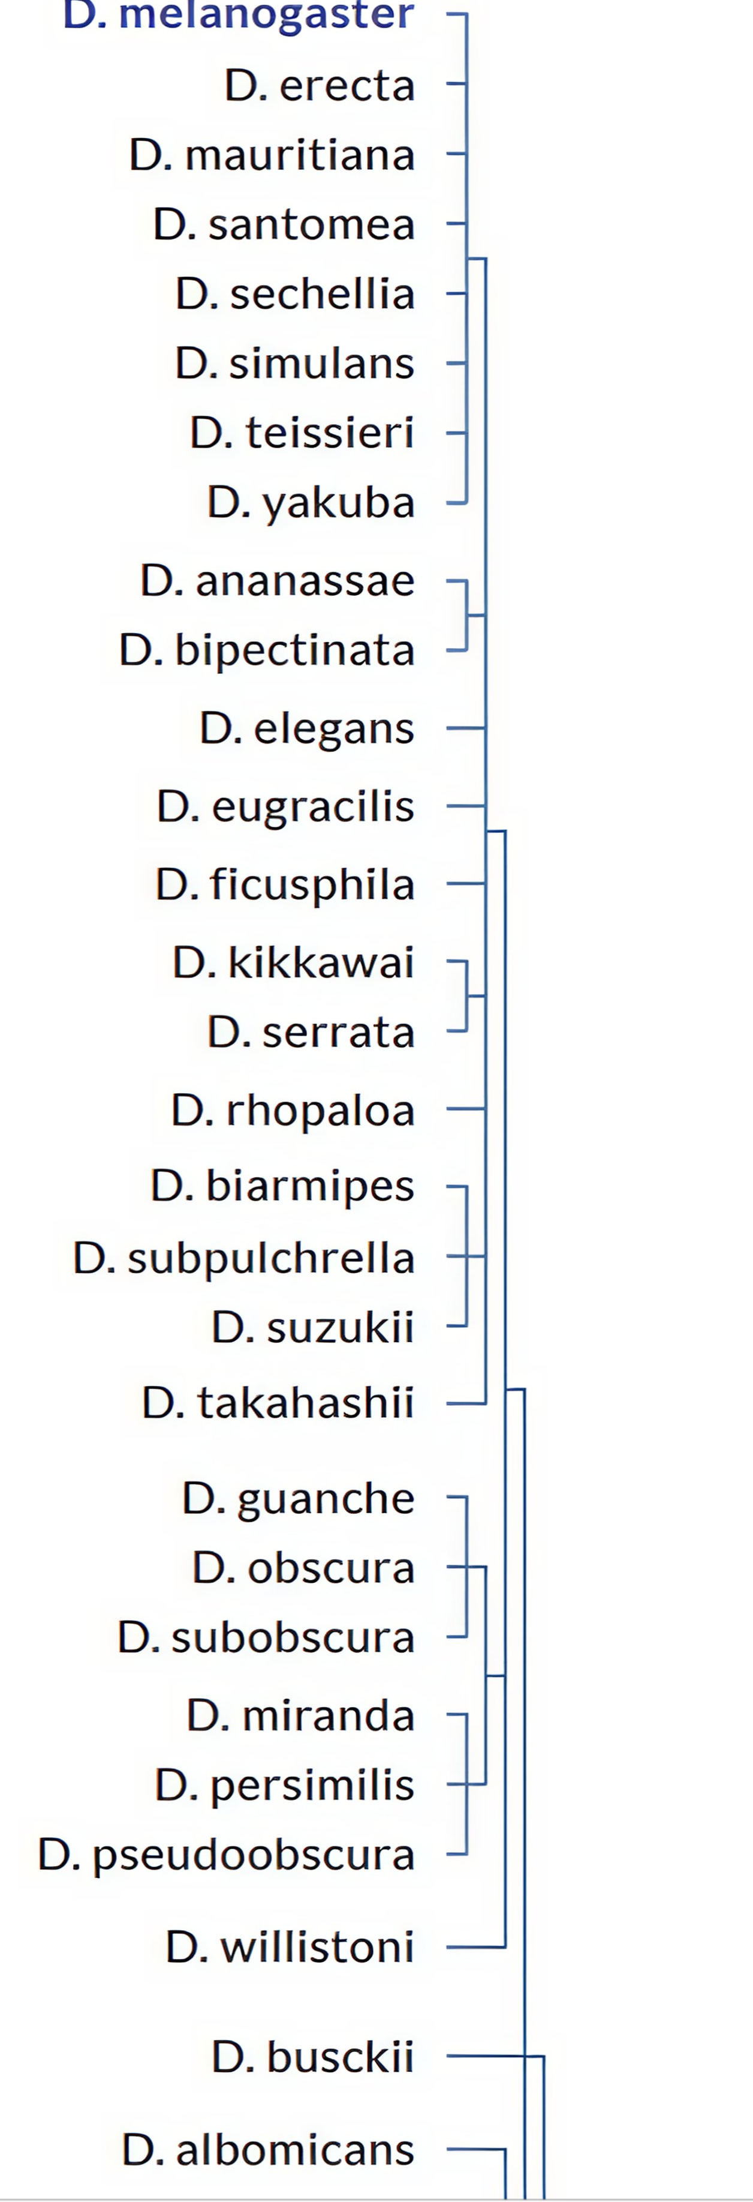

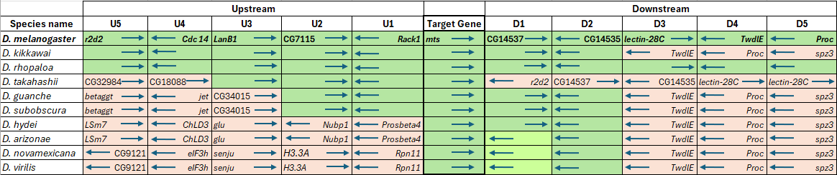
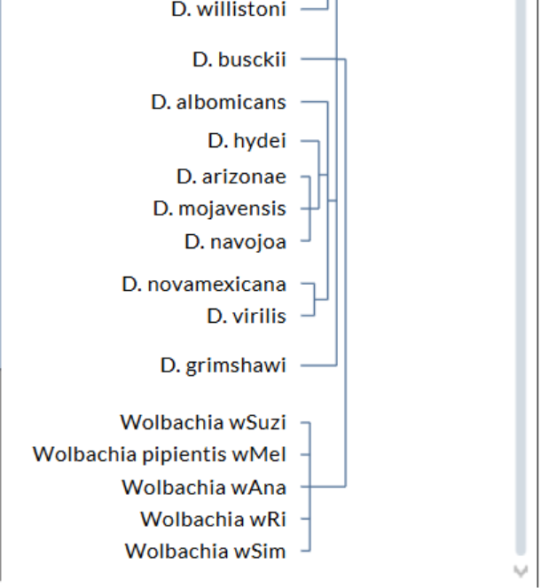
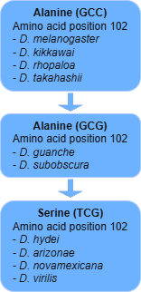

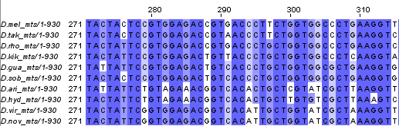
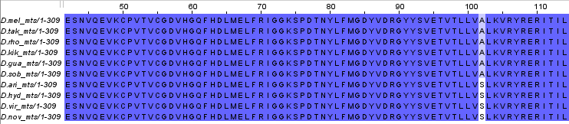
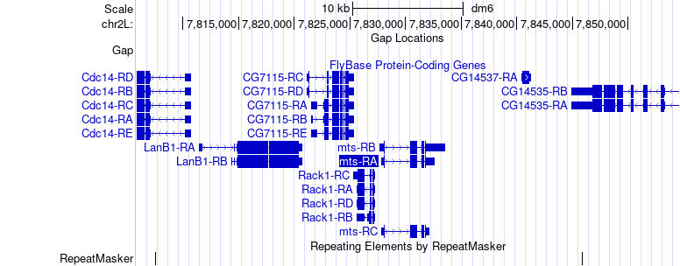









Synteny and Multiple Sequence Alignment of the microtubule star gene (mts) in Drosophila species
Sacha Maia Sandil, Erica Franke BS¹, Dr. Indrani Bose PhD²
¹Department of Chemistry and Physics at WCU, ²Department of Biology at WCU
Abstract
The mts (microtubule star) gene in Drosophila melanogaster encodes the catalytic subunit of the essential protein, protein phosphatase 2A (PP2A). This protein is responsible for dephosphorylating, or turning off, the signal cascade activated by the insulin receptor. This project focused on studying the gene synteny and amino acid sequence of mts in different Drosophila species to further the understanding of its genomic evolution and conservation. Using the GEP Genome Browser, BLAST alignments, RNA-Seq data, and Multiple Sequence Alignments (MSA), we investigated the changes in amino acid sequence and syntenic structure across 10 Drosophila spp. In D. melanogaster, the closest upstream gene to mts is Rack1 with the next closest being CG7115. The closest downstream gene is CG14537 with the next closest being CG14535. D. hydei, D. arizonae, D. novamexicana, and D. virilis have the same downstream neighbors but very different upstream genes. MSA of the amino acid sequence of mts showed that this was a very conserved gene in Drosophila spp. We observed a single change at alanine-102 (encoded by the codon GCC in D. melanogaster and its closest relatives), with some species exhibiting a synonymous change (GCC -> GCG in D. guanche and D. subobscura) and more distantly related species exhibiting a nonsynonymous change to serine (GCG -> TCG in D. virilis, D. hydei, D. arizonae, and D. novamexicana. This amino acid mutation does not appear to have an impact on gene function because the mts gene deletion is known to be lethal which speaks to the necessity of the mts gene for Drosophila growth and survival. Future studies may include analysis of the transcriptional start site and other regulatory elements for this gene.
Methods
To determine the genomic neighborhood of mts in D. melanogaster, GEP UCSC Genome Browser⁵ was used to record the upstream and downstream genes. The scaffold with the highest alignment score was analyzed in the Genome Browser for the genetic neighborhood. Ortholog analysis was done by inserting the translated protein sequence of the mts gene from one of the Drosophila species against D. melanogaster using the TBLASTN program from NCBI⁶ to determine the percentage identity and E-value of the protein sequence. From this data, we were able to confirm whether the mts gene of interest was present in the Drosophila spp. Multiple sequence alignment was done via EMBL-EBI Clustal Omega⁷ and Jalview⁸ once the protein and nucleotide sequences of the mts gene were recorded.
Results and Discussion
The synteny map shows an interesting trend in the conservation of the upstream and downstream neighbors of mts.
• Upstream genes show a steady alteration. U5 genes stay conserved until D. rhopaloa. In D. takahasii the two furthest genes studied change positions. As the species move further away from D. melanogaster, more upstream genes get rearranged or replaced. These changes are often in keeping with the clade structure of the phylogenetic tree.
• Interestingly, two immediate downstream genes (CG14537 and CG14535) stay conserved in most species studied, with the notable exception of D. takahashii. The D3 – D5 genes are also mostly preserved, although lectin-28C appears to have moved. The D. arizonae – D. virilis clades show the CG14537 gene flipping from the positive strand to the negative strand.
The mts gene encodes for a very conserved protein. Through the Drosophila lineage, only one amino acid change was seen at position A102S. The probable pathway of this change can be followed via synonymous and non-synonymous mutations in the different species (Fig 6), with the codon changing from GCC -> GCG -> TCG. This change does not seem to impact the overall functionality of mts, since it is an essential gene in D. melanogaster.
Figure 3. Above is a screenshot of the top five hits of a tblastn query of the experimental protein sequence of mts in D. virilis, XP_002051861.1, against the D. melanogaster sequence database where the percentage identity is 99.68%, the E-value is 0.0, and the query cover is 100%. These blast results show great evidence that the mts gene located in D. vir is almost identical to the one found in D. mel.
Synteny
Introduction
The mts gene in Drosophila species encodes for the catalytic subunit of protein phosphatase 2A (PP2A), an enzyme crucial to several cellular processes like signaling and development. One of the initiated proteins, kinase B, helps to supervise the development of cell size, growth, and division in an organism as it matures. After a certain point, PP2A is required to turn off the kinase B recruiting signal. Dysregulation of PP2A leads to an irregular “star” formation of microtubules in the cells, which can cause ill-timed condensation of chromatin, disrupting proper cell division during mitosis.¹ In Drosophila, PP2A has also been found to stop neuroblasts from renewing too rapidly, reducing the risk of developing brain tumors.² PP2A is essential for dendrite pruning during development, a process in which excess or inappropriate projections are eliminated for the formation of Drosophila’s “neural circuits”.³ The mts gene is homologous in several other species, such as Tyto alba (barn owls), Takifugu rubripes (pufferfish), and Mus musculus (mouse). Additionally, it is found in humans, with some neurological disorders being caused by mutations affecting PP2A, such as moderate intellectual disability (ID), hypotonia, and epilepsy.⁴ In the interest of the Pathways Project, the conservation of mts within the Drosophila species was studied, with a focus on different target species that span across the evolutionary tree.
Figure 4. Synteny map illustrating the location of the mts gene and the neighboring upstream and downstream genes in the 10 Drosophila species studied. The species are listed in the order of the phylogenetic tree. The model organism D. melanogaster is listed at the top with the genes surrounding mts bolded. The gene synteny of the following species are compared to D. mel, where genes that were found to be the same are colored green. When the gene synteny differs, the cells are colored pink, and the different gene name is listed. Left-pointing arrows indicate genes being located on the negative strand, and right-pointing arrows indicate genes are located on the positive strand.
Multiple Sequence Alignment
Figure 1. Phylogenetic tree of Drosophila spp. and their relatedness. The species included in this study are highlighted in yellow.
Figure 6. Flowchart showing the Alanine to Serine in mts.
Conclusion and Future Directions
The conservation of the mts gene throughout the 10 Drosophila spp. studied is evident and speaks to the necessity of the PP2A protein that is encoded. The insulin signaling response system requires regulation by PP2A, otherwise the cells will not grow and divide accurately for successful survival.
Further study on synteny and importance of neighboring genes
Observe nucleic acid change across whole phylogenetic tree
Determine effect of the Alanine to Serine change
References
Snaith HA, Armstrong CG, Guo Y, Kaiser K, Cohen PT. (1996) J Cell Sci. 109 ( Pt 13):3001-3012.
Wang C, Chang K, Somers G, et al. (2009) Development 136(13):2287-2296.
Rui M, Ng KS, Tang Q, Bu S, Yu F. (2020) EMBO Reports 21(5):e48843-e48843.
Houge G, Haesen D, Vissers LELM, et al. (2015) Journal of Clinical Investigation ;125(8):3051-3062
The GEP UCSC Genome Browser: https://gander2.wustl.edu/index.html
The NCBI BLAST: https://blast.ncbi.nlm.nih.gov/Blast.cgi
EMBL-EBI Clustal Omega Multiple Sequence Alignment (MSA): https://www.ebi.ac.uk/jdispatcher/msa/
Waterhouse, A.M., Procter, J.B., Martin, D.M.A, Clamp, M. and Barton, G. J. (2009) "Jalview Version 2 - a multiple sequence alignment editor and analysis workbench"
Acknowledgements
We would like to thank Genomics Education Partnership for the use of their resources and websites, and Dr. Laura Reed (University of Alabama) for implementation of the Pathways Project. We would also like to thank Dr. Indi Bose, our instructor and mentor for this research.
Figure 5. Multiple sequence alignment for the mts gene in the 10 Drosophila species studied with a focus on the nucleotide transversions (top) and the resulting amino acid changes in the protein sequence (bottom). The nucleotide MSA shows a synonymous mutation from GCC (alanine), to GCG (alanine), then a non-synonymous mutation of TCG (serine). As the Drosophila species get more distantly related to D. melanogaster, the non-synonymous alanine to serine mutation is present. It is possible that this change from a hydrophobic residue to a polar residue might have some influence on the shape of the protein, but it most likely does not affect the function of this necessary gene.
Figure 2. Screenshot from GEP Genome Browser showing the structure of mts and its neighboring genes.

