Slide 1


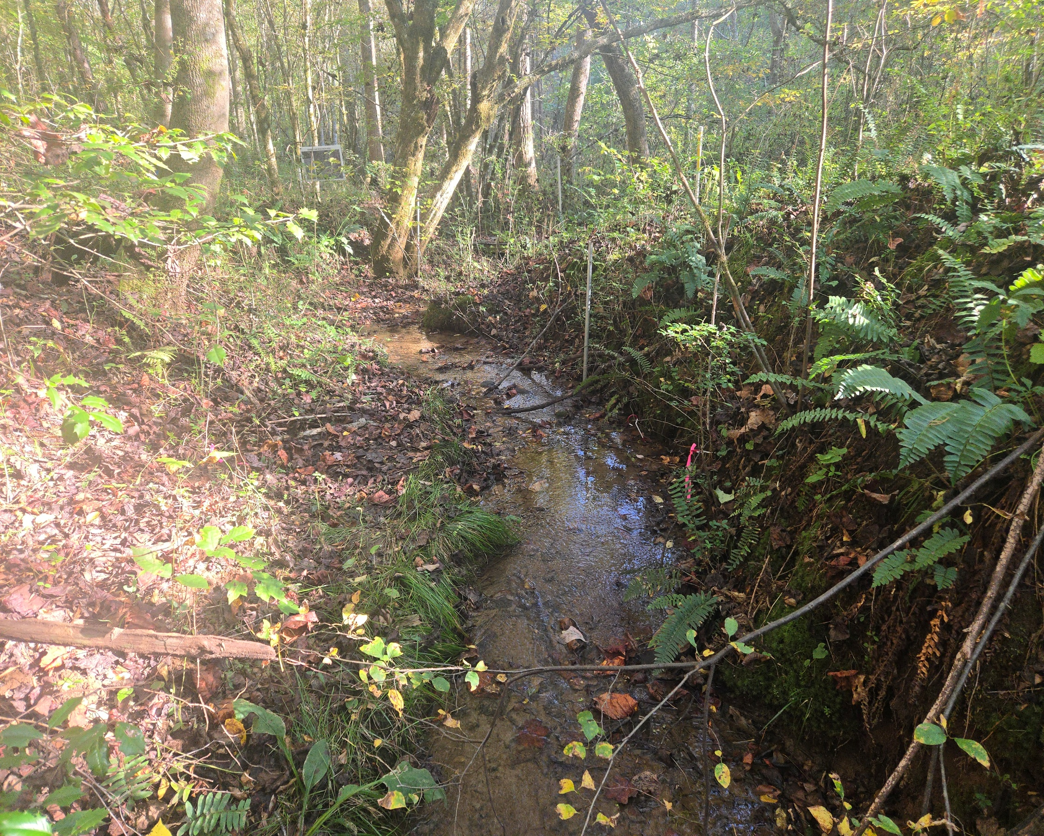
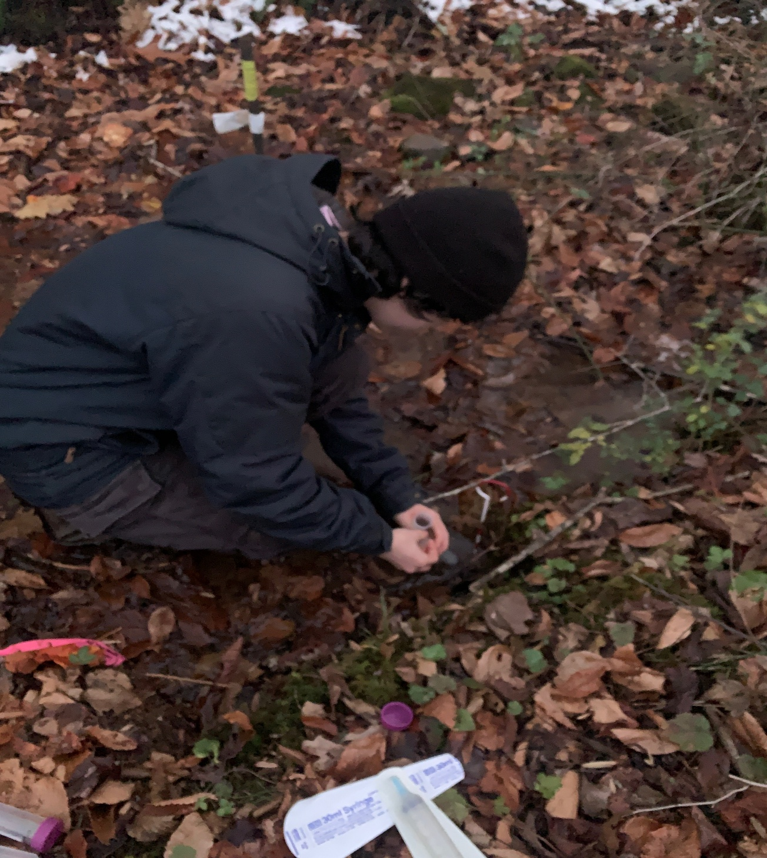
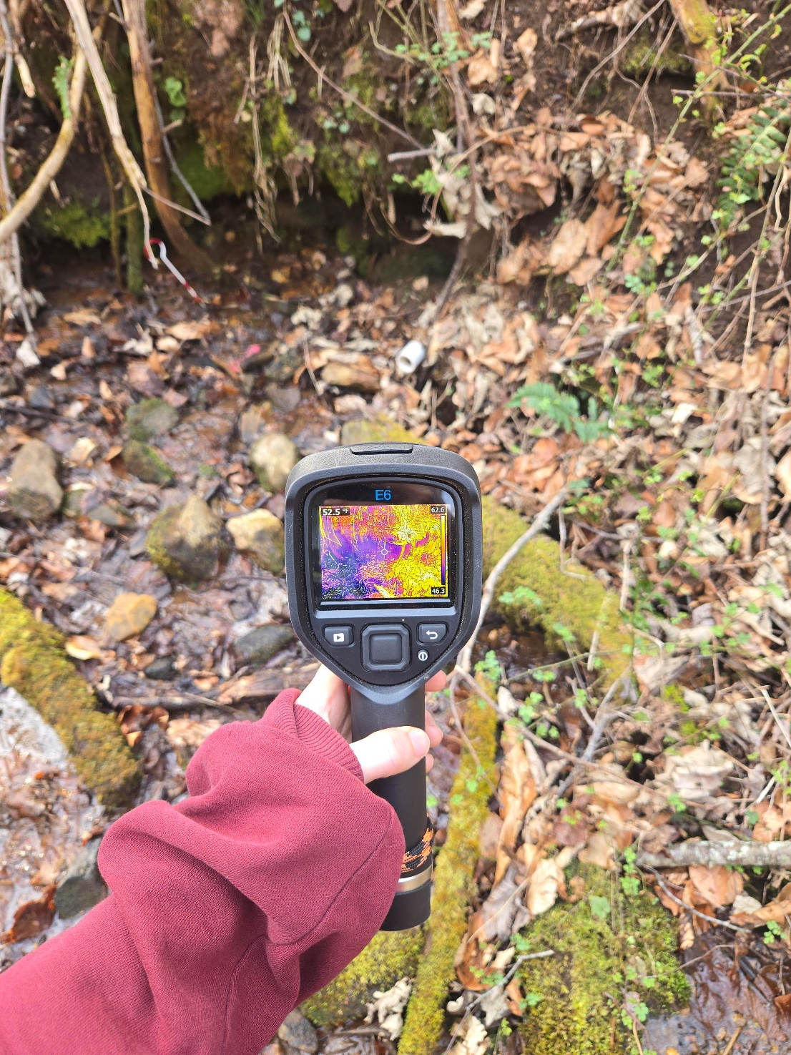

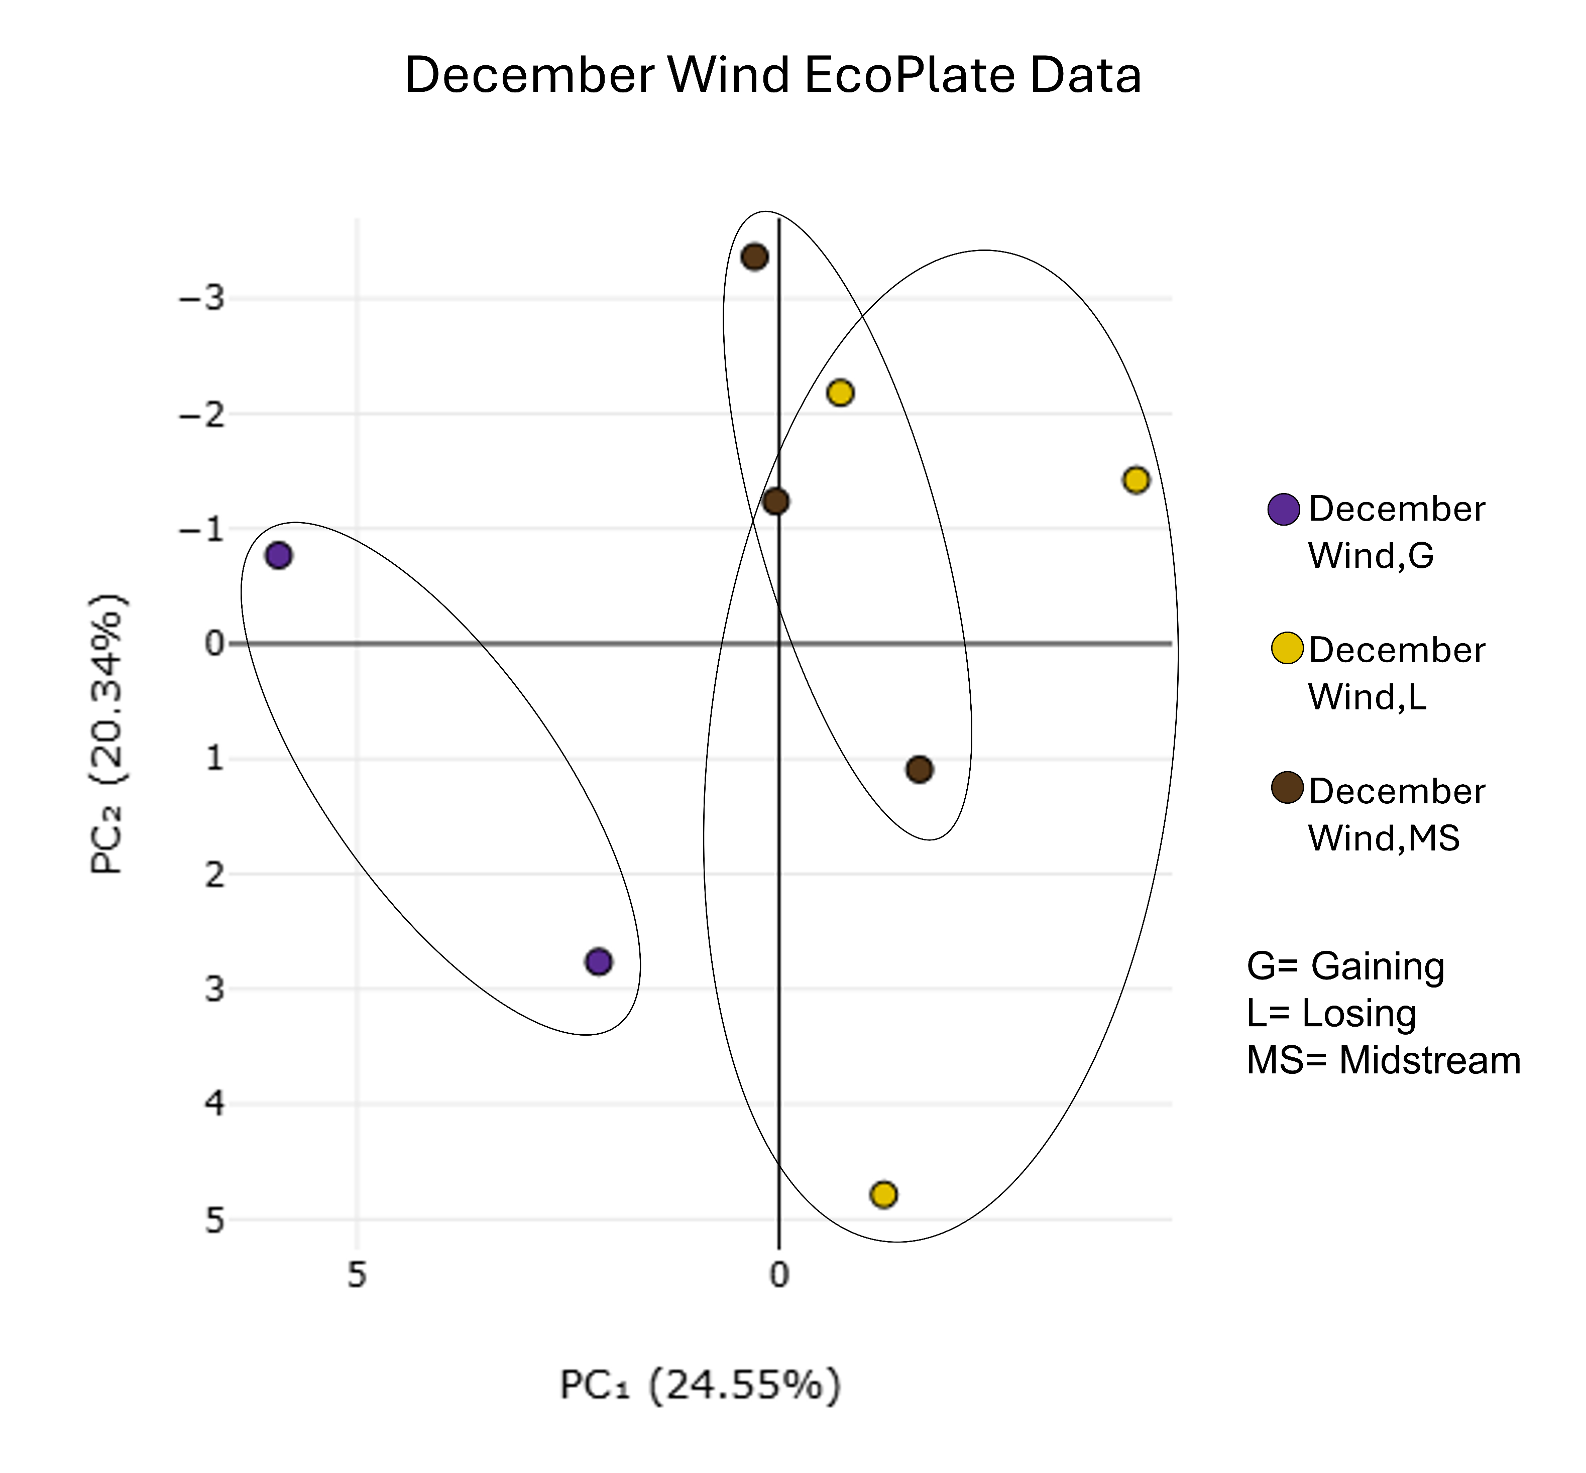
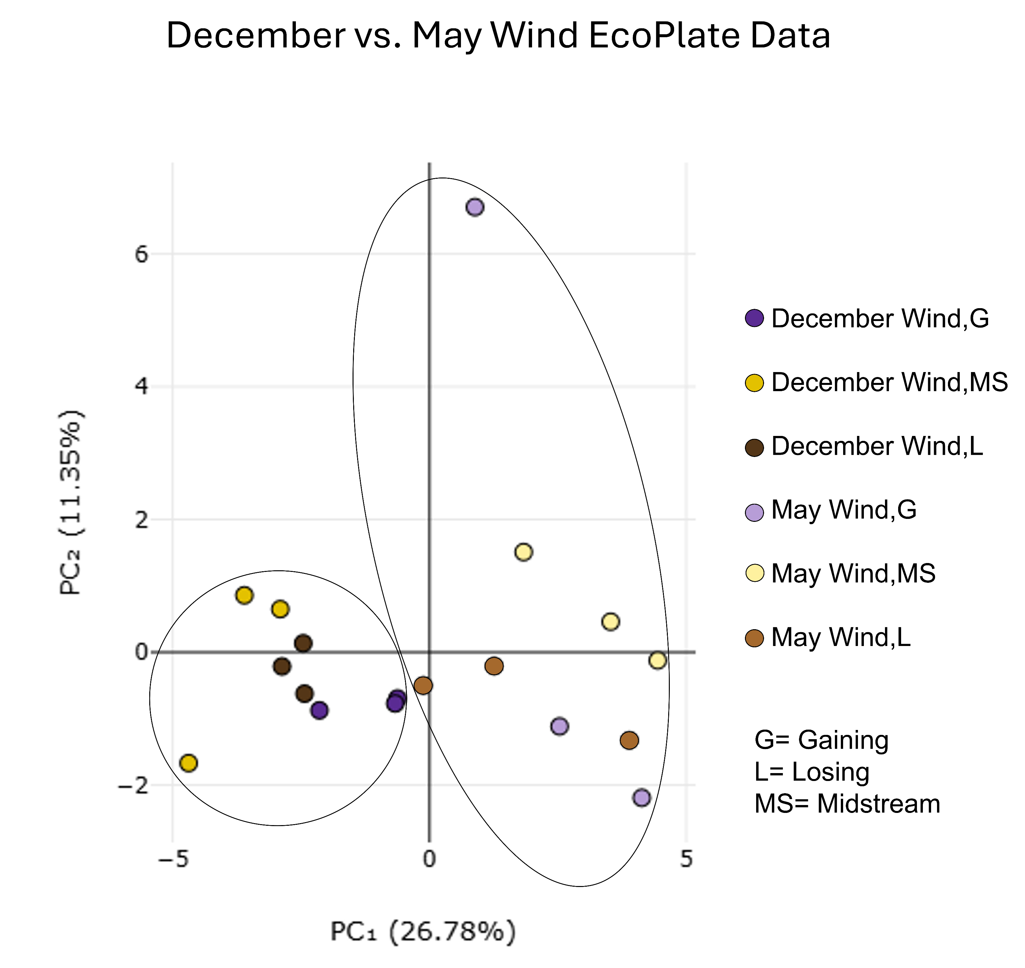
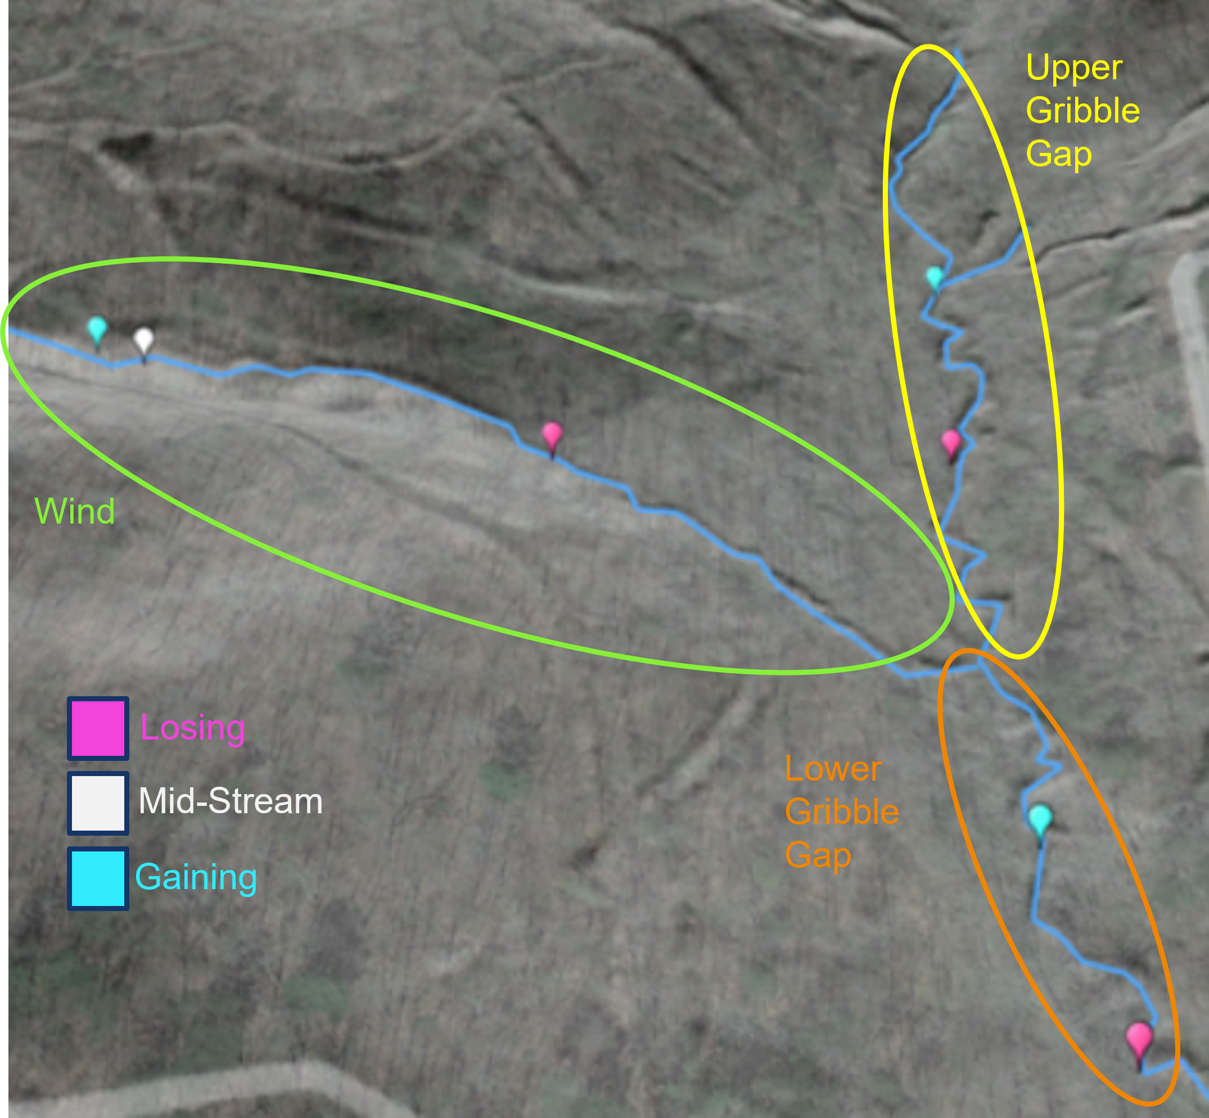
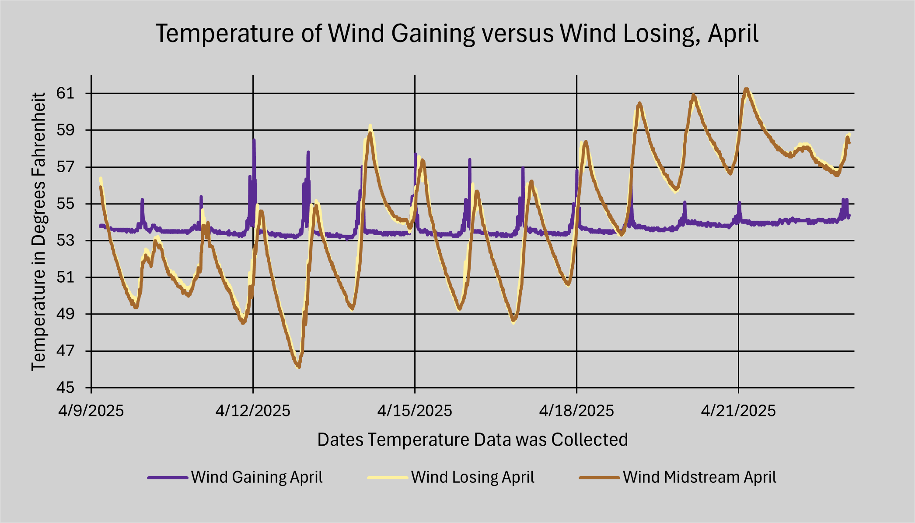
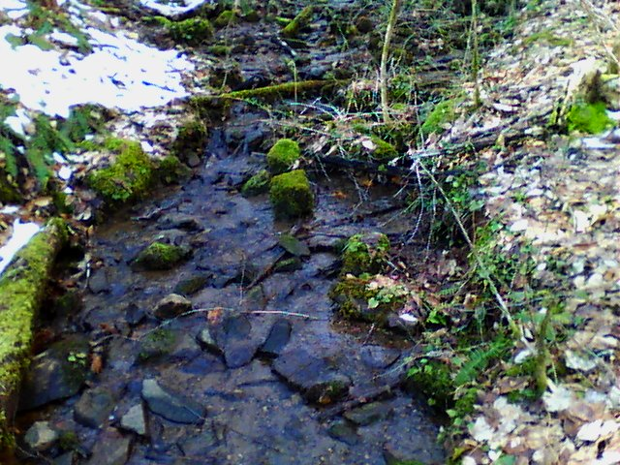
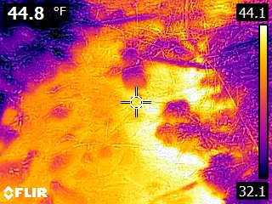
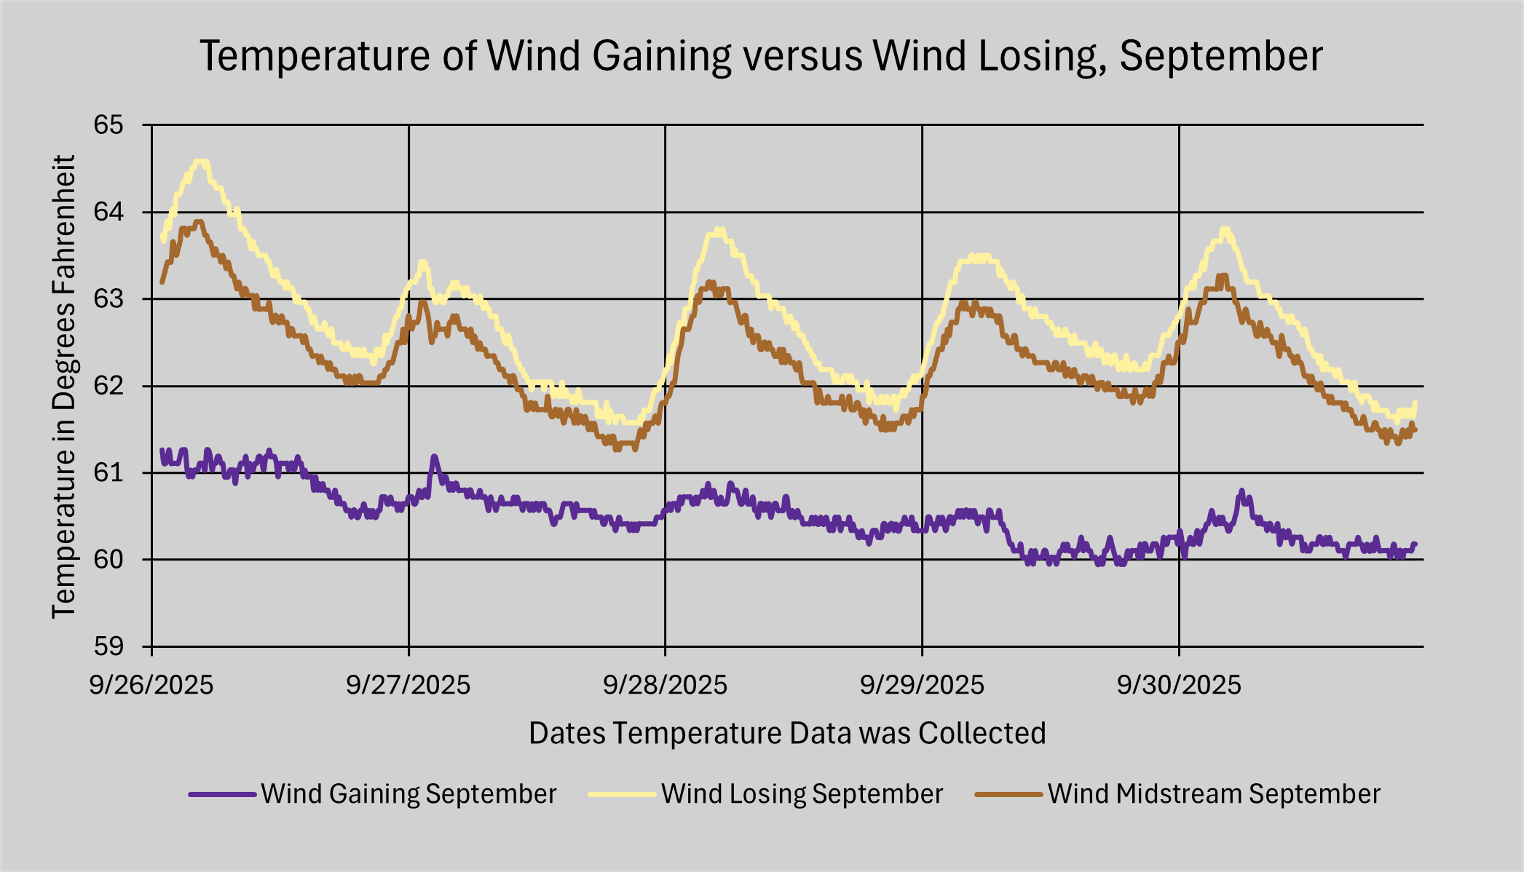
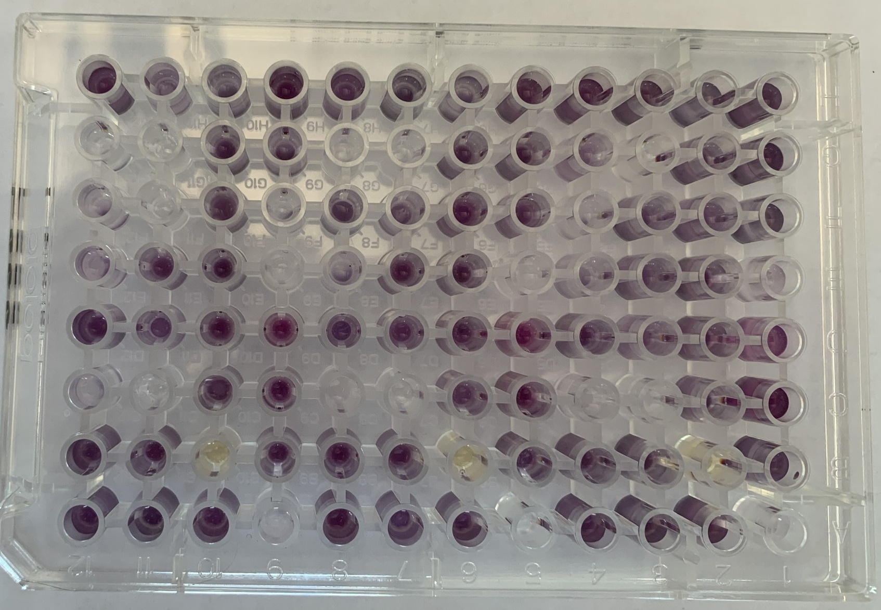
Microbiological Diversity in Areas of Groundwater Seepage and Surface Water Infiltration in Southern Appalachian Headwater Streams
HUTCHINSON, Austin², KOURY, Agnes², MADDLE, Liberty¹, LORD, Mark², and O’CONNELL, Sean¹
Department of Biology¹, Department of Geosciences and Natural Resources²
INTRODUCTION
METHODS
CONCLUSIONS
FUTURE WORK
This project explores the effects of surface water and groundwater interactions on microbial biodiversity within a Southern Appalachian headwaters' region.
Field Methods
Lab Methods
Microbial metabolism differs between gaining and losing reaches, both at the site level and reach level.
Co-occurrence of aerobic and anaerobic taxa at all sites.
Wind midstream and most Gribble Gap stream sites reflect hydrologic mixing dynamics.
Water from groundwater seeps into the stream, likely mixing quickly with upstream waters.
Seasonal changes in hydrology and likely other environmental conditions, cause shifts in microbial composition.
Evaluating more environmental factors that could be affecting microbial composition of gaining and losing reaches.
Determining how the hydrological setting independently plays a role in microbial distribution by testing more variables.
Study Objective
To determine whether microbial biodiversity differs between zones of groundwater seepage (gaining reaches) and zones of surface water infiltration (losing reaches).
Collected stream temperature and turbidity data.
Collected triplicate water samples for carbon media in December and May (Fig. 10).
Collected 7 additional water samples for genome sequencing.
Biolog EcoPlates
EcoPlates show what carbon sources the microbes prefer.
Darker wells = greater metabolic activity
3 replicates per sampling site.
Sequencing of 16S rRNA genes
Water samples taken at all 7 sites in December
Microbes concentrated via centrifuge and shipped to Zymo NGS services for targeted amplicon sequencing of 16S rRNA.
Purpose
Investigating microbial biodiversity to build a stronger understanding of how ecology is affected by hydrology.
Acknowledgements
Thank you to our faculty advisors, Mark Lord and Sean O’Connell, and the Departments of Biology and Geosciences and Natural Resources for support.
Figure 1. Upper Gribble Gap losing site
Hypothesis
Hydrologic differences between gaining and losing reaches will correspond to measurable differences in microbial diversity.
Figure 4. Researcher using syringe to take bank edge stream samples at site for EcoPlates.
Figure 5. Researcher using an infrared thermal FLIR camera at Wind gaining site.
SETTING
RESULTS
Location
Site Traits
Microbe Characteristics
The study takes place in the Gribble Gap catchment of the Western Carolina Hydrological Research Station, Cullowhee; it is a headwaters for the Little Tennessee River (Fig. 2).
Temperature data shows a typical diurnal cycle indicative of gaining (low variability) and losing (high variability) stream reaches.
Wind midstream site’s temperature signature and EcoPlate data closely followed the Wind losing sites.
Microbial Metabolism
Distinct clustering: gaining vs. losing sites
Seasonal shift in microbial communities between May and December
DNA Sequencing
Phylum Level: Proteobacteria most abundant (aerobic + anerobic) and Actinobacteria second most abundant (mostly aerobic) at most sites
Wind Sites: Lower proportion of Proteobacteria and higher proportion Actinobacteria
Genus Level: Geothrix (anaerobic) and Methanobacterium (anaerobic) present at all sites
Gribble Gap catchment area: 0.44 km²
Reaches of Gribble Gap have unique hydrogeologic settings.
May
Climate is humid subtropical with mild winters and summers.
Figure 6.
December
Figure 2. Map of Gribble Gap study area headwaters setting, tributaries, and study reaches
Site Assessment
Two streams were divided into three reaches and classified as gaining (groundwater input) or losing (surface water infiltrates groundwater) using:
Geomorphic interpretation
Infrared thermal imaging (Fig. 3)
Continuous temperature monitoring
Upper Wind: narrow valley, shallow bedrock, predominantly gaining.
Lower Wind/Gribble Gap: wider valley, thicker sediment over bedrock, few gaining reaches.
Figure 8. Principal Components Analysis (PCA) showing the variation between gaining, losing, and midstream sites of Wind with 3 replicates for each site. Gaining sites are distinct from losing and midstream (mixed) site.
Figure 9. Principal Components Analysis (PCA) showing the variation between the December and May sampling, as well as gaining, midstream, and losing reaches of each sampling for Wind with 3 replicates for each site. Gaining sites are distinct in both seasons, but all sites showed a seasonal shift (circles)
Figure 7.
Site | Proportion of Anaerobes | Proportion That Switch Between Both | Proportion of Aerobes
Wind Gaining | 1 | 1.7 | 3.5
Wind Midstream | 1 | 1.2 | 3.9
Wind Losing | 1 | 0.5 | 2.8
Upper GG Gaining | 1 | 1 | 3.4
Upper GG Losing | 1 | 1.3 | 5.7
Lower GG Gaining | 1 | 0.7 | 4.9
Lower GG Losing | 1 | 1.3 | 4.5
Recently obtained DNA Sequencing analysis identified over 3200 species of microbes. Our preliminary analysis examines the 30 most common genera with a known environmental affinity: obligate anaerobes, obligate aerobes, and groups that can switch their metabolism between anaerobic and aerobic processes.
Table 1. Ratios compare the December proportion of anaerobes at each site to the proportion of aerobes, and microbes that switch between being aerobic and anerobic. There is no significant difference in ratios of gaining and losing sites, but the average portion of aerobes is lower in Wind (mostly gaining).
Figure 3. Images of same gaining reach site in Wind during winter (snow on ground). Infrared image on bottom shows ‘hot’ water (groundwater) seeping in right bank.
Figure 10. EcoPlate for triplicate samples from 1 site. There are different carbon sources in each well. The darker purple the well, the more the microbes consume and metabolize that source.
Notes:
Hypothesis: The geomorphological difference within the Gribble Gap watershed are reflected in gaining and losing reaches and will also show differences in the microbiological diversity of the gaining and losing reaches.
Add departments
Add line to PCA instead and circle gaining vs losing
December vs. May instead of Fall v spring

