Slide 1
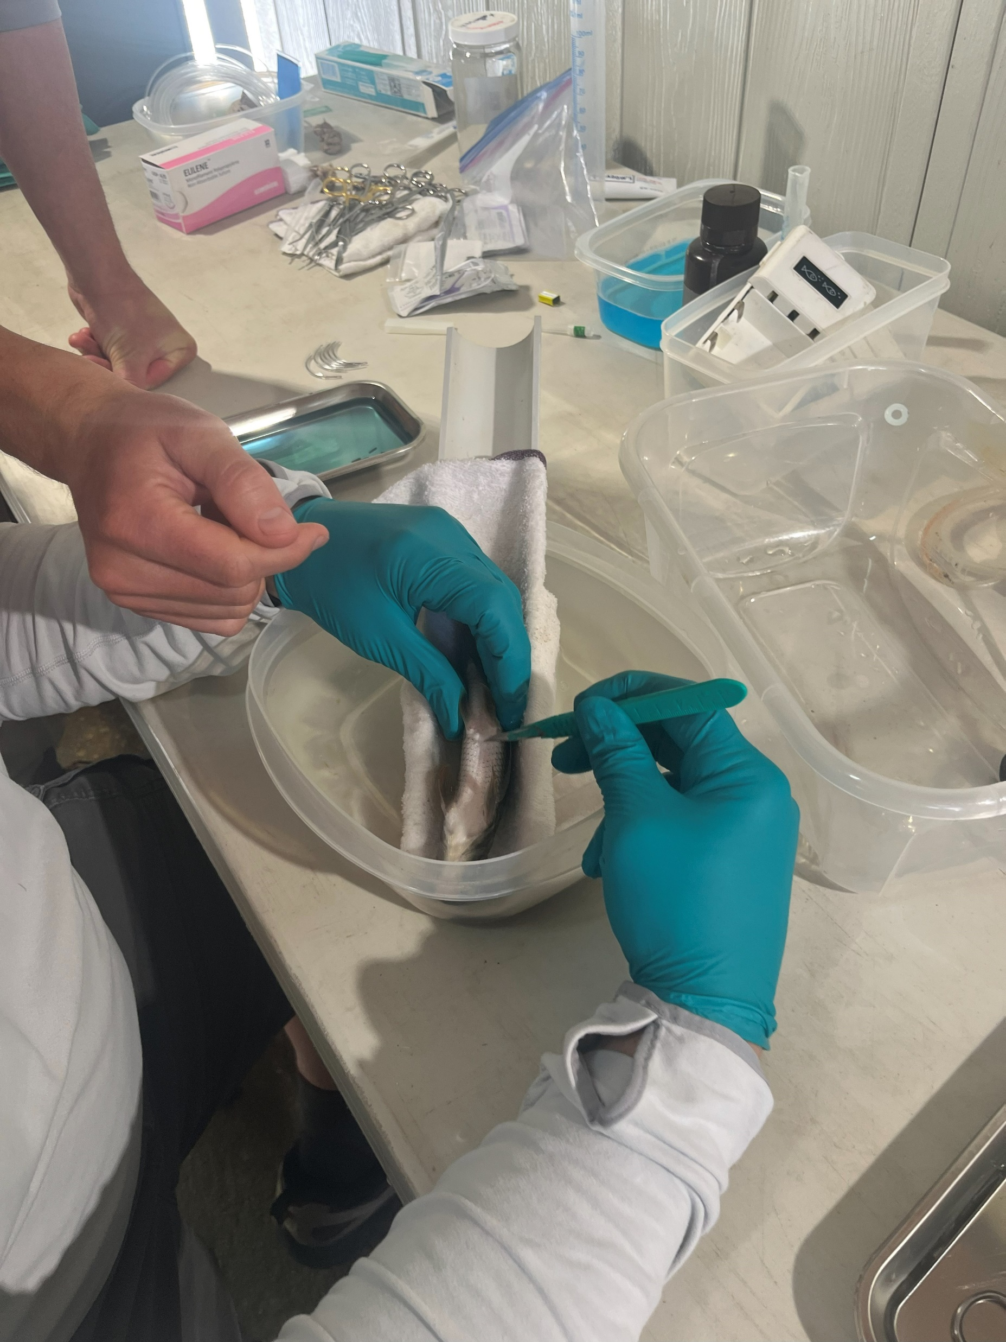
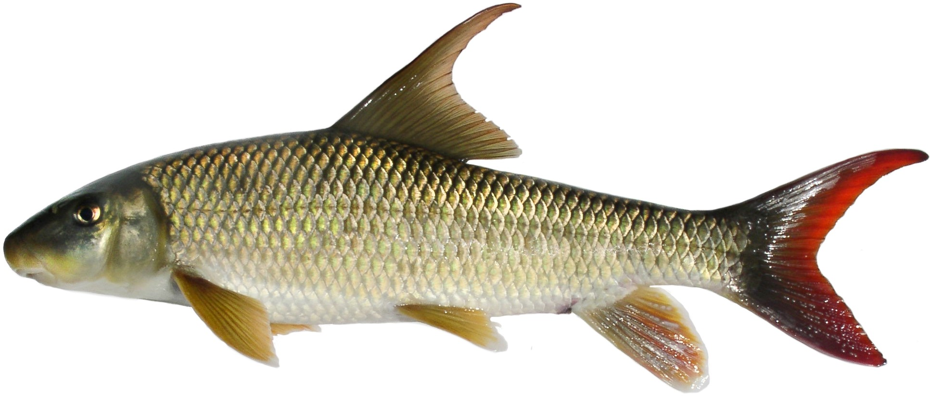
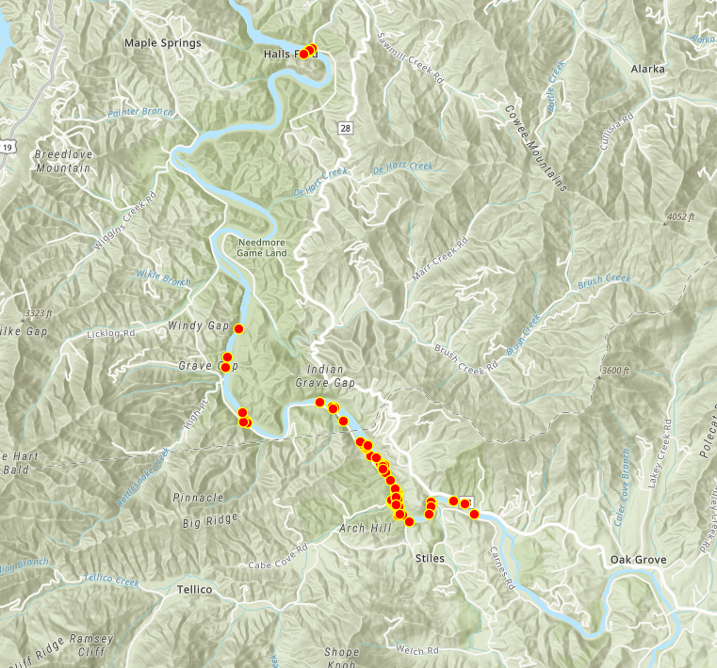
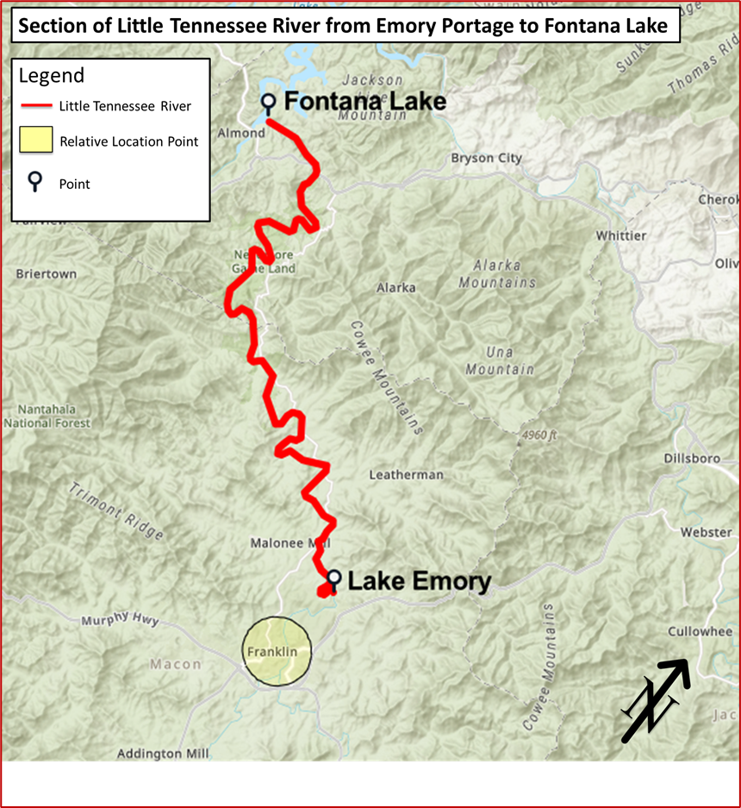


Movement and Habitat Use of the Sicklefin Redhorse (Moxostoma ugidatli) in the Little Tennessee River
Garrett McCarson¹ & Dr. Keith Gibbs²
¹Department of Biology, ²Department of Geosciences and Natural Resources
ABSTRACT
The sicklefin redhorse (SFRH) (Moxostoma ugidatli) is an imperiled catostomid endemic to the Little Tennessee River (LTR) and Hiwassee River basins. Its habitat use and movement patterns remain poorly understood. We used radio telemetry to track wild adults and hatchery-raised juveniles in the LTR, during the summer of 2025. Fish were surgically implanted with transmitters and monitored weekly within a river reach bounded by Emory Dam and Fontana Lake. Juveniles were most frequently detected in runs and pools and were strongly associated with sandy substrates and bedrock ledges. Adults were most frequently detected in runs and showed broader substrate use. Some fish showed site fidelity, and others moved several river miles within weeks. Tag loss and mortality complicated tracking and highlight the importance of tag retention in telemetry.
Fish Tagging and Release: Wild adult and hatchery-raised juvenile SFRH were surgically implanted with radio transmitters under buffered lidocaine anesthesia (Figure 2). Tagged fish were released near Tellico Creek in summer 2025.
Telemetry and Habitat Sampling: Fish were tracked weekly using handheld radio telemetry from boat or roadside surveys. At each detection, microhabitat variables including depth, velocity, substrate, habitat unit (pool, riffle, run) and water quality were recorded.
Analysis: Location was recorded using ArcGIS Survey123 and mapped in ArcGIS Pro (Figure 3). Movement and habitat associations were summarized using descriptive statistics.
Habitat Type:
CONCLUSIONS
Variable | Juveniles | Adults
Habitat Type | Pools > Runs > Riffles | Runs > Pools > Riffles
Substrate | Sand > others; Silt ↓ | Broad use; Bedrock > others; Silt ↓
In-stream Cover | Bedrock ledges > other cover | No cover ≈ Boulders > other cover
Depth | = (no pattern detected) | = (no pattern detected)
Velocity | Narrow range tolerated | Broad range tolerated
Water Quality | = (no pattern detected) | = (no pattern detected)
Riverweed | = (no association) | Riverweed > non-riverweed
Figure 8. Table of results.
Figure 4. Habitat use by JUV and ADLT SFRH in the LTR. Both age classes most frequently detected in run habitats. Error bars = SE
Key findings:
Runs were the most frequently used habitat for both age classes (Figure 4).
Juveniles associated with sand and bedrock ledges; adults used coarser substrates, especially bedrock (Figure 5).
Adults tolerated wider velocity ranges and often occurred with little cover (Figure 6).
Riverweed was more frequently present at adult locations than juvenile locations (Figure 7).
No clear patterns were detected for depth or water quality (Figure 8).
Substrate:
OBJECTIVES
1. Investigate the spring and summer movement patterns of captive-raised juvenile sicklefin redhorse and translocated wild adults.
2. Investigate the spring and summer habitat use of captive-raised juvenile sicklefin redhorse and translocated wild adults.
Figure 2. Surgical implantation of transmitters at WSNFH, GA.
Challenges:
LTR was exceptionally turbid this season.
Rained in excess.
Debris Removal paired with Roadwork.
Mortalities and tag rejection.
Figure 5. Substrate composition at detection. JUV often associated with sand. ADLT most frequently detected over coarse substrates. Error bars = SE
RESULTS
Detections:
Cover Type:
sicklefin redhorse.jpg, NC Wildlife Resources Commission, Copyrighted, All Rights Reserved - Used by Permission, https://www.fws.gov/media/sicklefin-redhorsejpg
Implications:
The majority of fish showed site affinity.
Restoration targeting runs/eddies.
Surgical refinement is required for juveniles.
Are they even surviving release?
Predation may be higher than first thought.
METHODS
Study Area: Conducted in a ~40 km reach of the LTR (Figure 1) between Emory Dam and Fontana Lake. These barriers created a semi-closed system. Individuals were released at Tellico Creek Access.
Acknowledgments:
Dr. Luke Etchison, Dylan Owensby, Chantelle Shuford, NCWRC.
Jason Mays, USFWS.
Dr. Keith Gibbs, Dr. Joe Pechmann, Dr. Oliver Larouche, WCU.
Dr. William McClarney, Jason Meador, Mainspring Conservation Trust.
The Sicklefin Working Group.
Warm Springs National Fish Hatchery
Josh Williford, Atley Elliott, Skyler Wechsberg, Katherine Hopkins, Quentin Lachance.
Figure 6. In-stream cover types observed at detection. JUV often associated with bedrock ledges/boulders. ADLTS most frequently detected in areas with no cover. Error Bars = SE
Presence of riverweed:
Figure 1. Study reach of the LTR between Emory Dam and Fontana Lake.
Figure 3. Telemetry detections of tagged SFRH (ADLT & JUV) in the LTR. Each point represents a detection.
Figure 7. Frequency of riverweed (Podostemum spp.) at detection.

