Slide 1
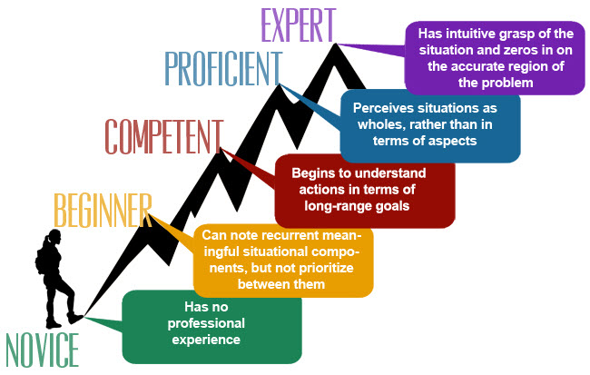
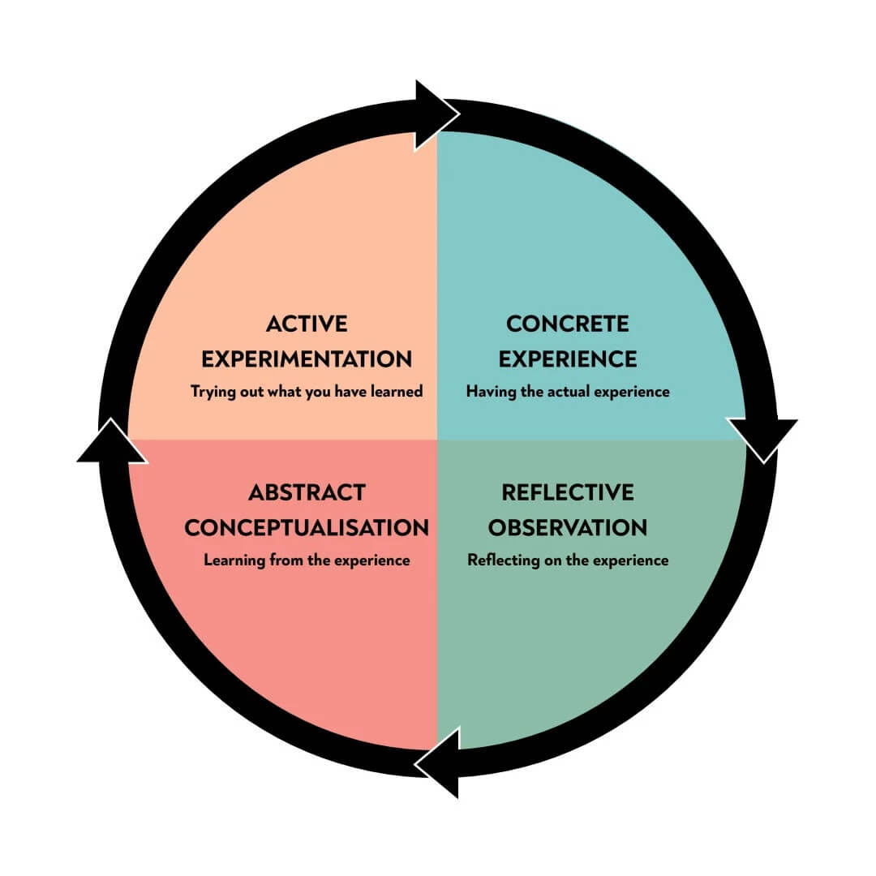

Reviving the Tradition: Leveraging Apprenticeship Models in Nursing Education –
An Integrative Literature Review
Grayson Lewis Mizlo, BSN, RN, CRRN, MSN Nurse Educator Student
Chair: Amy Putnam DNP, RN, CNE
Committee: Candice Laney, DNP, RN, CNE
INTRO / GOALS
Purpose: review literature examining nurse apprenticeship models
Evaluate apprenticeship-aligned clinical learning
Examine effects on student readiness for practice
CONCLUSIONS AND RECOMMENDATIONS
Apprenticeship-aligned education increases clinical immersion and supports earlier professional socialization and mentorship
Improved workforce readiness and reduced orientation time
Further research is needed to evaluate long-term outcomes, scalability, and the effectiveness of apprenticeship integration
Apprenticeship models may strengthen the connection between nursing education and clinical workforce preparation
ABSTRACT
Nursing education is facing clinical placement shortages and faculty limitations
Apprenticeship models are emerging as a strategy to potentially strengthen experiential learning
Integrative review evaluating the viability of nurse apprenticeship frameworks for prelicensure nursing students
Findings suggest improved clinical immersion, support transition to practice, and organizational benefits for healthcare systems.
Standardization of apprenticeship models is needed
Scalability studies are needed for full integration
Keywords: nursing education, nurse apprenticeship, experiential learning, transition to practice
METHODOLOGY
Electronic Databases
  PubMed
  Elsevier
  ResearchGate
Inclusion Criteria
  Peer-reviewed literature
  Published in English
  2013-2026
19 Articles Included
  Initial Search: 8,647 Articles
  Filtered Results: 132 Articles
  Full Text Reviewed: 132
THEORETICAL FRAMEWORK
Kolb’s Experiential Learning Theory (1984)
Benner’s Novice to Expert Theory (1984)
Credentials
Earn your license
Paid Job
Earn a wage from day one
Education
Gain knowledge from on-the-job training
THEMES / OBJECTIVES
Clinical Competency Development
Transition to Practice and Workforce Readiness
Professional Identity Formation and Belonging
Financial and Institutional Impact
Policy and Regulatory Implications
REFERENCES
References are provided on handout.
School of Nursing

