Slide 1

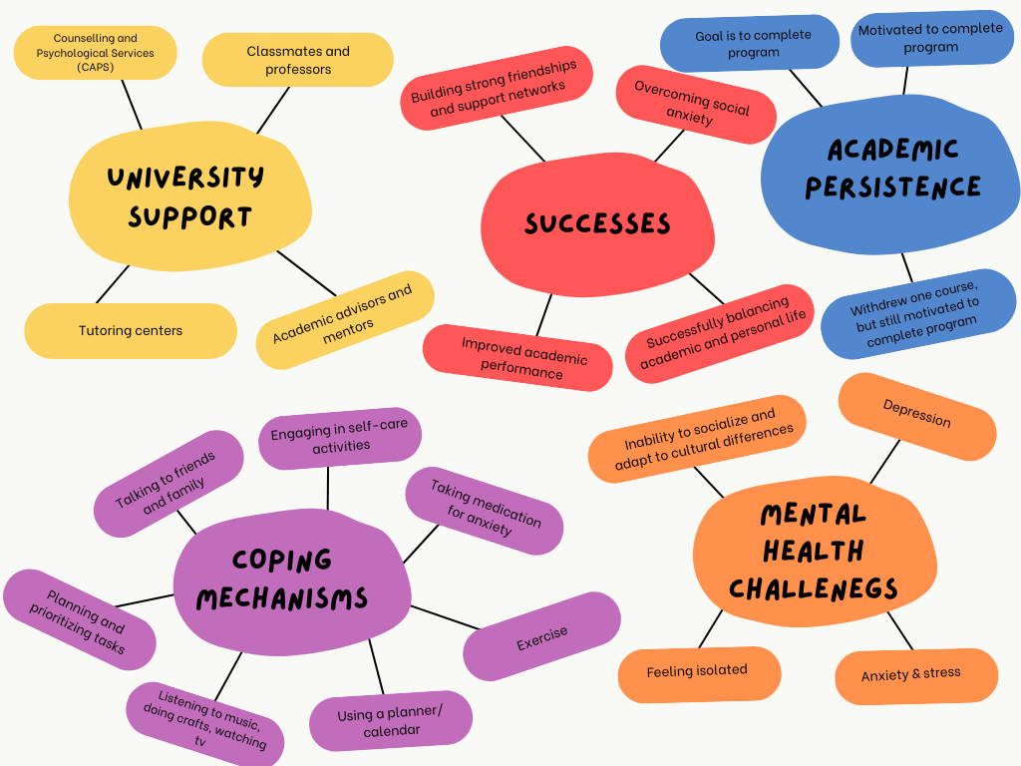
The Role of Mental Health in Shaping University Students’ Persistence: A Study on Challenges and Successes.
Henrietta Sackey
Literature Review
Introduction
Findings
Lately, a record number of students facing mental health challenges have been identified by universities (Byrd & McKinney, 2012). Mental health issues are not only caused by academic pressures, but also several variables including transitions into maturity, personal challenges, establishing and sustaining relationships and other unrelated concerns in addition to the stress of academic obligations (Rodgers & Tennison, 2009). Recognizing the relationship between psychological health and academic success is a significant step towards measuring the returns to preventing, identifying and treating these issues (Eisenberg, Golberstein, & Hunt, 2009).
According to the American College Health Association (2021), mental health issues such as anxiety, depression, academic pressure and trauma have become notable barriers to university students’ success, impacting not only their academic performances but also higher education retention rates. Mental health greatly shapes university students’ capacity to overcome challenges and succeed academically. In addition to personal and social pressures, the demands of academic life can intensify mental health issues, making it more difficult for them to succeed. The study examines the role of mental health in shaping university students' persistence, while studying their challenges and successes.
The findings reveal that mental health challenges come from both academic and social pressures. Findings also show the different coping mechanisms that participants adopt to combat mental health issues. Furthermore, the university also plays a huge role in assisting students in overcoming these challenges through support services like the Counselling and Psychological Services. Lastly, despite experiencing these psychological issues, the students still thrive and strive for success.
Discussion
Analysis
It is evidenced from the findings that mental health plays a significant role on university students’ academic persistence with stress and anxiety acting as key challenges. The results of the findings are consistent with the “whole university” strategy proposed by Hughes and Spanner (2019), which combines academic support and well-being to promote resilience. Ensuring fair access to support for all students must therefore be addressed.
Methods
To analyze the data, I used the thematic analysis. The codes produced were psychological issues, perseverance, support services, personal strategies and achievements. From these codes, five main themes were derived : mental health challenges, coping mechanisms, academic persistence, university support and successes.
To examine the role of mental health in shaping university students’ persistence, I used the qualitative method as my research design. The study was conducted in a regional comprehensive institution in the Southeastern region of the United States. I interviewed three students; one graduate student and two undergraduate students. The dialogues were audio recorded and lasted for approximately 20 minutes.
Research Questions
Implications
The results of this study highlight the need for universities to implement comprehensive support systems that combine academic, mental health, and wellness services into a cohesive structure to effectively meet the varied needs of students (Hughes & Spanner, 2019). Preventive measures, including stress management workshops, activities that promote community engagement, and wellness initiatives, are crucial for helping students build resilience and create a feeling of belonging.
How has mental health played a role in your academic journey as a university student?
What mental health challenge have you faced during your time in the university?
What are some coping mechanisms that helped you remain engaged in your studies despite these challenges?
What are some personal strategies or approaches that have helped you succeed academically despite experiencing these challenges?
Have you ever sought help from faculty members, academic advisors or the Counselling and Psychological Services in relation to your mental health? How did they support your persistence?
What successes have you had in overcoming mental health challenges ?
References
American College Health Association. (2021). National College Assessment III: Undergraduate student reference group executive summary spring 2021. American College Health Association.
Byrd, D. R., & McKinney, K. J. (2012). Individual, interpersonal, and institutional level factors associated with the mental health of college students. Journal of American College Health, 60(3), 185–193. https://doi.org/10.1080/07448481.2011.584334
Eisenberg, D., Golberstein, E., & Hunt, J. B. (2009). Mental health and academic success in college. The B.E. Journal of Economic Analysis & Policy, 9(1), Article 40. https://doi.org/10.2202/1935-1682.2191
Hughes, G. & Spanner, L. (2019). The University Mental Health Charter. Leeds: Student Minds
Rodgers, L.S., & Tennison, L.R. (2009). A preliminary assessment of adjustment disorder among First-Year College Students. Archives of Psychiatric Nursing, 23(3), 220-230.
Fig.1: Thematic findings showing the themes and subthemes
Notes:
Download more poster presentation templates from FPPT.com

