Slide 1
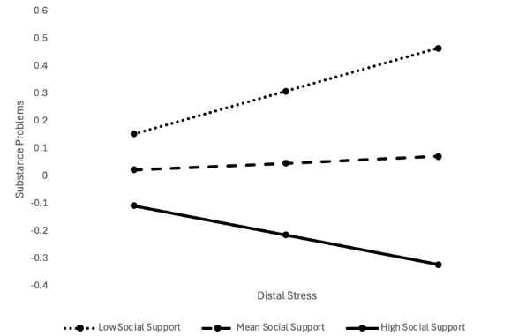
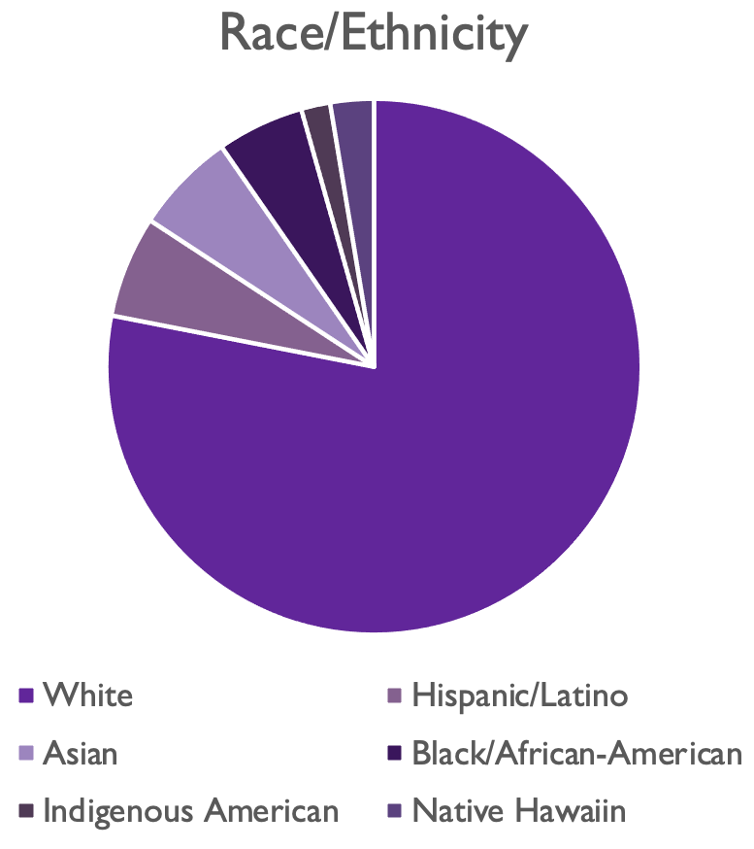
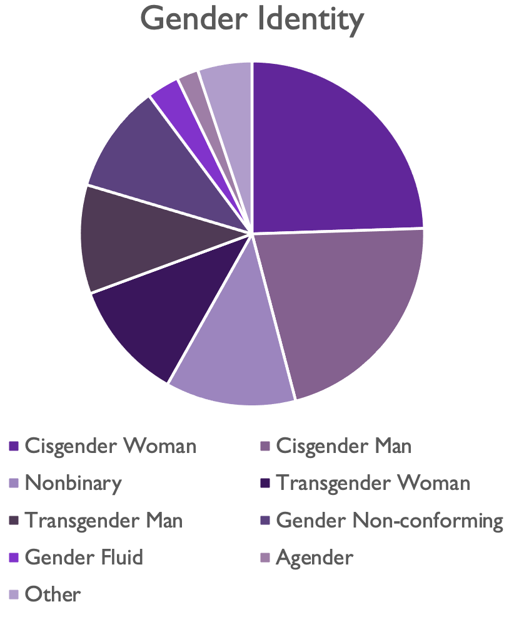
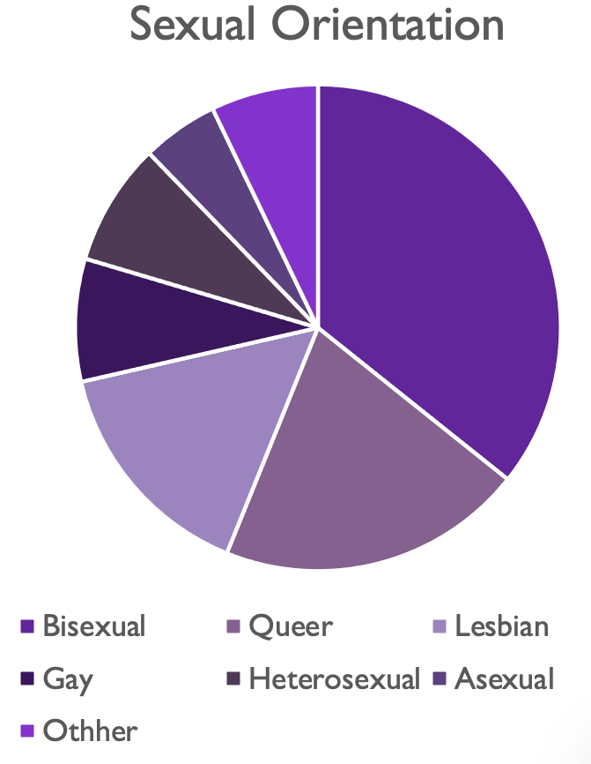

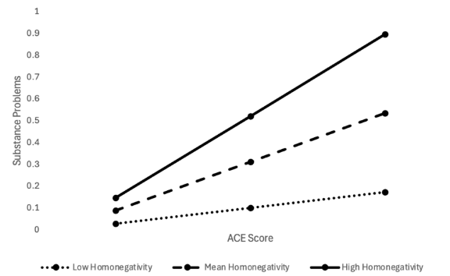
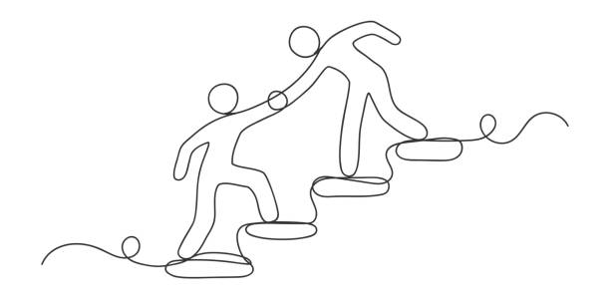
The Impact of Social Support on Substance Outcomes in Sexual Minorities
Jessica Minieri, Harrison Highshaw, & Erin Myers
---Department of Psychology, College of Education & Allied Professionals
ABSTRACT
This study examined whether perceived social support and internalized homonegativity would moderate the relationships between experienced prejudice, adverse childhood experiences (ACEs), and substance use problems in 98 sexual minority adults. Minority Stress theory was used as the guiding framework for analyzing sexual minorities (Meyer, 2003). The study found that social support marginally buffered the association between distal minority stress and substance problems. However, proximal minority stress was not found to strengthen the relationship between distal minority stress and substance problems. In contrast, proximal minority stress did significantly strengthen the relationship between ACEs and substance problems, such that greater childhood adversity was more strongly associated with substance problems at higher levels of internalized homonegativity. These findings identify functional social support as a protective factor and internalized homonegativity as a key risk factor for problematic substance use in sexual minorities. Targeting community connection and identity affirmation in treatment may represent effective intervention strategies to reduce substance-related dysfunction for sexual minorities.
INTRODUCTION
Sexual minorities experience disproportionately high rates of substance use problems relative to heterosexual populations (Dyar et al., 2023;Solberg et al., 2023). One widely supported explanation is Minority Stress Theory (Ilan H. Meyer), which states that chronic exposure to stigma, prejudice and discrimination increases psychological distress and vulnerability to maladaptive coping behaviors, like substance misuse. Minority stress operates at both distal (e.g., harassment, discrimination) and proximal (e.g., internalized shame, rejection of identity) levels, each contributing to mental health disparities.
In addition to minority-specific stressors, sexual minorities report higher rates of ACEs, including abuse and neglect. ACEs are robust predictors of later substance problems, particularly when substances are used to cope with negative emotions (Zaso et al., 2023). Importantly, research suggests that social support serves as a protective factor against stress-related psychopathology (Helgson, 2003).
This study investigates the relationships between minority stress factors, early adversity, and social relationships to clarify both risk and resilience processes contributing to differences in drug use disparities among sexual minorities.
Hypothesis I
Social support was predicted to moderate the relationship between experienced prejudice and substance use problems.
Hypothesis II
Internalized homonegativity was predicted to moderate the relationship between experienced prejudice and substance use problems.
Hypothesis III
Internalized homonegativity was predicted to moderate the relationship between ACE scores and substance use problems.
METHOD
Participants
N = 98 Sexual Minority Adults
Age Range: 18-64 years
  Participants were recruited via social media platforms (e.g., reddit) and community flyers in Western Carolina. This study was approved by the Western Carlina University IRB.
  Procedure
  Participants competed an anonymous online survey via Qualtrics assessing for minority stress, childhood adversity, social support, and substance-related outcomes.
  Measures
  Adverse Childhood Experiences Questionnaire; Tranter et al., 2021
  Sexual Minority Stressors Scale; Heron et al., 2018
  Clinical Measure of Internalized Homonegativity; Solomon et al., 2021
  Functional Social Support Questionnaire; Broadhead et al., 1988
  Short Inventory of Problems–Revised; Kiluk et al., 2013
  Substance Use Motives Measure; Biolcati & Passini, 2019
  Analytic Plan
  To test the hypotheses, moderation analyses were conducted using PROCESS Macro version 4.3 (Hayes & Little, 2018) in SPSS. In each model, coping motives for substance use and gender minority status were included as covariates to control for their potential influence on substance use outcomes.
RESULTS
Hypothesis I
The overall model was significant
F(5, 89) = 13.25, p < .001, R² = .43
Results indicated a significant interaction between experienced prejudice and functional social support (b = -.09, p = .041), suggesting moderation.
Hypothesis II
The overall model was significant
F(5, 89) = 11.40, p = < .001, R² = .39
The interaction between distal and proximal stress was not significant (b = -.03, p = .502), indicating no evidence of moderation.
Hypothesis III
The overall model was significant
F(5, 89) = 16.88, p < .001, R² = .49
Results revealed a significant interaction between ACEs and homonegativity (b = .04, p = .004), indicating moderation.
DISCUSSION
Clinical Implications
Due to the significant moderating effect of social support on substance problems for sexual minorities experiencing external prejudice, improving access to social resources may be a valid target of intervention for those exposed to distal minority stress. It is possible that reducing levels of internalized homonegativity could protect against substance problems, specifically for those with a history of childhood trauma. Therefore, internalized homonegativity should be considered a relevant treatment target for sexual minorities.
Limitations & Future Directions
Limited Racial Diversity: The sample was primarily white (90%), limiting generalizability to racially diverse sexual minority populations and intersectional identities.
Recruitment from affirming spaces: Participants were largely recruited from LGBTQ-affirming platforms, which may have resulted in lower levels of internalized homonegativity than in the broader population.
Cross-sectional design: Because data was collected at one time point, causal direction cannot be determined
Self-report measures: Responses may be influenced by recall bias or social desirability
Future research should examine these processes longitudinally to clarify possible causal relationships between minority stress, internalized homonegativity, ACEs, and substance use outcomes. Additionally, studies should differentiate sexual and gender minority experiences rather than grouping them together.
References
Biolcati, R., & Passini, S. (2019). Development of the Substance Use Motives Measure (SUMM): A comprehensive eight-factor model for alcohol/drugs consumption. Addictive Behaviors Reports, 10, 100199. https://doi.org/10.1016/j.abrep.2019.100199
Broadhead, W. E., Gehlbach, S. H., de Gruy, F. V., & Kaplan, B. H. (1988). The Duke–UNC Functional Social Support Questionnaire: Measurement of social support in family medicine patients. Medical Care, 26(7), 709–723.
Dyar, C., Lee, C. M., Rhew, I. C., & Kaysen, D. (2023). Sexual minority stress and substance use: An investigation of when and under what circumstances minority stress predicts alcohol and cannabis use. Journal of Psychopathology and Clinical Science, 132(4), 475–489. https://doi.org/10.1037/abn0000819
Hayes, A. F., & Little, T. D. (2018). Introduction to mediation, moderation, and conditional process analysis: A regression-based approach (2nd ed.). Guilford Press.
Helgeson, V. S. (2003). Social support and quality of life. Quality of Life Research, 12(Suppl 1), 25–31.
Heron, K. E., Braitman, A. L., Lewis, R. J., Shappie, A. T., & Hitson, P. T. (2018). Measuring sexual minority stressors in lesbian women’s daily lives: Initial scale development. Psychology of Sexual Orientation and Gender Diversity, 5(3), 387–395.
Kiluk, B. D., Dreifuss, J. A., Weiss, R. D., Morgenstern, J., & Carroll, K. M. (2013). The Short Inventory of Problems–Revised (SIP-R).
Meyer, I. H. (2003). Prejudice, social stress, and mental health in lesbian, gay, and bisexual populations: Conceptual issues and research evidence. Psychological Bulletin, 129(5), 674– 697.
Solberg, M. A., Blair, L. M., Schlegel, E. C., & Kurzer, J. A. M. J. (2023). Health disparities among sexual and gender minorities with adverse childhood experiences. American Journal of Public Health, 113(12), 1343–1351.
Solomon, D. T., Morey, K. E., Williams, C. J., Grist, C. L., & Malesky, L. A. (2021). Internalized stigma and health behaviors in a sexual minority sample. Psychology of Sexual Orientation and Gender Diversity, 8(2), 159–171.
Tranter, H., Brooks, M., & Khan, R. (2021). Adverse Childhood Experiences Questionnaire— Amended Version. PsycTESTS.
Zaso, M. J., Read, J. P., & Colder, C. R. (2023). Coping-motivated escalations in adolescent alcohol problems following early adversity. Psychology of Addictive Behaviors, 37(2), 331– 340. https://doi.org/10.1037/adb0000788

