Slide 1


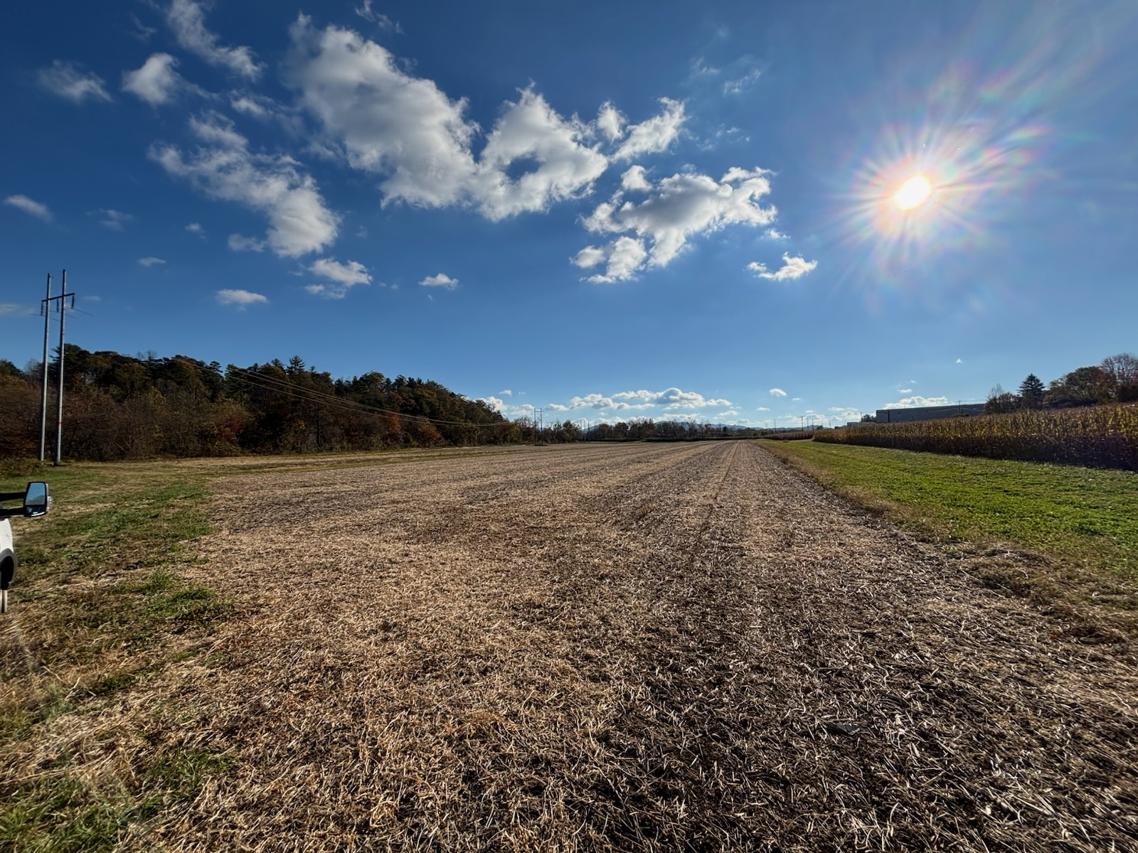



The Dynamic Virome: A Temporal Analysis of Viral Community Structure and Function Surrounding a Staple Crop
Jorryn Cooper
Introduction
Objectives
Expectations
Soil microbiota participate in biogeochemical cycling, playing a crucial role in providing bioavailable nutrients to plants¹. The relationship is dynamic, as plants secrete root exudates which promote the growth of microorganisms specific to the needs of their current developmental stage²⁻⁶. Soil viruses can alter the activities of their microbial hosts, upregulating processes related to C, N, O, P metabolism through auxiliary metabolic genes⁷⁻¹⁰. Thus, it is possible we are underestimating the ecological impact of viruses, especially in terms of plant health and growth. Of particular human interest is how this plant-microbe-virus interaction plays out in agricultural soils.
Aim 1. To characterize the changes in microbial community composition and diversity in rhizosphere throughout the life cycle of a soybean, including fungi, bacteria, and archaea.
Aim 2. To characterize the changes in viral community composition and diversity in the rhizosphere throughout the life cycle of a soybean.
Aim 3. To characterize the changes in present and/or active auxiliary metabolic genes are present in the rhizosphere throughout the life cycle of a soybean, paying particular attention to those related to biogeochemical cycling or other proteins which may impact plant health.
An AMG is any gene originating from a virus which is not directly involved in viral metabolism. These genes are usually obtained from a host via horizontal gene transfer¹². Previous research has demonstrated that certain AMGs can upregulate these host-derived genes, including those related to biogeochemical cycling⁷⁻¹⁰. Given that the microbiome of the rhizosphere is dynamic throughout a soybean’s life cycle¹³, and the composition of the viral community is dependent on their hosts⁷, I expect to see a dynamic viral population expressing diverse AMGs with differential expression based on the reproductive stage they were obtained during.
Methods
Soil samples will be collected at four different developmental stages to represent the dynamic nature of the soil microbiome throughout a soybean’s life cycle.
Samples will then be sent for both DNA and RNA extraction to attempt to isolate the genomes of any RNA viruses present, as well as identify which AMGs are being actively transcribed.
Once metagenomic sequencing is complete, the bioinformatics platform KBase will be used for genome annotation, identification of viral OTUs, identification and annotation of AMGs, viral lifestyle prediction, and host matching.
Acknowledgements
Soybeans were chosen as a model organism for this study due to their well characterized relationship with nitrogen fixing rhizobia¹³, as well as their importance as a staple crop. Cultivated soil
was collected
from a recently
harvested field
at MHREC* and
set aside for
potting.
Dr. Sean O’Connell
Dr. Andre Velasquez
Dr. Maria Gainey
*Mountain Horticultural Crops Research and Extension Center
Western Carolina University Graduate School and Office of the
Provost
Please scan the QR code for a list of references

