Slide 1



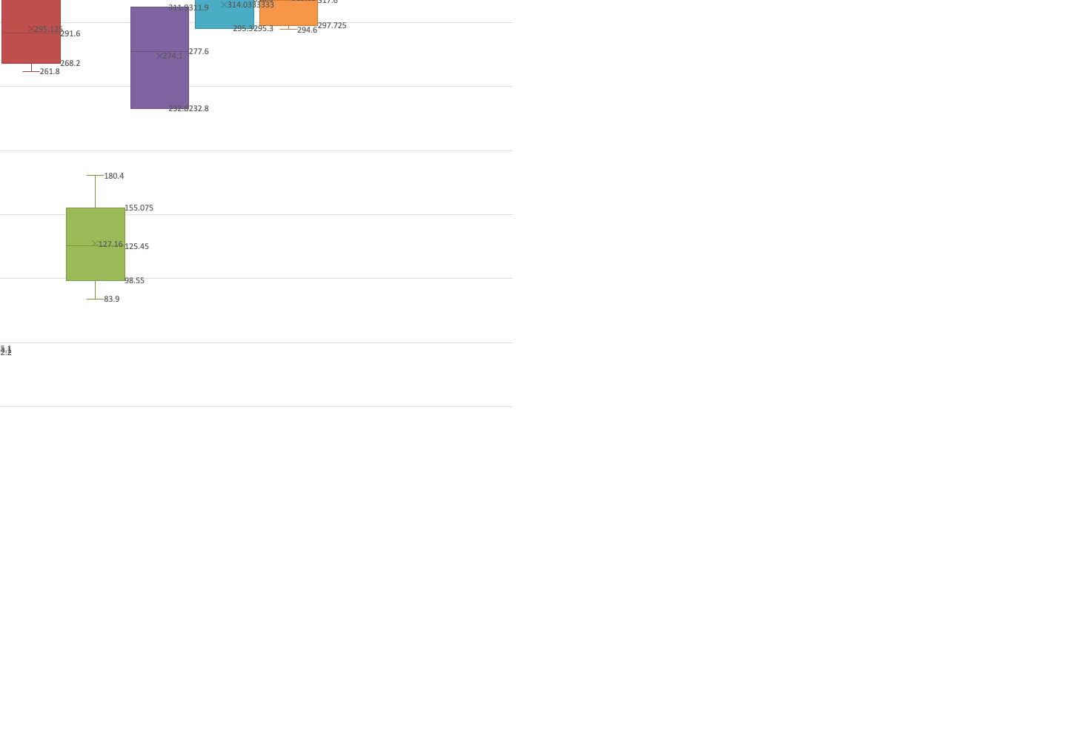

Optimization of Isolation Protocols for Plasmids that Code for an Autophagy Protein LC3 Using the Invitrogen Mini-Prep Kit
Kiera Grandell & Heather Coan
Department of Biology, Western Carolina University
ABSTRACT
pBABE-puro mCherry-EGFP-LC3B is a plasmid that codes for an LC3 protein used to facilitate degradation of biological macromolecules and organelles by autophagy. As a large plasmid, LC3 is notoriously difficult to isolate often resulting in small and less pure yields in the laboratory using the Invitrogen™ PureLink™ Quick Plasmid Miniprep Kit. LC3 was ran multiple times under different plate ages and inoculation times to determine which set of variables produces the highest yields to reduce the need for multiple plasmid vials in experiments utilizing LC3. Patterns show that plasmid yield increases directly with inoculation time and slightly inversely with bacterial plate age. Further study is needed to determine how the results with LC3 would apply to plasmids of different sizes.
OBJECTIVES
In the lab, LC3 has shown inconsistent plasmid yields when isolated using the Invitrogen™ PureLink™ Quick Plasmid Miniprep Kit. The goal of this study was to test a series of parameters to find an ideal set of variables to maximize the yield from each isolation.
The variables that were tested in this study were the age of the bacterial plate used in the inoculations and the length of time the inoculation vials spent in the shaker.
RESULTS
Inoculation time has a major effect on isolation yield, with major increases beginning around minute 1340 (22 hours 20 minutes) (Figures 1 & 2). There was a drop in yield from data at minutes 1305 which may indicate external errors in the procedure at that time, likely a buffer that was past expiration, when compared with the data from the surrounding groups.
The data shows no significant effect by the age of plate on isolation yield, though there appears to be a minor trend downwards after several days and the one-week time point (Figures 3, 4, & 5)
Based on a minimum recommended yield of 60 ng/uL, the minimum time recommended for inoculation would be 720 minutes or 12 hours. Recommended time for inoculation is 1320-1440 minutes or 22-24 hours.
CONCLUSIONS AND RECOMMENDATIONS
The data shows no significant effect by the age of plate on isolation yield, though there appears to be a minor trend downwards after several days or the one-week mark.
Inoculation time has a major effect on isolation yield, with major increases beginning around minute 1340 (22 hours 20 minutes) according to the data. There was a drop in yield from data at minutes 1305 which may indicate external errors in the procedure at that time, likely a buffer that was past expiration, when compared with the data from the surrounding groups.
Based on a minimum recommended yield of 60 ng/uL, the minimum time recommended for inoculation would be 720 minutes or 12 hours. Recommended time for inoculation is 1320-1440 minutes or 22-24 hours.
Further research would focus on finding a maximum recommended inoculation time, when the yield plateaus or begins to trend down. Research could also be applied to plasmids of other sizes to see if trends continue or plasmids could be compared that have the same vs different antibiotic resistances to see if that effects yield or the inoculation time required.
While these experiments can give us some general guidelines to follow when isolation plasmids, more carefully controlled experiments could better inform the study. For example, the size of the bacterial colony that was inoculated for growth might impact isolation yield. Also, the inoculations could have been measured for bacterial concentration prior to isolation, so that bacterial grown could be used to control for plasmid isolation.
In conclusion, this study sets some general parameters for the lab to use when isolating LC3 plasmids for use, but further study is needed to refine method recommendations.
Figure 1. Inoculation time impacts plasmid yield. Inoculation time is shown in minutes, and plasmid yield is shown in ng/uL. All measurements were taken one day old plates.
METHODS
Preparation for the study included creating plates to be streaked with the LC3 culture- a mixture of nutrient broth, agar, and ampicillin- and nutrient broth for the inoculations
The full procedure is a three-day process of streaking plates, creating inoculations, and then performing the isolations.
On day one, a plate was quadrant streaked with LC3 from stock and left to incubate for 24 hours at 30°C
On day two, the plate is removed from the incubator, and 3-6 inoculation vials are made from that plate and a plate from the weeks previous with 5mL of nutrient broth each time. The inoculations are placed into a heated shaker, and an alarm is set for their removal and isolation the next day
On day three the inoculations are removed and the plasmids are isolated following the protocol for the miniprep kit. The resuspension buffer and spin columns are kept on ice during the process, and the optional wash (w10) is included every time.
Figure 2. Inoculation time impacts plasmid yield. Inoculation time is shown in minutes, and plasmid yield is shown in ng/uL. All measurements are taken in 6-8 days plates.
Figure 4. The age of the plate does not appear to impact isolation yields. Age of plate is shown in days, and plasmid yield is shown in ng/uL. Inoculations were timed to be consistent, and all occurred between 1340-1400 minutes.
References
1. N’Diaye EN;Kajihara KK;Hsieh I;Morisaki H;Debnath J;Brown EJ;, E.-N., Kajihara, K. K., Hsieh, I., Morisaki, H., Debnath, J., & Brown, E. J. (n.d.). PLIC proteins or ubiquilins regulate autophagy-dependent cell survival during nutrient starvation. EMBO reports. https://pubmed.ncbi.nlm.nih.gov/19148225/ .
PBABE-puro mcherry-EGFP-LC3B (plasmid #22418). Addgene. (n.d.). https://www.addgene.org/22418/
PureLinkTM quick Plasmid Miniprep Kit - User Guide. (n.d.). https://documents.thermofisher.com/TFS-Assets/LSG/manuals/purelink_quick_plasmid_qrc.pdf
Acknowledgements
Thank you to the NSF LSAMP program for funding to complete this project and to the Biology Department and College of Arts and Sciences for equipment and lab support.
Figure 3. The age of the plate does not appear to impact plasmid yield, but the large variance observed in 1-day old plates may be due to error and results are inconclusive. Age of plate is shown in days, and plasmid yield is shown in ng/uL. Inoculations were timed to be consistent, and all occurred between 1279-1339 minutes.
Figure 5. The age of the plate does not appear to impact isolation yields. Age of plate is shown in days, and plasmid yield is shown in ng/uL. Inoculations were timed to be consistent, and all occurred at or above 1400+ minutes.
Department of Biology, College of Arts and Sciences

