Slide 1
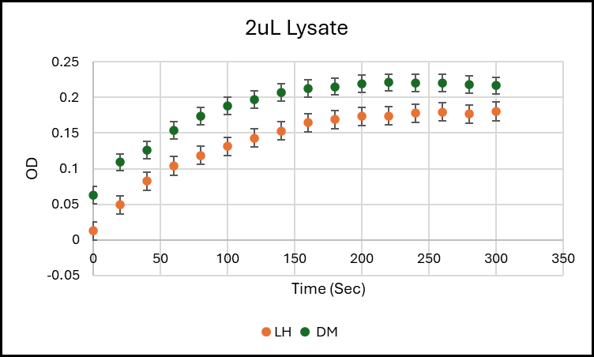
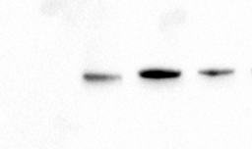
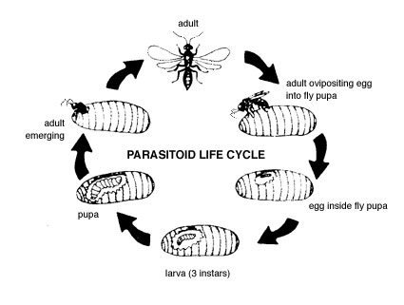
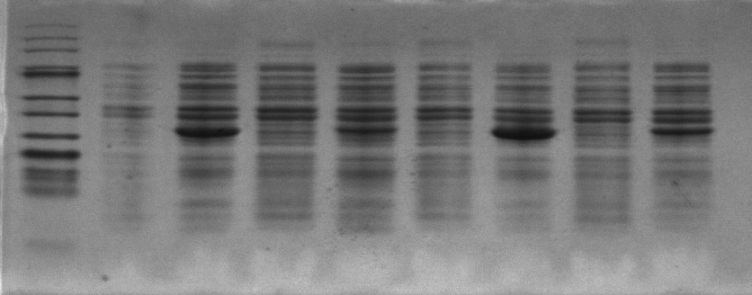
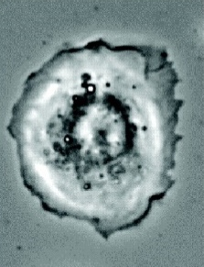
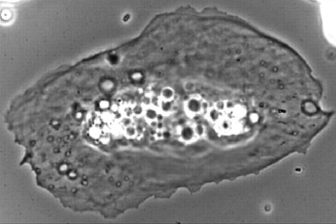
The expression and characterization of glyceraldehyde-3-phosphate dehydrogenase found in parasitoid wasp venom
Kaela Bernecky
Department of Biology at Western Carolina University
INTRODUCTION
EXPRESSION OF A PUTATIVE WASP VENOM ENZYME
ASSAY OF ENZYME ACTIVITY
Hymenoptera are a large group of insects that include the parasitoid wasps. Many of these wasps reproduce by laying eggs inside the larvae of hosts. The wasps Leptopilina heterotoma, L. boulardi, and Ganaspis hookeri are parasitoid wasps that lay their eggs in the larvae of the fruit fly, Drosophila melanogaster. As the parasitoid wasps use their ovipositors to inject their egg into the body of the fruit fly larva, the larvae fight back by trying to encapsulate the egg with cells called lamellocytes that help in the production of melanin. Melanin is a very hard substance that inhibits the wasp eggs from hatching. Wasp-injected venom proteins are thought to reduce this inhibition by preventing lamellocytes differentiation.
T7 promoter
GAPDH
HIS₆
T7 terminator
D. mel
L. het
LIFE CYCLE OF A PARASITOID WASP
-
30ug
30ug
20ug
Recombinant pET plasmid GAPDH
The putative glyceraldehyde 3-phosphate dehydrogenase enzymes were cloned into pET expression vectors with an in-frame His₆-tag at the C-terminus. The plasmids were transformed into E. coli lysY cells and protein production was induced by 0.4mM IPTG treatment.
Figure 4b. Western blot to normalize the GAPDH protein in D. mel and L. het lysates. ImageJ was used to analyze the images to determine an estimate of GAPDH per sample.
STUDYING A VENOM PROTEIN
D. mel
L. het
L. bou
G. hoo
Figure 4a. GAPDH activity in lysates from D. melanogaster and L. heterotoma expressing the recombinant protein (background subtracted). The total concentration of the D. melanogaster (DM) lysate used was 0.5 mg/mL. The activity of GAPDH is determined by measuring the formation of NADH at 340nm light using the formula G3P + GAPDH+ NAD⁺ → 1,3-BPG + NADH.
0h
7h
0h
7h
0h
7h
0h
7h
Inoculate pET plasmid into lysY cells
D. mel
L. het
L. bou
G. hoo
In this project, a putative glycolytic enzyme glyceraldehyde 3-phosphate dehydrogenase (GAPDH), found in wasp venom is being studied. The gene for GAPDH from the three parasitoid wasps were cloned and their expression in E. coli cells were optimized in Luria-Bertani (LB) vs. autoinduction media. It was found that the E. coli lysY cells gave better and more controlled expression of the proteins in LB when induced with the lactose analog, IPTG, than the commonly used BL21(DE3) cells. Preliminary results show that lysates from bacterial cells expressing the enzyme have measurable GAPDH activity. In addition, the expressed proteins contain a His₆-tag, that will be purified on Ni-columns, and the characteristics of the purified protein will also be studied.
Induce protein with IPTG
CONCLUSIONS
• Genes for the putative GAPDH homologs from three different parasitoid wasp venoms, as well as the reference organism (D. melanogaster) have been cloned into pET plasmids.
• Expression of the four proteins have been tested under various conditions and induction with IPTG for 7 h from lysY cells have shown the most promising results.
• Activity assay with lysates from these strains have detectable GAPDH activity and can form the basis for further enzyme characterization.
Lyse cells with Gold bio lysis buffer + lysozyme
Figure 2. Protein profiles of uninduced (0h) and induced (7h) samples for the species Drosophila melanogaster, Leptopilina heterotoma, Leptopilina boulardi, and Ganaspis hookeri. Protein concentrations were calculated and 30 ng total lysate was run on SDS-PAGE and stained by Coomassie blue. GAPDH is 38 kDa in size and is indicated by the arrow. The uninduced samples did not produce GAPDH as expected. A Western blot was performed to confirm the identity of GAPDH.
Run BCA to determine protein concentration
FUTURE RESEARCH
CELLULAR IMMUNE RESPONSE TO PARASITOID INFECTION
Run Western blot
• To study the enzyme kinetics of the purified enzyme, the His₆-tagged protein will be pulled down using a nickel column.
• Inhibitor studies will be performed using the competitive inhibitor oxamic acid.
• Optimizing the expression of other GAPDH homologs will be undertaken.
Plasmatocytes
Activity assay
REFERENCES
D. mel
L. het
L. bou
G. hoo
G. R. Burke and B. J. Sharanowski, “Parasitoid wasps,” Current Biology, vol. 34, no. 10, pp. R483–R488, May 2024, doi: 10.1016/j.cub.2024.03.038.
J. Goecks, N. Mortimer, J. Mobley, G. Bowersock, J. Taylor, and T. Schlenke, “Integrative Approach Reveals Composition of Parasitoid Wasp Venom,” PLOS One, vol. 8, no. 5, pp. 1–14, May 2013, doi: 10.1371/journal.pone.0064125.
M. Kazek et al., “Glucose and trehalose metabolism through the cyclic pentose phosphate pathway shapes pathogen resistance and host protection in Drosophila,” PLoS Biol, vol. 22, no. 5, p. e3002299, May 2024, doi: 10.1371/journal.pbio.3002299.
M. Quicray, L. Wilhelm, T. Enriquez, S. He, M. Scheifler, and B. Visser, “The Drosophila ‐parasitizing wasp Leptopilina heterotoma : A comprehensive model system in ecology and evolution,” Ecology and Evolution, vol. 13, no. 1, p. e9625, Jan. 2023, doi: 10.1002/ece3.9625.
B. Wey, M. E. Heavner, K. T. Wittmeyer, T. Briese, K. R. Hopper, and S. Govind, “Immune Suppressive Extracellular Vesicle Proteins of Leptopilina heterotoma Are Encoded in the Wasp Genome,” G3 G
Figure 3. Western blot of the samples from Figure 1 with anti-His₆ antibody. This shows that the cultures induced for 7 h express the GAPDH protein of the correct size. Since the His6 tag is at the C-terminal of the protein, this also shows that the full-length, undegraded protein is present in the supernatant.
0h
7h
0h
7h
0h
7h
0h
7h
Lamelloyctes
Mortimer, unpublished
Figure 1. Schematic of the immune response of fruitfly larvae to infection by parasitoid wasps.
ACKNOWLEDGEMENTS
As the fruitfly larvae develop an immune response, the parasitoid wasps are hypothesized to counteract this response via injected venom proteins.
I would like to acknowledge my advisor Dr. Indrani Bose and my committee Dr. Amanda Storm and Dr. Robert Youker, as well as the WCU Department of Biology for funds and equipment.
I would also like to acknowledge Dr. Nate Mortimer for information about the background on this research project and Dr, Lindsey Long for her help with some of the protocols

