Slide 1
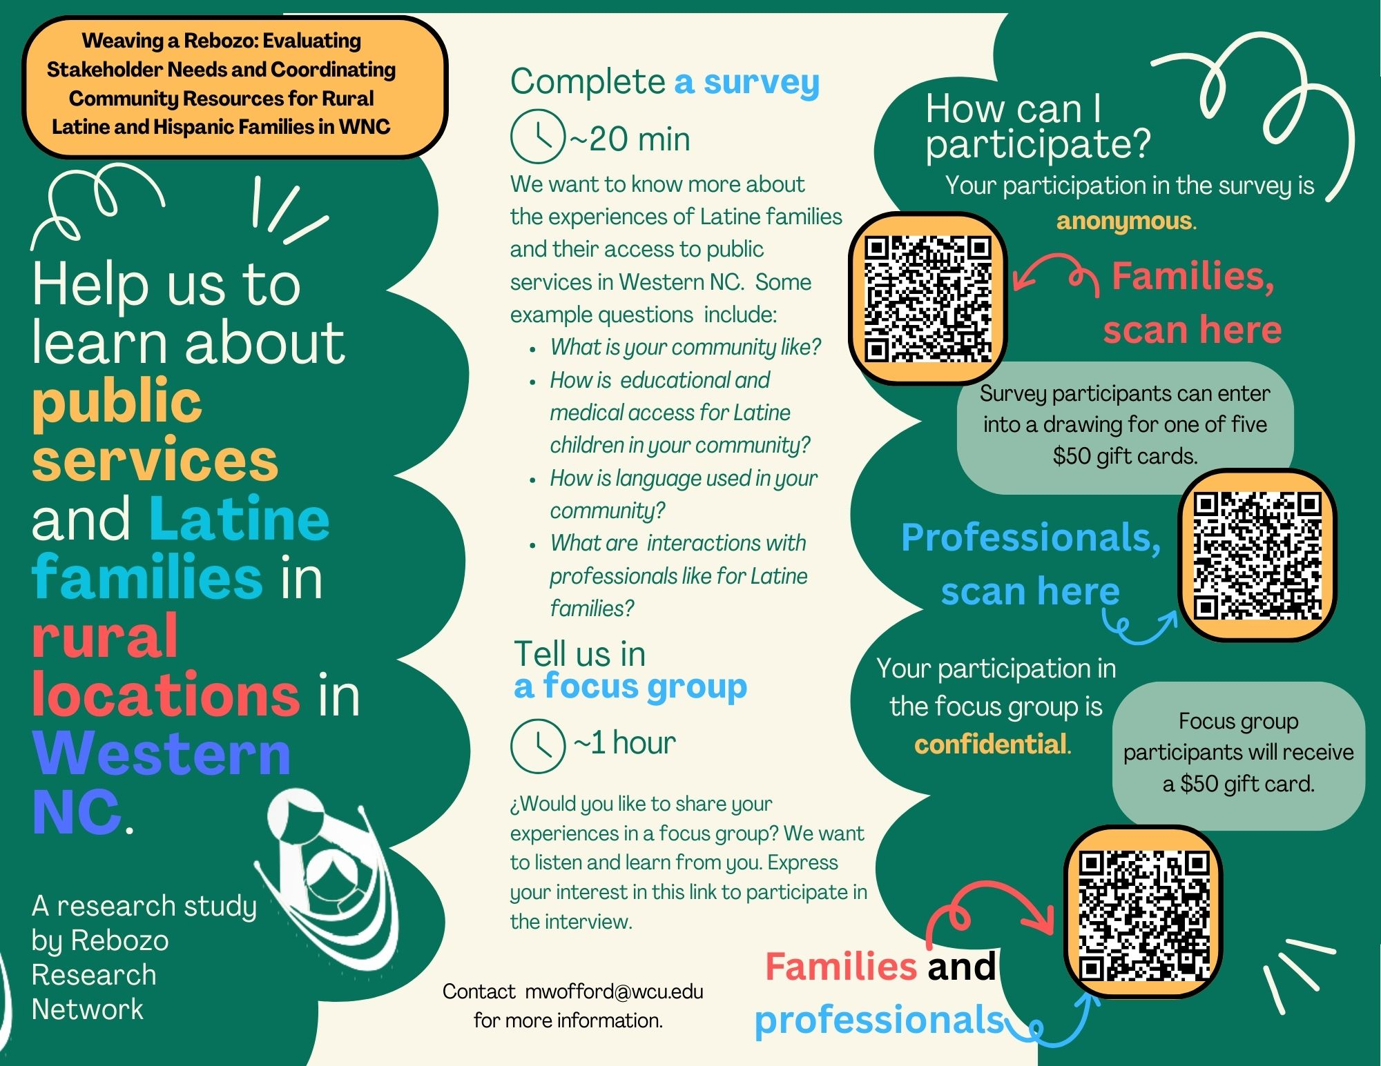
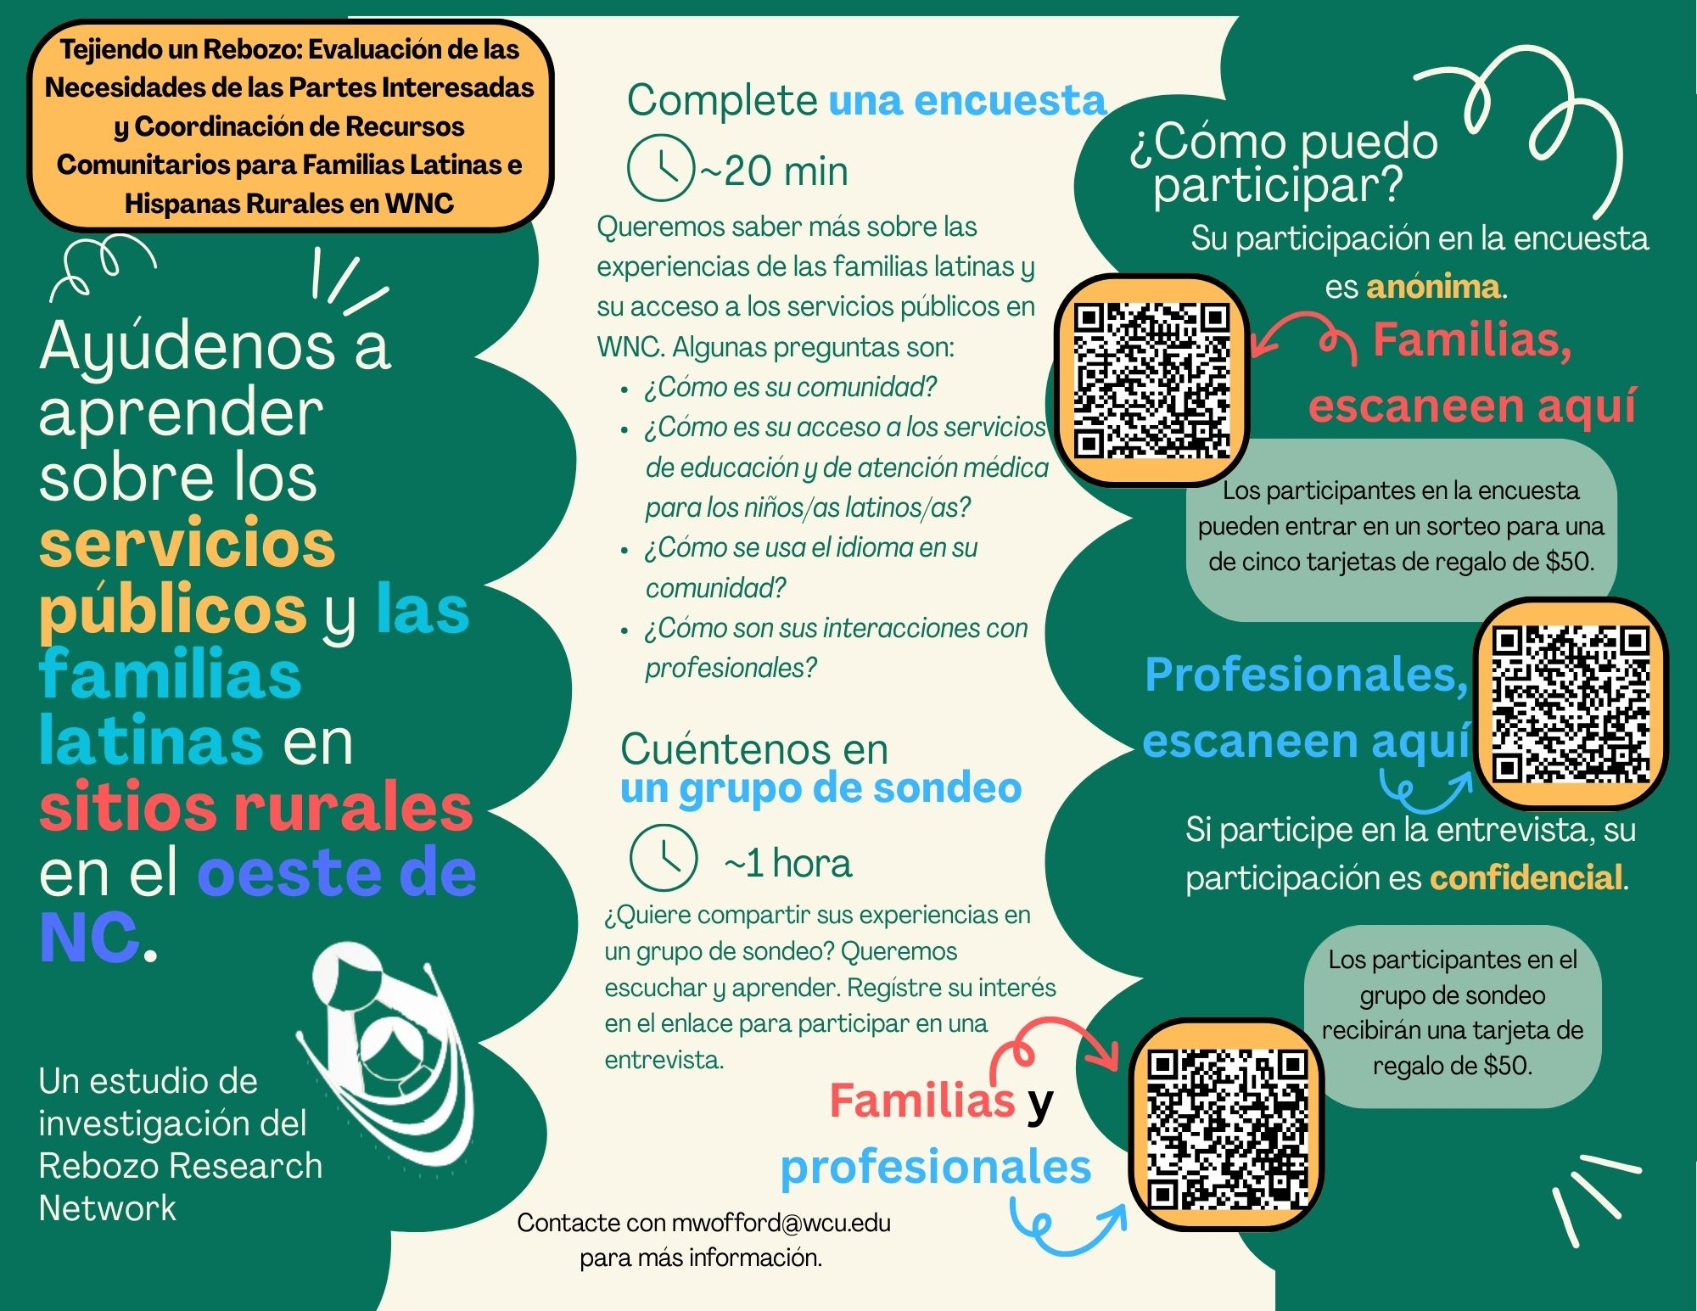
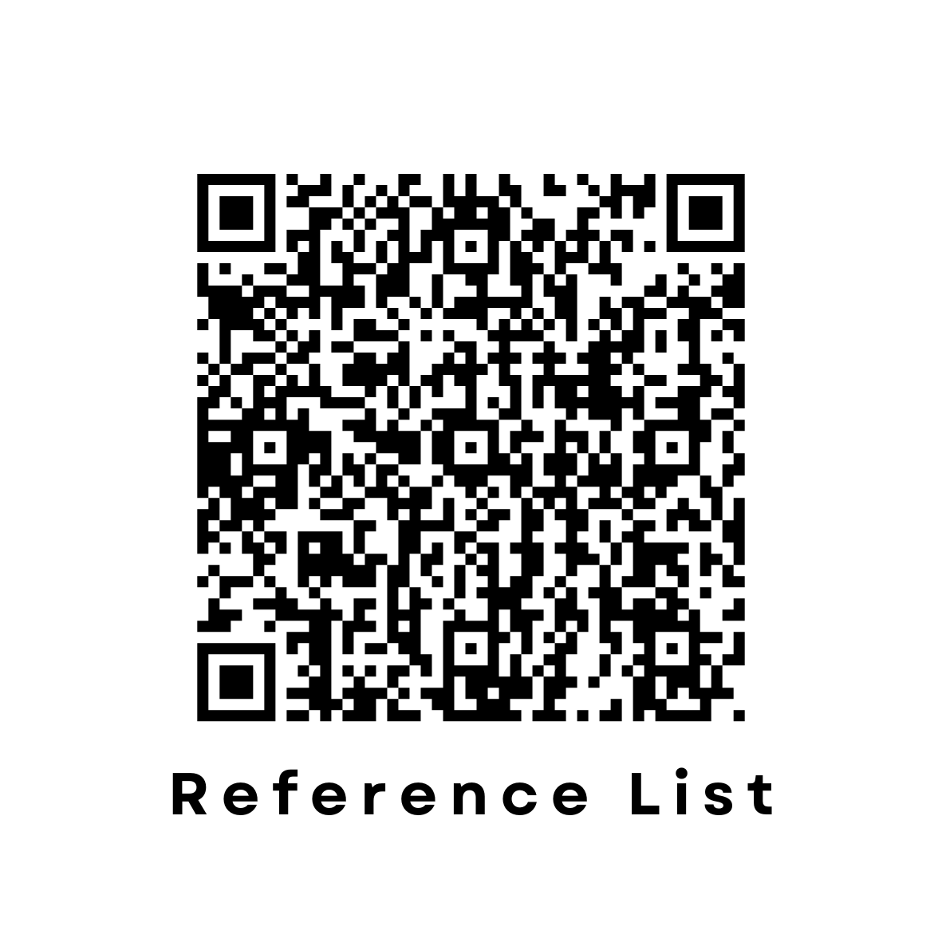


Weaving a Rebozo: Evaluating Stakeholder Needs and Coordinating Community Resources for Rural Latine and Hispanic Families in Western North Carolina
Kelci Owen – MAED School Counseling Student | Cielo Vera – BS Psychology Student | Antonia Wielandt – BS Psychology Student
Interdepartmental work funded by 2025 Provost Scholarship Development Award
Faculty support: Dr. Melissa Mecadon-Mann, Department of Human Services, Counseling Program
INTRODUCTION
The Rebozo Research Network has developed from our shared interests in interdisciplinary collaborations for supporting the clinical, educational, mental health, and psychological needs of bilingual Latine families, children, and adolescents in and around Jackson County, NC.
Specifically, we hail from Counseling, TESOL/Linguistics, Communication Sciences and Disorders, Early Childhood Education, and Psychology. We consider ourselves to have identities and allyship as multilingual practitioners and researchers in these fields.
Across our disciplines, we see that rural Latine groups face different challenges than those living in urban contexts (Figuerora et al., 2021; Francis et al., 2019; Stone et al., 2019).
Access to transportation
Systems that had difficulty retaining highly trained personnel
Inadequate language assistance services
Higher rates of poverty
90% of rural public school staff are monolingual and non-Hispanic White (de Brey et al., 2019). This highlights the important role that multilingual, multicultural, multiracial, and allied staff may play in brokering services for Latine and Hispanic families. Research shows that multilingual school staff can effectively serve as "brokers" for Hispanic families during health and school-system interactions (Campbell-Montevalo & Castañeda, 2019).
Medical settings where children and families most often receive developmental, psychological, mental, or basic healthcare guidance may be less responsive to families with limited English proficiency. This is due to a lack of bilingual providers or effective interpretation (Avila & Bramlett, 2013; Flores et al., 2005).
Families who experience language-matching to their children's teachers and service providers perceive fewer cultural and relational barriers to family engagement (Li et al., 2024).
Culturally and linguistically responsive school counselors, speech language pathologists, and other allied health and mental health personnel are essential to student's academic and social wellbeing (González-Rosario & Gibbons, 2024; Tuttle et al., 2022).
Hence, our interdisciplinary approach to collaborating among our disciplines in health, human services, and education/allied professions are essential for supporting rural Latine families, especially in Appalachian juvenile populations.
Fittingly, a rebozo is a long shawl worn by mothers of diverse Latine heritages. It is used as a physical support for pregnant and perinatal mothers. Our group gleans inspiration from this culturally significant item as we too seek to support Latine families in our community.
In 2025, Rebozo was granted a Provost Scholarship Development Award which funded a community-based participatory research project. The primary goal of this project was to develop a community landscape survey to better understand the experiences of families in our rural communities as the access different human services for their children. IRB approval was obtained prior to collection of any data.
TRANSPORTATION
Long distances
INTERPRETATION & TRANSLATION
Reliance on bilingual staff who aren't certified employers
COMMUNICATION
Unstable phone access/limited cell service
LANGUAGE-APPROPRIATE MATERIALS
Forms sent home in both English and Spanish
ACCESS TO MULTILINGUAL PROFESSIONALS
Shortage of Spanish-speaking professionals
ACCESS TO CULTURALLY-APPROPRIATE CARE
Trust through rapport-building
ACCESS TO HEALTHCARE
High cost
EDUCATION
Access to free public education
FINANCIAL
Limited access to insurance benefits
STRENGTHS
Community networks & resources
Lack of public transportation
Fear/avoidance of driving
Live interpreters are more effective than automated
Availability of interpretation services
Risk of poor interpretation
Concerns with confidentiality and privacy
Availability of WiFi
Overreliance on technology
Do no answer unrecognized phone numbers
WhatsApp helps, does not use data, only WiFi
Some parents aren't fluent readers
ESL teachers provide broader support
Higher burnout in bilingual workers
Fear linked to immigration status
Greater trust in organizations led by Latine leadership
Limited insurance access
Telehealth limitations
Lack of knowledge on how to access healthcare
Fear/avoidance of attending appointments
Stigma around mental health in Hispanic culture
Schools accept alternative documents when official records are unavailable
Rigid school policies
Schools accept everyone regardless of immigration status
Costs preventing healthcare access
Reliance on private donations to fund services
Teachers, ESL staff, Bilingual staff
Relationship-centered care
Using word-of-mouth to spread information
Inability to be included/help with child's school
Lack of employment opportunities
High expectations for their children
High resilience levels and self-advocacy
Need for translated textbooks in schools
English and GED classes at community center and/or community college
Sports provide connection for kids and families
SURVEY DEVELOPMENT & DISTRIBUTION
Based on our findings, Rebozo developed two surveys: one for families to complete and one for professionals to complete. Additionally, we created a script to use for focus group meetings with both families and professionals. We are currently collecting survey responses and hosting focus groups. Student interpreters are present at focus group meetings.
Survey and focus group results will be utilized to facilitate further community supports for Spanish-speaking families in rural Western North Carolina.
Rebozo members plan to create and distribute informational materials (infographics, handouts, presentations, social media posts) to support Spanish-speaking families in their specific field of study.
ADVISORY BOARD MEETINGS
Rebozo collaborated to create a list of professionals and organizations in the region that serve Latine children and families. Three advisory board meetings were held across July and August of 2025. Advisory board meetings followed a SWOT format: Strengths, Weaknesses, Opportunities, Threats. Meetings were held in both English and Spanish.
ADVISORY BOARD MEMBERS
Non-profit organizations
WCU Students
Media
Educators
Healthcare Professionals
Community Centers
Medical & Behavioral Health
SLPs
ESOL Teachers
EC Teachers
Behavioral Health
SLPs
Medical Translators
TRANSCRIPTION & THEMATIC ANALYSIS
Transcriptions were downloaded and first reviewed by Rebozo faculty.
Three students were brought onto the project for cross-referencing.
Students reviewed transcripts individually to identify patterns and recurring ideas.
Collaboratively identified 10 themes: Transportation, Interpretation & Translation, Communication, Language-Appropriate Materials, Access to Multilingual Professionals, Access to Culturally-Appropriate Care, Access to Healthcare, Education, Financial, and Strengths.
The Rebozo Research Network:
Mary Claire Wofford, Ph. D., CCC-SLP, Associate Professor of Communication Sciences & Disorders
Alleyne Broomell, Ph. D., Assistant Professor of Psychology
Erin Callahan, Ph.D, Associate Professor of English
Loidaly González-Rosario, Ph. D., LCMHC-A, DeColores Family Wellness
Melissa Mecadon-Mann, Ph. D., LPC, Assistant Professor of Counseling
Sarah Pedonti, Ph. D., Assistant Professor of Birth-Kindergarten Education
Nancy Valverde, Ph.D., LCMHC-A, Assistant Professor of Counseling
Student Support (Research Assistants, Language Support, Survey Dissemination):
Aaliyah Duncan
Sofia Fernandez Rojas
Isaias Maldonado-Figueroa
Daniel McCall
Alejandra Montoaya
Lindsey Morgan
Kelci Owen
Rebecca Pechmann
Sheyla Rodriguez Macario
Allem Rojas
Cielo Vera
Antonia Wielandt

