Slide 1
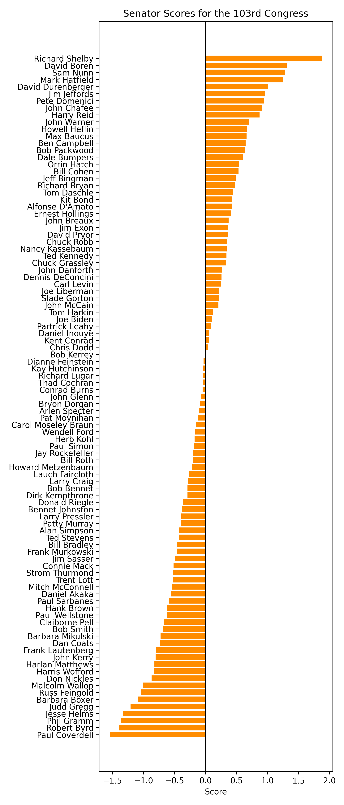
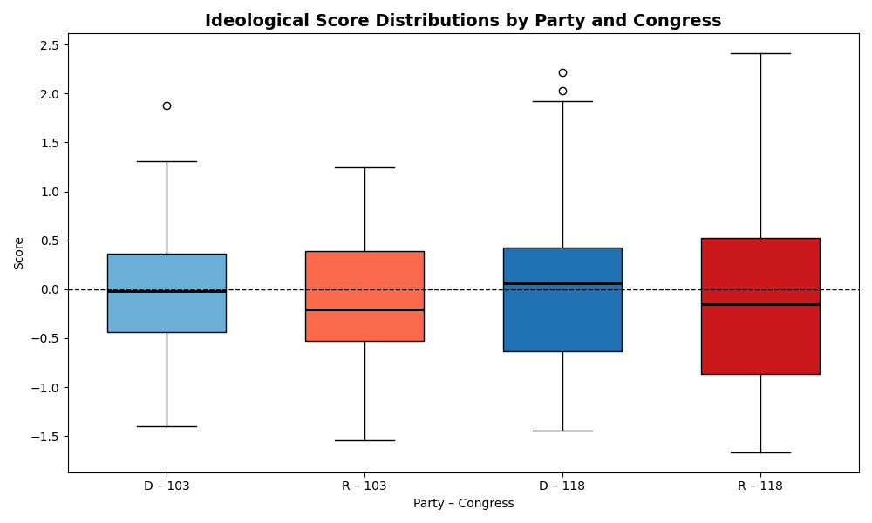
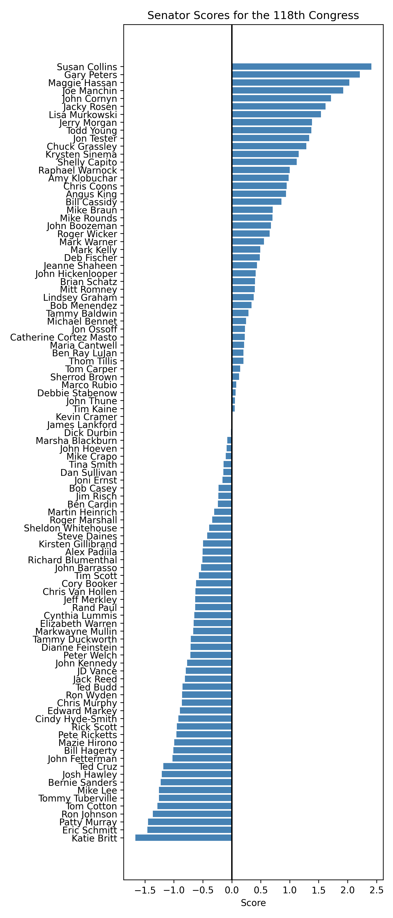
How Much has Partisanship Changed in the Senate: Comparing the 103rd to the 118th
Kenneth Beacham Jr.
Political Science, College of Arts
ABSTRACT
This poster is a visual summary of the data I collected specifically tracking how partisanship and polarization has changed in the Senate. I am using the Lugar Index, a model that tracks each individual member of Congress and gives them a score based on how often they Co-sponsor a bill or how often their proposed legislation is Co-sponsored by member of the opposite party. After the conclusion of the research, I found that that the 118th has more extreme outliers as well as higher numbers on the zero line. The Republican party also has more extreme outliers than the Democrat Party. This is a change from the 103rd where scores are more condensed with less outliers. The 103rd also has much less extreme outliers.
INTRO
In a time where it seems that constant fighting within in Congress is the current norm, it is important to understand just how much our legislators are trying to work together as well. This is important to the field because it can help paint the larger picture of just how much out senators truly work together. It also allows us to be able and see in a condensed easy way, which Senators specifically value working with the other party. The Lugar Index is not used much in the field, so this is a way to give a different angle than roll call votes or other commonly used methods would.
In this research, I hope to better understand the Senate, and how much Senators try to work together. I want to create a visual representation by comparing a relatively effective Senate in the 103rd to the most recent Senate the Lugar Index has created in the 118th
The objectives on this presentation is to compare the past to the present and see how much it has changed. In a time where Congress is reaching some of its lowest approval ratings ever seeing how well our Senators work together is critical. I want to be able and shine light upon how much these Senators work with each other and how much they do not. I hypothesize that the 118th will be more extreme than the 103rd because we know partisanship has been steadily increasing since the 1970’s
The Lugar Index
The Lugar Index is a scale that measures and tracks how bipartisan individual members of Congress are. The Index is created by The Lugar Center and Georgetown University's McCourt School of Public Policy. These two work together by seeing how much legislation a MoC co-sponsors with someone of the opposite party or how much of their legislation is co-sponsored by someone of the other party. A score below -.5 is poor below -1.0 is very poor the opposite apply for .5 and 1.0The limitations are that sometimes there is less legislation proposed, which can lead to a decrease in bipartisan legislation being able to be cosponsored.
METHODS
Within Excel, I transcribed the results of the Lugar Index from the 103rd Senate along with the 118th Senate. I wrote down the Names of the members, their party affiliation, the state they represent, and their bipartisan index score. The Index itself also excludes all party leadership and senators who served less than 10 months of the full Congress. Below will show the graphs I have constructed to show the data collected.
Scores of the 103rd Congress
Ideological Score Distribution by Party and Congress
Scores of the 118th Congress
This graph on the previous panel shows what factor party affiliation plays with their score. The Republican party appears to be more diverse have their mean being below 0, while having more extreme outliers amongst 0 in comparison to the Democrats who are slightly more condensed in terms of their scores.
RESULTS
The results show that Senators have changed overtime. After analyzing the data, the 118th has more extreme outliers with the ranges being from roughly -1.5 to +2.0 versus the 103rd being between -1.5 to +1.0. The scores under the 0 line in the 118th Congress are higher than those in the 103rd showing in increase in partisanship among members. The numbers of senators under the 0 line in both graphs are the same, but the 118th out scores the 103rd Congress meaning these senators are co-sponsoring even less bipartisan legislation than their predecessors
The 103rd Congress is one of the more effective Congress with passing major legislation. This factor as well as it being the oldest Congress listed on the Lugar is why it was chosen to be the comparison. I am not surprised by the range of the Congress. It shows to be fairly condensed -1.5 to 1.0. This show that there is less outliers amongst this Congress, so more bipartisan legislation is being proposed. It is also shown that a fair amount of the Senators below the zero line and many of those are only around the -.5 mark which is still relatively fine in the terms of the index. I am surprised about how there is not at least a few extreme outliers in the data. I was expecting a few within both of the data sets, but the 103rd did not have any true outliers in either the negative or positive side.
Discussion
This research has helped create a picture of how well our Senators work together, as well as how partisanship has shifted our a rather short period of time. Within thirty years the Senate has become more much more partisan. Senators are less willingly to work together on legislation, and a Senate that cannot compromise is an ineffective Senate. I have recommendations below on areas that could improve further research.
Comparing more than 2 Congress
Constantly comparing the most updated Congress to a a Congress within the last 30 years
This graph is quite surprising in a few ways. The extreme in 118th are much more than I expected. Multiple Senators being in the 2+ range was quite a shock. I was not shocked though by number of senators well beyond the -1 range. This fits the hypothesis with showing the increase in partisanship we are having in Congress.
References
The Lugar Center. (n.d.). Bipartisan Index. Retrieved March 19, 2026, from https://www.thelugarcenter.org/ourwork-Bipartisan-Index.html
U.S. House of Representatives. (n.d.). 103rd Congress (1993–1995). History, Art & Archives. Retrieved March 19, 2026, from https://history.house.gov/Congressional-Overview/Profiles/103rd/

