Slide 1
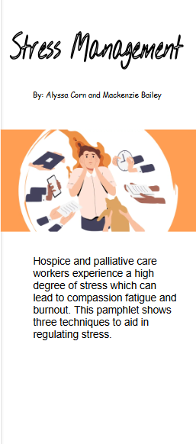
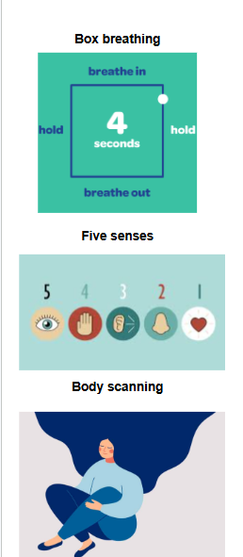
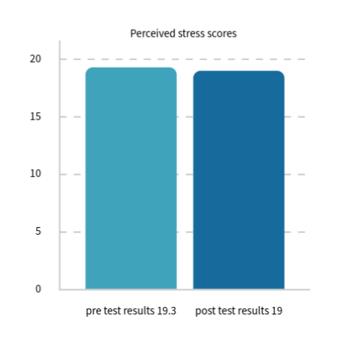
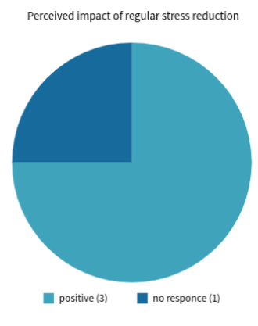

The Effects of Stress and Stress Management on Hospice and Palliative Nurses
Alyssa Corn & Mackenzie Bailey
Family Nurse Practitioner (FNP) DNP program
ABSTRACT
Hospice and palliative care nurses often experience high occupational stress due to the emotional demands of end-of-life care.
This stress can lead to burnout, compassion fatigue, vicarious trauma, and death anxiety, affecting both nurse well-being and patient care.
The project evaluated whether a mindfulness-based educational intervention could influence perceived stress levels among hospice nurses.
Guided by Roy’s Adaptation Model, nurses completed a pre-survey using the Perceived Stress Scale followed by education on mindfulness techniques.
Techniques included box breathing, the five-senses grounding exercise, and body scanning.
Nurses at a hospice facility in North Carolina practiced these techniques for 30 days before completing a post-survey.
The mean Perceived Stress Scale score decreased slightly from 19.3 to 19 (1.55% reduction).
Despite minimal quantitative change, most participants reported that regular stress-management practices improved their stress levels.
Findings suggest mindfulness education may help support stress management among hospice nurses, though larger and longer studies are needed.
GOALS
The main goals of this project are:
To review existing research on stress management strategies for these nurses.
To implement and evaluate an educational intervention on stress management.
To measure whether stress management education affects nurses’ perceived stress levels.
To examine stress and burnout in hospice and palliative care nurses.
To determine whether mindfulness and self-care practices can help reduce burnout and support nurse well-being.
METHODS
The intervention began with an anonymous pre-education survey sent via email to nurses at Elizabeth House.
Survey used the Perceived Stress Scale plus two additional questions asking whether nurses currently used stress reduction techniques and how often they practiced them.
Nurses attended a 20–30 minute online educational presentation during a staff meeting that introduced stress management and mindfulness techniques, including box breathing, the body scan method, and the five senses exercise.
Pamphlets with step-by-step instructions, and reminder posters were placed in the staff break room.
Nurses were encouraged to practice a chosen stress reduction technique regularly for 30 days
A post-survey was distributed to evaluate stress levels, frequency of technique use, and perceived effectiveness.
RESULTS
The pre-survey results showed that 10 of the 11 participants (90.9%) already practiced some form of mindfulness or self-care before the study.
11 participants completed the pre-intervention survey, but only 4 completed the post-intervention survey.
Participants reported using stress reduction techniques at least twice per week.
The mean Perceived Stress Scale score before the intervention was 19.3, indicating a moderate stress level.
After the 30-day intervention, the mean score decreased slightly to 19, which still falls within the moderate stress range.
A 1.55% reduction in perceived stress was shown. Additionally, three of the four post-survey respondents reported that regular stress management positively impacted their stress levels.
CONCLUSION
While the quantitative results of the perceived stress score only improved by 1.55%, the subjective responses from individuals indicated that regular stress management makes a positive difference in the overall stress level of hospice nurses. Stress management is paramount to a long and healthy career in any nursing profession, but especially when caring for those at the end of life. Therefore, stress management techniques should continue to be recommended due to their potential to decrease stress.
RECOMMENDATIONS
Repeat study on larger group
Improved retention through frequent follow-up/ reminders
Improved participation through in-person education rather than virtual
Because of the low risk of harm and in spite of the lack of strong evidence (in this project) for its efficacy we recommend continued educating of palliative nurses on stress reduction techniques
Survey Results
References
Cleveland Clinic. (2024a, July 2). How box breathing can help you destress. https://health.clevelandclinic.org/box-breathing-benefits
Cleveland Clinic. (2024b, October 9). Body scan meditation for beginners: How and why to try it. https://health.clevelandclinic.org/body-scan-meditation
Dong Jin Kim. (2025). Understanding the History, Theoretical Perspectives, and Influence of Mindfulness: Building Sustainability through Mindfulness in Education. International Journal of Educational Reform, 34(1), 21–42. https://doi.org/10.1177/10567879221106715
Watts, K. J., O’Connor, M., Johnson, C. E., Breen, L. J., Kane, R. T., Choules, K., Doyle, C., Buchanan, G., & Yuen, K. (2021). Mindfulness-based compassion training for health professionals providing end-of-life care: Impact, feasibility, and acceptability. Journal of Palliative Medicine, 24(9), 1364–1374. https://doi.org/10.1089/jpm.2020.0358
Williams, A. M., & Williams, N. J. (2023). Using a cognitive framework with nurses to manage stress. Journal of Evaluation in Clinical Practice, 29(2), 282–291. https://doi.org/10.1111/jep.13763
Acknowledgements
We would like to thank Tarmera Pearson our char for this project, April Messer our project committee member, the nurses of the Elizabeth House for their participation, and Western Carlina’s School of Nursing.
Affiliate logos
Photo Caption: Images taken from the stress management pamphlet that was left for the nurses

