Slide 1
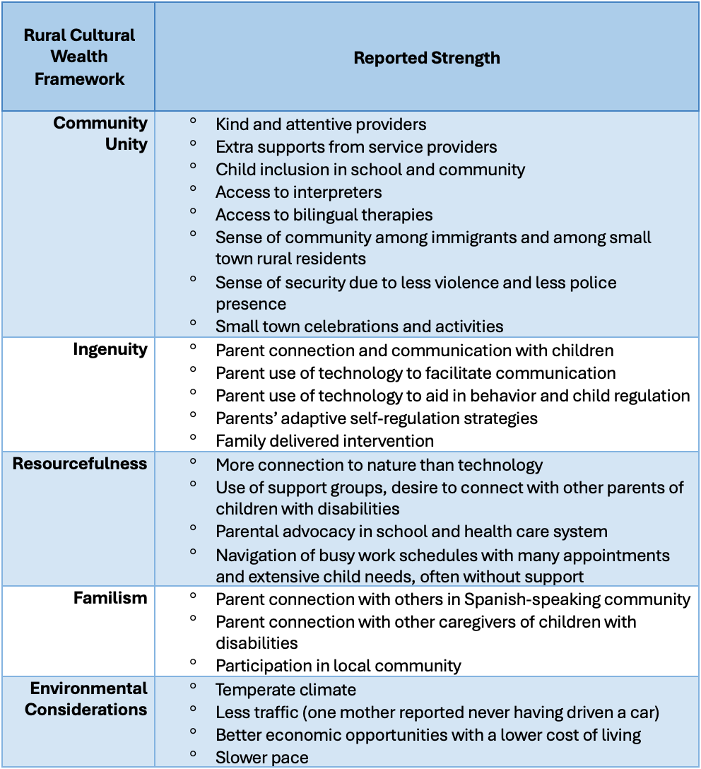
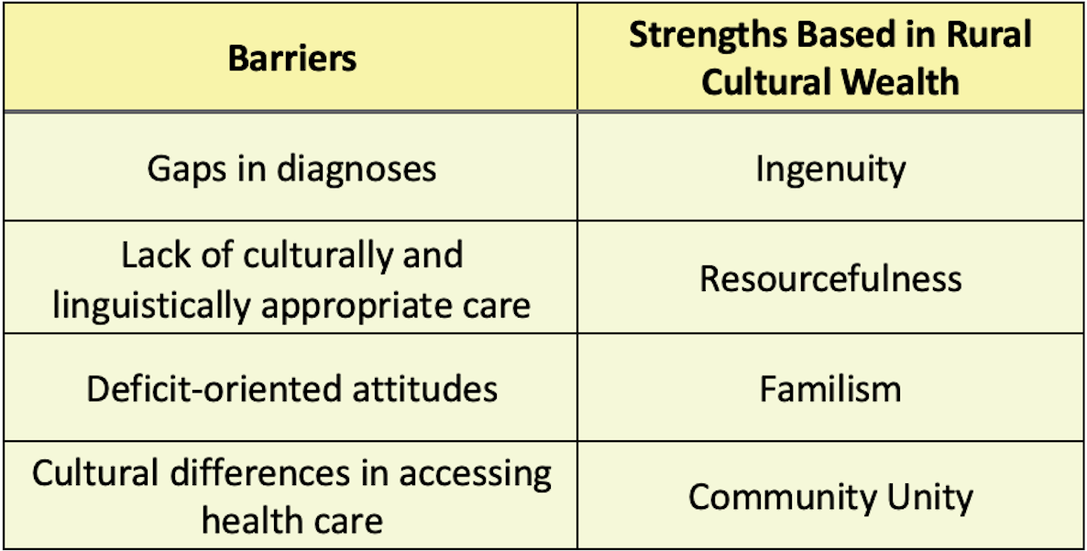

En las Afueras: A Qualitative Analysis of Spanish-speaking Caregiver Perspectives in Rural Spaces
Lindsey Morgan, Rebecca Pechmann, Allem Rojas, Mary Wofford
Research Questions
RQ1: What are the challenges in accessing speech and language services faced by rural Latine families whose children have communication-related disabilities?
RQ2: Taking into account the framework of rural cultural wealth, how does the rural environment affect Latine experiences in speech and language services?
Objective: Discuss clinical considerations for rural Latine families whose children access communication related services.
Methods
Participants: n=9 caregivers of children with diverse communication related disabilities (e.g., severe expressive delay, Autism spectrum disorder, Down syndrome, etc.)
Inclusion criteria:
Spanish-speaking mothers of children aged 1-7
First generation immigrants
Residents of rural Western North Carolina
Data Collection & Analysis:
Two semi-structured, individual interviews (initial and final) 10-20 minutes
Four focus groups across four topic areas related to speech and language services, 50-75 minutes
A bottom-up qualitative analysis to allow themes to emerge from the data using Delve software
Identification of raw units organized into themes and subthemes
Themes examined for clarity, relevance, and value to the field and clinicians
Background
Caregiver perspectives are essential for Evidence-Based Practice and culturally responsive intervention. In rural areas, many monolingual professionals work with multilingual Latine families.
Rural cultural wealth is a conceptual framework of rurality. It is a strengths-based perspective that recognizes rural resilience through ingenuity, resourcefulness, familism, and community unity (Crumb et al., 2023)
Results: Strengths of Rural Environment
Takeaways
Takeaway 1: Importance of caregiver inclusion in assessment, goal planning, and intervention. This finding is consistent with other work on Latine families receiving SLP services. Irizarry-Pérez et al. (2024) found that including client perspectives was insufficient and that bilingual families sought participation and inclusion in the entire process.
Takeaway 2: The present study found that location-specific needs are diverse and often contradictory, yet significant. Crumb et al. (2023) suggests capitalizing on assets and collaborative engagement in rural spaces. SLPs should promote person- and family-centered care.
Takeaway 3: SLPs can act as cultural brokers. Rios et al. (2020) reported that Latina mothers reported high levels of stress related to IEP meetings. They call on providers to connect caregivers to information about special education rights and involve them more in the IEP process (Rios et al., 2020). The present study suggests that SLPs can work to facilitate access to services, to enhance family participation and impact of services, and to aid in stress management by:
Connecting parents to local support groups in Spanish
Hosting advocacy trainings
Using an interdisciplinary lens
Providing contextualized care
Limitations: Small sample, exploratory nature, attrition, power
Table 2: Parent-reported Strengths of Latine families in Rural Western North Carolina
Table 1: Recognized Barriers and Strengths in Accessing Communication-Related Services
Results: Barriers
Many challenges found were related to communication and resources. Communication challenges included an increased wait time when using an interpreter, lack of regular access to providers in native language, and a lack of explanation of services. Examples of resource challenges were frequency of appointments, distance, expense, lack of transportation, lack of cell signal, and the difficulty of working long hours combined with caregiving. Other challenges noted were legal status, and emotional and mental overload exacerbated by stigma and pressure to assimilate. Other barriers:
Empathy
Lack of explanation or communication after diagnosis
Desire for more family inclusion in intervention
Hesitation to speak up to school/health care professionals
Discussion
Ideas about learning two languages: Main themes included a lack of communication by health and school professionals about literacy and language learning, lack of resources in native language, desire to simplify child’s life, difficulty of learning AAC and sign language in addition to native and heritage languages.
Cultural differences: Parents report a feeling of “encierro”, being closed-off in the United States, and of feeling unwelcome in their child’s school. They also report overall more access to care than in their home countries.
Underlying fears:
Selected References
Barnard-Brak, L., Morales-Alemán, M. M., Tomeny, K., & McWilliam, R. A. (2021). Rural and Racial/Ethnic Differences in Children Receiving Early Intervention Services. Family & community health, 44(1), 52–58. https://doi.org/10.1097/FCH.0000000000000285
Crumb, L., Chambers, C., Azano, A., Hands, A., Cuthrell, K., & Avent, M. (2023). Rural cultural wealth: Dismantling deficit ideologies of rurality. Journal for Multicultural Education, 17(2), 125-138. https://doi.org/10.1108/JME-06-2022-0076
Irizarry-Pérez, C. D., Bell, L. M., Rodriguez, M. N., & Viramontes, V. (2024). Spanish-Speaking Mothers’ Experiences of School-Based Speech Therapy. Language Speech and Hearing Services in Schools, 55(3), 629–647. https://doi.org/10.1044/2024_lshss-23-00043
Rios, K., Aleman-Tovar, J., & Burke, M. M. (2020). Special education experiences and stress among Latina mothers of children with autism spectrum disorder (ASD). Research in Autism Spectrum Disorders, 73, 101534. https://doi.org/10.1016/j.rasd.2020.101534
Soto-Boykin, X. T., Larson, A. L., Olszewski, A., Velury, V., & Feldberg, A. (2021). Who Is Centered? A Systematic Review of Early Childhood Researchers’ Descriptions of Children and Caregivers From Linguistically Minoritized Communities. Topics in Early Childhood Special Education, 41(1), 18–30.
Disclosures
Lindsey Morgan received graduate and research assistantships through WCU. Rebecca Pechmann received graduate and research assistantships through WCU, and funding through ASHA’s Students Preparing for Academic-Research Careers (SPARC) program. Mary Wofford received funding from ASHFoundation New Investigator’s Research Grant and the WCU Provost Scholarly Development Grant to support this research.
"Ahorita como estamos viviendo esta época de las leyes, todo eso sí me asusta un poco en pensar en tenerme que ir a mi país, porque yo sé que para mí, no sería fácil trasladarme a la ciudad para buscar ayuda para [mi hijo].”
[Right now, given the current legal climate, the thought of having to return to my home country does scare me a bit, because I know that for me, it wouldn't be easy to travel to the city to seek help for [my son].]
“No nos creían y no nos daban el soporte extra.”
[they did not believe us and did not give us the extra support.]
Communication Sciences and Disorders

