Slide 1

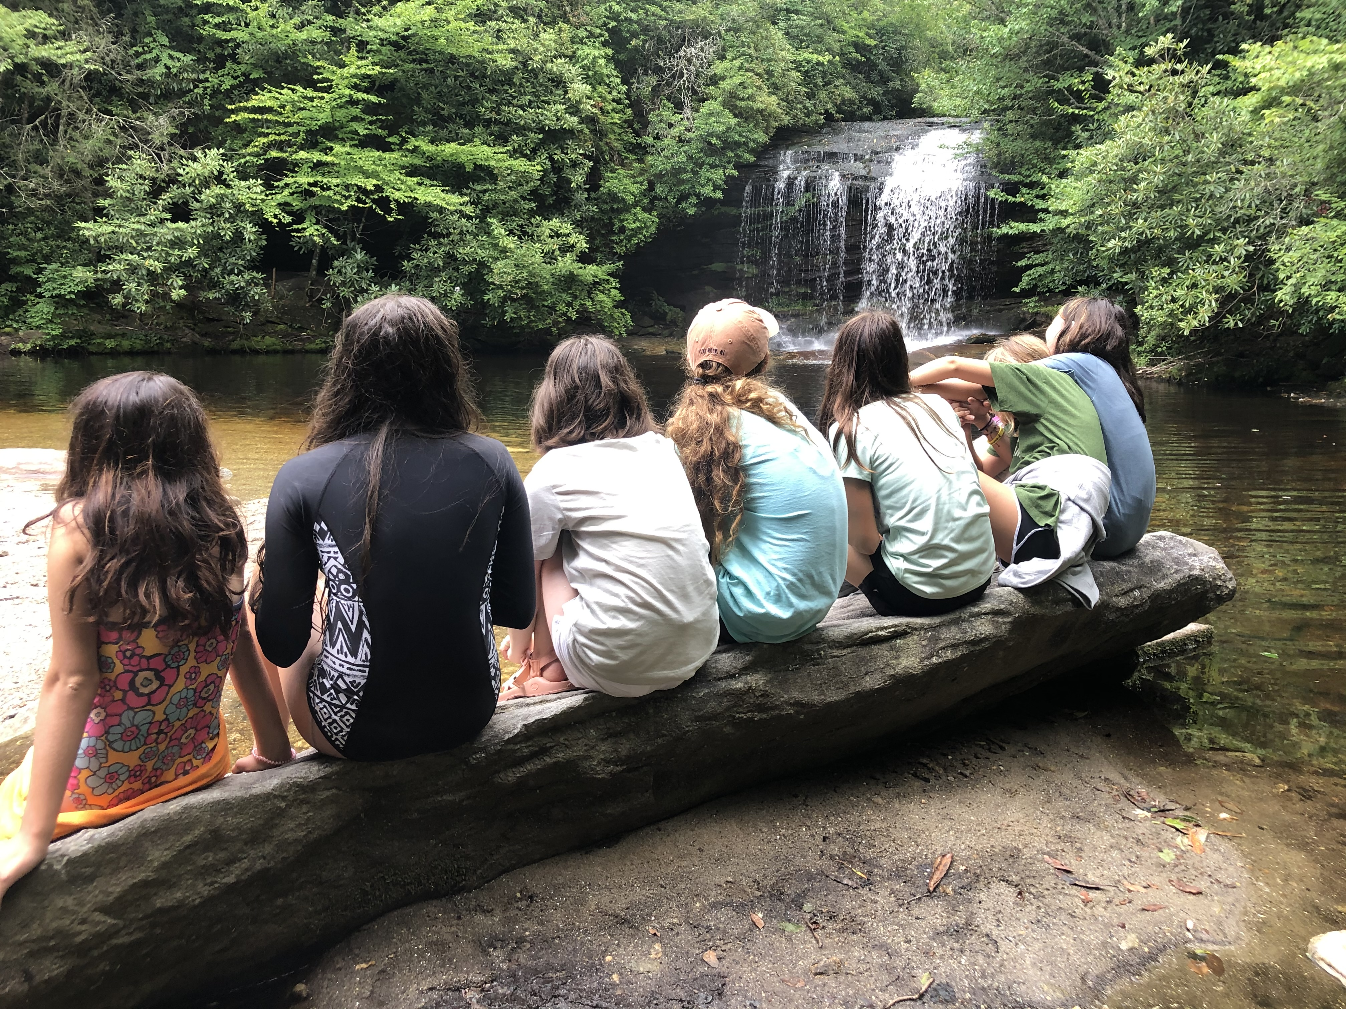
Letting Group Work Breathe: Why Nature-Based Social Group Work Supports Adolescent Well-Being
Margaret “Marge” Timberlake, MSW Student
Kristina Lind, PhD, LICSW-NH (Faculty Sponsor)
Department of Social Work, Western Carolina University
INTRODUCTION
Adolescent distress tolerance has declined in recent years, with excessive screen use identified as a significant contributing factor (Haidt, 2024). Reduced opportunities for developmentally necessary challenges may weaken self-efficacy and emotional regulation, both of which are essential for positive therapeutic outcomes (Xu et al., 2024, pp. 2-3).
The physical environment plays a critical yet often overlooked role in group work. Research suggests that environmental conditions influence nervous system regulation, affecting a participant’s capacity to engage, learn, and benefit from treatment (Sui et al., 2023, pp. 5-9). Adolescents, whose brains are still developing, may be particularly sensitive to environmental input.
Despite this evidence, facilitators often have limited control over adolescents’ device use but can intentionally modify the group setting. Nature-based environments may offer a practical and research-supported avenue to enhance therapeutic outcomes (Wales et al., 2022, pp. 2-3).
METHODOLOGY
This poster presents a literature-informed conceptual analysis synthesizing current interdisciplinary research on:
Adolescent distress tolerance and screen use
Environmental psychology and nervous system regulation
Nature exposure and cortisol reduction
Brain development and environmental sensitivity
Peer-reviewed studies from psychology, neuroscience, and environmental health were reviewed to identify themes relevant to group facilitation practice.
FINDINGS FLOW CHARTS
EXCESSIVE SCREEN USE ↓ Reduce Distress Tolerance ↓ Lower Self- Efficacy ↓ Reduce Treatment Engagement
NATURE-BASED ENVIRONMENTS
↓ Improve Nervous System Regulation ↓ Increase Distress Tolerance ↓ Enhance Group Outcomes
FUTURE DIRECTION
Empirical studies directly comparing indoor vs. outdoor group outcomes
Longitudinal research examining nature-based interventions and distress tolerance development
Exploration of cost-effective environmental modifications in schools and clinics
Development of facilitator training models focused on therapeutic environmental design
DISCUSSION
The nervous system plays a central role in therapeutic receptivity. When adolescents enter group settings already experiencing heightened arousal or anxiety, environmental stressors may further impair engagement.
Nature-based environments appear to support parasympathetic activation, increasing emotional regulation and cognitive flexibility. While facilitators cannot fully control adolescents’ broader technological exposure, they can intentionally design group spaces that promote regulation.
RESEARCH FINDINGS
Excessive screen use is associated with reduced distress tolerance in adolescents.
Lower distress tolerance may negatively impact self-efficacy and treatment engagement.
Physical environments influence autonomic nervous system regulation.
Exposure to nature-based settings is associated with:
Reduced cortisol levels
Improved emotional regulation
Enhanced cognitive receptivity
Even simulated or partial nature exposure (light, plants, sound, airflow) may provide regulatory benefits.
REFERENCES
Haidt, J. (2024). The anxious generation: How the great rewiring of childhood is causing an epidemic of mental illness. Penguin Press.
Sui, T. Y., McDermott, S., Harris, B., & Hsin, H. (2023). The impact of physical environments on outpatient mental health recovery: A design-oriented qualitative study of patient perspectives. PLOS ONE, 18(4), e0283962.
Wales, M., Mårtensson, F., Hoff, E., & Jansson, M. (2022). Elevating the role of the outdoor environment for adolescent wellbeing in everyday life. Frontiers in Psychology, 13, 774592.
Wang, X., Chen, L., Li, Y., & Gong, Y. (2025). Nature-based interventions reduce physiological stress in children with chronic illnesses: Evidence from salivary biomarkers. Frontiers in Public Health, 13, 1698278.
Xu, J., Falkenstein, M. J., & Kuckertz, J. M. (2024). Feeling more confident to encounter negative emotions: The mediating role of distress tolerance on the relationship between self-efficacy and outcomes of exposure and response prevention for OCD. Journal of Affective Disorders, 353, 34–42.
CONCLUSIONS
Nature-based group work may meaningfully enhance adolescent well-being by supporting nervous system regulation, distress tolerance, and self-efficacy. Intentional nature-based design should be considered for more effective group facilitation, particularly when working with adolescents. Small environmental adjustments may improve therapeutic engagement.

