Slide 1
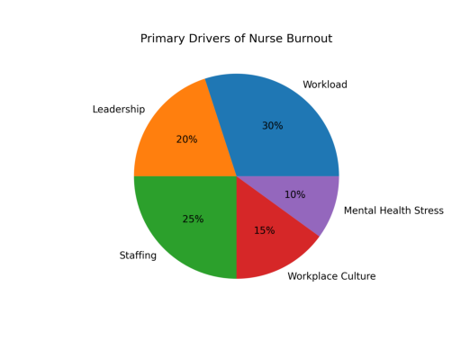
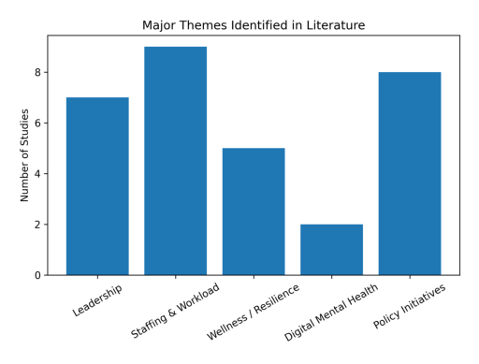
Nursing Burnout and Retention: Evidence-Based Strategies for Healthcare Leaders
Benjamin McKinney, BSN, RN, Ramona Whichello DNP, RN, NEA-BC, Amy Putnam DNP, RN, CNE
Western Carolina University- MSN Nurse Leadership Program
ABSTRACT
Nurse burnout represents one of the most significant challenges that affects the healthcare workforce. Burnout contributes to increased nurse turnover, decreased job satisfaction, and poorer patient outcomes. Healthcare organizations continue to experience workforce instability as emotional exhaustion and workplace stress increase among nurses.
An integrative literature review examined evidence-based strategies that healthcare leaders can use to reduce burnout and improve nurse retention. Peer-reviewed research published between 2018 and 2024 was reviewed to identify organizational, psychological, and policy-level interventions associated with improved workforce stability.
Leadership style, staffing adequacy, workplace culture, and organizational support strongly influence nurse well-being and retention outcomes. These results highlight the importance of leadership engagement and systemic workplace reform to effectively address nurse burnout.
INTRODUCTION
Burnout represents a major challenge for healthcare organizations and contributes to workforce shortages, reduced job satisfaction, and compromised patient outcomes (Shah et al., 2021; White et al., 2019).
Burnout is characterized by emotional exhaustion, depersonalization, and decreased professional accomplishment (Dall’Ora et al., 2020).
Nurses frequently experience burnout when workplace demands such as excessive workloads, inadequate staffing, and limited leadership support persist over time. These conditions contribute to high turnover rates and create significant financial and operational strain for healthcare organizations (Kelly et al., 2021).
OBJECTIVES
• Identify organizational factors that contribute to nurse burnout. • Evaluate interventions that reduce burnout and improve nurse retention. • Examine the role of leadership and workplace culture in workforce stability. • Identify gaps in current research related to nurse burnout and retention.
RESULTS
Leadership-Driven Work Environments Transformational and authentic leadership styles were associated with higher nurse job satisfaction and lower turnover intention (Boamah et al., 2018; Kelly et al., 2021). Leadership support and shared governance structures contributed to stronger professional practice environments (Boamah et al., 2018).
Staffing, Workload, and Organizational Conditions High workloads and inadequate staffing levels were consistently associated with emotional exhaustion and burnout (Dall’Ora et al., 2020; Shah et al., 2021). Safe staffing policies and balanced workloads were identified as key organizational strategies to reduce nurse stress (Dall’Ora et al., 2020).
Resilience and Wellness Interventions Resilience education, mindfulness training, and stress-management programs demonstrated improvements in coping ability and reductions in burnout indicators among nurses (Pressley & Garside, 2023).
Digital and e-Mental Health Solutions Technology-based interventions such as mobile applications and online mental health programs improved access to psychological support resources and reduced stress among healthcare professionals (Pressley & Garside, 2023).
Policy and System-Level Strategies National initiatives and professional organization recommendations emphasized leadership accountability, psychological safety, and workforce investment as essential strategies to address burnout (U.S. Department of Health and Human Services, 2022).
PRELIMINARY CONCLUSIONS
Nurse burnout primarily results from organizational conditions rather than individual coping deficits (Shah et al., 2021). Leadership behaviors, staffing adequacy, workplace culture, and professional support significantly influence nurse well-being and retention.
Burnout contributes to workforce instability, decreased job satisfaction, and compromised patient safety outcomes (Boamah et al., 2018; Kelly et al., 2021).
Healthcare organizations that provide supportive leadership, adequate staffing, and strong professional practice environments demonstrate improved retention outcomes (Boamah et al., 2018; Kelly et al., 2021).
PRELIMINARY RECOMMENDATIONS
Implement comprehensive strategies that address both organizational demands and workforce support systems (Kelly et al., 2021; Shah et al., 2021).
Develop transformational leadership skills among nurse managers (Boamah et al., 2018).
Implement safe staffing policies and balanced workloads (Dall’Ora et al., 2020).
Expand workplace wellness and resilience programs (Pressley & Garside, 2023).
Integrate digital mental health resources for staff (Pressley & Garside, 2023).
Support national and organizational policy initiatives that prioritize workforce well-being (U.S. Department of Health and Human Services, 2022).
Sustain leadership engagement and organizational commitment to address nurse burnout and promote long-term workforce stability (Kelly et al., 2021; U.S. Department of Health and Human Services, 2022).
Organizational conditions such as workload, staffing, leadership support, and workplace culture represent the primary contributors to nurse burnout identified in the literature.
METHODS
Electronic databases searched included CINAHL Plus, PubMed, MEDLINE, Academic Search Premier, and PsycINFO. Search terms included nurse burnout, nurse retention, job satisfaction, staff turnover, resilience, leadership, and workplace wellness.
The initial database search identified 412 articles. After limiting results to peer-reviewed publications written in English between 2018 and 2024, 142 articles remained. Articles were screened for relevance, duplicates were removed, and full-text reviews were completed.
Twenty-seven studies met the final inclusion criteria and were analyzed. Studies were evaluated for study design, sample characteristics, intervention strategies, and outcomes related to nurse burnout and retention. Results were synthesized into thematic categories to identify patterns across the literature.
Records identified through database searching (n = 412)
Records after duplicates removed (n = 142)
Records screened (n = 142)
Full-text articles assessed for eligibility (n = 87)
Studies included in integrative review (n = 27)
REFERENCES
Boamah, S. A., Spence Laschinger, H. K., Wong, C., & Clarke, S. (2018). Effect of transformational leadership on job satisfaction and patient safety outcomes. Nursing Outlook, 66(2), 180–189. https://doi.org/10.1016/j.outlook.2017.10.004
Dall’Ora, C., Ball, J., Reinius, M., & Griffiths, P. (2020). Burnout in nursing: A theoretical review. Human Resources for Health, 18, 41. https://doi.org/10.1186/s12960-020-00469-9
Kelly, L. A., Gee, P. M., & Butler, R. J. (2021). Impact of nurse burnout on organizational and position turnover. Nursing Outlook, 69(1), 96–102. https://doi.org/10.1016/j.outlook.2020.06.008
Pressley, C., & Garside, J. (2023). Safeguarding the retention of nurses: A systematic review on determinants of nurses’ intentions to stay. Nursing Open, 10(5), 2842–2858. https://doi.org/10.1002/nop2.1588
Shah, M. K., Gandrakota, N., Cimiotti, J. P., Ghose, N., Moore, M., & Ali, M. K. (2021). Prevalence of and factors associated with nurse burnout in the United States. JAMA Network Open, 4(2), e2036469. https://doi.org/10.1001/jamanetworkopen.2020.36469
U.S. Department of Health and Human Services. (2022). Addressing health worker burnout: The U.S. Surgeon General’s advisory on building a thriving health workforce. https://www.hhs.gov/sites/default/files/health-worker-wellbeing-advisory.pdf
White, E. M., Aiken, L. H., & McHugh, M. D. (2019). Registered nurse burnout, job dissatisfaction, and missed care in nursing homes. Journal of the American Geriatrics Society, 67(10), 2065–2071. https://doi.org/10.1111/jgs.16051
Figure. PRISMA flow diagram illustrating the literature search and article selection process.

