Slide 1
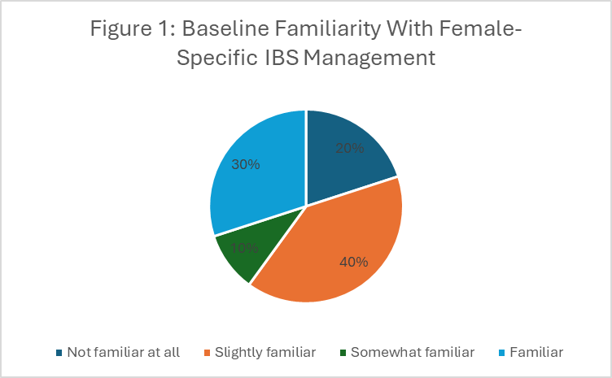


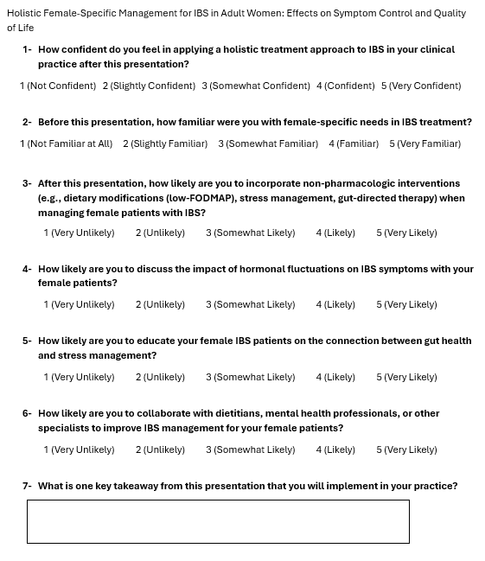
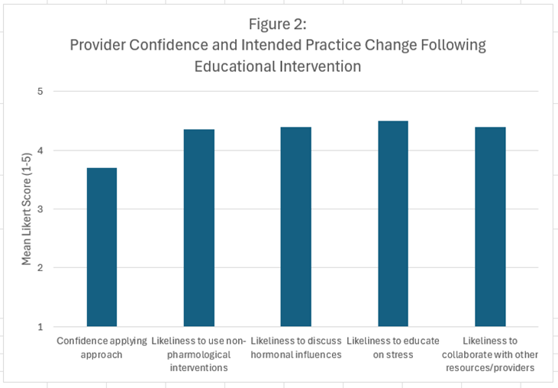
Holistic Female-Specific Management for IBS in Adult Women: A Quality Improvement Project
Megan Ruckman, RN
Tamera Pearson, PhD, FNP, ACNP- Project Chair
Jessica Fisher, MD- Committee Member
Western Carolina University DNP/FNP Program
ABSTRACT
Background:
Irritable bowel syndrome (IBS) disproportionately affects women and traditional management does not address female-specific factors, such as hormones. Primary care providers have reported limited knowledge on specific IBS needs in women, as well as low confidence in treatment.
Purpose:
This quality improvement project evaluated whether an educational intervention could improve primary care provider knowledge and willingness to incorporate holistic, female-specific IBS management strategies.
Methods:
An educational presentation was delivered to primary care providers. Participants completed a post-intervention survey assessing knowledge and likelihood of implementing holistic IBS management approaches into practice.
Findings:
Post-intervention responses showed increased provider confidence in applying a holistic, female-specific approach to IBS management, as well as a high likelihood of incorporating their increased knowledge into practice.
Discussion:
A one-time educational intervention may effectively address knowledge gaps related to female-specific IBS management among primary care providers.
INTRODUCTION
• Irritable bowel syndrome (IBS) is a common gastrointestinal disorder that affects one in five women and occurs twice as often in women as compared to men (OHSU, 2024).
• Women experience IBS symptoms influenced by hormonal fluctuations, psychological stressors, and gut microbiome changes. Women with IBS report more fatigue, depression, anxiety, and overall lower quality of life as compared to men with IBS (Kim & Kim, 2018).
• Despite its high prevalence among women and association with increased symptoms and reduced quality of life, traditional IBS management often overlooks gender-specific differences (Lenhart et al., 2020).
• Studies show that primary care providers in the United States find IBS difficult to diagnose and treat and often refer the patients to a gastroenterologist, even in mild cases (Heidelbaugh et al., 2024).
PROJECT GOAL
To improve primary care provider awareness and knowledge of holistic, female-specific management strategies for IBS through an educational intervention.
OBJECTIVES
• Educate primary care providers on female-specific IBS factors and symptoms
• Increase provider awareness of holistic management strategies including diet, psychological factors, and hormonal influences.
• Evaluate provider knowledge and likelihood of implementing holistic IBS management approaches following the educational intervention.
METHODS
Quality improvement project using a pre- and post-intervention survey design. Primary care providers (nurse practitioners, physicians, and physician assistants) participated voluntarily during a scheduled provider meeting. Participants attended a brief virtual educational presentation on holistic, female-specific IBS management. A post-presentation study assessed provider knowledge, confidence in applying holistic strategies, and likelihood of implementing these approaches. Responses were analyzed using descriptive statistics to evaluate changes in knowledge and clinical practice intentions.
RESULTS
Key Findings of Post-Intervention Likert-Scale Questions (n = 20)
30% of participants reported familiarity with female specific needs in IBS management prior to the educational intervention, while 70% responded they were somewhat, slightly, or not familiar with these needs.
Key Findings of Post-Intervention Free-Text Responses (n = 8)
Free-text responses indicated increased awareness of hormonal influences on IBS symptoms and the importance of cycle-specific management, along with improved confidence discussing sexual health and related conditions such as endometriosis.
RECOMMENDATIONS
Integrate female-specific IBS education into primary care.
Emphasize hormonal, psychological, and holistic management strategies.
Support ongoing provider education in women’s health.
CONCLUSIONS
The educational intervention improved provider knowledge and confidence.
Providers reported increased awareness of female-specific IBS management.
Holistic, gender-informed care may improve outcomes for women with IBS.
Improved Provider Confidence
100% reported confidence applying holistic IBS management
Mean Likert score: 3.70
Integration of Non-Pharmacologic Management
90% likely or very likely to incorporate dietary and stress-based therapies
Mean Likert score: 4.35
Recognition of Hormonal Influences
100% likely or very likely to discuss hormonal impacts on IBS
Mean Likert score: 4.40
Education on the Gut–Brain Connection
100% likely or very likely to educate patients on stress and gut health
Mean Likert score: 4.50
Interdisciplinary Collaboration
90% likely or very likely to collaborate with dietitians and mental health providers
Mean Likert score: 4.40
Post-Presentation Questionnaire
References
Heidelbaugh, J. J., A. Pali Hungin, Palsson, O. S., Anastasiou, F., Lars Agreus, Fracasso, P., Heidi‐Ingrid Maaroos, Matic, J. R., Mendive, J. M., Seifert, B., & Drossman, D. A. (2024). Perceptions and Practices of Primary Care Providers in Europe and the US in the Diagnosis and Treatment of Irritable Bowel Syndrome: A Multinational Survey. Neurogastroenterology & Motility. https://doi.org/10.1111/nmo.14967
Kim, Y. S., & Kim, N. (2018). Sex-Gender Differences in Irritable Bowel Syndrome. Journal of Neurogastroenterology and Motility, 24(4), 544–558. https://doi.org/10.5056/jnm18082
Lenhart, A., Naliboff, B., Shih, W., Gupta, A., Tillisch, K., Liu, C., Mayer, E. A., & Chang, L. (2020). Postmenopausal women with irritable bowel syndrome (IBS) have more severe symptoms than premenopausal women with IBS. Neurogastroenterology & Motility, 32(10). https://doi.org/10.1111/nmo.13913
OHSU. (2024). What You Need to Know About IBS | Center for Women’s Health | OHSU. Ohsu.edu. https://www.ohsu.edu/womens-health/what-you-need-know-about-ibs

