Slide 1


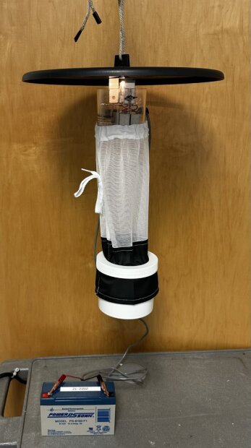
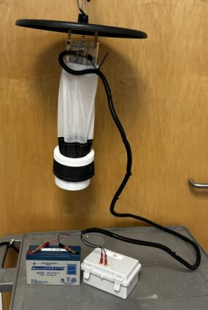
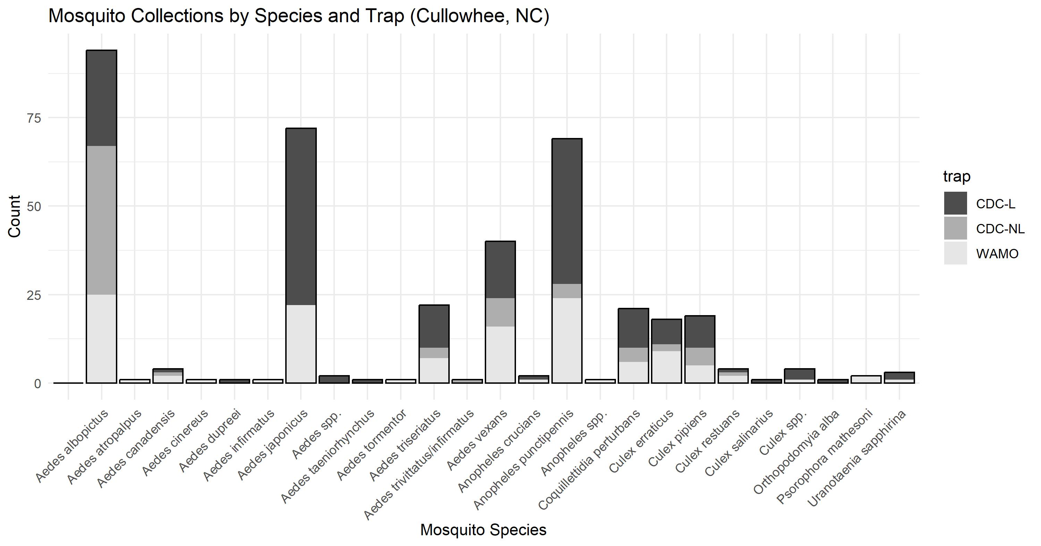
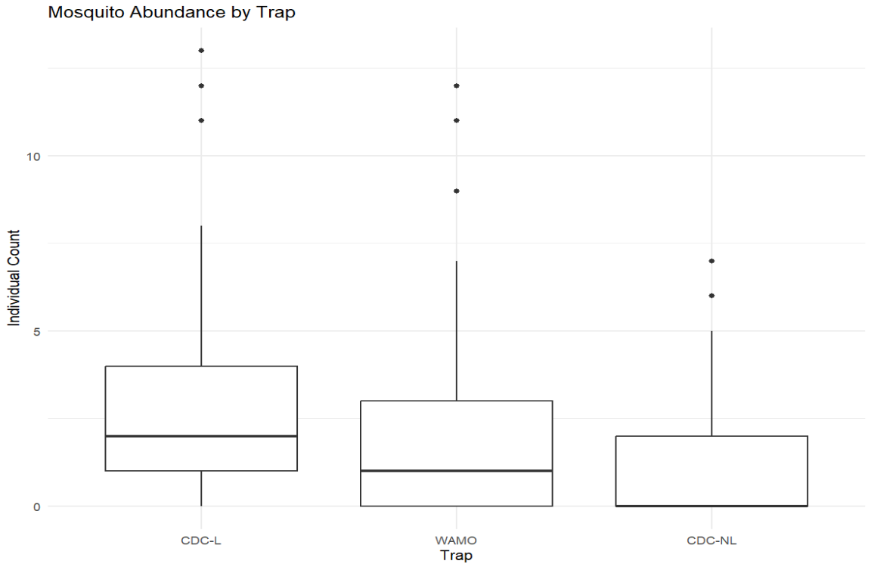
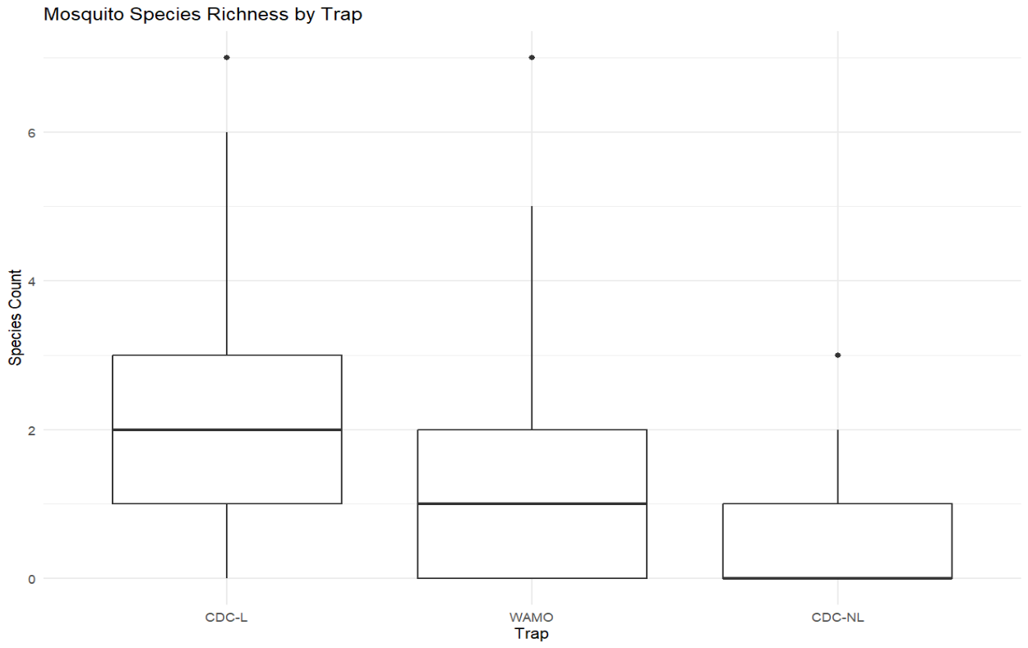
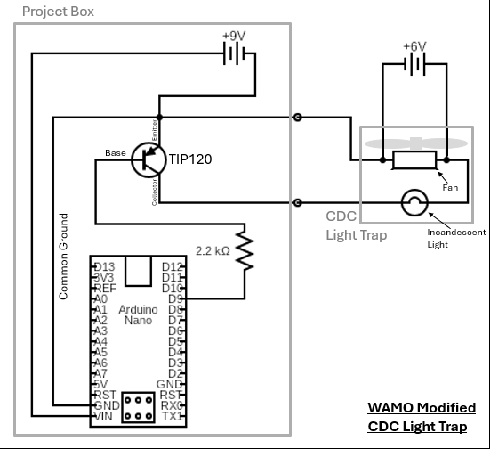

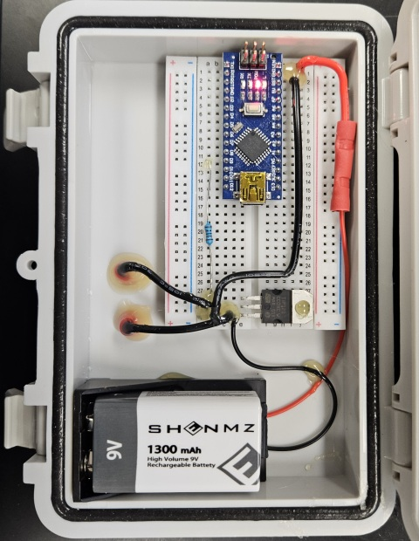
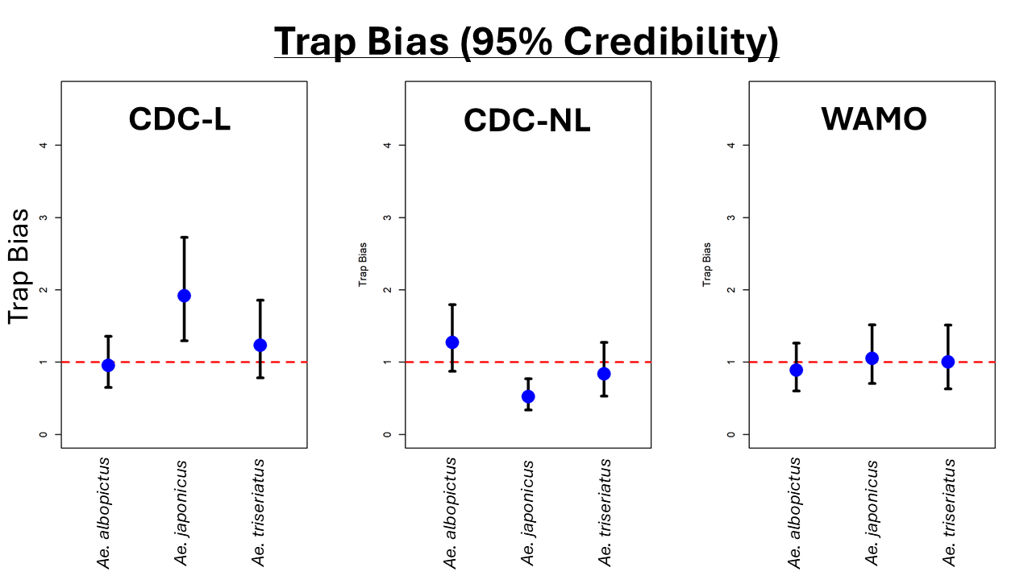
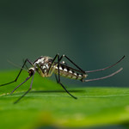
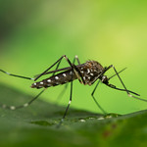
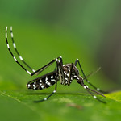
Evaluating a modified CO₂-baited CDC light trap to improve trapping effectiveness in a La Crosse virus endemic area
Mitch Mullin^{1,2}, Alana Eargle^{1,2}, Makayla Humphrey^{1,2}, Julie Cadigan^{1,2}, Yoosook Lee³, Charlie Sither¹, Gary Nordgulen¹, and Brian Byrd¹
¹Mosquito and Vector-borne Infectious Disease Laboratory, Western Carolina University, Cullowhee, NC
²Department of Biology, Western Carolina University, Cullowhee, NC, ³Florida Medical Entomology Laboratory, Vero Beach, FL
Figure 1
Figure 4
a) Standard CDC Light Trap Setup
b) Modified WAMO CDC Light Trap Setup
ABSTRACT: The CDC Miniature Light Trap (Figure 1a) is an important tool used for mosquito surveillance and risk assessment for arboviral disease. The fan-based trap is generally baited with CO₂ and uses an incandescent light to attract phototactic mosquitoes – typically nocturnal and crepuscular species. Some mosquitoes, particularly daytime active Aedes species are not readily attracted to the light, but do host seek and orient towards CO₂ plumes. Mixed evidence in the literature also suggests that removing the light source may increase the collection of some diurnal Aedes species, including invasive container-inhabiting Aedes. Here we sought to improve trap catch and bias by modifying the existing light trap with a programmable light-interrupting mechanism so that the trap may operate both with the light on and off giving opportunities for the trap to collect mosquito species that exhibit both positive and negative phototaxis. The “WAMO” (WCU Arduino Mosquito light Oscillator) was designed to control the cycle of the incandescent light activation (Fig. 1b). The WAMO was designed using an Arduino open-source electronic prototyping platform (Fig. 2). We compared this configuration in the context of trapping three Aedes vectors (one native, two invasive) of La Crosse virus (LACV) (Fig. 3). Field trials conducted in 2024-25 and programmed with light “on/off” periodicity (15-minute intervals) demonstrated that the overall mosquito counts, and species richness values, vary among the trap configurations (Fig. 4). Importantly, the WAMO “smoothed” trap bias with the invasive species, where both Ae. japonicus and Ae. albopictus trap biases were reduced toward 1 (equivocal) (Fig. 5).
Results of 3 X 3 X 3 Latin Square Design Field Studies (7 Trials). Boxes (4b, 4c) indicate no statistical difference.
a) Species abundance by trap-type (cumulative)
b) Mosquito counts (per trap session)
c) Mosquito richness (per trap session)
1a
1b
LACV Vectors:
Red: Invasive Aedes
Green: Native Aedes
4a
4b
4c
Figure 2
a) WAMO Trap Circuit Schematics
b) WAMO Project Box Interior
2a
Arduino Code for WAMO
Figure 5
2b
Figure 3
Comparison of trap bias for LACV vectors; vertical bars are 95% credibility scores.
a) Aedes triseriatus (native La Crosse virus vector)
b) Aedes japonicus (invasive La Crosse virus vector)
c) Aedes albopictus (invasive La Crosse virus vector)
3a
3b
3c
Acknowledgements: Madeleine Craig, Nick Lundy, Hannah Alexander, and Mary Nordgulen (WCU), Massimo Banzi and the greater Arduino community. This project is supported by USDA Award 2023-70006-40598 (UF/WCU).
Mitch Mullin | mbmullin1@catamount.wcu.edu | WCU Mosquito and Vector-borne Infectious Disease Laboratory | Health and Human Sciences Building Room 439, 3971 Little Savannah Rd, Cullowhee, NC 28723

