Slide 1
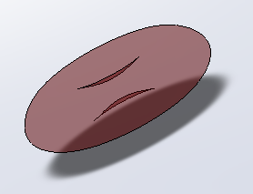
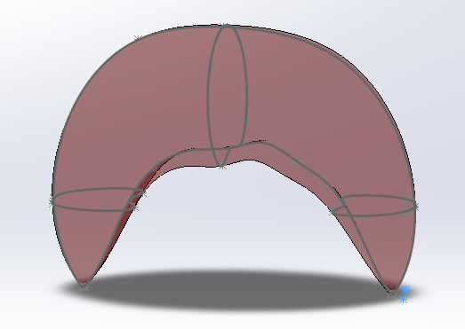

Quantifying Microvascular Flow Sensitivity to Red Blood Cell Rigidity
Shaneil Lysight, Martin L. Tanaka, Namhee Kim
INTRODUCTION
RESULTS
Key findings:
A 20% reduction in effective radius caused ~60% reduction in flow
Significant flow loss occurs before full vessel blockage
Partial obstruction from rigid cells can strongly impact circulation
Background
Sickle cell disease causes red blood cells (RBCs) to become rigid and irregularly shaped, which interferes with blood flow in small vessels. While the biological cause of sickling is well understood, the mechanical impact of reduced RBC deformability on circulation is less intuitive and is often described only qualitatively.
In the microcirculation, capillary diameters can be as small as 3-5 μm, while normal RBCs are approximately 7-8 μm in diameter. Because of this size difference, RBCs must deform to pass through many capillaries.
Reduced deformability increases resistance to blood flow even when vessels are not completely blocked.
Objective
This study evaluates how sensitive microvascular blood flow is to changes in RBC rigidity and whether small geometric disruptions alone can lead to large reductions in blood flow.
Figure 1: SolidWorks CAD model of a normal and sickled red blood cell geometry used for microvascular flow analysis.
.
For laminar flow in small vessels:
Q ∝ r4
This relationship means that small reductions in vessel radius cause very large decreases in blood flow.
DISCUSSION
CONCLUSION
METHODS
These findings highlight how sensitive microvascular blood flow is to changes in vessel radius.
Because flow depends on the fourth power of radius, small geometric disruptions caused by rigid RBCs can significantly reduce circulation. This helps explain why reduced RBC deformability in sickle cell disease can strongly affect blood flow even when vessels are not completely blocked.
Reduced blood flow also decreases oxygen delivery to surrounding tissues, which may contribute to fatigue, pain, and other complications associated with sickle cell disease.
This study demonstrates that microvascular blood flow is highly sensitive to changes in effective vessel radius.
Even small geometric disruptions caused by rigid RBCs can lead to large reductions in circulation due to the fourth-power relationship described by Poiseuille’s Law.
These findings suggest that partial obstruction and increased resistance alone may significantly impair oxygen delivery in sickle cell disease, even without complete vessel blockage.
RBC Modeling
Normal and sickled red blood cell geometries were created using SolidWorks CAD software.
The normal RBC was modeled by drawing a spline representing one half of the biconcave cell profile and revolving it 360° to generate a symmetric three-dimensional solid.
The sickled RBC geometry was created using spline-based sketches guided by reference images to capture the elongated curved shape associated with sickling.
Capillary Flow Model
Capillaries were approximated as cylindrical tubes, and flow was assumed to be laminar, which is appropriate for microvascular flow conditions.
Reduced deformability was modeled as a reduction in effective flow radius, representing the limited space available for plasma flow around a rigid RBC.
REFERENCES
Nader et al., Frontiers in Physiology, 2019; Alapan et al., Lab on a Chip, 2016; Sant et al., International Journal of Molecular Sciences, 2023; The Blood Project, 2025
College of Engineering and Technology, Western Carolina University, Cullowhee, NC, USA
This research was supported by a grant from the National Science Foundation

