Slide 1
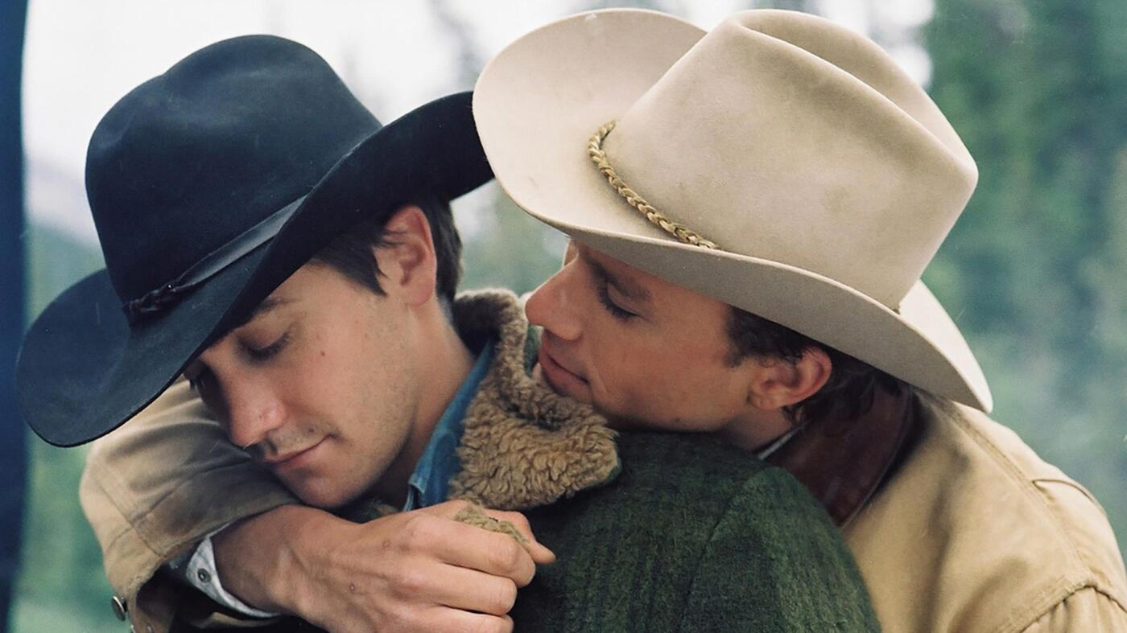
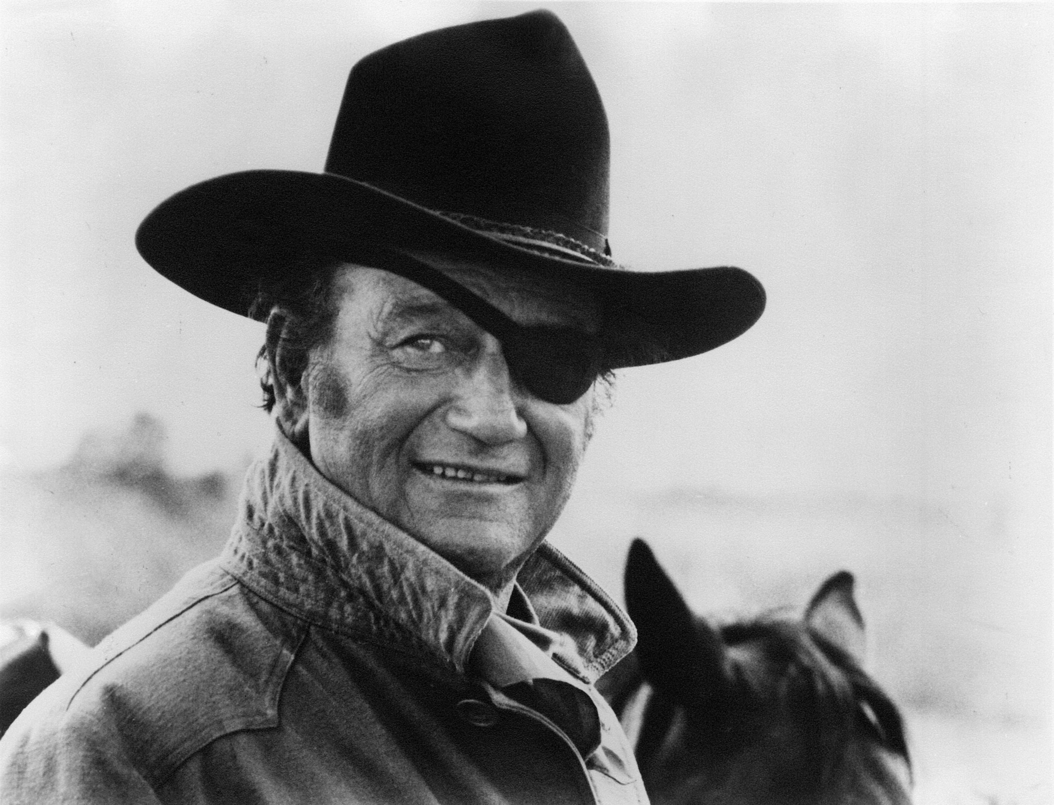
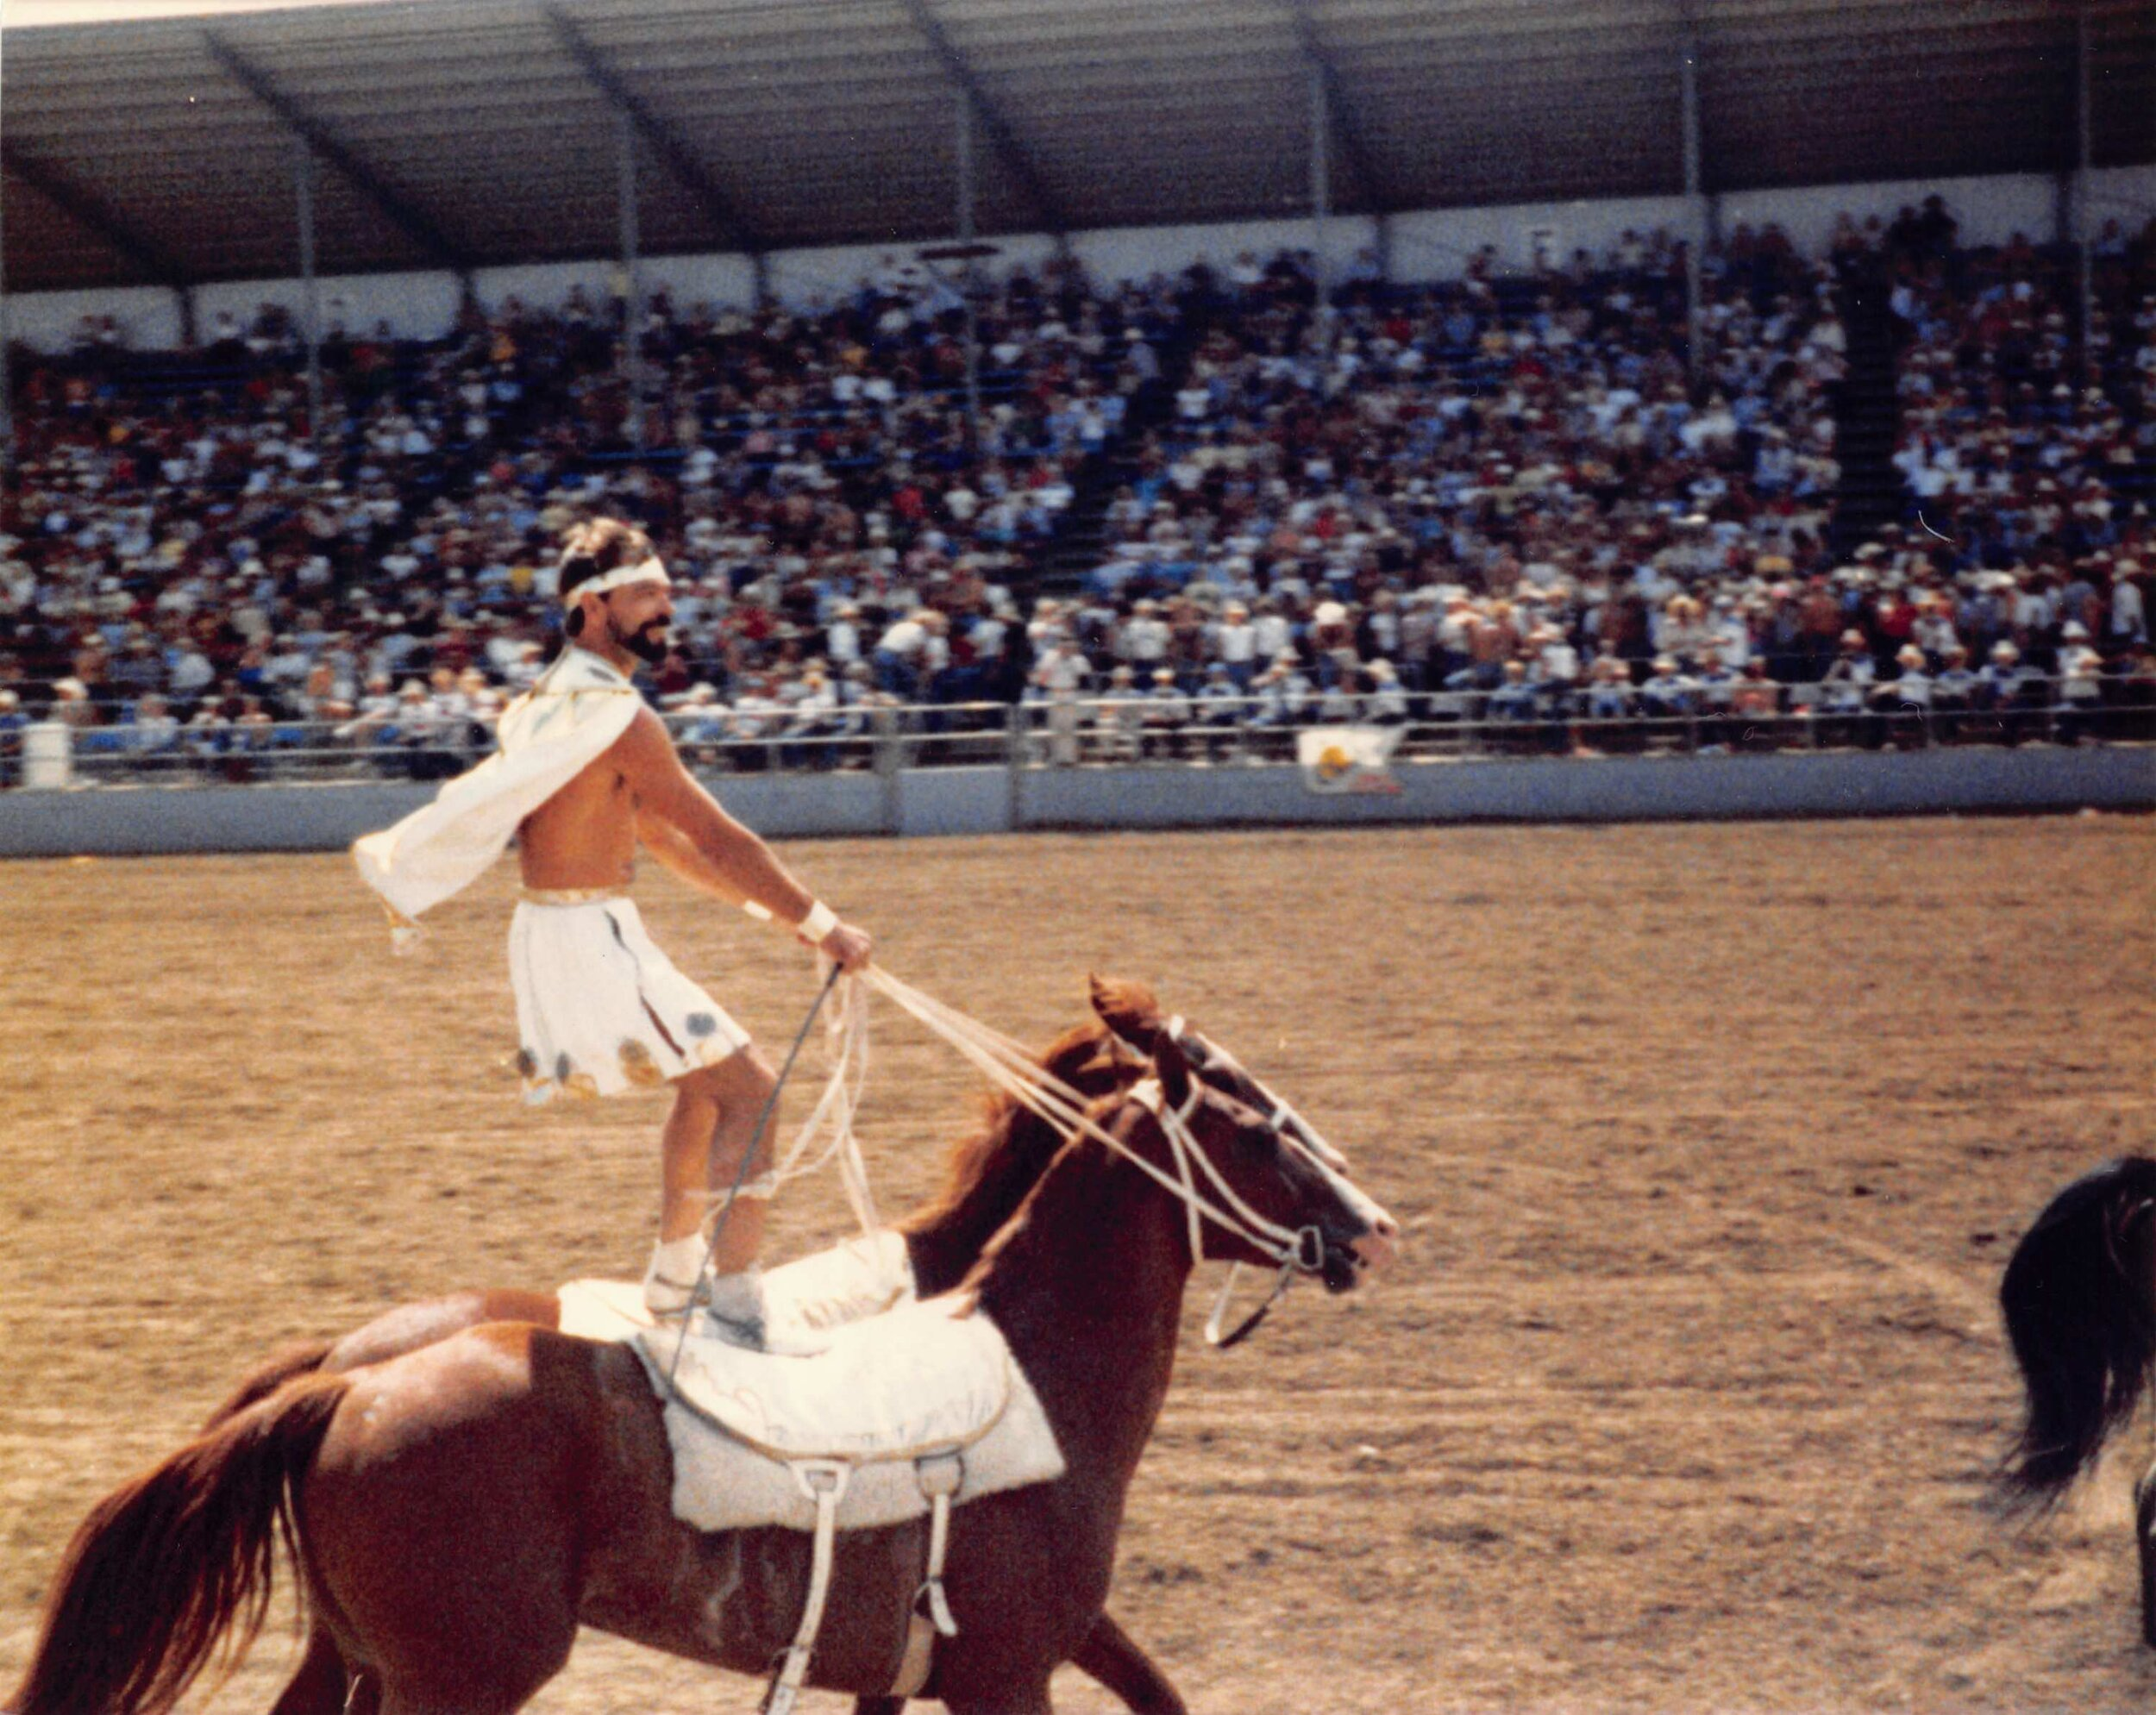
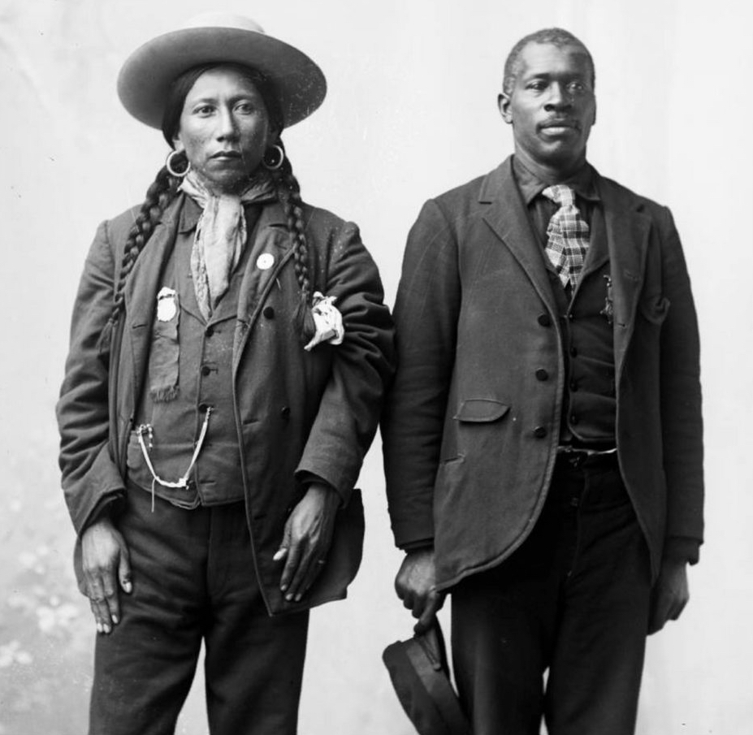
“There Ain’t No Queer in Cowboy”: Challenging Conservative, Heteronormative Perceptions of Cowboys in American Popular Culture
Kaz Brannon
History Department, College of Arts and Sciences
ABSTRACT
Upon the release of Brokeback Mountain in 2005, the film received immense critical acclaim and even won an Academy Award nomination. However, despite being lauded for its portrayal of homosexuality in the 1960s American West, it ultimately did not win an Oscar. Arguably, this decision came about due to what film critic Kenneth Turan called “unspoken fears and unconscious prejudices” among discomforted viewers. Typical responses among general audiences included remarks that the film did not accurately depict cowboy culture, and that cowboy legends such as John Wayne would “be rolling in his grave.” These responses highlight the fundamental issues in the public’s perceptions of American cowboys as white, hyper-masculine, and heterosexual. Historical evidence points out that the American cowboy derives from Mexican vaqueros, as well as Spanish, Native American, Black, and Anglo influences which have been amalgamated and whitened into the popular cowboy image of today. The romanticized image of the all-American cowboy as rugged, masculine, and charmingly heterosexual has ben cemented by figures such as Roy Rogers, Gene Autry, and John Wayne, who were in turn claimed and propagated by the conservative, New Right political movement in the mid-20th century. These figures deliberately whitewashed and heterosexualized cowboy lifestyles, as well as ignored both historical and literary evidence that supports homosexuality and same-sex partnerships in cowboy and Western cultures. This presentation challenges New Right conservative perceptions of the stereotypical American cowboy by examining historical and literary evidence that supports the existence of queer cowboy culture. Additionally, I highlight how the LGBTQIA+ community pushed back against narrow and ahistorical understandings of cowboy culture with an increase in queer cowboy representation starting in the 1960s through avenues such as songs, films, and openly gay rodeos.
WHAT IS A COWBOY?
Popular media often conflates historical cowboys with cattle rustlers, sharp shooters, bandits, and the occasional vigilante sheriff. Historically, though, cowboys were hired laborers who drove cattle herds from one farm to another. Typically, cowboys worked for a single season, therefore it was not a steady occupation. However, being a cowboy was more than a job, it was a way of life.
WHO WERE COWBOYS?
Cowboys foundationally derive from Spanish, Mexican, Native American, and Black backgrounds, all of which have been whitened and amalgamated into what is commonly thought of as an all-American cowboy today.
PERCEPTIONS OF QUEER COWBOYS IN MEDIA
RECLAIMING QUEERNESS IN COWBOY CULTURE
From the late 1960s on, the queer community fought back to reclaim cowboys as their own. In some cases, media representation of queer cowboys were meant to mock heterosexual, hypermasculine cowboy imagery in films like Midnight Cowboy and Lonesome Cowboys. In others, queer cowboy representation was meant to reclaim queer spaces through community and healing such as with Rainbow Riders and Willie Nelson’s cover of the song “Cowboys Are Frequently, Secretly Fond of Each Other.”
Photo credit: Glen Weldon, “20 years later, is it time to quit ‘Brokeback Mountain’?” NPR, September 6, 2025, https://www.npr.org/2025/09/06/nx-s1-5529288/brokeback-mountain-20-years-old.
CONCLUSIONS
The public response to Brokeback Mountain not only prompted conversations of queerness in cowboy culture but also challenged commonly held perceptions of the heteronormative cowboy image. When myths are regraded as fact, it not only hurts those whose history is concerned, but it also creates further dissonance between what is real and what is perceived as real. For many conservatives during the New Right era, figures like John Wayne represented an ideal Americanism: straight, white, and hypermasculine. However, this image buried queer cowboy historical and literary narratives popular during the mid- to late-1800s. Though New Right Conservatives gatekept cowboy culture, at the same time the counter-culture movement of the 1960s pushed back and openly mocked the straight-shooter image while upholding cowboy queerness. Homosexuality in cowboy culture was much more prevalent in Western history and popular culture than is perceived in modern-day interpretations, but is frequently overshadowed and robbed by heteronormative, homophobic myth.
“It is a perversion of Westerns. All Western heroes have been portrayed as straight shooters—and that doesn’t just mean hitting a target with a gun.”
--Robert Knight on Marvel Comics’ The Rawhide Kid
“There ain’t no queer in cowboy and I don’t care for anyone suggesting there is.”
--Jim-Bob Zimmerschied, Wyoming cowboy
COWBOYS IN AMERICAN POP CULTURE
“The cowboy in various guises is popularly accepted by Americans as a symbol, indicative of his stature as myth. He represents rugged individualism in beer commercials, unadorned masculinity in cigarette advertising, and ultimate heroism in fiction and film.”
--William Savage, The Cowboy Hero
John Wayne, aka “the Duke,” often portrayed individualistic, common sense, gunslinging cowboys who represented a type of hypermasculinity embraced by many traditional conservatives in the mid-20th century. With “benevolent and all-wise” monolithic characterizations, Wayne embodied a bootstraps Americanism so powerful the basic conceptualizations of all cowboys became “the promise of American in a cowboy suit” (Savage, 24).
COWBOY CULTURE IS QUEER
The popular image of the heterosexual, hypermasculine cowboy is not supported in history or in literature. Due to relaxed propriety demands and standards, governance on gender and sexuality was remarkably different in the West than on the East coast. Cowboy relationships between ‘pardners’ often exemplified same-sex desire and frontier life. This desire is reflected in works from Western literary figures such as Badger Clark, Ralph Waldo Emerson, and Henry David Thoreau.
References
Bronski, Michael. A Queer History of the United States. Beacon Press, 2011.
Fuller, Marc, Christopher Fuller, and Alyssa Harris. Ute Dick Charlie and Black cowboy John Tyler. Digital image. Black Music Project. 2023. https://www.blackmusicproject.com/exhibit/the-black-history-of-cowboys-and-cowboy-music.
John Wayne Enterprises. John Wayne with his signature eye patch on the set of True Grit in Ridgway, Colorado. Digital image. https://www.johnwayne.com/journal/news/2019-7-2-john-wayne-grit-series/.
Liebrand, Claudia. “’John Wayne wouldn’t like gay cowboys’: Ang Lee’s Western Brokeback Mountain and the genre tradition.” Queer Lecture series. Proceedings of the 25th International Conference on Literature and Psychanalysis, October 2008.
Packard, Chris. Queer Cowboys. Palgrave Macmillan, 2005.
Sauvegeau, Carly. “Rainbow Rodeo: Reno and the Gay Rodeo Movement.” Nevada Humanities. June 18, 2020. https://www.nevadahumanities.org/blog/2020/6/17/rainbow-rodeo-reno-and-the-gay-rodeo-movement.
Savage, William W. The Cowboy Hero: His Image in American History and Culture. 1st ed. University of Oklahoma Press, 1979.
Weldon, Glen. “20 years later, is it time to quit ‘Brokeback Mountain’?” NPR. September 6, 2025. https://www.npr.org/2025/09/06/nx-s1-5529288/brokeback-mountain-20-years-old.
Acknowledgements
Thank you to Dr. Rob Ferguson for sponsoring this project and for being a stalwart ally to the queer community.
The traditional American cowboy foundationally derives from Spanish, Mexican, Black, and Native American roots. Pictured here: Ute Dick Charlie (L) and Black cowboy John Taylor (R). Photo courtesy of Marc Fuller, Christopher Fuller, and Alyssa Harris, “The Black History of Cowboys and Cowboy Music,” Black Music Project, 2023, https://www.blackmusicproject.com/exhibit/the-black-history-of-cowboys-and-cowboy-music.
Reno Gay Rodeo Trick Rider. Photo credit: Ray Martin and Michael Yaeger. Carly Sauvegeau, “Rainbow Rodeo: Reno and the Gay Rodeo Movement,” Nevada Humanities, June 18, 2020, https://www.nevadahumanities.org/blog/2020/6/17/rainbow-rodeo-reno-and-the-gay-rodeo-movement.
Photo courtesy of John Wayne Enterprises.

