Slide 1
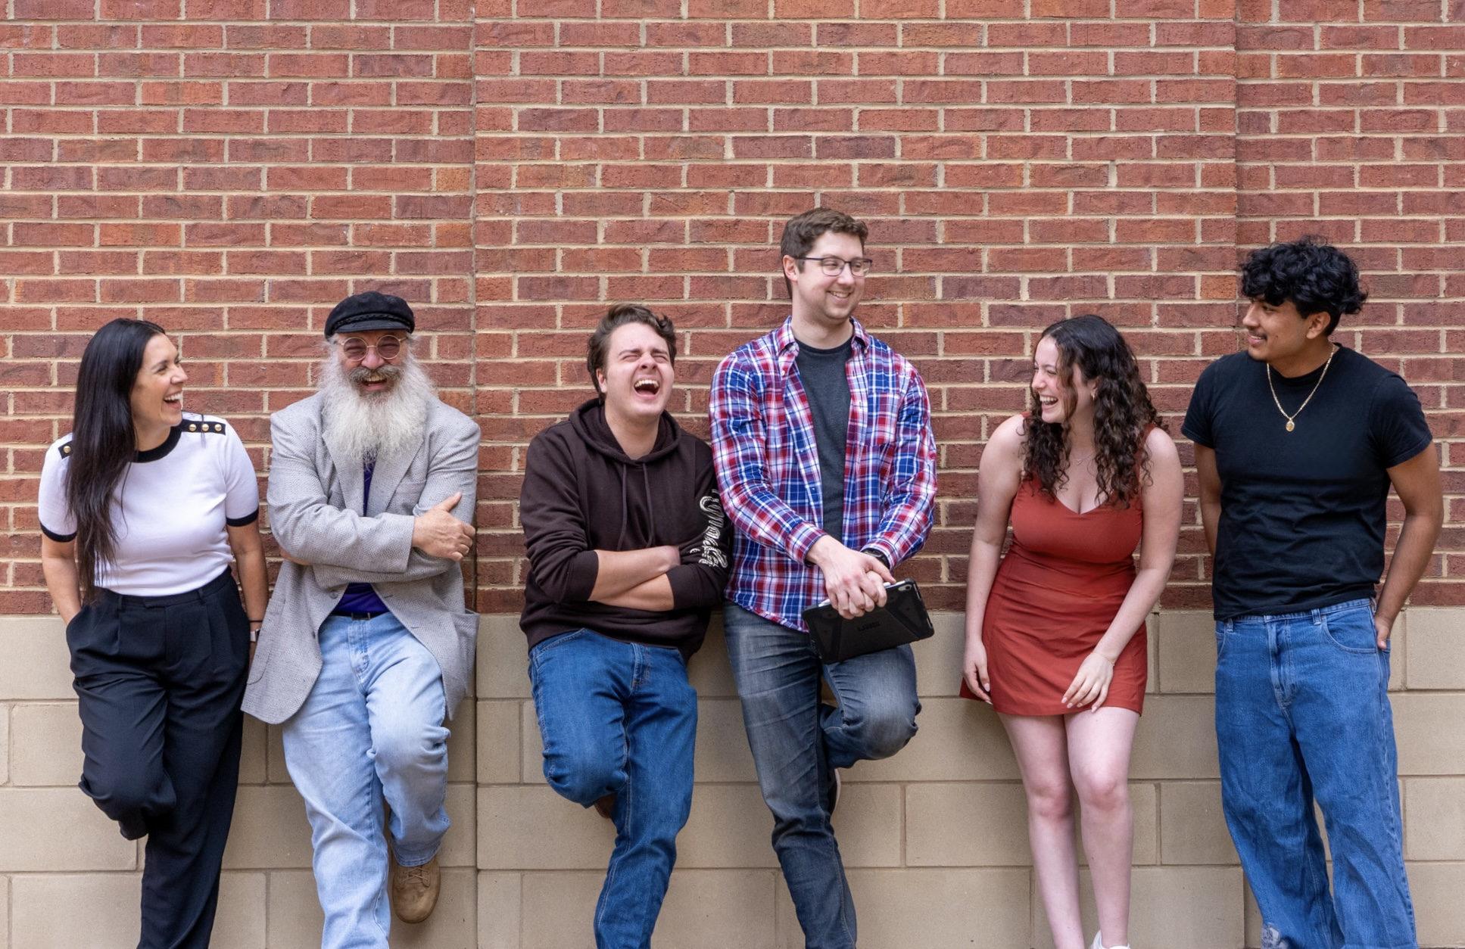
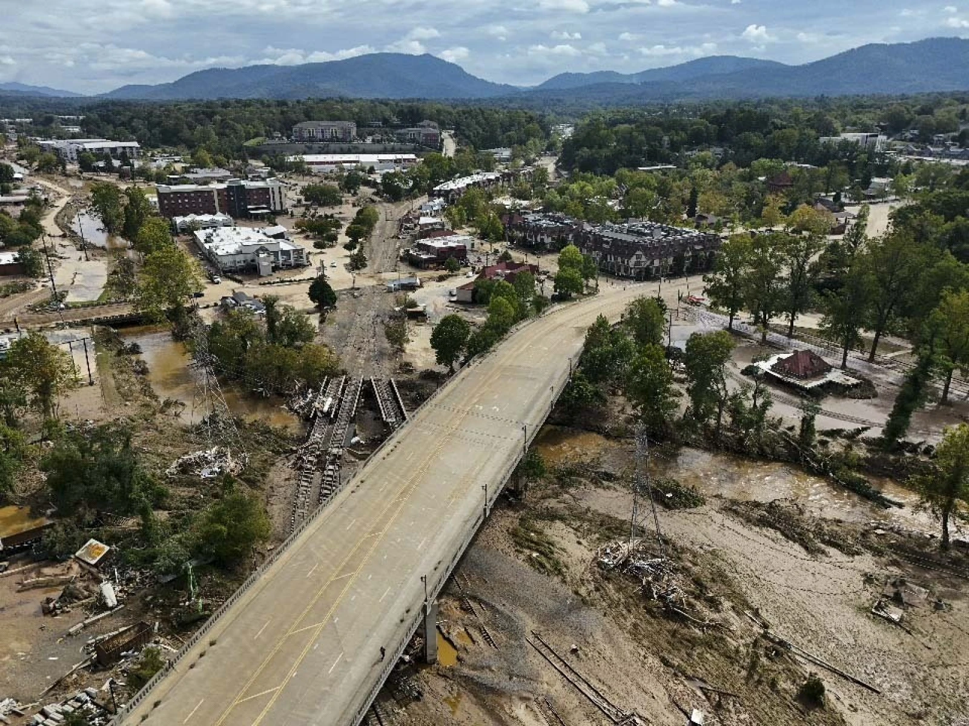
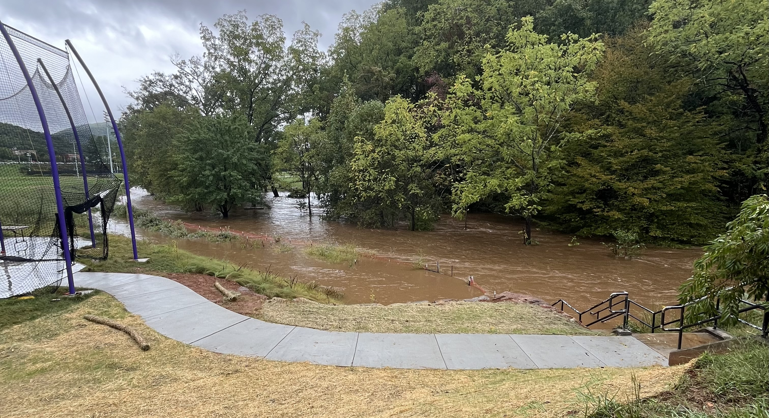
Voices of Resilience: Documenting the Human Impact of Hurricane Helene in Western North Carolina
Mindy Weathers, PhD, MPH; Matt Binford, PhD; Mark Poff; Megan Baker; Jacob Pendergraph; Frankie Gonzalez-Nicolas
Communication Department, College of Arts and Sciences
ABSTRACT
In late September 2024, Hurricane Helene unleashed catastrophic forces across the western Appalachian region of North Carolina, claiming at least 104 lives, with 200 more individuals missing, and inflicting extensive damage on infrastructure and residential spaces (Arriens, 2024; Nicholls et al., 2024). Hurricane Helene deposited unprecedented rainfall across communities such as Asheville, Swannanoa, Spruce Pine, Chimney Rock, and others, highlighting the harsh realities of climate change (Osaka & Kaplan, 2024). As climate-driven disasters intensify, there is an urgent need to center human experiences alongside scientific data (Moezzi et al., 2017). This project documents and analyzes the lived experiences of individuals directly impacted by Hurricane Helene using an oral history methodology.
Using a qualitative research design, we are conducting in-depth interviews with affected residents, emergency responders, and community leaders (n = 15 to date; data collection ongoing). Interviews are video- and audio-recorded and supplemented with still photography, observational field notes, and demographic surveys. Through narrative analysis, we examine how individuals experienced Hurricane Helene before, during, and after landfall, how resilience was enacted, and how recovery continues to unfold (Reynolds, 2024).
Beyond documentation, the project advances four core objectives: (1) generating a digital dataset to contribute to scholarship in climate communication and disaster response; (2) developing multimedia educational resources, including an interactive website; (3) engaging policymakers through community-informed recommendations; and (4) preserving these narratives within a publicly accessible digital archive.
By integrating storytelling with climate science, this project positions narrative as both data and intervention. Ultimately, it seeks to transform lived experience into actionable knowledge that strengthens disaster preparedness, informs equitable climate policy, and fosters long-term community resilience (Staddon, 2017).
OBJECTIVES
This project is dedicated to documenting the experiences of communities severely impacted by Hurricane Helene. Employing oral history methodology (Firouzkouhi & Zargham-Boroujeni, 2015), our project aims to achieve four objectives:
Document Personal Experiences: We are conducting in-depth interviews with residents, emergency responders, and community leaders who experienced Hurricane Helene firsthand. These narratives will illuminate the immediate impacts, the resilience demonstrated during recovery, and the ongoing challenges these communities continue to face.
Analyze Climate Communication: This project will significantly contribute to academic research by creating a unique digital dataset valuable for scholars studying climate change communication, disaster response, and community resilience. We will explore how collected narratives can be strategically used to enhance future understanding and mitigation of hurricane impacts. We will investigate the potential contributions these stories can make toward improving disaster preparedness and response strategies. Findings will be shared through academic conferences and publications, enriching the field with new empirical evidence and methodological insights.
Develop Educational Resources: We will create a suite of multimedia materials to disseminate these stories to a broader audience. This includes the production of digital archives to preserve the oral histories collected, a short documentary film to visualize these stories, and an interactive web platform designed to educate the public about disaster preparedness and resilience.
Engage Policy Makers: By leveraging the insights gained from these narratives, we intend to advocate for more effective policy measures at both local and state levels. Our goal is to use the real-world experiences and needs of communities to inform and enhance disaster response strategies and promote comprehensive climate adaptation policies that are rooted in community-based knowledge and experiences.
PLAN OF ACTION
Recruitment uses a snowball sampling method, starting with known affected individuals and expanding through their networks. As we compile a list of potential participants, we vet each one to understand their experiences and stories. Selected participants (age 18 and older) are invited to participate in a face-to-face in-depth interview. We conduct interviews using a semi-structured guide to elicit detailed personal narratives about experiences before, during, and after Hurricane Helene. Interviews are video- and audio-recorded, complemented by still images of participants and observational field notes. Before participating in the project, participants sign an electronic consent form and complete a demographic survey, which takes approximately 15 minutes. Participation in the interview typically takes between 1-2 hours, depending on the participant’s willingness to share their story.
OUTCOMES & CONTRIBUTIONS
The significance of this project extends beyond mere documentation, aiming to provide a nuanced understanding of disaster impacts and resilience strategies from the perspectives of those directly affected. It will contribute significantly in four ways:
Advancing Knowledge: By focusing on personal narratives, this research will deepen the academic and practical understanding of disaster response and recovery, adding a socio-cultural dimension to the data on hurricanes. This granular view enriches our comprehension of the immediate and long-term community impacts, filling the gaps often left by broader quantitative studies.
Informing Policy and Practice: Insights from firsthand accounts will be crucial in shaping effective disaster response and mitigation policies. Understanding the specific needs and challenges faced by communities during Hurricane Helene will enable policymakers to devise targeted, equitable interventions that meet actual on-the-ground conditions. These evidence-based recommendations will enhance disaster preparedness and response practices across various sectors, revealing critical gaps and suggesting improvements.
Educational Impact: The project will also generate accessible multimedia resources to educate local communities and institutions about hurricane risks and preparedness. These resources aim to train disaster response professionals and inform the public about effective strategies, boosting community resilience. Public engagement through these educational initiatives is crucial for fostering a culture of preparedness and resilience, particularly in regions prone to such disasters like the western Appalachian region of North Carolina.
Cultural Preservation: Archiving these stories ensures that the experiences of those impacted by Hurricane Helene are preserved as part of the historical record, providing a resource for future research and a repository for understanding the human aspects of disaster impacts.
Overall, this project is crucial in enhancing our understanding of how climate change communication and
disaster management intersect, particularly through the lens of storytelling. By documenting the firsthand accounts of those impacted by Hurricane Helene, this initiative will significantly enrich the fields of disaster management, public policy, and community resilience. It offers a uniquely personal perspective on hurricane impacts, highlighting the real-world effects of environmental changes and underscoring the urgent need for strategic, informed responses. This project not only assists stakeholders in better preparing and responding to future disasters but also deepens our understanding of how environmental communication influences perceptions of climate change’s impacts.
RESEARCH TEAM
Research Team Photo. From Left to Right: Mindy Weathers, PhD, MPH, Professor of Health Communication (Principal Investigator), Mark Poff, Assistant Professor of Practice in Broadcasting (CO-PI), Jacob Pendergraph (Broadcasting Research Assistant), Matt Binford, PhD, Assistant Professor of Broadcasting (CO-PI), Megan Baker (Communication Research Assistant), Frankie Gonzalez-Nicolas (Communication Research Assistant)
REFERENCES
Arriens, J. (2024, October 23). Hurricane Helene highlights Appalachia’s rising flood risk. National Wildlife Federation Blog. Retrieved from https://blog.nwf.org/2024/10/ hurricane-helene-highlights-appalachias-rising-flood-risk/
Firouzkouhi, M., & Zargham-Boroujeni, A. (2015). Data analysis in oral history: A new approach in historical research. Iranian Journal of Nursing and Midwifery Research, 20(2), 161-164.
Moezzi, M, Janda, K. B., & Rotmann, S. (2017). Using stories, narratives, and storytelling in energy and climate change research. Energy Research & Social Science, 31(1), 1-10.
Nicholls, C., Paddison, L., Salahieh, N., Ebrahimji, A., Zdanowicz, C., Chavez, N., Hammond, E., Elassar, A., & Tucker, E. (2024, September 29). September 27, 2024 news on Tropical Depression Helene. CNN Weather. Retrieved from https://www. cnn.com/weather/live-news/hurricane-helene-florida-georgia-09-27-24/index.html
Osaka, S., & Kaplan, S. (2024, October 1). Before the floods, Asheville was called a “climate haven.” Is anywhere safe? The Washington Post. Retrieved from https:// www. washingtonpost.com/climate-environment/2024/10/01/asheville-climate-haven-flooding-hurricane/
Payne, K., Collins, J., & Whittle, P. (2024, September 30). Hurricane Helene’s aftermath: Supplies rushed to isolated communities as deaths rise. AP News. Retrieved from https://apnews.com/article/hurricane-helene-north-carolina-asheville-f02869c7 d01e68f2d7f0553abb82252f
Reynolds, B. M. (2024). What’s so critical about critical oral history? The Oral History Review, 51(1), 47-69.
Staddon, S. (2017). Reflecting on personal and professional energy stories in energy demand research. Energy Research & Social Science, 31(1), 158-163.
Debris is seen in the aftermath of Hurricane Helene, Sept. 30, 2024, in Asheville, N.C. (AP Photo/Mike Stewart). https://apnews.com/article/hurricane-helene-north-carolina-asheville-f02869c7d01e68f2d7f0553abb82252f
Flooding on Western Carolina University’s campus next to Village Student Housing on September 27, 2024. (WCU Student Photo/Megan Baker).

