Slide 1

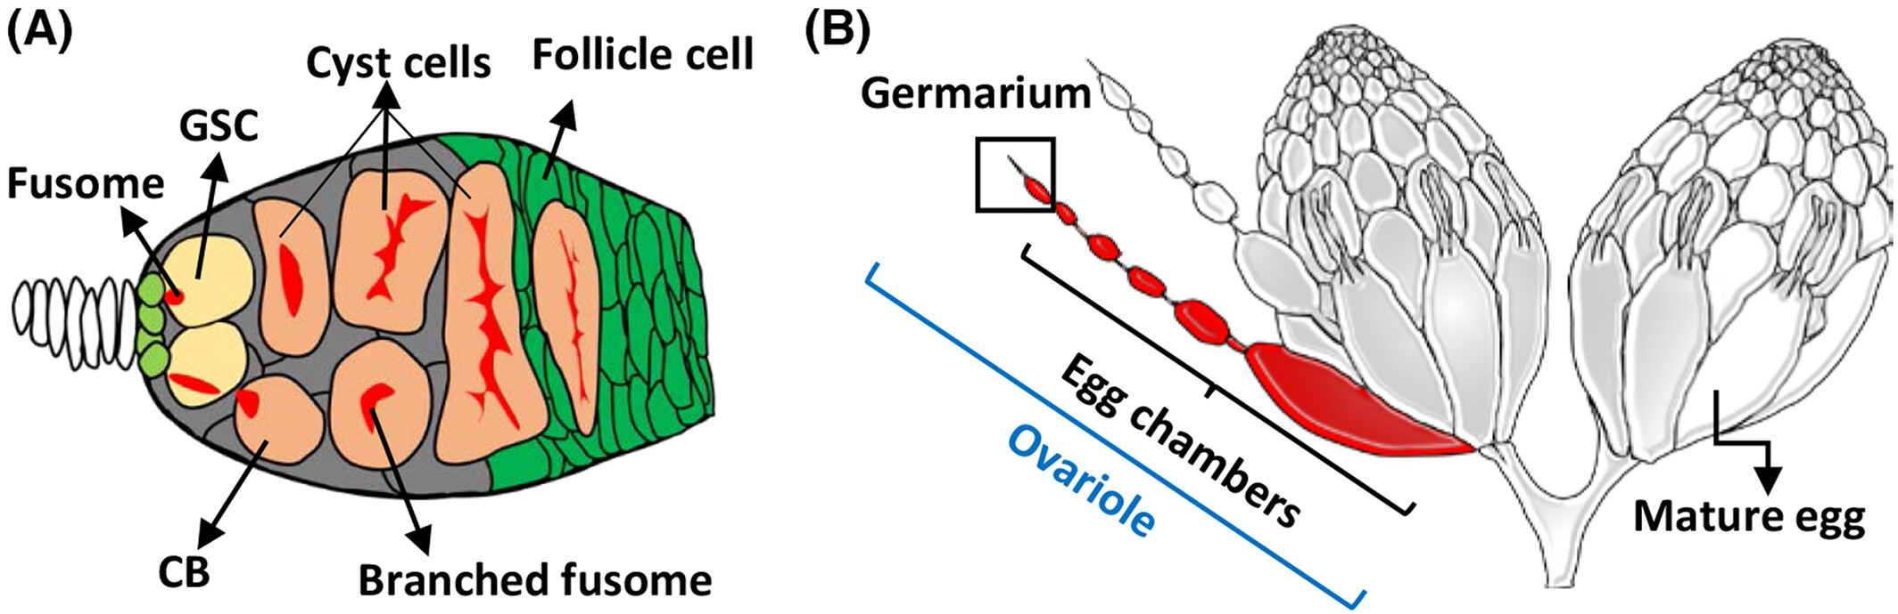
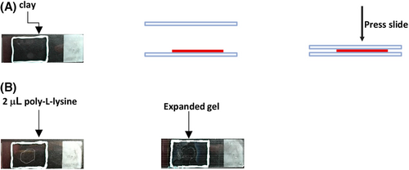
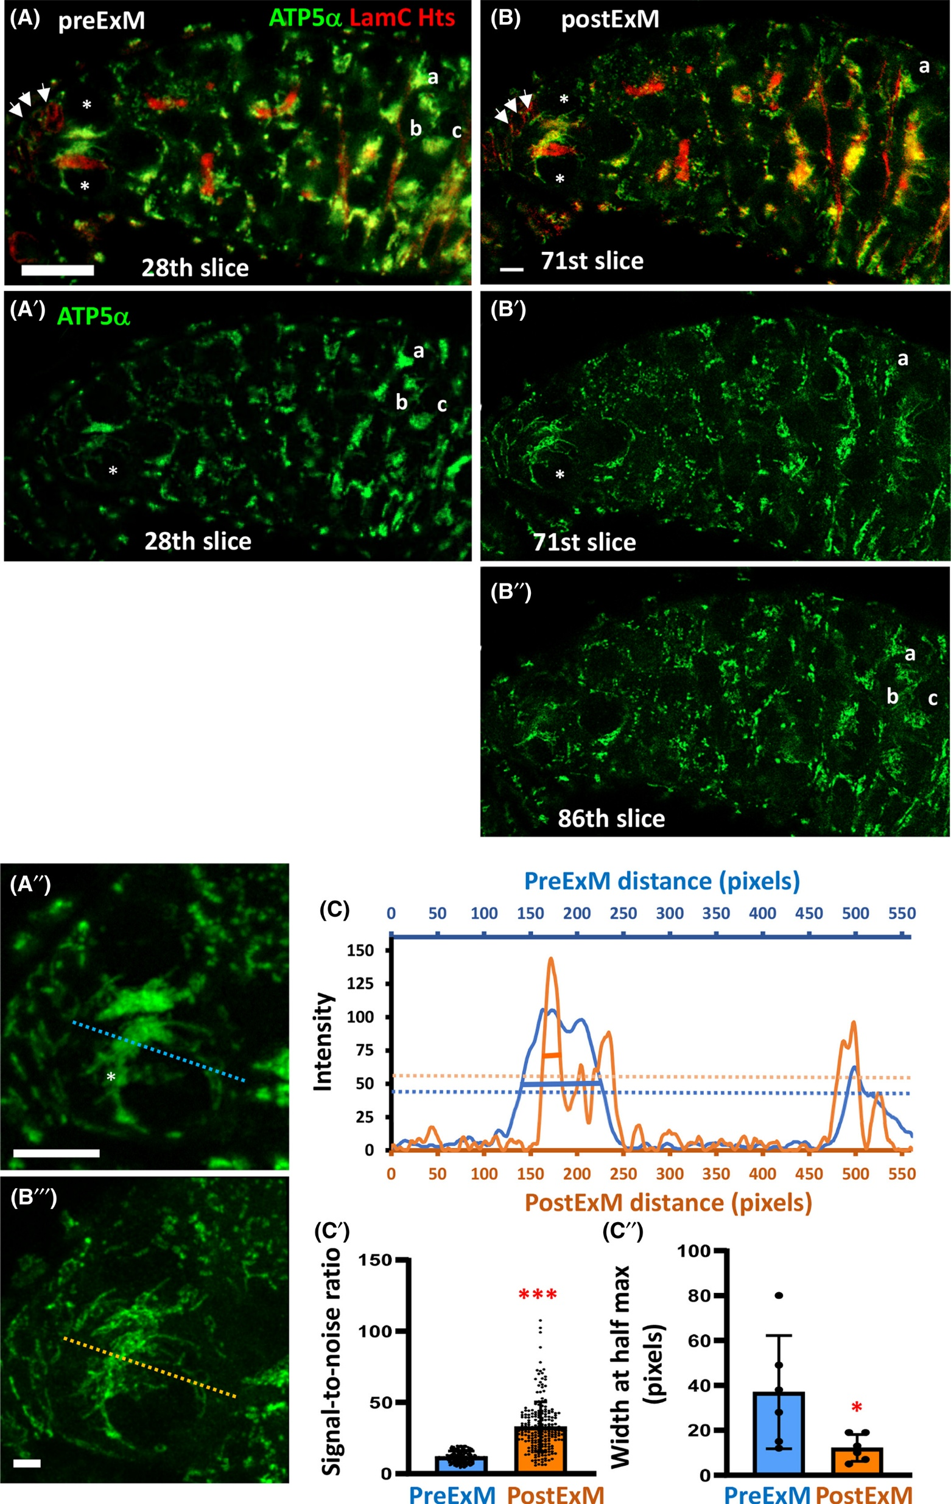
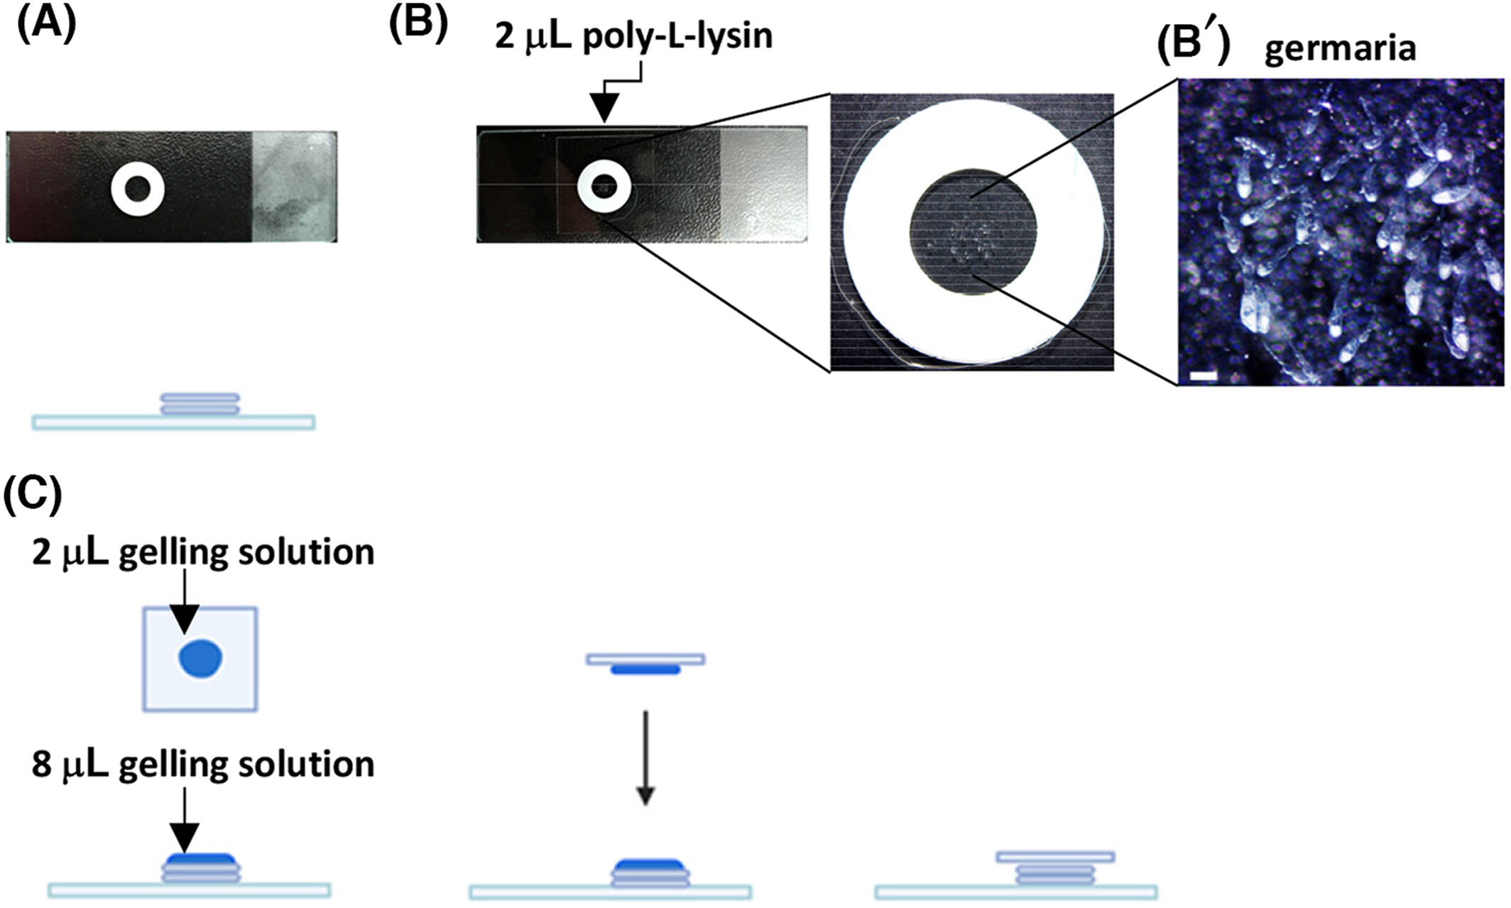
Expansion Microscopy protocol development for micro-structural Analysis of the Drosophila melanogaster germarium
Isaac Douglas and Subhshri Sahu, Department of Biology, Western Carolina University, NC
Abstract
Expansion microscopy (ExM) is a super resolution imaging technique that physically enlarges biological samples, enabling higher-resolution imaging using conventional fluorescence microscopy. Traditional fluorescence microscopy can sometimes produce low-quality images and may be limited in its ability to clearly resolve structures below a certain size threshold. The application of ExM offers a more accessible method for studying cellular organization and developmental processes and may support investigations into mechanisms regulating stem cell differentiation and oogenesis. The objective of this proposed study is to develop a protocol to apply ExM to the germarium of Drosophila melanogaster to improve visualization of structures involved in early oogenesis. Following standard dissection and Immunofluorescence labeling, the D. melanogaster germarium are treated with Acryloyl X-SE to allow crosslinking between antibodies, gel, and cellular structure. Then, the germarium is incubated in a gelling solution containing Proteinase K, to soften the samples and prevent/ reduce tearing and distortion. Lastly, the samples are submerged in distilled water and allowed to expand. We hope the final imaging yields an expansion of 4X the original sample size.
The Drosophila Ovary
Expansion
Following digestion, the germarium are transferred to a slide with a clay well coated with
Poly-L-Lysine (see below) and submerged in distilled water to expand.
Figure 1- The drosophila germarium (A) and Ovaries (B).²
Materials
Distilled water
Poly-L-lysine
Clay
Materials and Methods
Immunofluoresence
Materials¹
Primary antibodies (mouse anti-LamC, mouse anti-αspectrin, rabbit anti-Dcp1)
Secondary antibodies (goat anti mouse Alexa 488, goat anti rabbit Alexa 568)
Block- PBT (PBS and Triton X-100)
Immunostaining Steps ¹
Dissect
Fix
Wash
Block
Wash
Figure 3- Steps for mounting expanded gel on the slide.²
6. Primary antibodies
7. Day 2: Wash
8. Secondary antibodies
9. Vectashield (with DAPI)
Imaging
Gelation and Digestion
Wells are made using paper hole reinforcing rings and coating the area inside the ring with
Poly-L-Lysine to adhere germarium to the slide. Germarium are gelled, and a digestion buffer
containing proteinase K is added to soften the germarium for expansion. Pre-expansion imaging
can be done after gelation and digestion
Green- ATP5α labels mitochondria
Red- LamC Hts labels fusomes
Figure 4- Representative images of a one-week-old germarium before expansion (A) and after (B). LamC labels the nuclear envelope of GSC niche cells (red; indicated by arrows). A" and B''' are enlarged views of GSCs shown in only the green channel. Statistical differences in C' and C'' were analyzed by two-tailed Student's t-test. *, P < 0.05; ***, P < 0.001. Scale bars in A and B are 10 μm, and in A' and B' are 5 μm. ²
Materials
PBST
AcX solution
Gelling Solution
Poly-L-Lysine
Hole reinforcing rings
Digestion Buffer
Proteinase k
PBS
Discussion
We are in the process of developing a protocol for ExM on wild type flies, where our goal is to better vizualize stem cells and the differences in cyst stages.
References
1. Sahu Lab, SOP for immunostaining
2.Lin, Chi‐Hung, et al. “Expansion Microscopy‐Based Imaging for Visualization of Mitochondria in Drosophila Ovarian Germline Stem Cells.” FEBS Open Bio, vol. 12, no. 12, 4 Nov. 2022, pp. 2102–2110, https://doi.org/10.1002/2211-5463.13506.
‌
Figure 2- Steps for the gelation process. Scale bar is 200 μm (B’).²
Acknowledgments
Dr. Subhshri Sahu, Vega Faust, WCU Department of Biology

