Slide 1
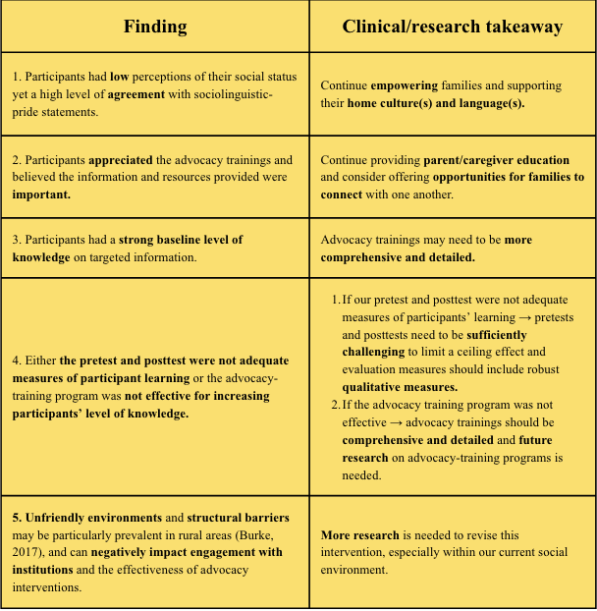
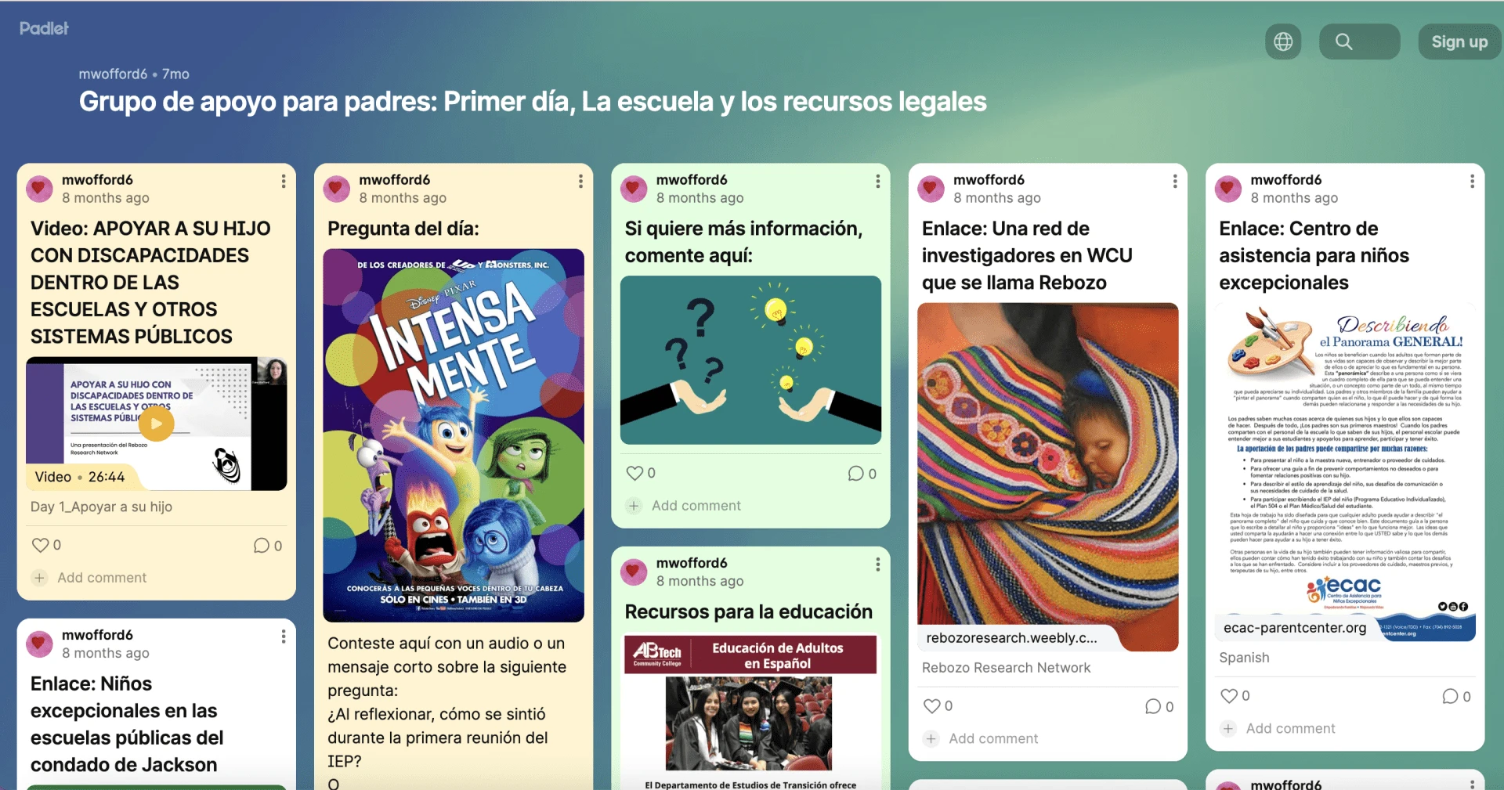
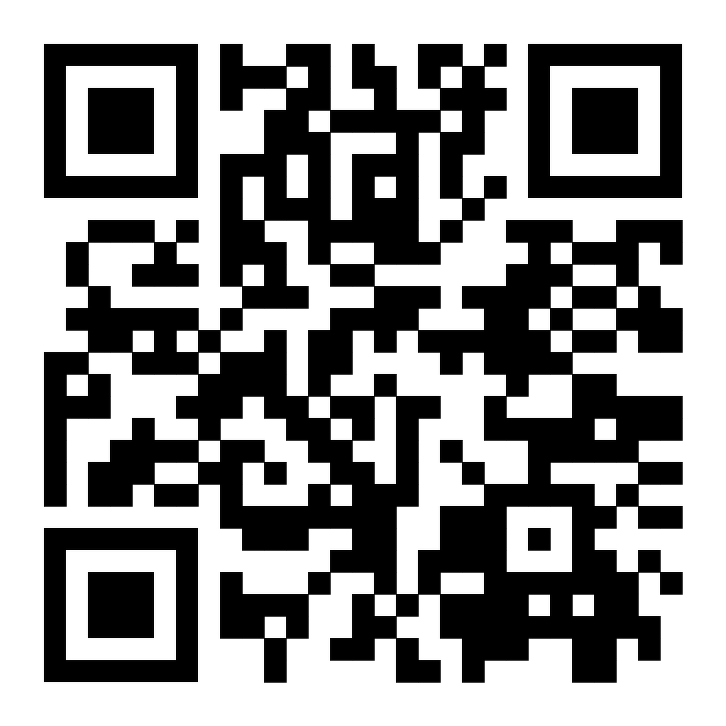

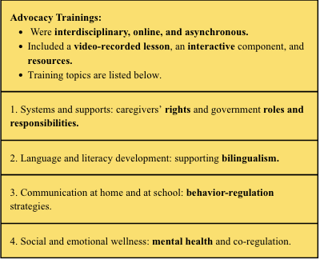
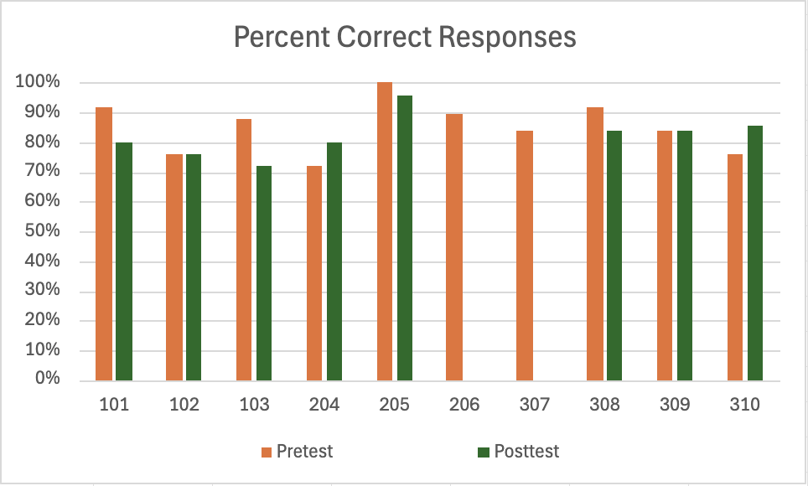
En las afueras: Implementing an Advocacy Training Program for Latine Families in Rural Areas
Rebecca Pechmann, Lindsey Morgan, Aaliyah Duncan, Sheyla Rodriguez Macario, and Mary Claire Wofford
Introduction
-In rural areas, Spanish-speaking families often have limited access to appropriate speech-language pathology services (Malik et al., 2018; Morgan et al., 2016).
-Advocacy trainings are effective among Latine parents/family members of children with disabilities (Burke et al., 2016; Luelmo & Kasari, 2021; and Rios et al., 2021).
-The training programs utilized in previous studies were lengthy or individualized.
-We attempt to increase feasbility of implementation of and engagement with a brief group advocacy-training program.
The Present Study
- Participants: Ten Spanish-speaking mothers of children with communication-related disabilities who are living in rural western North Carolina and who have experience accessing speech-language pathology services in rural areas.
- Methods: As a part of this study, participants:
1) Participated in an initial interview, 2) Completed multiple-choice pretests, 3) Engaged with four interactive advocacy trainings (see chart below), 4) Completed multiple-choice posttests, 5) Participated in an exit interview.
The Present Study (Continued)
Social Validity
-We assessed social validity via exit interviews with participants.
-Participants expressed gratitude for the trainings and the opportunity to connect with other participants and reflected on the importance of the knowledge presented and resources provided.
-One participant stated, “Pues yo creo que sí es importante saber los derechos que uno tiene como papás de ellos” and described increasing their communication with their child’s school because of the trainings.
-Another participant stated, “De hecho, de ahí tomé la información de GED- de este Padlet que ya mandaba con los recursos que podíamos utilizar.”
Discussion
We delivered brief, online advocacy trainings and evaluated their effectiveness via pretests and posttests.
- Results and clinical/research takeaways are summarized in the chart in the next column.
References
Disclosures and Acknowledgements
To support this research, Rebecca Pechmann and Lindsey Morgan received graduate and research assistantships through WCU. Rebecca Pechmann also received funding through ASHA’s Students Preparing for Academic Research Careers program. Dr. Mary Clarie Wofford received funding from ASHFoundation’s New Investigator’s Research Grant and the WCU Provost Scholarly Development Grant. Aaliyah Duncan and Sheyla Rodriguez Macario also were also supported by the ASHFoundation’s New Investigator’s Research Grant.
I am extremely thankful to our research team, the professors of the Communication Sciences and Disorders department, my family, and my friends for their collaborations and support.
A screenshot of the padlet webpage for our “systems and supports” advocacy training.
Results
- MacArthur Scale of Subjective Social Status (n = 7): average rating of perceived social status within the United States : 3.87/10, range: 1-6; average rating of perceived social status within the participants’ communities: 5.01/10, range: 1-7.
-Sociolinguistic pride questionnaire (n = 7): average score: 3.19/4, range: 2.69-3.72/4.
-Pretest and posttest: scores for each participant are illustrated in the graph below. There was no significant difference between pretest and posttest scores (paired t-test: t=0.869, p=0.414).
Department of Communication Sciences and Disorders, College of Health and Human Sciences, Western Carolina University

