Slide 1

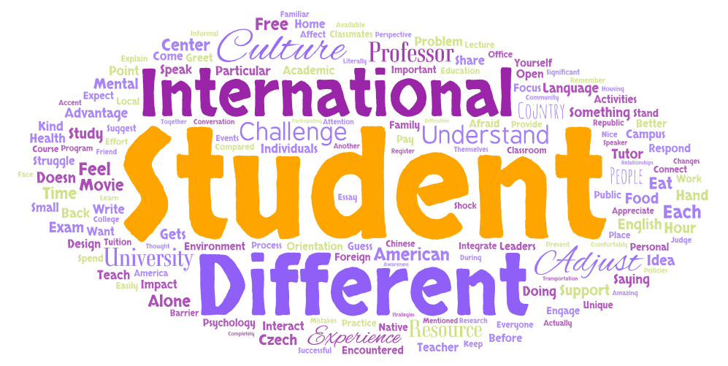
HOW DO INTERNATIONAL STUDENTS ADJUST CULTURALLY TO COLLEGE?
Richard Antwi
Literature Review
Introduction
Findings
The literature highlights the complex nature of international students’ cultural adjustment to college, particularly the interplay of socio-cultural, academic and psychological factors. Studies have shown that socio-cultural adaptation challenges such as language barriers and difficulty in building relationships with host communities have a great impact on students’ integration and general wellbeing (Ammigan et al., 2023). Studies emphasize the significant cultural differences in teaching styles, classroom engagement and assessment methods pose challenges to international students (Bastien et. al., 2018). Additionally, research indicates that international students often experience academic disorientation when they transition from a more directive pedagogical system to the independence learning environment typical of Western higher educational institutions (McClure, 2007). This study examines the cultural adjustment experience of international students at a regional Southeastern university in the United States.
The globalization of higher education has led to a growing number of international students seeking academic opportunities abroad. These students enrich the social and academic environments on campuses by contributing significantly to the cultural diversity on campuses. The cultural transition experience of these students can impact their academic and overall success (Bastien, et al., 2018). This research investigated the challenges international students goes through while adjusting culturally to college life in the United States. By analyzing the cultural adjustment experiences, this research aims to improve international students’ experiences by identifying insights for improving institutional support system for international students.
The study revealed five major themes: difficulty in adjusting to the food preferences and social interactions; the interactive and participatory classroom setting as challenging and enriching; accessibility of academic and administrative support; forming a sense of belonging as critical to social integration; and their status presenting unique opportunities. These findings are crucial as they provide insights regarding the experiences and challenges of international students as they transition to college life.
Discussion
The findings reveal that international students experience challenges with cultural differences such as food preferences, language barriers and social integration. The interactive learning environment and the availability of institutional support resources are critical to their transition. Despite their resilience, students emphasize the need for a more inclusive and culturally responsive teaching methods and language support programs. These findings support earlier literature particularly Singh (2021) study on how international students overcome challenges in Malaysia. These insights underscore the importance of providing an inclusive and supportive campus environment for international students to thrive.
Figure 1
Word Cloud from Transcripts
Methods
I used a qualitative design and the research question that guided the study is, how do international students adjust culturally to college? To ensure diverse cultural and academic background, I interviewed three international students from China, Morocco and Czech Republic. Open-ended questions were used to encourage participants to share their personal stories and perspective from their own words. Each interview lasted for approximately 20 minutes and was audio-recorded and transcribed to ensure accuracy.
Implications
The findings reinforce the need for institutions to improve international students’ experiences, by prioritizing culturally responsive programs, expanding the availability of language and academic support services, and creating a more welcoming campus environment. Addressing these needs can support the academic success and socio-cultural adaptation of international students while enriching the institutional community with diverse global perspective.
Analysis
I used priori coding to identify themes in the data. I identified patterns and specific quotes to reflect the participants’ perspectives and experiences. The codes were based on the literature of Ammigan et al. (2023) and Kamran and Awan (2024).The analysis revealed five main themes: adjusting to the cultural differences, academic experience and engagement, support resources, social integration and community building, and resilience.
References
Ammigan, R., Veerasamy, Y. S., & Cruz, N. I. (2023). ‘Growing from an acorn to an oak tree’: a thematic analysis of international students’ cross-cultural adjustment in the United States. Studies in Higher Education, 48(4), 567-581.
McClure, J. W. (2007). International graduates’ cross-cultural adjustment: Experiences, coping strategies, and suggested programmatic responses. Teaching in Higher Education, 12(2), 199-217.
Bastien, G., Seifen-Adkins, T., & Johnson, L. R. (2018). Striving for success: Academic adjustment of international students in the US. Journal of International Students, 8(2), 1198-1219.
Kamran, K., & Awan, A. A. R. (2024). The American campus kaleidoscope: Examining the academic and social experiences of international students. Journal of International Students, 14(4), 919-938.
Singh, J. K. N. (2021). Academic resilience among international students: lived experiences of postgraduate international students in Malaysia. Asia Pacific Education Review, 22(1), 129-138.
Notes:
Download more poster presentation templates from FPPT.com

