Slide 1
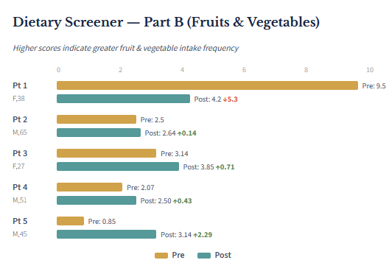
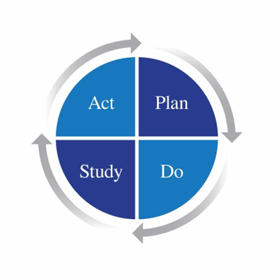
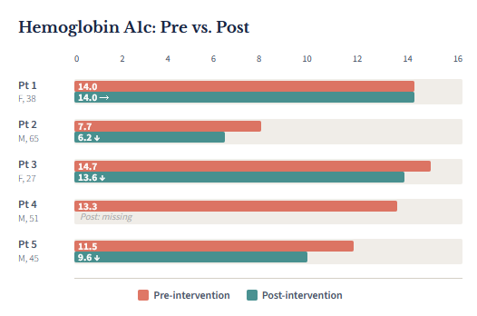
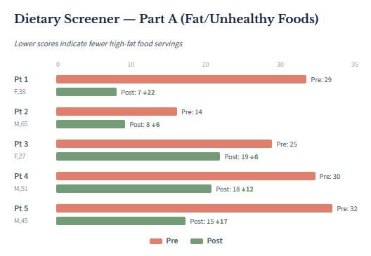

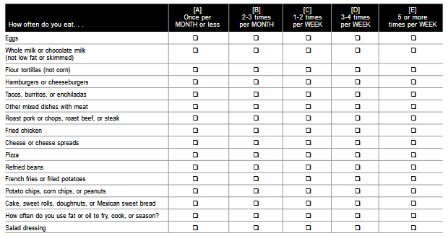
Using a Validated Dietary Screening Tool and Culturally Specific Dietary Education to reduce Hemoglobin A1c in the Hispanic Population.
Ryan Thomas Pettit, BSN, RN; Dr. Mariana Da Costa, DNP, RN, Project Chair; Dr. April Messer, Ph.D., RN, Committee Member
ABSTRACT
Type 2 diabetes mellitus (T2DM) is a leading cause of morbidity and mortality worldwide and requires long-term management that includes lifestyle modification and medication therapy. Culturally tailored dietary interventions may provide an effective approach to improving glycemic control but remain underutilized in clinical practice. This cohort study evaluated the impact of culturally tailored dietary education for Hispanic adults with T2DM using a validated dietary screening tool. After three months, participants demonstrated a mean decrease in HbA1c of 1.13 points, along with reduced consumption of unhealthy foods and increased intake of fruits and vegetables. These findings support the use of culturally adapted dietary screening tools as a valuable component of diabetes education and management in Hispanic populations.
INTRO / GOALS / OBJECTIVES
Significance of the Problem:
T2DM affects more than 40 million people in the U.S., approximately 12% of the population (CDC, 2024a).
Hispanic population experience higher races of diabetes and related complications when compared to non-Hispanic White populations (Vidal et al., 2022).
15% of the Hispanic population has T2DM with an increasing prevalence of 21% by 2040
These disparities include increased risk of:
Hospitalizations
Visual impairment
End-stage renal disease
Lower Extremity amputations
Diabetes-related mortality
Purpose of the Project This Doctor of Nursing Practice (DNP) project implemented a validated dietary screening tool combined with culturally tailored dietary education for Hispanic adults with T2DM at a community health clinic in Western North Carolina serving primarily migrant agricultural workers and their families.
Project Goal The goal of this project was to provide culturally sensitive dietary education to improve knowledge of healthy food choices among Hispanic adults with T2DM.
Expected Outcomes
Improved dietary knowledge related to culturally relevant food choices
Increased adoption of healthier dietary behaviors
Reduction in HbA1c levels
METHODS
Population
Hispanic Adults with T2DM
5 participants
Inclusion Criteria
Hispanic
Age >18 years
T2DM diagnosis
New to clinic or new to care management
Exclusion Criteria
Type 1 diabetes
Age < 18 years
Currently enrolled in care management’s dietary education
Interventions
Dietary education based on dietary screener
Evaluation
Pre- and post-intervention comparison of:
Dietary screening tool scores
HbA1c
Data collection
HbA1c (pre and post-intervention)
Dietary Screening Scores
Age
Timeframe
3-month implementation
Ethics This quality improvement project was reviewed by the WCU Institutional Review Board and determined to be exempt from IRB review.
RESULTS
Mean baseline HbA1c: 12.24 (SD = 2.803)
Mean post-intervention HbA1c: 10.85 (SD = 3.682)
Average HbA1c reduction: 1.13 (9.43%)
Average ending HbA1c: 10.85
Statistical significance: p= .071
Wilcoxon signed-rank test revealed statistically significant improvements dietary habits following education (z = -2.032, p = .04.)
The initial median score was 29 and follow-up was reduced to 15, indicating improved dietary choices.
A Spearman’s correlation found no significant relationship between change in dietary screener Part A and HbA1c (rs(4) = -.479, p = .521)
Spearman’s correlation found a significant negative relationship between change in dietary screener Part B and HbA1c (rs(4) = -.959, p=.041.)
Increased fruit and vegetable intake was strongly associated with HbA1c reduction.
CONCLUSION AND RECOMMENDATIONS
Despite the small sample size, the dietary screener identified improvements in dietary behaviors, including reduced intake of unhealthy foods and increased fruit and vegetable consumptions. Participants experienced a mean HbA1c reduction of 1.13 over three months, though only one participants achieved controlled diabetes )HbA1c <7.0%).
Further research on culturally tailored nutrition education for Hispanic populations is warranted.
Longer study duration (≥1 year) may improve enrollment and strengthen findings.
Future studies should account for confounding factors such as medication use, obesity, and physical activity.
Dietary screeners should be tested in larger, more diverse population to test feasibility and impact.
References
Scan QR code for project references.
Acknowledgements
Thank you to Vecinos Clinic for taking on my project, Dr. Graham Potter for accepting it, and especially Esperanza Dominguez for all the hard work she put in to help with this project.
Thank you to Dr. Mariana Da Costa and Dr. April Messer for helping me organize, write, and report this project.
Thank you to my family for all the support they gave me through this journey.
Figure 1. Dietary Screening Tool used to help evaluate for unhealthy dietary choices (Part A and Fruit and Vegetable intake (Part B, not show).
School of Nursing, College of Health and Human Sciences

