Slide 1

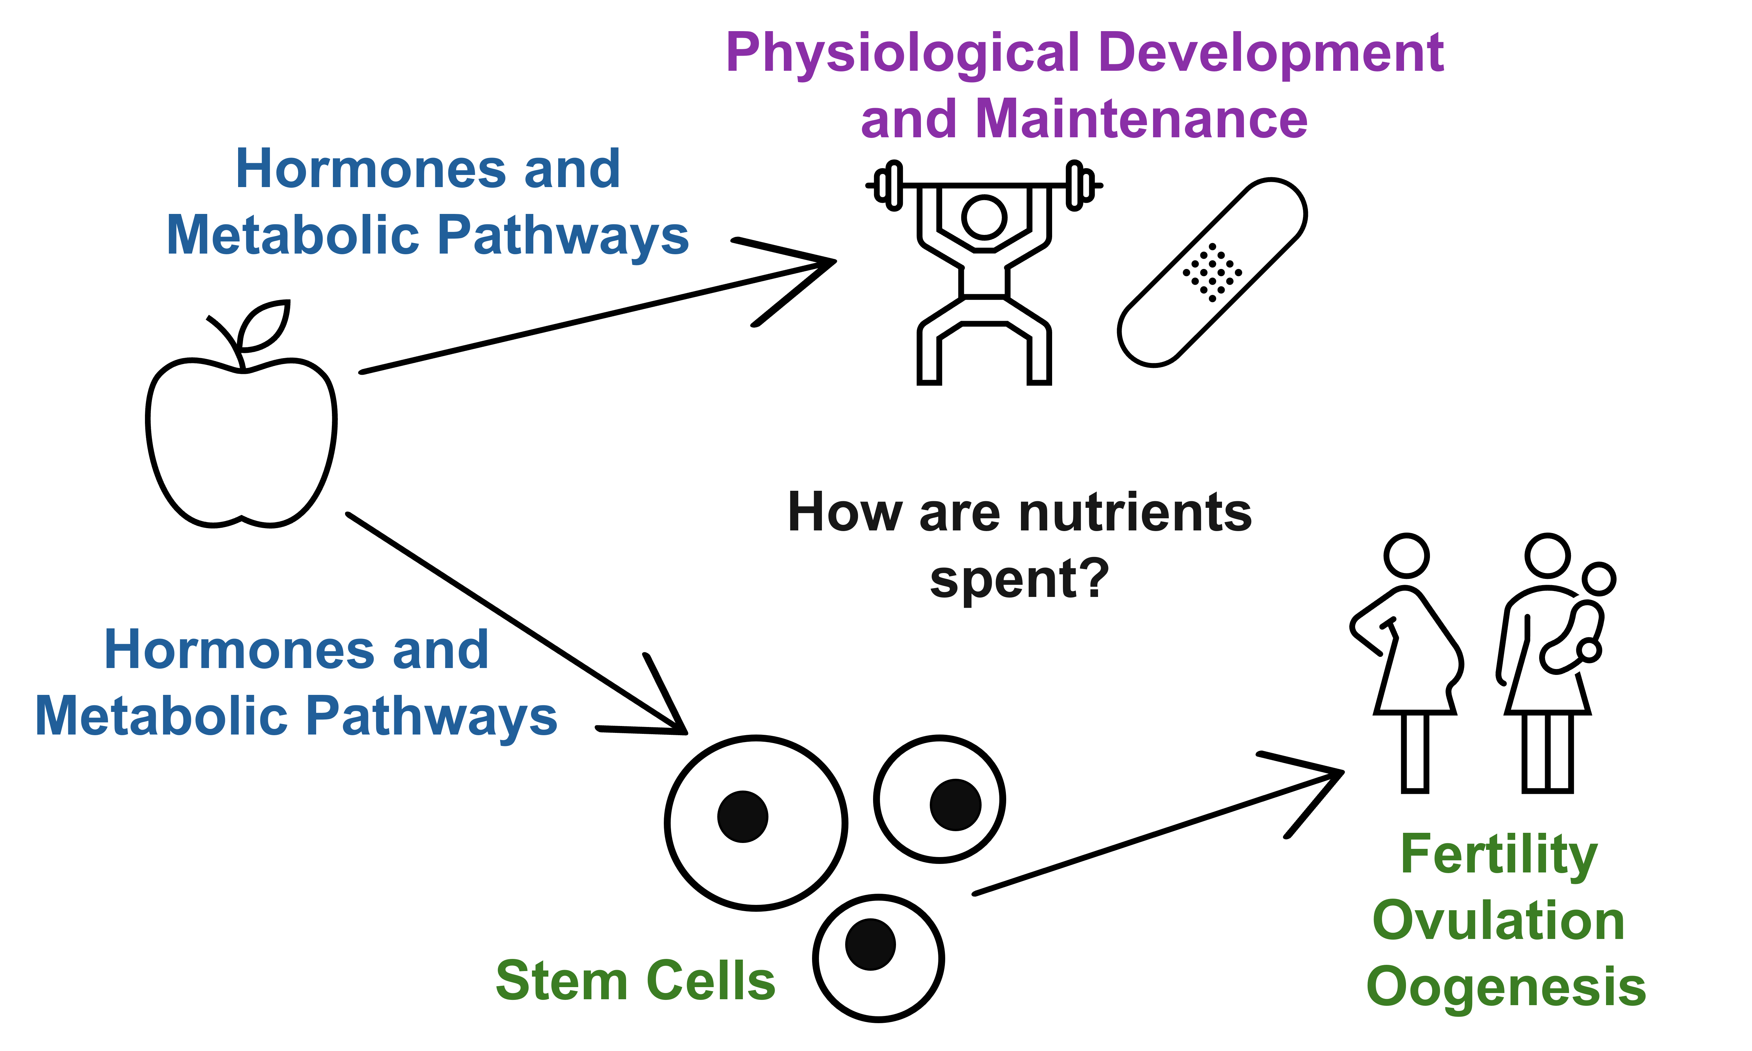
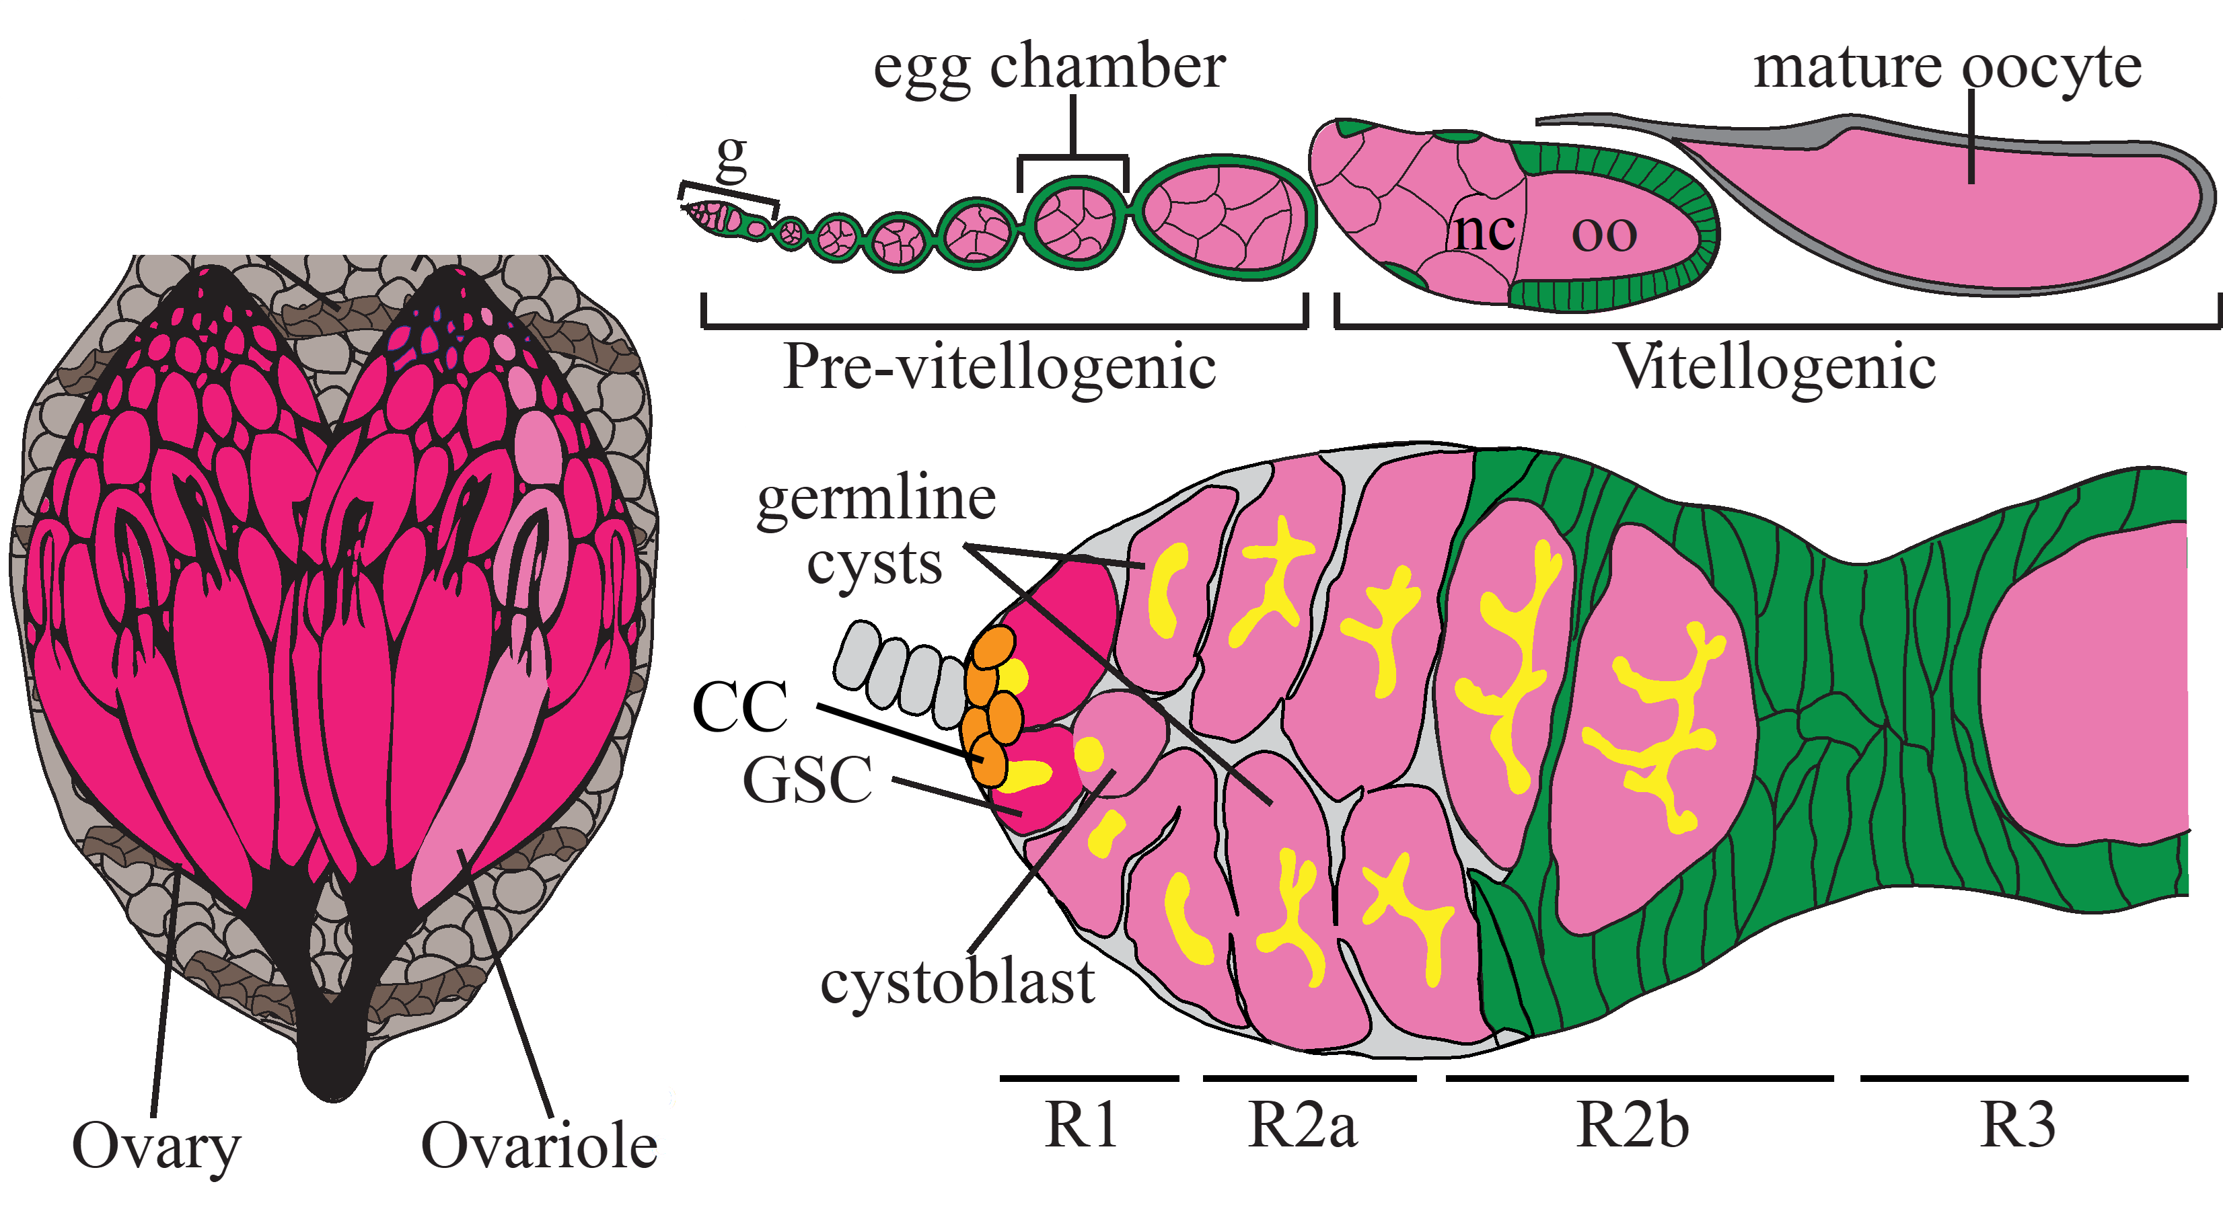
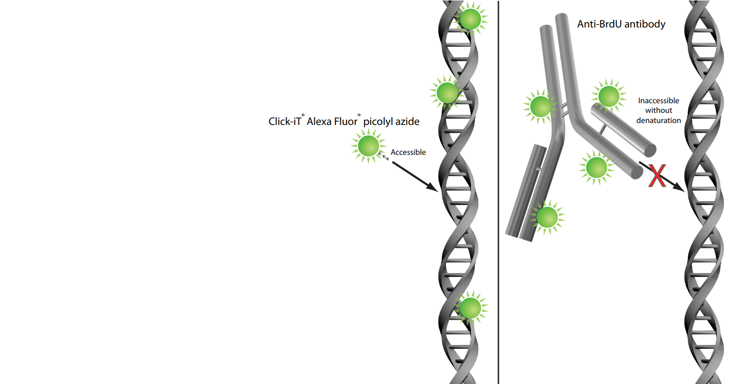
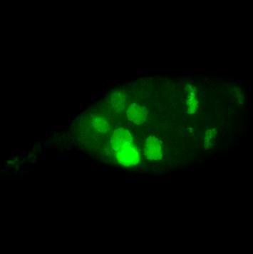
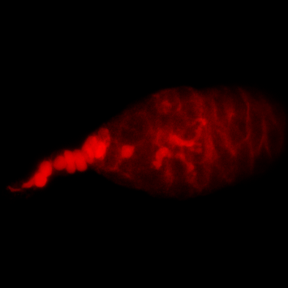
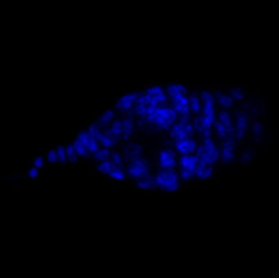
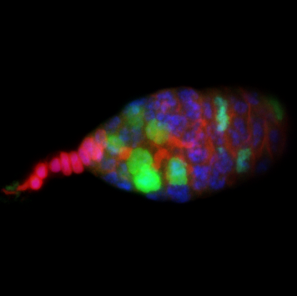
Development of protocol for analyzing the frequency of proliferating germline
stem cells using Click-iT Edu nucleoside labeling.
Vega Faust and Subhshri Sahu, Department of Biology, Western Carolina University, NC
Abstract
The Relationship Between Nutrition
and Hormonal Signaling
Drosophila melanogaster Oogenesis
Peptides and steroid hormones play key roles in coordinating and regulating essential physiological processes like development and reproduction. The relationship between ecdysone, the insect molting hormone, and DILP8, an insulin-like peptide, has been well documented in Drosophila melanogaster larvae. DILP8 acts as a biological checkpoint, decreasing the amount of ecdysone in the brain of the larvae, giving the individual time to regenerate and repair in response to damage or stress. The function of DILP8 in adult flies is not well studied, but it is highly expressed in the ovaries and may offer a similar mechanism in Drosophila oogenesis. Oogenesis is the process of egg production, and in Drosophila melanogaster, it is well studied and heavily dependent on nutrition. When reared using food poor in protein, flies go from producing hundreds of eggs a day to an average of less than a dozen. Exploring differences in nutrient allocation and stem cell survival in response to starvation and DILP8 can be done by analysis of germline stem cell proliferation. To further understand the role of dilp8 in oogenesis, the number of proliferating germline stem cells in flies reared with poor and rich food conditions, with and without DILP8 expression, will be compared. This study aims to develop a protocol for using Click-iT chemistry to visualize proliferating stem cells and investigate the relationship between DILP8 and ecdysone through stem cell proliferation.
Introduction to EdU Click-iT Chemistry
Methods
EdU, or 5-ethynyl-2'-deoxyuridine, is a nucleoside analog that is incorporated into DNA where thymine is typically added. Once bound to DNA during synthesis, the sample is fixed and the reaction cocktail is added. Once added, the fluor-azide reacts directly with the EdU via a copper catalyst-controlled reaction to produce a single product that fluoresces.
The wavelength of the fluorophore is chosen depending on experimental design. If the experiment requires fluorescent staining of other structures, a fluorophore with a different wavelength range from the secondary antibody is required. This experiment additionally requires immunostaining to differentiate between stem cells and other cells in the germarium.
Edu experiments focus on proliferation, meaning incubation must be done on live tissue or cell samples. It is incorporated only into the DNA of dividing cells, which can be visualized and resolved from non-dividing cells after the azide click reaction occurs.
EdU is an alternative to traditional BrdU staining, which requires DNA denaturation and immunostaining, making it a harsher and longer process. It also binds more specifically than BrdU, as it is smaller and can be added to newly synthesizing DNA easily. The EdU analog is also considered less toxic than BrdU when used in short-term experiments.
Husbandry and Dissection
EdU
Protocol is shorter
Faster reaction
High labeling specificity
DILP8-null flies and wild type flies are raised on a rich-to-poor food regime. Their ovaries are removed and the ovarioles are made into florettes.
EdU Detection
The samples are incubated in a reaction cocktail containing 1X Click-iT reaction buffer, copper protectant, Alexa Fluor λ488 picolyl azide, and 1X Click-iT buffer additive, for 30 minutes at RT protected from light. In this step the incorporated EdU is labeled with a fluorescent azide.
EdU Incorporation
The ovaries are incubated in a solution containing 10μM of EdU in Grace’s medium for 2 hours at RT on a nutator. During this step, the EdU nucleoside analog is incorporated into the DNA of proliferating cells.
Immunostaining and Mounting
The cap cells and fusomes are labeled according to standard immunostaining procedure using a secondary antibody in the red field. The ovaries are then dissected and mounted using VectaSheild media containing DAPI, which is an intercalating dye in the blue field.
Fixation and Permeabilization
BrdU
Requires denaturation
Requires antibody labeling
Ovaries are fixed in 5.3% formaldehyde for 13 minutes at RT and permeabilized with PBT.
Results
(Click-iT® Plus EdU Imaging Kits 2014)
Discussion and Conclusion
Proliferating Cells / Cap Cella And Fusomes / Nuclei / Merged
In this experiment Click-iT EdU protocol was successfully adapted for labeling Drosophila melanogaster stem cells. This was done by combining the original protocol and a protocol designedby Zhe Chen and Hongwith standard immunostaining protocol developed by the Sahu lab. EdU was successfully detected in female adult Drosophila melanogaster stem cells. In future experiments this protocol will be used to label and compare proliferating germline stem cells in DILP8 and W1118 Drosophila melanogaster under poor and rich food conditions.
Acknowledgements
A.
Immunostaining
DAPI
Composite Image
A.
B.
C.
D.
E.
This work has been supported by funds from Department of Biology at WCU.
Thank you Dr. Sahu with your assistance and guidance in developing this protocol
and to Dr. Youker for assisting with confocal microscopy.
Figure 1. Confocal images of a W1118 Drosophila melanogaster germarium showing the results of EdU labeling and immunostaining. Image A. is a diagram of a Drosophila melanogaster germarium with the cap cells, germline stem cells, cystoblasts, and cysts. B. shows proliferating cells made visible using EdU labeling, C. shows immunolabeled fusomes and cap cells in red, D. shows intercalated DAPI dye in nuclei, and E. is a composite image of the first three.

