Slide 1

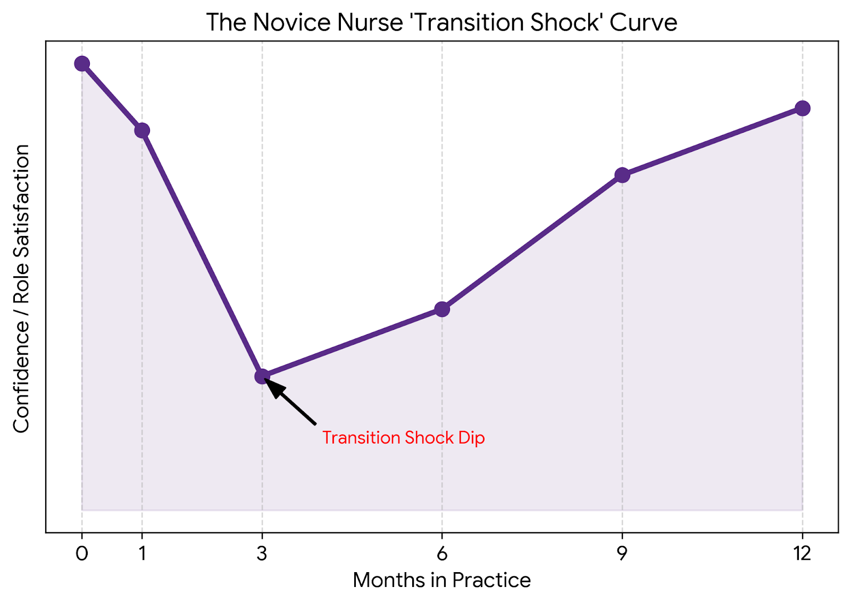
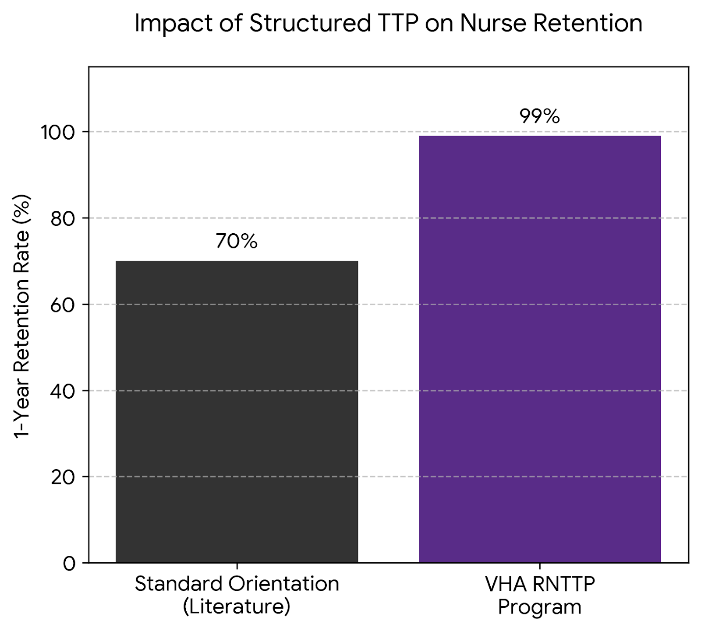


Transition to Practice in Nursing: An Integrative Literature Review
Vickie M Wiley, BSN, RN, MSN Nurse Educator Student
Chair: Amy Putnam DNP, RN, CNE
Committee: Candice Laney DNP, RN, CNE
ABSTRACT
Abstract
• Integrative review examining evidence on transition‑to‑practice (TTP) programs for new graduate nurses.
• Four themes identified: structured transition programs, preceptorship/mentorship, competency development, and psychosocial support.
• TTP programs improve confidence, clinical judgment, and role adaptation while reducing transition shock and early turnover.
• Comprehensive models, especially within federal systems, strengthen professional identity and support a more stable nursing workforce.
Purpose
• To evaluate the impact of structured TTP programs on competency, retention, and professional identity in new graduate nurses.
Research Questions
• What federally structured TTP models support new nurse transition
• How do preceptorship and mentorship influence outcomes
• How do TTP programs support clinical competency development
• What strategies improve psychosocial adjustment
KEY FINDINGS: FOUR MAJOR THEMES
Structured Transition Programs
• Formal onboarding reduces transition shock
Preceptorship & Mentorship
• Preceptors support clinical skill development
Competency Development
• Scaffolding enables gradual, intentional skill mastery
Psychosocial Adjustment
• Emotional support promotes resilience
METHODOLOGY
IMPACT, IMPLICATIONS & CONCLUSION
Impact & Summary
TTP programs improve new nurse confidence, clinical readiness, and judgment
Structured onboarding reduces transition shock and early burnout
Mentorship and preceptorship strengthen role adaptation and skill development
Competency scaffolding supports safe, independent practice
Supportive learning environments enhance resilience and identity formation
Implications for Nursing Practice
Retention: Investment in TTP reduces turnover and stabilizes the workforce
Integration: Mentorship should be embedded as a formal part of onboarding
Safety: Competency‑based progression enhances safe patient care
Culture: Leadership must cultivate a supportive, learning‑focused environment
Conclusion
Comprehensive TTP programs are essential to:
Equip novice nurses with strong clinical competence
Strengthen long‑term retention and workforce stability
Promote professional identity formation and resilience
Improve patient care outcomes across healthcare settings
Electronic Databases
• CINAHL Complete
• MEDLINE
• PubMed
• Academic Search Complete
Inclusion Criteria
• Peer reviewed journals
• English language
• New graduate RN TTP focus
• Mentorship, preceptorship, or competency content
Article Selection
• Initial search: 312
• After duplicates: 248
• Abstracts screened: 41
• Full text included: 27
Analytic Approach
• Thematic synthesis
• Extraction of recurrent outcomes
• Coding into four major themes
REFERENCES
References are provided on handout.
WCU School of Nursing

