Slide 1
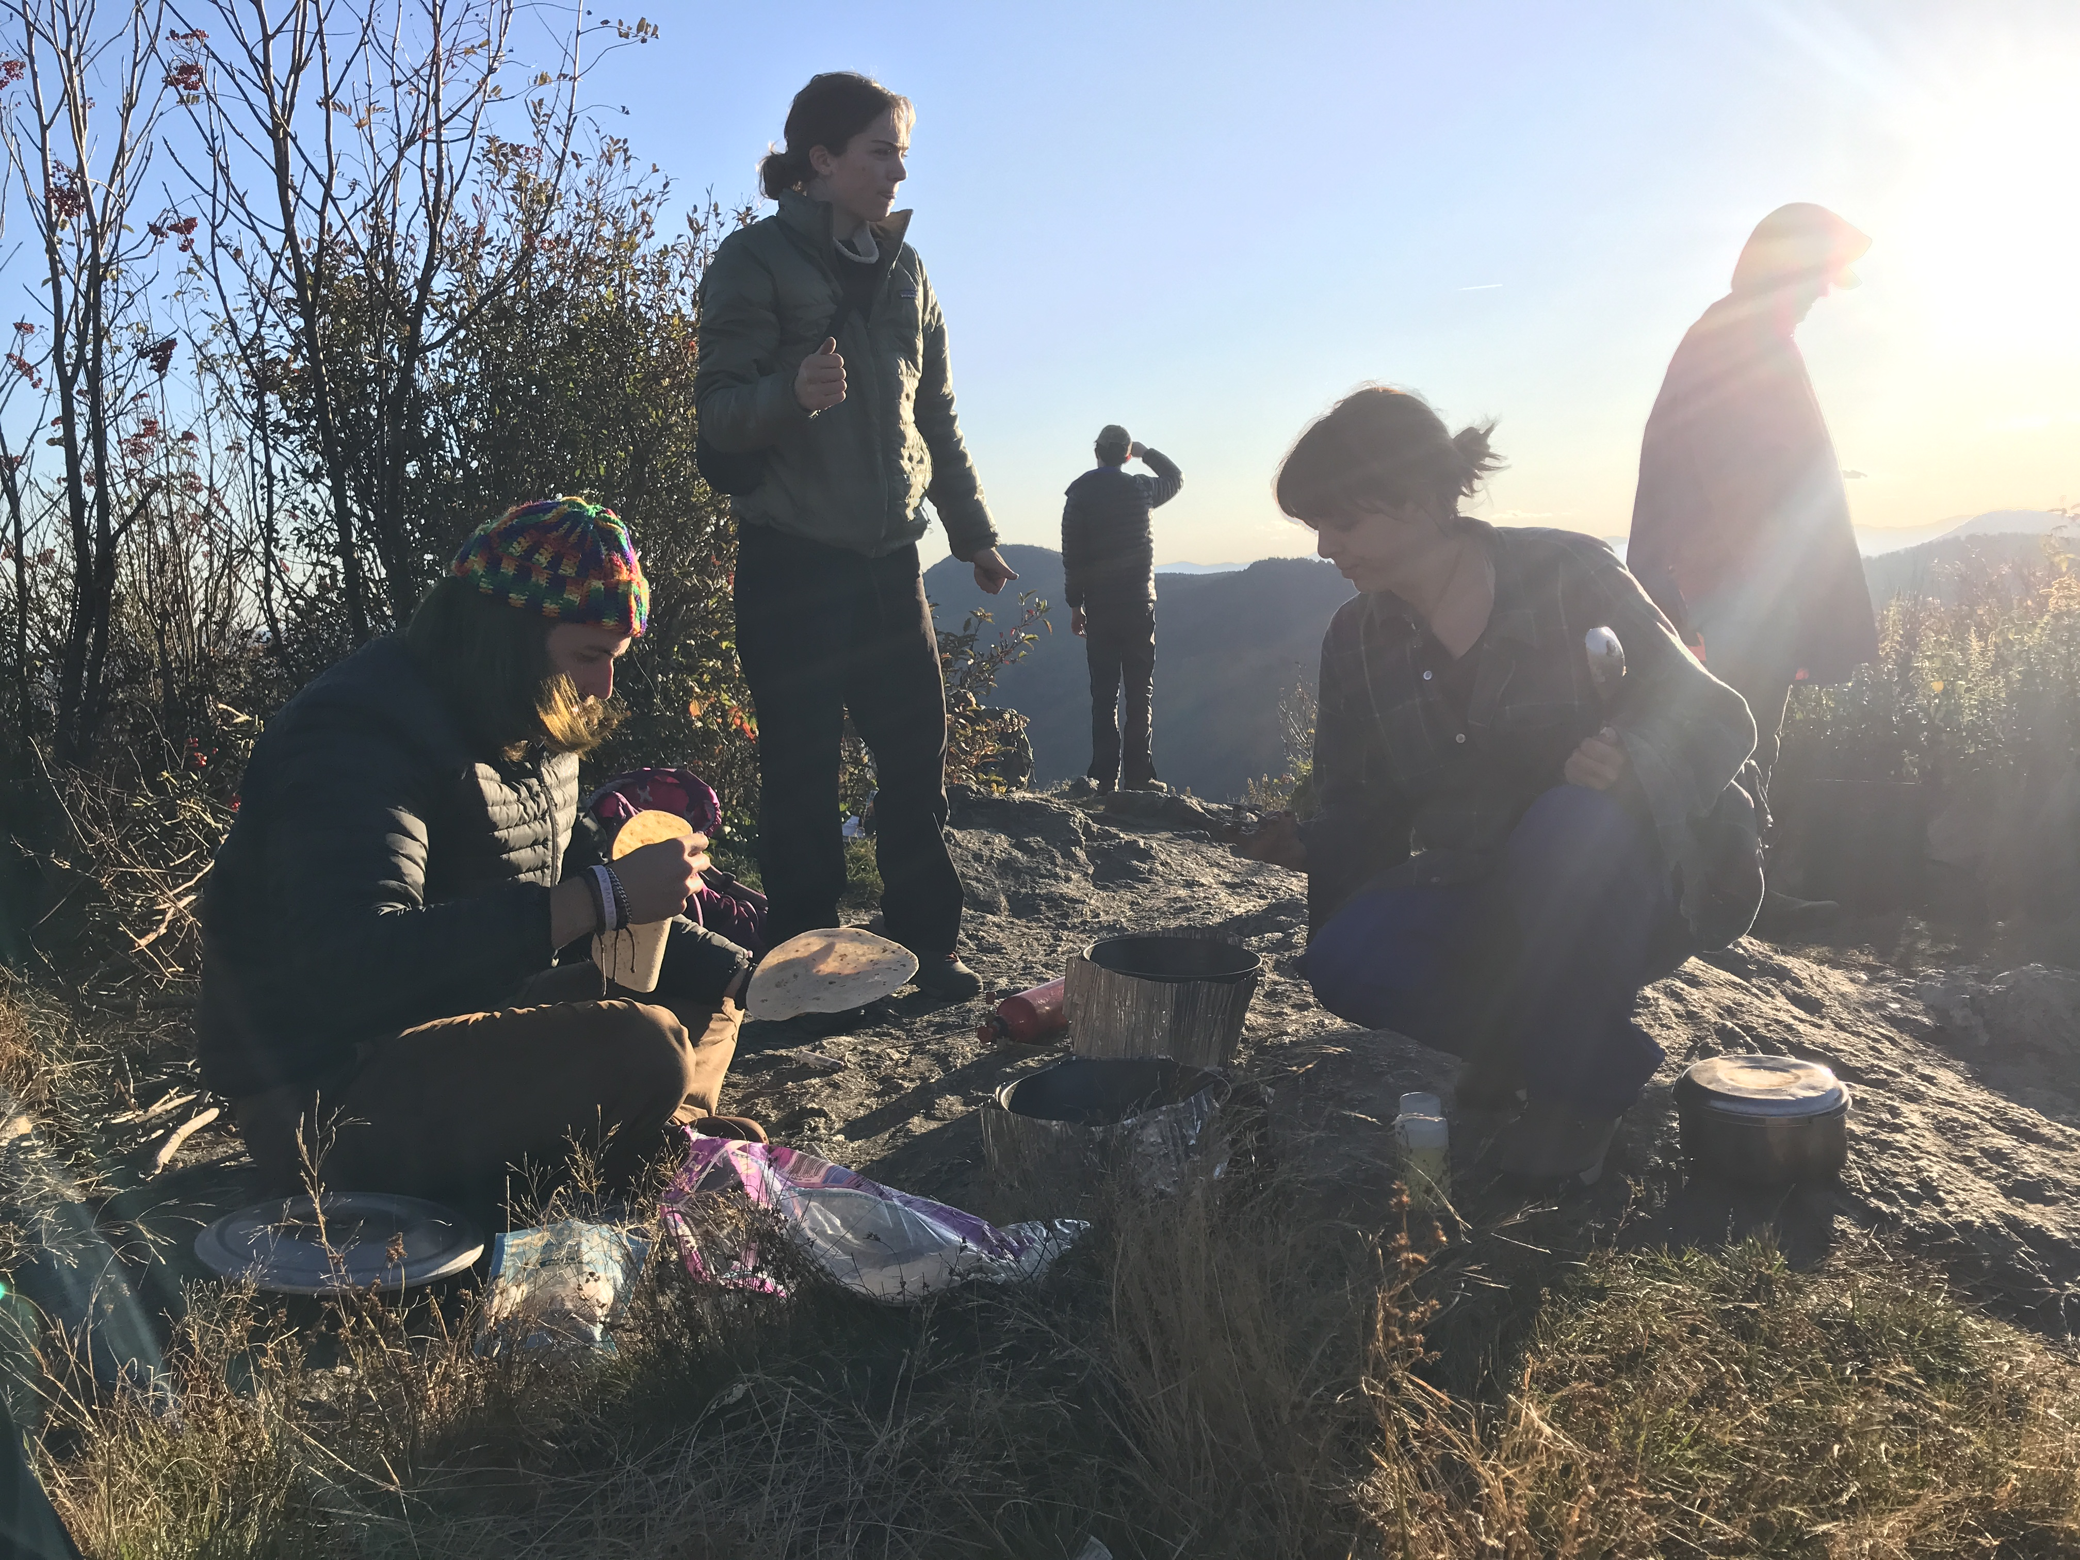
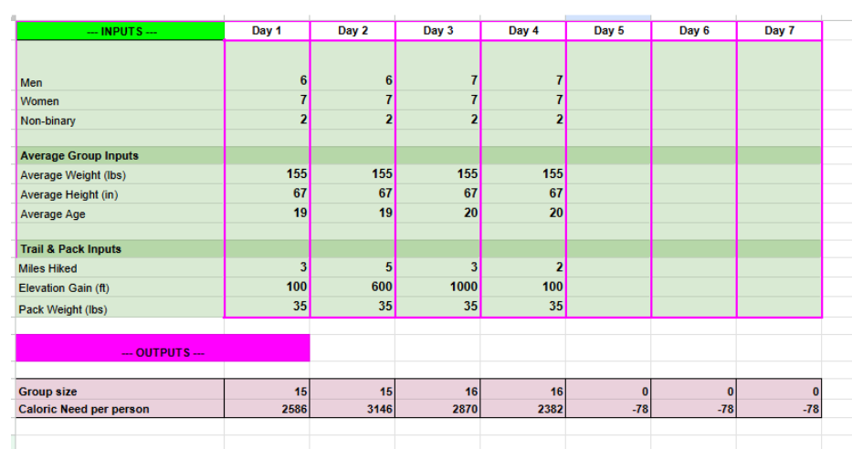
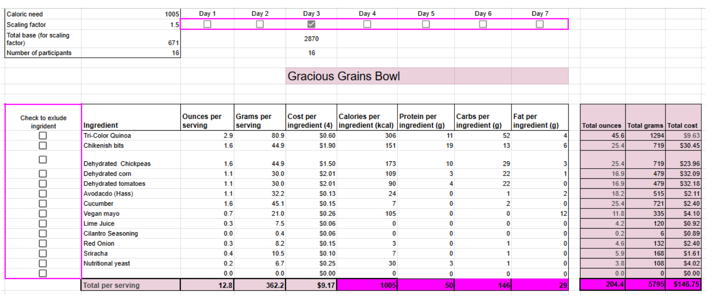

Do You
Feed Groups
In the Outdoors?
You Should Consider Vegan and Allergy Inclusive Meal Planning
Discussion
When done intentionally, an inclusive menu provides restricted participants that same experience as the group, without detracting from the group's overall happiness.
It is inadequate customer service to not meet the dietary needs of a participant and to create circumstances where they feel excluded from the group.
Recommendations
Emphasize Eating Together
  Programs should emphasize the importance of eating together. Participants that sit apart during a meal miss a valuable moment to connect with one another.
Reframe Restriction
  Pivot ingredients instead of removing. Serve meals that don’t depend on substitutions.
Market Strategically
  If food is delicious and nutritious, details about an inclusive menu do not need to be included in marketing.
Take Opportunities for Education
  Once on a program, food can be a conversation starter about program values and group impact.
Project Design
Creation: Make vegan and gluten-free and nut-free backpacking recipes, and a meal planning spreadsheet to adjust portions based on group need.
Implementation: Two UNCA students used the inclusive meal planning tool to prepare a 4-day backpacking trip, and 12 participants used the cooking directions to prepare and eat the food.
Evaluation: Using group debrief in the style of focus group interviews and participant observations, I determined the effectiveness of the meal planning tool and themes describing the role food plays in outdoor programming (Saldana, 2013; Guest et al, 2013).
Deliverables – Themes Around Food
All dinners were completely vegan and were unanimously enjoyed by all participants, none of whom were vegan.
Participants were either skeptical or neutral towards a plant-based and allergy inclusive menu, and all expressed an improved perception of vegan food.
Food created unique moments for people to connect with one another.
Preconceptions of what kind of food should be served during a program and individuals limited experience with inclusive meal planning can be barriers to generating buy-in from facilitators and participants
Why is this important?
The act of eating offers an opportunity to express and affirm bonds with others and plays an important part in defining a culture (Woolley & Lim, 2023).
People with food allergies often report that their allergy is a source of loneliness, as they are unable to share reaction-triggering meals that many others eat (Shemesh et al., 2013).
1 in 10 adults in the US have a food allergy (FARE Health, 2025)
It takes approximately 100 times less water to produce one kilogram of plant-based protein than animal-based protein (Chai et al., 2019).
Animals raised for human consumption are treated inhumanely during their short lives before slaughter (Animal Equality, 2024; Animal Legal Defense Fund, 2020).
Outdoor Adventure Education (OAE) Programs aim to promote personal development and education (Down et al., 2023; Mateer et al., 2022). To accomplish this, participants are presented with challenges to work through together, and group cohesion is an important part of program success (Mateer et al., 2022).
With food being an important component in building and expressing community, it is important for Outdoor Programmers to provide a menu that makes all participants feel included.
Goals
Leading resources available to plan food for OAE programs are geared towards unrestricted diets. To fill this gap, I created a gluten and nut-free vegan meal planning tool that contains recipes appealing to all eaters and streamlines the food preparation process for outdoor programmers working to feed large groups. The three goals of this project were as follows:
● Goal 1: Design a gluten-free and nut-free vegan cookbook and meal planning tool for use in both frontcountry and backcountry outdoor programs
● Goal 2: Implement the cookbook and menu planning tool on a 4-day frontcountry trip with college student participants
● Goal 3: Evaluate participant and outdoor program facilitator satisfaction with the cookbook and meal planning tool
Deliverables – Meal Planning Tool
Calorie Calculator
References
Animal Equality. (2024, August 19). 5 photos proving the dairy industry is cruel. Animal Equality. https://animalequality.org/blog/dairy-industry-hurts-cows/#:~:text=Each%20time%20she%20gives%20birth,machine%20several%20times%20per%20day.
Animal Legal Defence Fund. (2020, January 13). Lawsuit Seeks to Protect Pigs from Cruel High-Speed Slaughter. Animal Legal Defence Fund. https://aldf.org/article/lawsuit-seeks-to-protect-pigs-from-cruel-high-speed-slaughter/
Chai, B. C., van der Voort, J.R., Grofelnik, K., Eliasdottir, H. G., & Klöss, I. (2019). Which diet has the least environmental impact on our planet? A systematic review of vegan, vegetarian and omnivorous diets. Sustainability I(15), 4110. https://doi.org/10.3390/su11154110.
Down, M., Picknoll, D., Piggott, B., Hoyne, G., & Bulsara, C. (2023). “I love being in the outdoors”: A qualitative descriptive study of outdoor adventure education program components for adolescent wellbeing. Journal of Adolescence, 95(6), 1232–1244. https://doi.org/10.1002/jad.12197
FoodAllergy.org. (2025). Facts and Statistics Retrieved August 14, 2025, from https://www.foodallergy.org/resources/facts-and-statistics
McNeff Troy, M., & Phipps, M. L. (2010). The Validity of Petzoldt’s Energy Mile Theory. Journal of Outdoor Recreation, Education, and Leadership, 2(3). https://dSaldana, J. (2013). The coding manual for qualitative researchers. Sage Publications Ltd
oi.org/10.7768/1948-5123.1042
Shemesh, E., Annunziato, R. A., Ambrose, M. A., Ravid, N. L., Mullarkey, C., Rubes, M., Chuang, K., Sicherer, M., & Sicherer, S. H. (2013). Child and Parental Reports of Bullying in a Consecutive Sample of Children With Food Allergy. Pediatrics, 131(1), e10–e17. https://doi.org/10.1542/peds.2012-1180
Woolley, K., & Lim, S. (2023). Interpersonal consequences of joint food consumption for connection and conflict. Social and Personality Psychology Compass, 17(6), e12748. https://doi.org/10.1111/spc3.12748
Dramatic recreation of UNCA students cooking vegan food on a 4-day backpacking trip
What’s on the Menu?
Breakfast
  Dopemeal, Bussin Bagels, Pancakes, Tofu Scramble
Lunch
  Dankwich, Hella Hummus
Dinner
  Gracious Grains Bowl, Gado Gado, Bowlitos, PPPesto, Quesodillos, Evil Wizard’s Chili, Massaman Curry, Red Curry Ramen, Chicka Boom Boom Bowl, Southwest Hash
Facilitators input information about their group and the calculator uses base metabolic rate and calculations based on Petzoldt’s Energy Mile Theory to determine average caloric need per person per day (McNeff Troy and Phipps, 2010).
Menu item example (Gracious Grains Bowl)
Try it out!
Follow this QR code to access a copy of these recipes and the meal planning tool.
(Use on a computer, it’s too much to appreciate on a phone)
Each menu item provides details about macro nutrient information and cost for each ingredient, serving, and meal. Ingredients are adjusted automatically to met caloric need of the day, and can be removed based on availability or target cost.
Zax Milkereit, MS of Experiential and Outdoor Education

