Slide 1

Eating behaviors, obesity, and pelvic floor dysfunction in adolescent females
Audrey Shore and Dr. Meghan Gangel

Slide 2
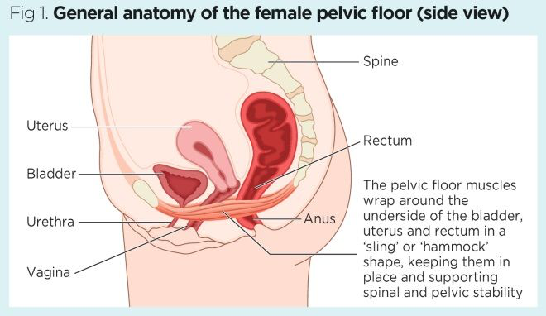
What is pelvic Floor Dysfunction?
Dysfunction symptoms include:
Urinary/fecal incontinence
Pelvic organ prolapse
Pelvic pain
(Peinado-Molina et al., 2023)
(Yates et al., 2019)
Notes:
Sagging of the organs, more studied in females due to childbirth, also can be in men but rarer and later in life

Slide 3

Why study adolescent female pelvic floor health
One study with over 1000 responses had rates of 10.3% of adolescent females having urinary incontinence (Parden et al., 2016).
Early prevention
Early intervention
Lack of awareness
Lack of research

Slide 4
Risk factors of Pelvic Floor Dysfunction
Childbirth and pregnancy (Peinado-Molina et al., 2023)
Age
(Peinado-Molina et al., 2023)
Intense physical activity
(Da Roza et al., 2015)
Obesity
(Schwartz et al., 2009)
Notes:
question is what predicts for obesity for prevention

Slide 5
Eating Behaviors and Pelvic Floor
Very few studies connect eating behaviors to pelvic floor
One study connected diet with pelvic floor dysfunction. Diets such as the mediterranean diet, anti-inflammatory diets, and the DASH diet were associated with less sexual dysfunction and urinary incontinence (Xing et al., 2025).
It is possible that since eating behaviors are connected to obesity (Karlsson et al., 2000), eating behaviors may also predict pelvic floor dysfunction
Eating Behaviors = Cognitive Restraint (decision to restrict food intake for purposes of controlling body weight)
Obesity may be a mediating factor between eating behaviors and pelvic floor dysfunction
Notes:
Seen research connect eating beh and obesity, uninhibited eating patterns predict obesity, obesity predicts relationship; uncontrolled eating increases pressure in pelvic floor bc people gain weight/become obese
Mention eating behaviors/diets and pfd connection
Define eating behaviors in 3 factor questionnaire (specifically cognitive restraint)

Slide 6
Current study
Question: What is the relationship between eating behaviors (cognitive restraint) and pelvic floor dysfunction, and is this relationship mediated by obesity?
Hypotheses: 1) If adolescent females have less cognitive restraint, then they will have more pelvic floor dysfunction, 2) obesity will mediate this association between lower cognitive restraint and higher pelvic floor dysfunction.

Slide 7
Mediation Model
Pelvic Floor Dysfunction
Cognitive Restraint
Obesity

Slide 8
Methods
78 participants, female ages 18-24
In person anthropomorphic measurements: height (inches), weight (pounds)
Survey measuring pelvic floor dysfunction (Pelvic Floor Impact Questionnaire; Barber et al., 2005) and eating behaviors (3-Factor Eating Questionnaire; Karlsson et al., 2000)

Slide 9
The 3-factor eating questionnaire
Includes statements regarding cognitive restraint, uncontrolled eating, and emotional eating
Scaled from 1-4
1= definitely false
2= mostly false
3= mostly true
4= definitely true
Notes:
Give example of statement regarding cogn restraint

Slide 10
Pelvic floor impact questionnaire
Includes questions about pelvic organ prolapse, colorectal-anal distress, and urinary distress
Scale from 1-4
1= not at all
2= somewhat
3= moderately
4= quite a bit
Notes:
Give example question in survey

Slide 11
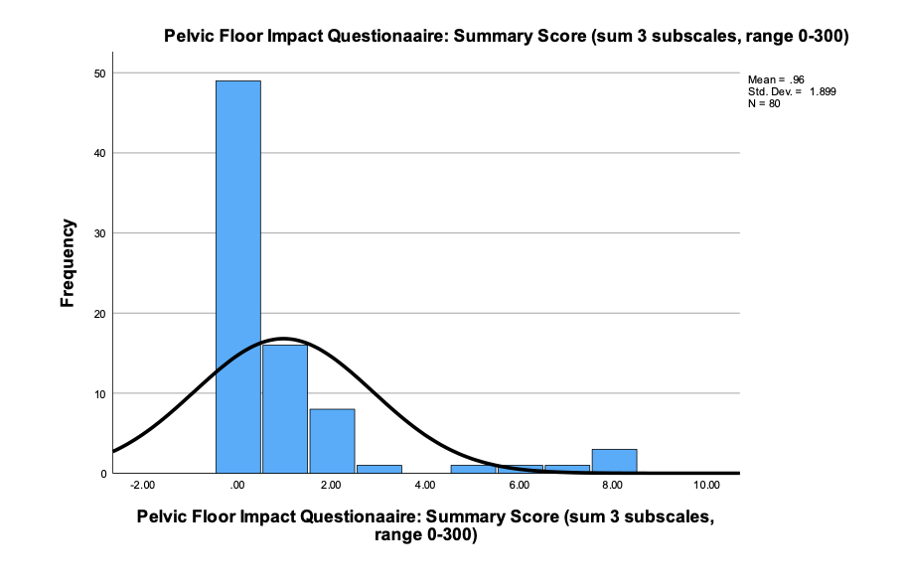
Pelvic floor dysfunction
Notes:
There is some pelvic floor dysfunction and distress in adolescents
Some skewness/kurtosis (but less than 5) (not a lot of dysfunction, but any dysfunction/distress is problematic, there are no clinical cut-off scores for adolescents, because most research is with female postpartum adults dealing with prolapse).

Slide 12
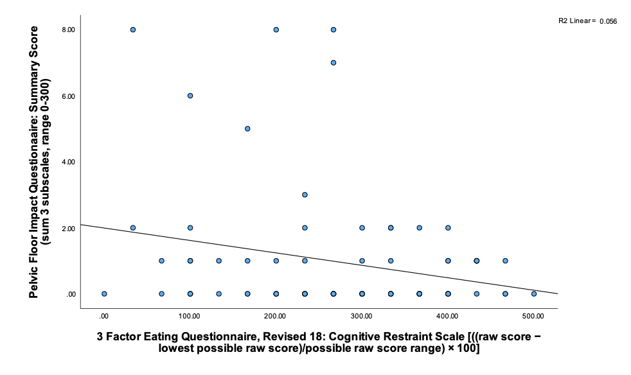
Cognitive Restraint Predicts Pelvic Floor Dysfunction
r = -.24
Notes:
Relationship betwen pfi and cog restraint, see moderate relationship; explains 5.6% but is significant

Slide 13
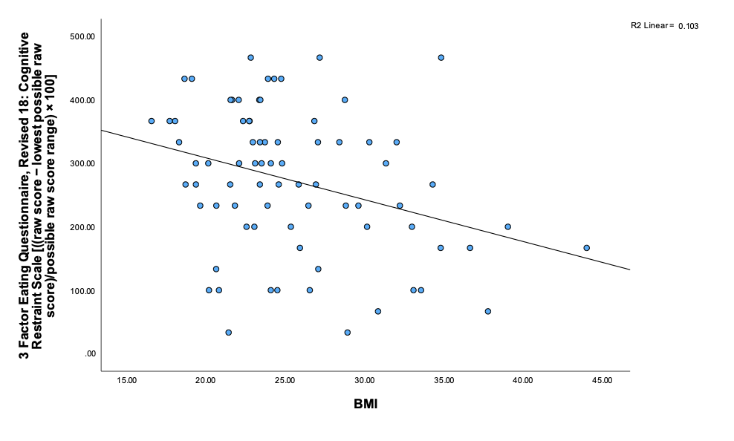
Cognitive Restraint Predicts Obesity
r = -.32
Notes:
Clear linear relationship; more cog restraint, lower bmi; explains 10% of variants

Slide 14
Obesity Does not Predict Pelvic Floor Dysfunction
BMI and Pelvic Floor: r = -.09, p = .455
Waist to Height Ratio: r = .02, p = .852
Body Roundness Index: r = .05, p = .682
Notes:
This null finding is interesting, because this is one of the only significant risk factors. Possibly because we are in a non-clinical sample

Slide 15
Multiple Regression in SPSS Using PROCESS to test indirect effects
Total Model Effects: r = .32 , r² = .10, p < .05
Direct effect of X on Y: B = -.01, t = -2.80, p <.05
Indirect effect of X on Y (through BMI): B = .00, Bootstrap 95% CI LL = .00, UP = .00, n.s.
Obesity does not indirectly explain the effect of Cognitive Restraint on Pelvic Floor Dysfunction

Slide 16
Discussion
No significant indirect effects
Those with less cognitive restraint had more pelvic floor dysfunction
It was found that there is not an indirect effect of cognitive restraint on pelvic floor through BMI or any other obesity metrics (e.g. waist-height ratio)
This means that obesity is not a mediating factor for the relationship between cognitive restraint and pelvic floor dysfunction.

Slide 17
Strengths/Limitations
Strength:
First study in adolescence to connect eating behaviors and pelvic floor dysfunction
Limitations
Correlational Design – cannot address causality or direction of effects
Possible biased answers due to taboo nature of subject
Low power to test a mediation (Gpower analysis requires n = 107)

Slide 18
Future research
Currently collecting more data through using online surveys to further power our study
Examine if this relationship exists in males as well as females

Slide 19
References
Parden, A. M., Griffin, R. L., Hoover, K., Ellington, D. R., Gleason, J. L., Burgio, K. L., & Richter, H. E. (2016). Prevalence, awareness, and understanding of pelvic floor disorders in adolescent and young women. Female Pelvic Medicine & Reconstructive Surgery, 22(5), 346–354. https://doi.org/10.1097/spv.0000000000000287
Peinado-Molina, R. A., Hernández-Martínez, A., Martínez-Vázquez, S., Rodríguez-Almagro, J., & Martínez-Galiano, J. M. (2023). Pelvic floor dysfunction: prevalence and associated factors. BMC Public Health, 23(1). https://doi.org/10.1186/s12889-023-16901-3
Da Roza, T., Brandão, S., Mascarenhas, T., Jorge, R. N., & Duarte, J. A. (2015). Urinary incontinence and levels of regular physical exercise in young women. International journal of sports medicine, 776-780.
Yates, A., & Contributor, N. (2019, April 22). Female pelvic floor 1: anatomy and pathophysiology. Nursing Times. https://www.nursingtimes.net/womens-health/female-pelvic-floor-1-anatomy-and-pathophysiology-22-04-2019/
Xing, D., Li, M., Zhong, Y., Liang, L., Yao, H., Liang, Y., Lyu, Y., & Yu, Y. (2025). Healthy dietary patterns improve sexual function and incontinence symptoms: systematic review and meta-analysis of dietary patterns and dietary interventions. Frontiers in Nutrition, 12, 1635909. https://doi.org/10.3389/fnut.2025.1635909
Karlsson, J., Persson, L., Sjöström, L., & Sullivan, M. (2000). Psychometric properties and factor structure of the Three-Factor Eating Questionnaire (TFEQ) in obese men and women. Results from the Swedish Obese Subjects (SOS) study. International Journal of Obesity, 24(12), 1715–1725. https://doi.org/10.1038/sj.ijo.0801442
Barber, M. D., Walters, M. D., & Bump, R. C. (2005). Short forms of two condition-specific quality-of-life questionnaires for women with pelvic floor disorders (PFDI-20 and PFIQ-7). American Journal of Obstetrics and Gynecology, 193(1), 103–113. https://doi.org/10.1016/j.ajog.2004.12.025
Stunkard, A. J., & Messick, S. (1985). The three-factor eating questionnaire to measure dietary restraint, disinhibition and hunger. Journal of psychosomatic research, 29(1), 71-83

Slide 20
Questions?

